Slide 1
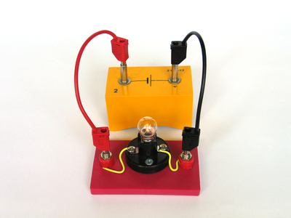
Electrical Circuits

Slide 2
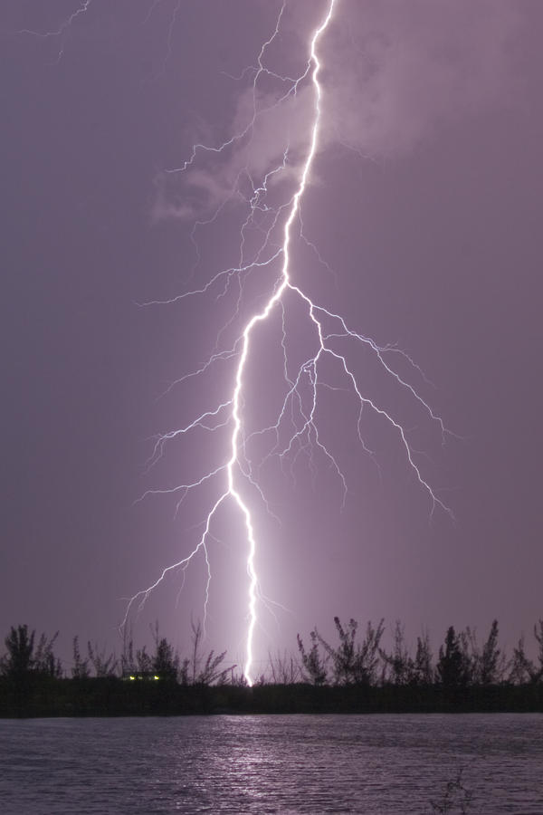
Electricity and Circuits
Up to this point we have learned that static electricity can build up to a point where it results in the discharge of that energy in the form of a spark or lightning strike.
Next we will draw on your prior knowledge (gr. 6) to help learn about currents and circuits.

Slide 3
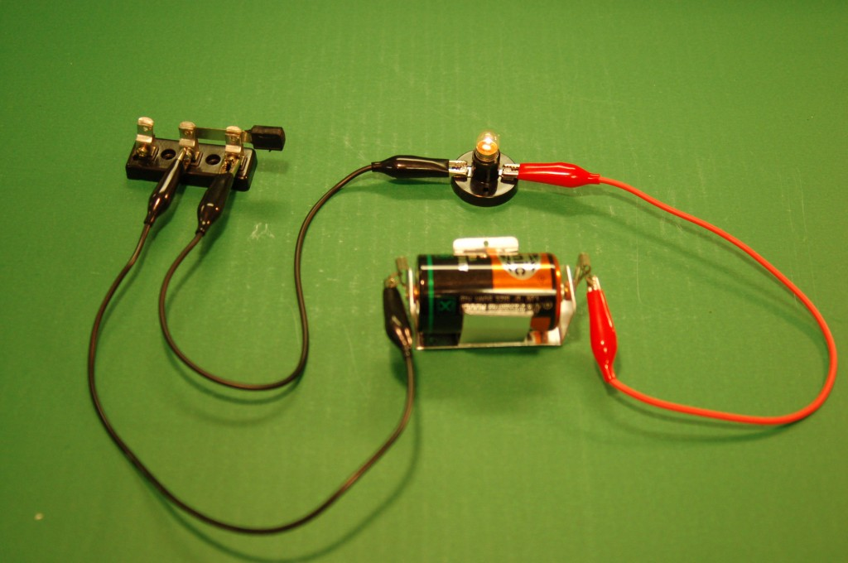
Electric Current – the movement or flow of electric charges from one place to another.
Electric Circuit – a controlled path in which electric current passes through.
Electric circuits are used to convert electrical energy into other forms of energy that we need such as heat or light.
Experimental Circuit

Slide 4
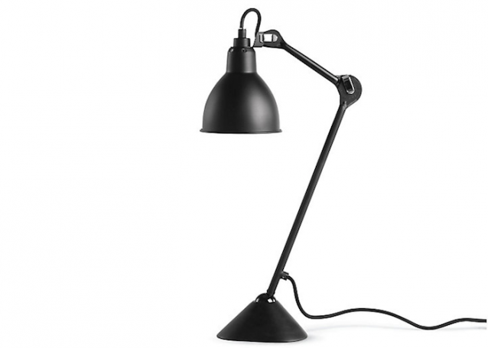
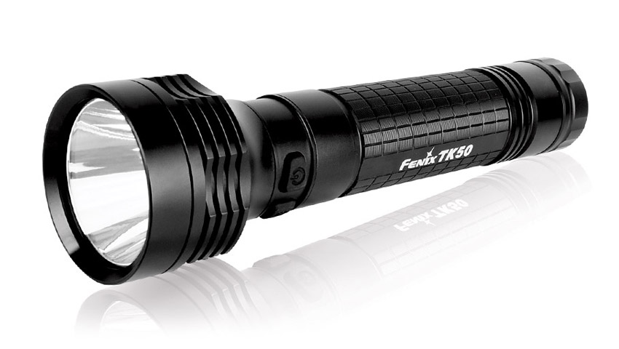
The Parts of an Electric Circuit
Lamps, flashlights and even the experimental circuit seen in the last picture all operate in a very similar way.
Each of these examples have four basic parts; the source of electrical energy, the electrical load, the circuit control device and connectors.

Slide 5
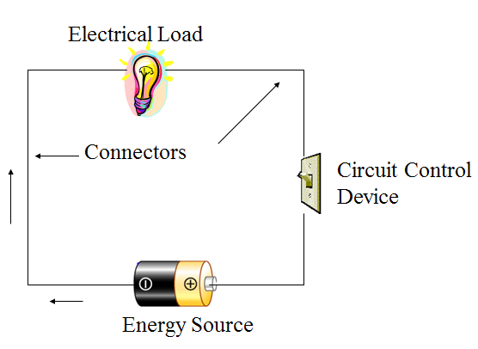
Typical Circuit

Slide 6
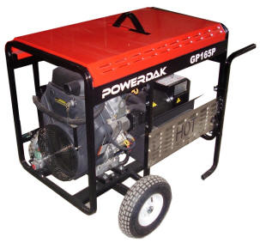
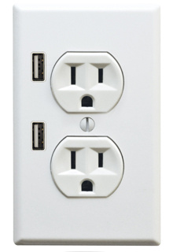
1. Source of Electrical Energy
Technological advances seem to create new and exciting ways to produce energy nearly everyday.
These advances range from tiny surges of electrical energy from computer hard drives to the enormous energy outputs from nuclear power stations.

Slide 7
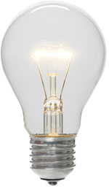
2. Electrical Load
The electrical load is actually the reason the electric circuit exists. It is anything that converts the electrical energy into whatever form of energy we need.
More familiar electrical loads include:
light bulbs
televisions
computers
toasters
dvd players

Slide 8
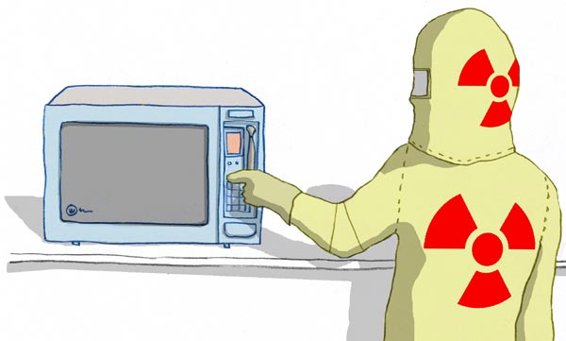
3. Electric Circuit Control Device
As the name suggests, this is a device for controlling an electric circuit.
You know these devices as switches we use in our homes to turn on/off lights and to open the garage door.
Other switches can be more sophisticated like the timer on a vcr or microwave oven.

Slide 9
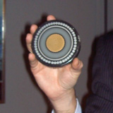
4. Connectors
Connectors are conducting wires that provide a controlled path for electric current to flow to each part of the circuit.
Some connector wires are so tiny that they can be only a few atoms wide. Some connector wires can be 10,000 times thicker than a human hair.

Slide 10
Confusion
When talking about the operation of circuits it is easy to be confused about some of the language used.
It is important to understand some of the key points such as:
When a circuit is operating, and current is flowing, it is said to be a closed circuit. (on)
When a circuit is not operating, and current is not flowing, it is said to be an open circuit. (off)

Slide 11
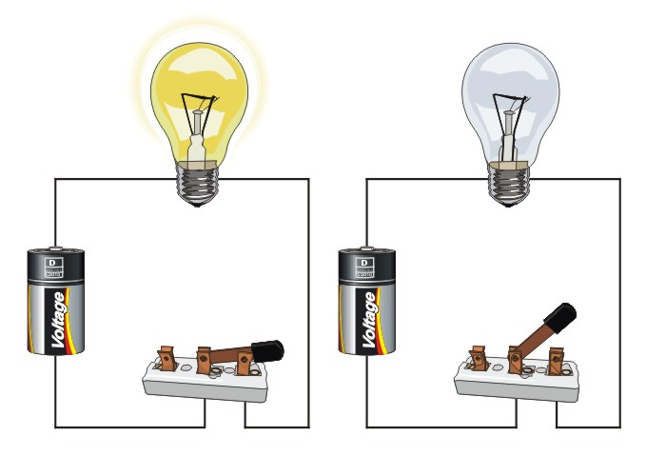
Closed Circuit
Open Circuit

Slide 12
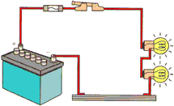
1. Source of electrical Energy – the place or thing that generates the electrical energy.
2. Electrical Load – anything that converts electrical energy into the form of energy needed.
3
2
1
4
3. Electric Circuit Control Device – a switch that controls the electricity (turn on and off).
4. Connectors – the conducting wires that provide the controlled path for electric current to flow to each part of the circuit.

Slide 13
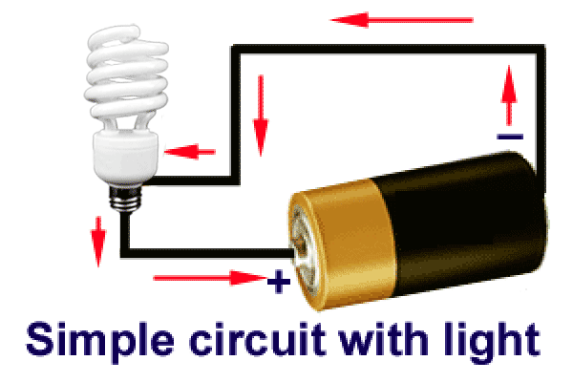
Electric current flows in a continuous loop from the negative terminal of the cell, through the wires, the switch, and the electric load (light), and returns to the cell’s positive terminal.

Slide 14
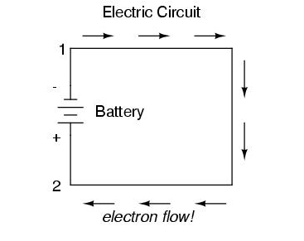
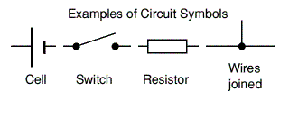
Electric Circuit Diagrams and Symbols
When drawing circuits it is often easier to draw symbols to represent the individual components.

Slide 15
Questions to Complete
Describe the difference between static electricity and current electricity.
Create a list of the 4 parts of a circuit and provide the function of each along with an example for each part.
In which direction does the electrical charge flow around a circuit? Why does it happen this way?
List 8 examples of electric control devices in your home and vehicle.

