Slide 1
Greece Society and Culture
Literature
Philosophy
-Socrates
-Plato
-Aristotle

Slide 2
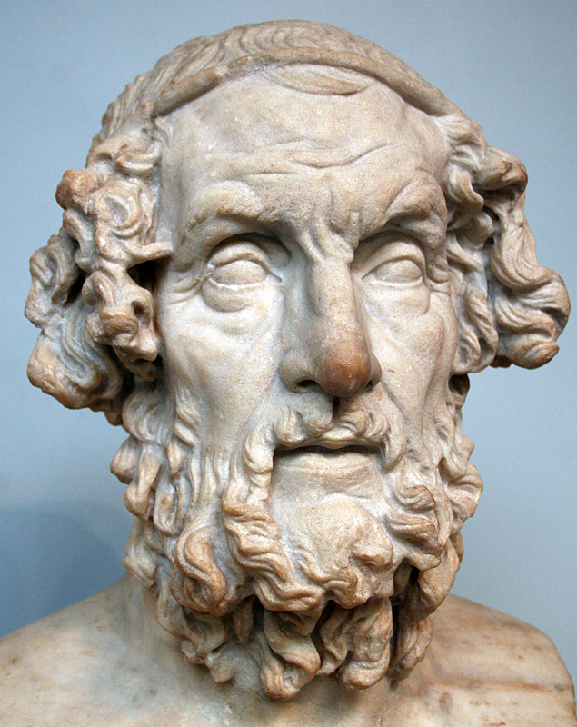
Literature
No single writer had a greater influence than Homer.
His epic poems The Odyssey and The Iliad helped create a national literature and became part of every Greek boy’s education.
A unifying force in Greek culture.

Slide 3
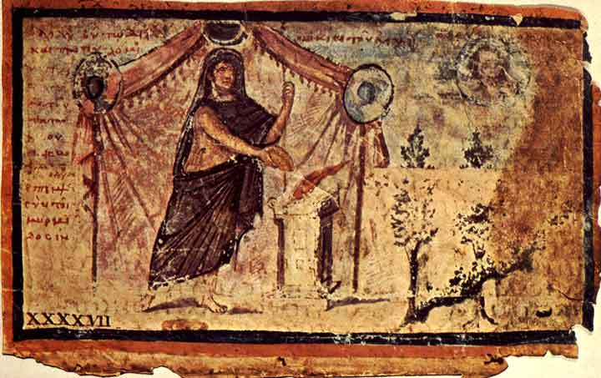
Types of literature included:
  EPICS: long poems telling stories of heroic deeds that often affected the fate of an entire city or people.
  FABLES: Short, concise tales that use animal characters to convey a moral message.
Notes:
Aesop’s fables are believed to have begun during the time of Ancient Greece at roughly the 4th century BCE. While Herodotus claimed that Aesop was a slave who wrote most of these stories it is now commonly believed that multiple writers contributed to the collection of stories.

Slide 4
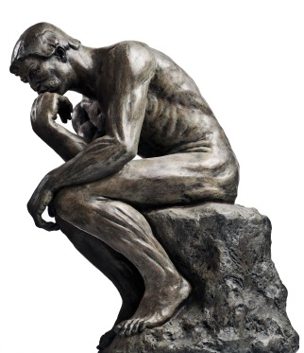
Philosophy
WHAT IS PHILOSOPHY??
  Most debates deal with questions of personal conduct and morality.
  Philosophy is the quest for knowledge.

Slide 5
Typical Philosophical questions:
How can people find happiness?
What makes some actions good and some actions bad?
Is it better to obey the rules of society or follow one’s own judgement?
How can we be certain of what we know?

Slide 6
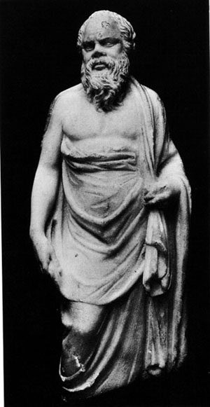
SOCRATES (470 BCE-399 BCE)
Questioned most of the ideas generally accepted during his lifetime.
Devoted himself to finding someone who knew more than he did.
Used the “Question- Answer” method which became known as THE SOCRATIC APPROACH.
Notes:
Born (470 BCE) to a working class family and a son of a sculpture who helped build the Parthenon. He learned the trade of stone cutting growing up but also served in the military .

Slide 7
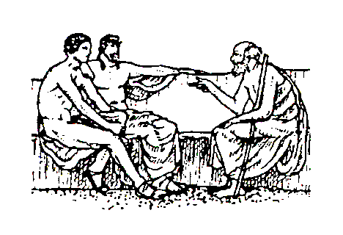
THE SOCRATIC APPROACH
He would pose a question and the student would answer.
Socrates would then use his logic to expose flaws in the answer.
This helped students to sharpen their thinking and sharpen their reasoning skills.

Slide 8
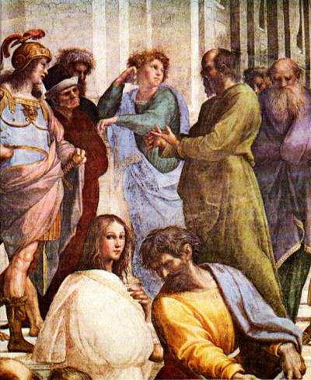
One of his central concerns was moral behavior.
He cast doubt on stories about Gods and Goddesses.
People saw him as destructive for criticizing so many accepted beliefs and questioned his loyalty to the state.

Slide 9
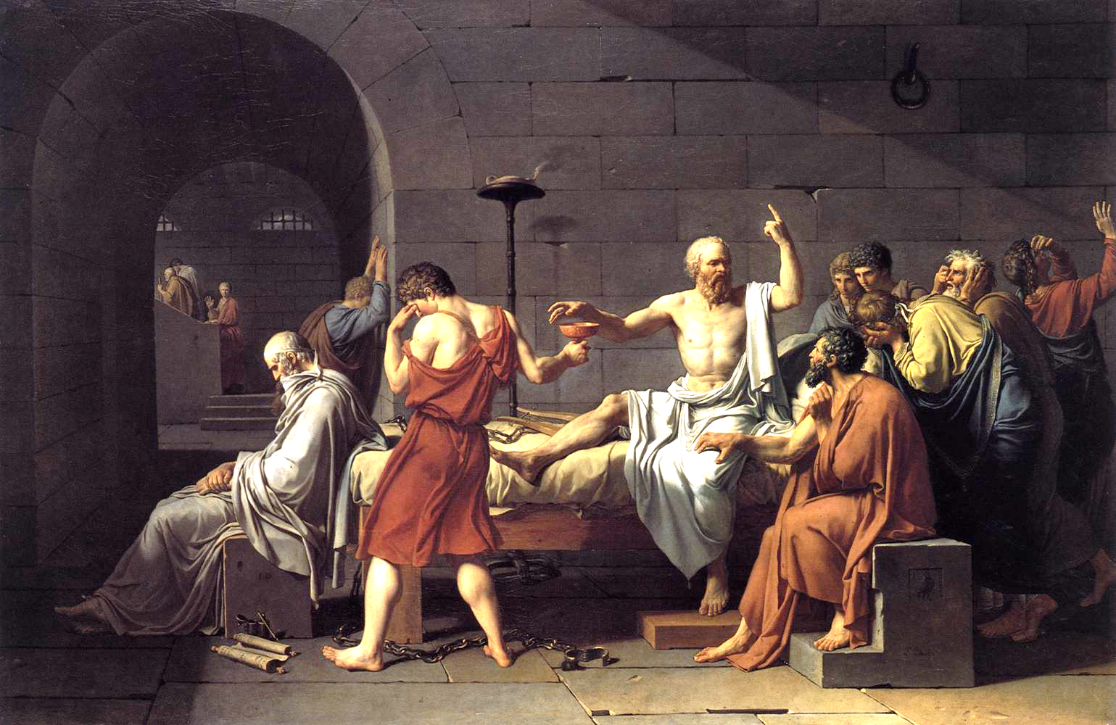
Government charged him with ATHEISM- sentenced to death, he chose poison and drank hemlock.

Slide 10
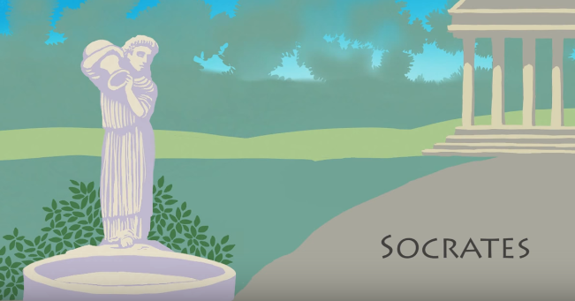
Video on Socrates

Slide 11
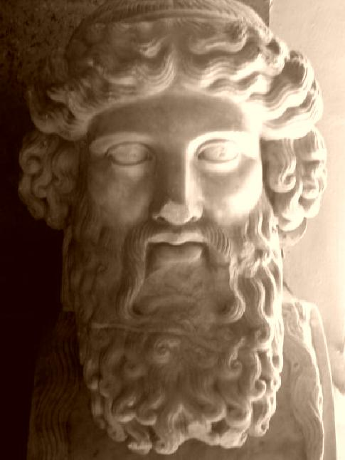
PLATO (427 BCE – 347 BCE)
A pupil of Socrates.
Wrote The Republic…first on political science.
Believed that the state could only achieve the good of all if citizens adhered to the four basic principles of:
    Truth
    Wisdom
    Courage
    Moderation
Notes:
Plato established a school called the Academy where he taught philosophy and science.

Slide 12
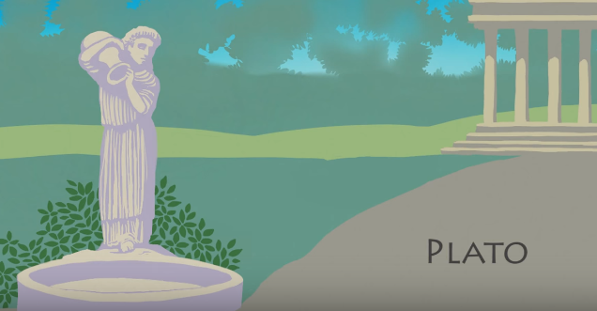

Slide 13
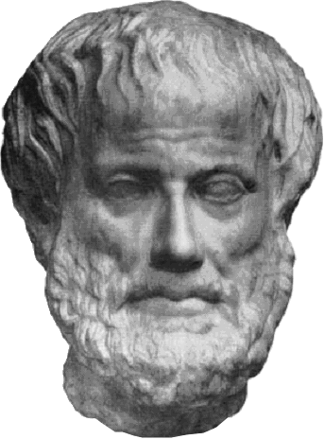
ARISTOTLE (384 BCE- 323 BCE)
A pupil of Plato
Served as a tutor to Alexander the Great.
Primary interests lay in the field of biology…paid attention to the observable world around him.
Began classifying animals and plants based on similar characteristics …became the basis of modern biology.
Also worked on the scientific method… first two steps:
1. Collecting information
2. Develop a hypothesis or possible explanation

Slide 14
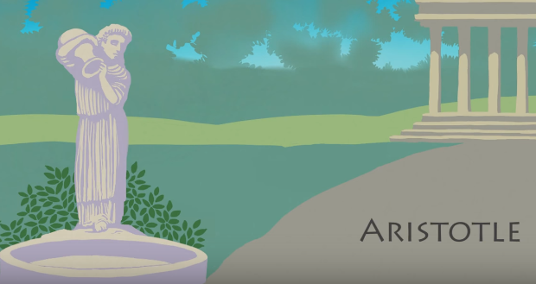

Slide 15
ASSIGNMENT:
Use page 191-193 of the text book to identify three major contributions of the ancient Greeks in each of the following fields and explain their importance. How have these contributions affected our lives today?
    MEDICINE
    MATHEMATICS
    ASTRONOMY
    It would be wise to compare these contributions to the Egyptian contributions of similar fields.

