Slide 1
Objects Beyond our Solar System

Slide 2
A Stars Life
We say that stars have a “life” because they evolve and follow a predictable pattern:
They are “born” from clouds of dust and gas.
They develop
They die
Each “life” may take billions of years, something that is very difficult for us to understand. Keep in mind that it would take nearly 32 years to count to a billion.

Slide 3
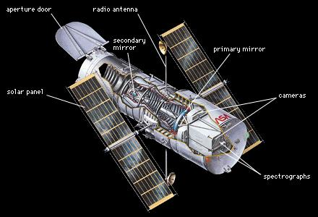
Using technology like the Hubble Telescope scientists have been able to study and examine millions of stars at different points in their life cycle. These stars are billions of light years away. (1 light year = 10 trillion km)
The study of these cycles have given us vast amounts of information that help develop a theory of the life of a star.

Slide 4
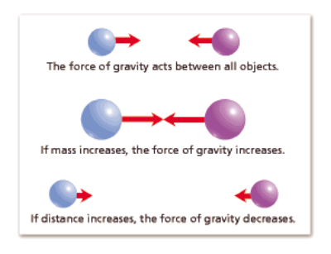
Information to Consider
Keep in mind that gravity is the force that pulls objects towards each other. The larger the object, the greater gravity it exerts and the stronger the pull.
We learned about gravity when Sir Isaac Newton “discovered” it in 1678 when he was attempting to figure out the force that changed the direction or speed of a moving object.
The force of Gravity gets smaller as the distance between objects increases.

Slide 5
Nebulas
Nebulas are the birth place for stars. A nebula is a huge cloud of cosmic dust and gases, mainly hydrogen and helium.
As mentioned before the dust and gases begin to move and become attracted to each other due to friction. Gravity eventually kicks in and eventually the dust become clumps and then over a very long time a new star is formed.
No two stars are the same just as no two planets are the same. Each star has unique qualities and characteristics.

Slide 7
Carina Nebula – around 10,000 light years from Earth

Slide 8
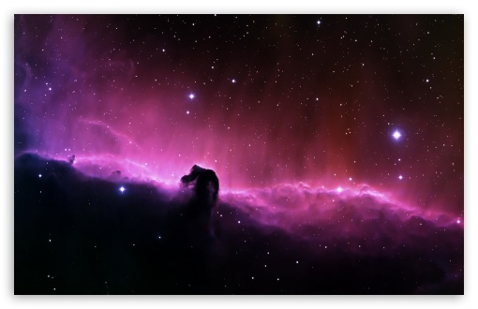
Types of Nebula
There are different types of nebula, they vary depending on whether they glow brightly due to gas, they may reflect other starlight and they may even absorb light as they are so dense.
Horsehead Nebula

Slide 9
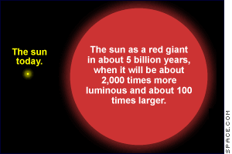
Giants and Dwarfs
When a star nears the end of its life it runs out of hydrogen and other gasses needed to produce energy. When this happen, the pressure holding the star together is reduced and it expands as it cools.
Thus, in “old age” stars that are relatively small, like our sun, become red giants.
Stars that are much larger than our sun become red supergiants.

Slide 10
White Dwarfs
Red giants, the dying stars that are about the size of our sun, eventually start to shrink and the out layer starts to drift away into space. The husk that is left behind is now called a white dwarf.
This dying star actually burns hotter than the sun but will slowly get cooler and cooler until it becomes a black dwarf…this has yet to happen as it is estimated to take longer than the known age of the universe, 13.8 billion years.

Slide 11
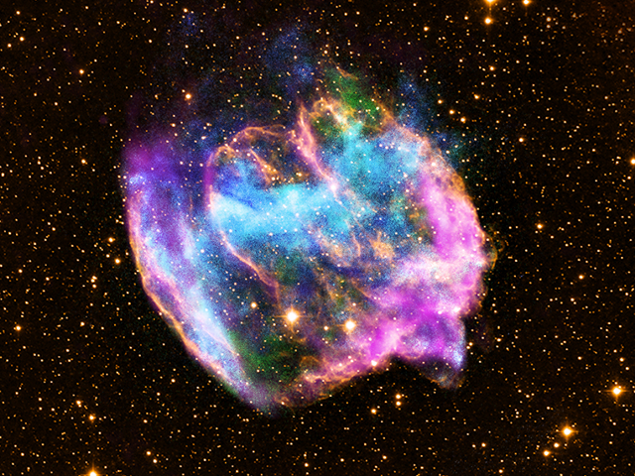
Supernova

Slide 12
Supernova
A supernova is an enormous explosion that occurs at the end of a large star’s life.
As a star runs out of fuel its core collapses inward due to the lack of pressure. This core now becomes a neutron star or a black hole.
When this change occurs the shock wave created explodes outward in a rapidly expanding nebula of dust and gases.
Supernovas are very rare events but can be very dramatic as indicated by historical records in China and India in 1054 where the explosion could be seen during the daytime and it lasted for around 21 months.

Slide 13
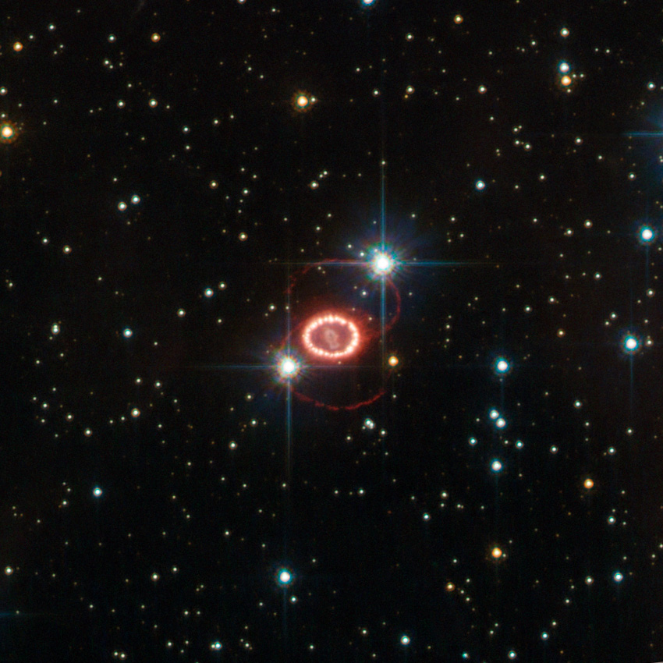
1987a

Slide 14
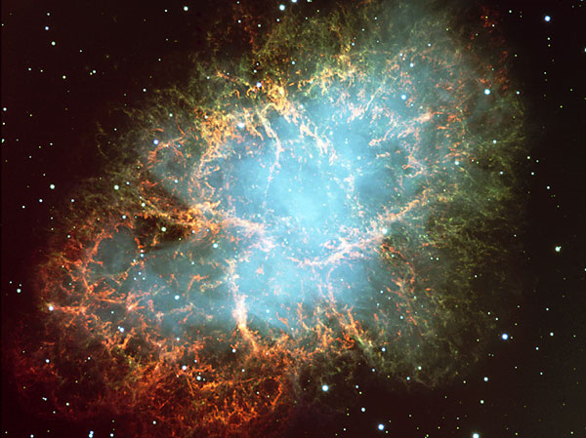
This famous supernova gave birth to the Crab Nebula, which can be seen in the constellation Taurus. Since the creation of the telescope only one supernova has been witnessed, in 1987 by a Canadian, Ian Shelton.

Slide 15
Neutron Stars
Neutron stars are the ultra dense cores left behind when a large sun comes to the end of its life and explodes. The outside of the star is blown outward but the core that is left behind collapses in on itself and creates an incredibly dense mass of material.
The core of a neutron star is so dense that one cupful of it would have a mass of millions of kilograms.
These stars are very small, just a few km across but they still have a mass that is as great as the sun.
The gravity of these stars are incredible; if you dropped a marshmallow onto the surface of a neutron star it would have as much energy as a nuclear bomb!

Slide 16
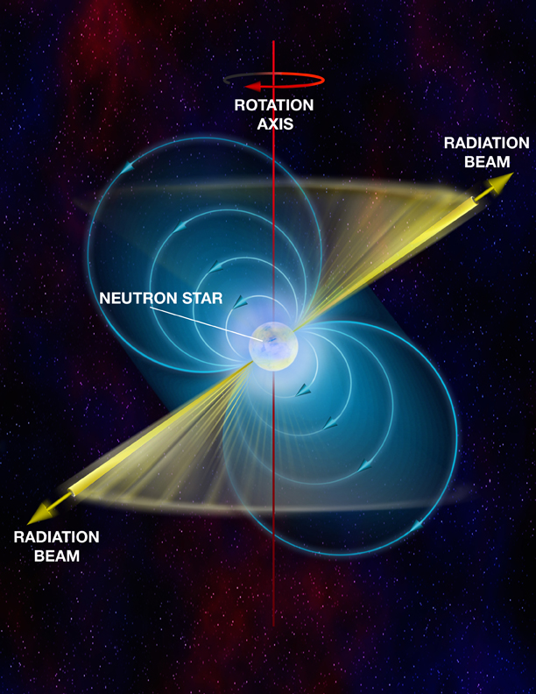
Pulsars
Pulsars are a type of neutron star that emit pulses of energy in the form of light and radio waves while rotating. We know of about 400 pulsars in the universe.

Slide 17
Black Holes
When enormous stars (30 times the size of our Sun) reaches the end it its life the resulting core is called a black hole.
Black holes are small but the most dense things in the known universe.
The gravity of a black hole is so strong that nothing can escape its pull, not even light.
It’s deceiving to think of a black hole as a hole as it may make you think there is nothing there but actually there is a mass that is only a couple km across.

Slide 18
Check your Understanding
How does a star form?
How does mass determine what happens to stars as they die?
How is observing evidence of a black hole an example of indirect evidence? (use page 471 to answer this question.

