Slide 1
THE HOLOCAUST

Slide 2
Of the 60 million World War II deaths, 11 million people died in German death camps including 3.5 million Russians, and 6 million Jews (2/3rds of all European Jews).
The word Holocaust was given to the killing of the 6 million Jews because it was a war of extermination designed to wipe out an entire group of people.
  Hitler’s “Final Solution”
  Systematic genocide

Slide 3
Holocaust Chronology
Jan 30, 1933 - Adolf Hitler is appointed Chancellor of Germany a nation with a Jewish population of 566,000.
March 22, 1933 - Nazis open Dachau concentration camp near Munich, to be followed by Buchenwald near Weimar in central Germany, Sachsenhausen near Berlin in northern Germany, and Ravensbrück for women.
April 1, 1933 - Nazis stage boycott of Jewish shops and businesses.
April 11, 1933 - Nazis issue a decree defining a non-Aryan as "anyone descended from non-Aryan, especially Jewish, parents or grandparents. One parent or grandparent classifies the descendant as non-Aryan...especially if one parent or grandparent was of the Jewish faith."

Slide 4
1933
July - Nazi Party is declared the only legal party in Germany; Also, Nazis pass Law to strip Jewish immigrants from Poland of their German citizenship.
July - Nazis pass law allowing for forced sterilization of those found by a Hereditary Health Court to have genetic defects.

Slide 5
1933
September – Jews excluded from the Arts
September – Jews prohibited from owning land
October – Jews prohibited from being newspaper editors
November – Law against Habitual and Dangerous Criminals, which allows beggars, the homeless, alcoholics and the unemployed to be sent to concentration camps

Slide 6
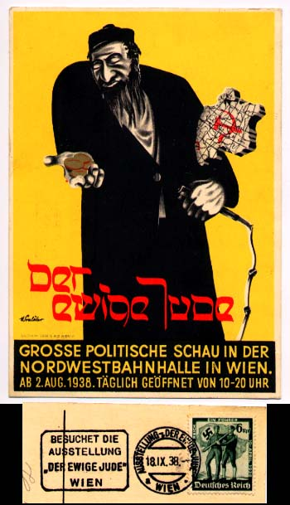
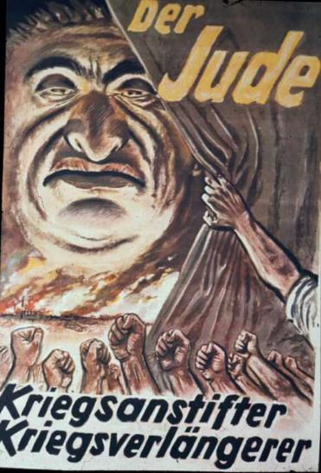
Nazi Propaganda

Slide 7
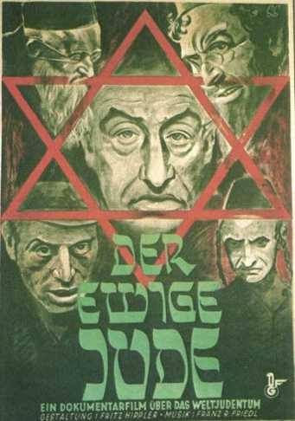

Slide 8
May – Nazis ban Jews from serving in the military
June – Nazis pass law allowing forced abortions on women to prevent them from passing on hereditary diseases.
Sept 15, 1935 - Nuremberg Race Laws against Jews decreed.

Slide 9
Nuremberg Race Laws of 1935
Deprived German Jews of their rights of citizenship, giving them the status of "subjects" in Hitler's Reich.
  The laws also made it forbidden for Jews to marry or have sexual relations with Aryans.
The Nuremberg Laws had the unexpected result of causing confusion and heated debate over who was a "full Jew."
  The Nazis settled on defining a "full Jew" as a person with three Jewish grandparents. Those with less were designated as Mischlinge.
  After the Nuremberg Laws of 1935, a dozen supplemental Nazi decrees were issued that eventually outlawed the Jews completely, depriving them of their rights as human beings.
Notes:
Mischlinge – mixed blood

Slide 10
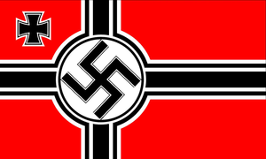
Nuremberg Laws
It was unlawful for Jews to “employ in their households female subjects of German or kindred blood who are under 45 years old.
Jews were not allowed to fly the German flag or display the Reich colours.
The law took effect the day after it was enacted.

Slide 11
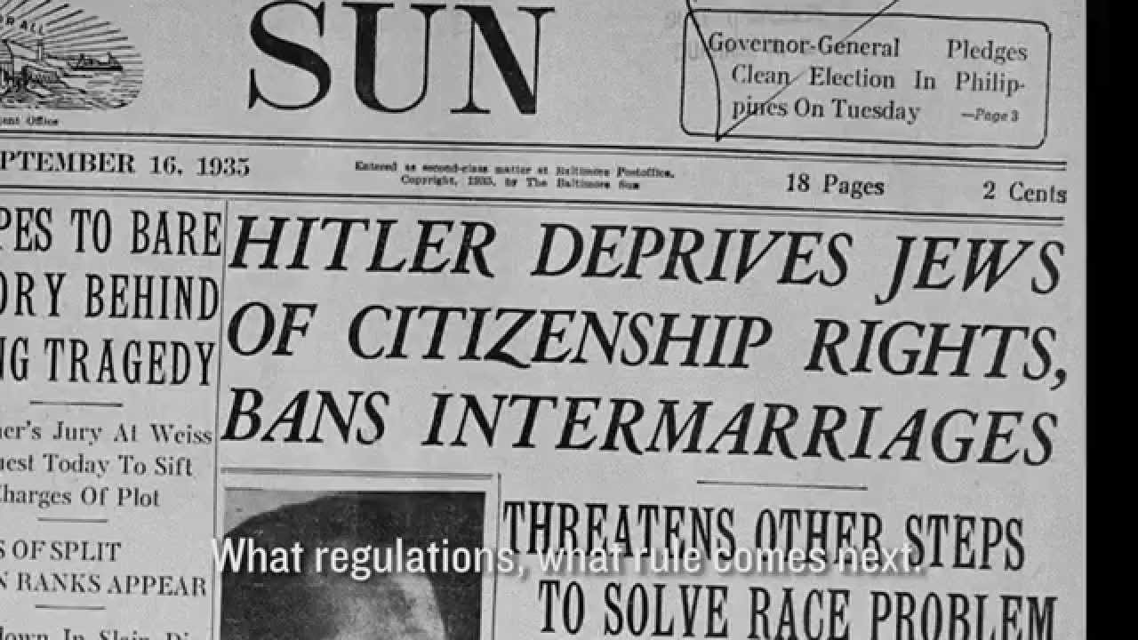
Nuremberg Laws
The Nuremberg laws were race laws.
They found Jewish blood to be inferior and dangerous. Jews could never be Germans. On the contrary, Jews were considered threats to German purity; their presence on German soil threatened the nation’s well-being.

Slide 12
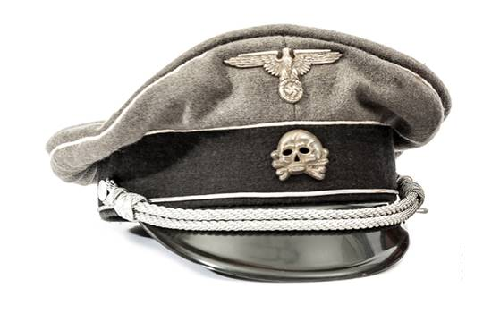
1936
March – SS “Death's-head” division is established to guard concentration camps.
August – Nazis create Office for Combating Homosexuality and Abortions (by healthy women).

Slide 13

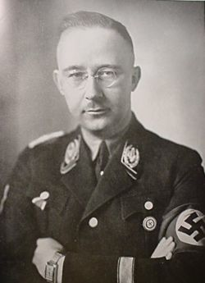
Adolf Eichmann established Office of Jewish Emigration in Vienna.
Heinrich Himmler establishes Mauthausen concentration camp near Linz.
Notes:
In brief - Karl Adolf Eichmann (1906-1962) headed Gestapo Department IV B4 for Jewish Affairs, serving as a self proclaimed 'Jewish specialist' and was the man responsible for keeping the trains rolling from all over Europe to death camps during the Final Solution.
Following the surrender of Nazi Germany in May of 1945, Eichmann was arrested and confined to an American internment camp but managed to escape because his name was not yet well known. In 1950, with the help of the SS underground, he fled to Argentina and lived under the assumed name of Ricardo Klement for ten years until Israeli Mossad agents abducted him on May 11, 1960.
Eichmann went on trial in Jerusalem for crimes against the Jewish people, crimes against humanity and war crimes. During the four months of the trial over 100 witnesses testified against him. Eichmann took the stand and used the defense that he was just obeying orders. "Why me," he asked. "Why not the local policemen, thousands of them? They would have been shot if they had refused to round up the Jews for the death camps. Why not hang them for not wanting to be shot? Why me? Everybody killed the Jews.”
He was found guilty on all counts, sentenced to death and hanged at Ramleh Prison, May 31, 1962.
Heinrich Himmler was to become one of the most feared men in Nazi Germany and Europe once World War Two broke out. As head of the SS, he had ultimate responsibility of internal security in Nazi Germany (as was seen in the Night of the Long Knives) and was associated with helping to organise the Final Solution.

Slide 14
1938
July - Nazis order Jews over age 15 to apply for identity cards from the police, to be shown on demand to any police officer.
July – The Evian Conference (France): US convenes a meeting to consider helping Jews fleeing Hitler, but results in inaction as no country will accept them.
Canada refuses to attend the conference.
October – Nazis arrest 17,000 Polish Jews living in Germany, then expel them back to Poland which refuses them entry – leaving them in ‘no-man’s land’ near the Polish border for several months.

Slide 15
1938
November 9-10 – Kristallnacht: The Night of Broken Glass
Jewish synagogues, cemeteries, hospitals, schools, businesses and homes were looted, wrecked and often burned. Many Jews were killed, thousands were arrested and sent to concentration camps.
The Jew’s German neighbours inflicted much of the damage. The police were under orders not to interfere. Fire brigades were under orders to let torched synagogues burn but to protect Aryan property nearby.

Slide 16
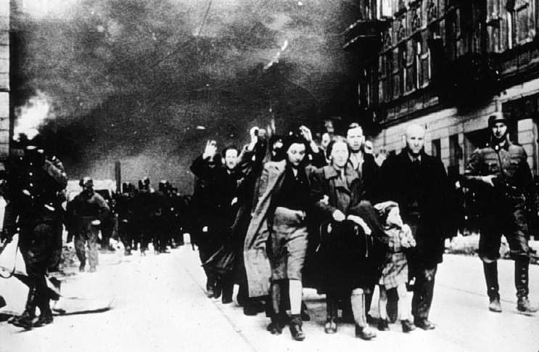

Slide 17
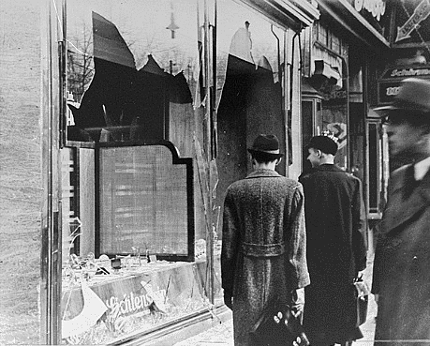

Slide 18
1938
November - Nazis fine Jews one billion Deutschemarks for damages related to Kristallnacht.
November – Jewish students expelled from non-Jewish schools.
December – Herman Goering takes charge of resolving the “Jewish Question.”
February – Jews forced to hand over all gold and silver items.
April – Jews lose rights as tenants and are relocated into Jewish houses.
Notes:
The Jewish Question boils down to “What are we going to do with this minority of people who refuse to follow our customs and set themselves apart from the rest of society?”

Slide 19
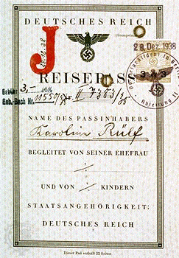
1938
October – Law requires Jewish passports to be stamped with a large red “J”.

Slide 20
1939
30 January – Hitler threatens Jews during Reichstag speech
“Europe will not have peace until the Jewish question has been disposed of. The world has sufficient capacity for settlement, but we must finally break away from the notion that a certain percentage of the Jewish people are intended, by our dear God, to be the parasitic beneficiary of the body, and of the productive work of other peoples. Jewry must adapt itself to respectable constructive work, as other peoples do, or it will sooner or later succumb to a crisis of unimaginable proportions….

Slide 21
…“If the international finance-Jewry inside and outside Europe should succeed in plunging the nations into a world war yet again, then the outcome will not be the victory of Jewry, but rather the annihilation of the Jewish race in Europe!”

Slide 22
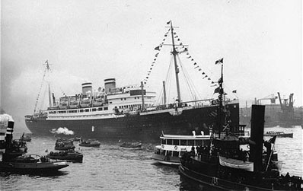
May 1939 - The St. Louis, a ship crowded with 930 Jewish refugees, is turned away by Cuba, the United States and other countries and returns to Europe.
Notes:
May – The “St. Louis,” a ship crowded with 937 Jewish refugees, is turned away by Cuba, the USA and Canada. It returns to Europe. Only 240 would survive the Holocaust.

Slide 23
1939
Sept - Nazis invade Poland (Jewish pop. 3.35 million, the largest in Europe).
Sept – SS Einsatzgruppen (special death squads) issued instructions in Poland regarding treatment of Jews: they are to be gathered in Ghettos near railroads for the future “final goal”.
Oct - Nazis begin euthanasia on sick and disabled in Germany.
November – Yellow stars required to be worn by Polish Jews.

Slide 24
February – First deportation of German Jews into Poland.
April – The Lodz Ghetto in Poland is sealed off from the outside world with 230,000 Jews locked inside.
November – Krakow Ghetto is sealed off containing 70,000 Jews.
November – The Warsaw Ghetto is sealed off containing 400,000 Jews.

Slide 25
1941
September – 23,000 Jews killed at Kamenets-Podolsk, in the Ukraine.
September - SS Einsatzgruppen murder 33,771 Jews at Babi Yar near Kiev.
October – 35,000 Jews from Odessa shot.
October – Nazis forbid Jews from emigrating out of Germany.
December – Chelmno camp opens in Poland. Jews taken there are placed in mobile gas vans and driven to a burial place while carbon monoxide from the engine exhaust is fed into the sealed rear compartment, killing them.

Slide 26
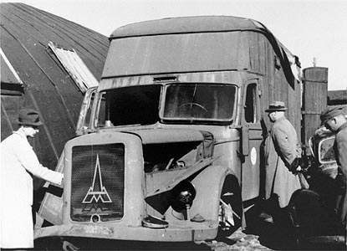

Slide 27
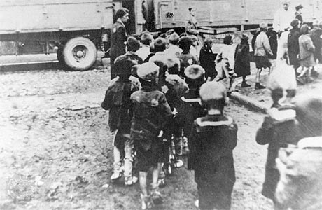

Slide 28
’41
March 7, 1941 - German Jews ordered into forced labor.
26 March – SS Einsatzgruppen begin mass murder of Jews in occupied Poland.
July – Himmler tells Auschwitz commander “The Fuhrer has ordered the Final Solution of the Jewish question.”

Slide 29
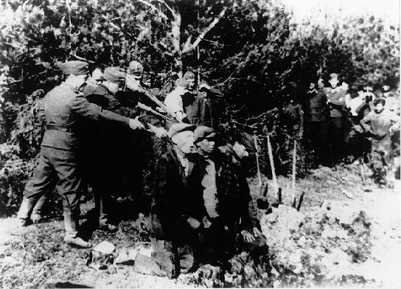

Slide 30
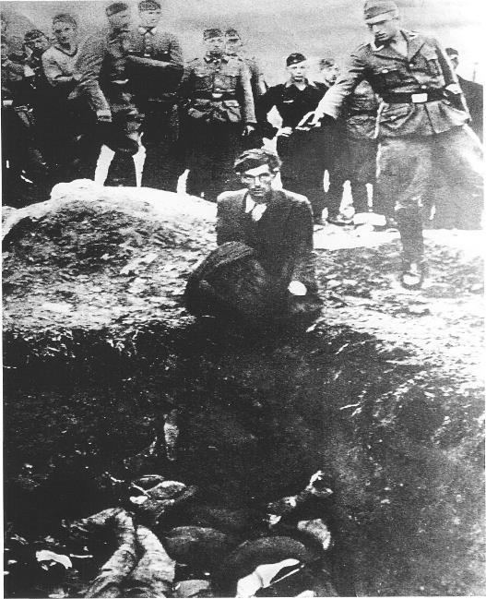

Slide 31
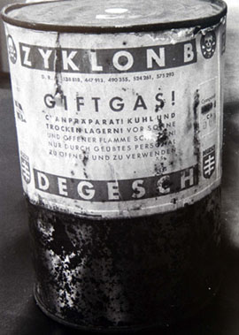
September – first use of Zyklon-B gas at Auschwitz.

Slide 32
1942
January – Mass killings of Jews using Zyklon-B begin at Auschwitz-Birkenau with the bodies being buried in mass graves in a nearby meadow.
January – Wannsee Conference to coordinate the “Final Solution”.
January – SS Einsatzgruppen reports 229,052 Jews killed.
March – Belzec extermination camp becomes operational in Poland.

Slide 33
1942
March – Jews from Polish Ghettos, Slovakia, and France arrive at Auschwitz-Birkenau.
April – German Jews are banned from using public transportation.
June – Jews in France, Holland, Belgium, Croatia, Slovakia, and Romania ordered to wear yellow stars.
By this point approximately 1,000,000 Jews have been killed by the Nazis.
July – Operation Reinhard; mass deportations of Jews in Poland to extermination camps.
Oct - Himmler orders all Jews in concentration camps in Germany to be sent to Auschwitz and Majdanek.

Slide 34
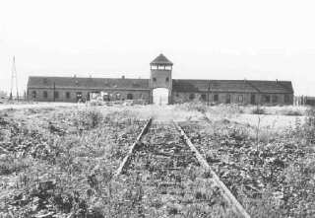
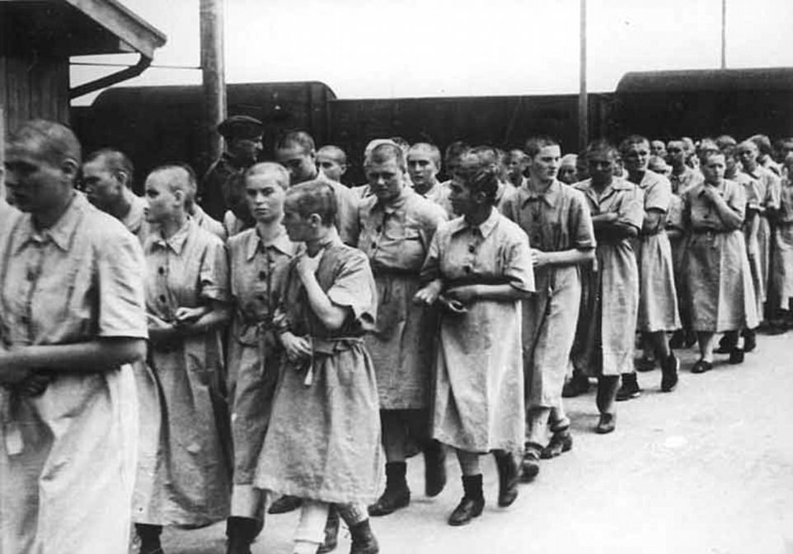
1942
July – Treblinka extermination camp opens in Poland. It has 10 gas chambers each holding 200 persons.
October – Himmler orders all Jews in concentration camps in Germany to be sent to Auschwitz.
October – Jews from Norway arrive at Auschwitz.

Slide 35
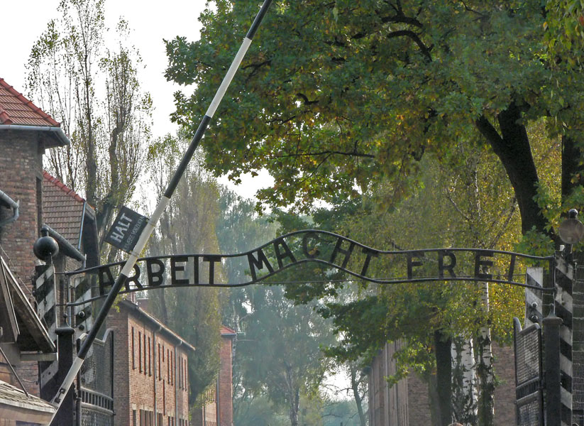

Slide 36
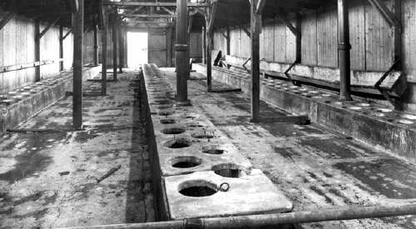

Slide 37
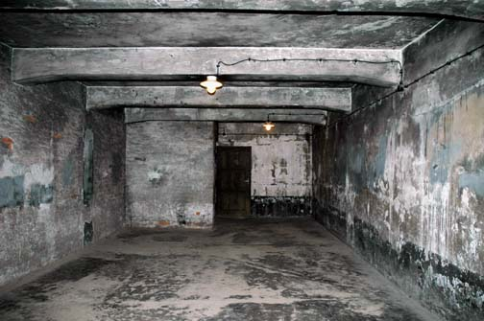

Slide 38
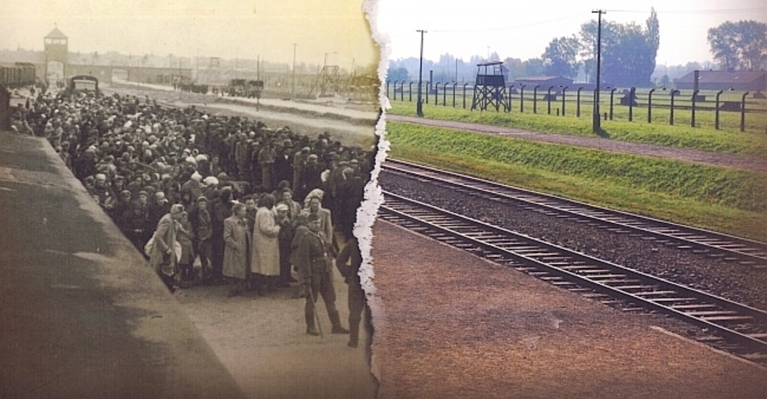

Slide 39
1943
The number of Jews killed by SS Einsatzgruppen passes 1,000,000. Nazis then use special units of slave labourers to dig up and burn the bodies to remove all traces.
29 January – Nazis order all Gypsies arrested and sent to extermination camps.

Slide 40
1943
February – The Romanian government proposes to Allies the transfer of 70,000 Jews to Palestine, but receives no response from Britain and the USA.
March – 50,000 Greek Jews are sent to extermination camps.
March – All Jews in the Krakow Ghetto are killed.

Slide 41
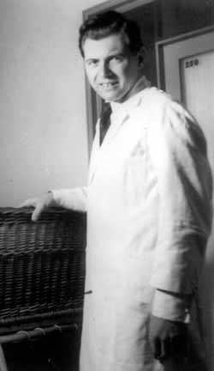
1943
May – Dr. Josef Mengele arrives at Auschwitz
May – Nazis declare Berlin to be “Judenfrei”(cleansed of Jews)
Notes:
The Angel of Death
He gassed all 750 women in one block of a camp when they found lice.

Slide 42
1943
Many of the extermination camps and concentration in eastern Poland were closed as Russian troops pushed the Germans back. Camps were destroyed, plowed over and trees were planted in their place.
This was an attempt to cover up their actions – Obviously they knew it was wrong.

Slide 43
1944
Poland’s Jewish population drops from 3.35 million to less than 100,000.
May – 100,000 Jews from Hungary arrive at Auschwitz. By the end of June 381,661 Hungarian Jews (about ½) are in Auschwitz.
June – 40,000 Polish children are taken as slave labour in Germany.

Slide 44
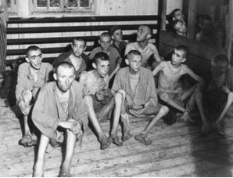
Auschwitz-Birkenau records its highest ever daily number of persons gassed and burned at just over 9000. Six huge pits are used to burn the bodies, as the number exceeds the capacity of the crematories.
As the Russians move closer and the western Allies land after D-Day, the Nazis order an increase in exterminations.

Slide 45
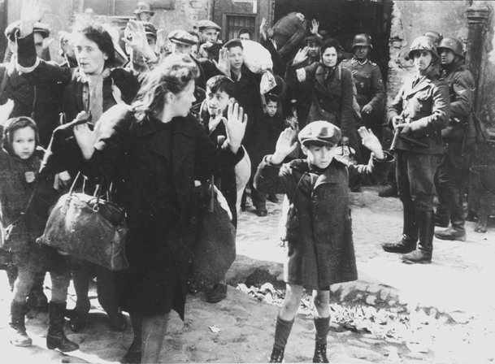
Notes:
One of the most famous photos taken during the Holocaust shows Jewish families arrested by Nazis during the destruction of the Warsaw Ghetto in Poland, and sent to be gassed at Treblinka extermination camp.

Slide 46
1944
July – Soviet troops liberate Majdanek extermination camp where 360,000 had been murdered.
August – Ann Frank and family arrested and sent to Auschwitz.
October – Last reported use of gas chambers at Auschwitz.
November – Himmler orders destruction of crematories at Auschwitz.

Slide 47
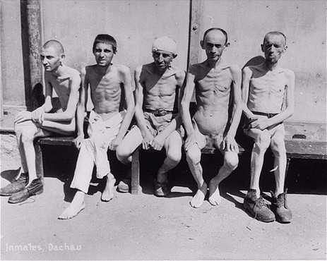
Jan 27, 1945 - Soviet troops liberate Auschwitz. By this time, an estimated 2,000,000 persons, including 1,500,000 Jews, have been murdered there.
April 29, 1945 - U.S. 7th Army liberates Dachau.

Slide 48
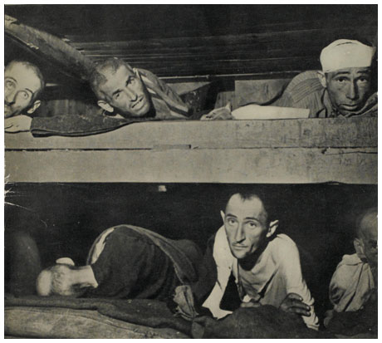

Slide 49
The Holocaust (‘41-’45)
There have been many massacres during the course of world history. And the Nazis murdered many non-Jews in concentration camps.
What is unique about Hitler’s “Final Solution of the Jewish Problem,” was the Nazi’s determination to murder without exception every single Jew who came within grasp, and the fanaticism, ingenuity, and cruelty with which they pursued their goal.

Slide 50
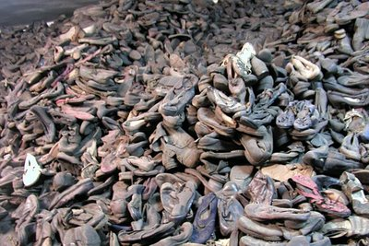
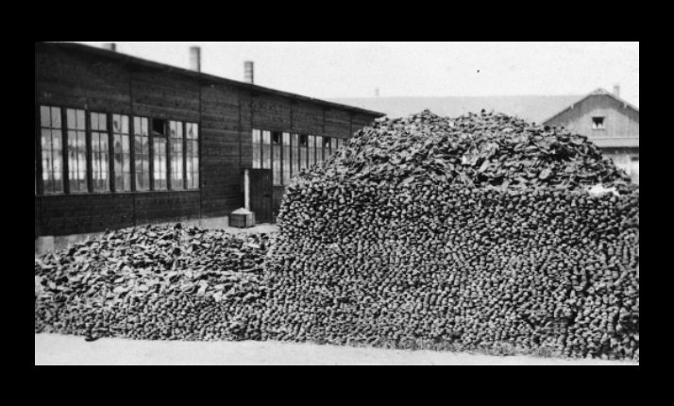

Slide 51
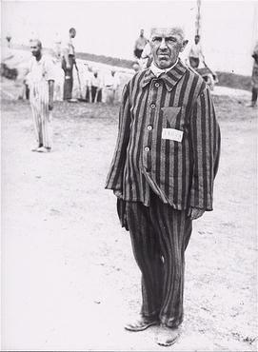
Life in a Concentration Camp
A prisoner in Dachau is forced to stand without moving for endless hours as a punishment. He is wearing a triangle patch identification on his chest.
A chart of prisoner triangle identification markings used in Nazi concentration camps which allowed the guards to easily see which type of prisoner any individual was.

Slide 52
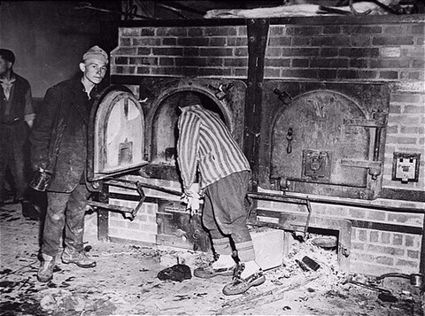
Survivors in Mauthausen open one of the crematoria ovens for American troops who are inspecting the camp.

Slide 53
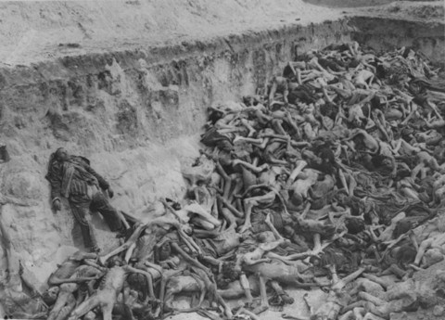
A mass grave at Bergen-Belsen Concentration Camp.

Slide 54
1945
15 April – British troops liberate 40,000 prisoners at Bergen-Belsen camp.
29 April – US Army liberates Dachau camp.
30 April – Hitler commits suicide.
7 May – Germany surrenders unconditionally to Allied forces.
23 May – Himmler commits suicide.
20 November – Opening of Nuremberg International Military Tribunal.

Slide 55
Statistics
Country Jewish Pop Killed
Poland 3,350,000 3,250,000
USSR 3,020,000 1,100,000
Hungary 800,000 596,000
Germany 566,000 200,000
France 350,000 77,320
Romania 342,000 287,000
Austria 185,000 65,000
Lithuania 168,000 143,000
Netherlands 140,000 100,000

Slide 56
Statistics
Country Jewish Pop. Killed
Netherlands 140,000 100,000
Moravia 118,310 71,150
Latvia 95,000 80,000
Slovakia 88,950 71,000
Yugoslavia 78,000 63,300
Greece 77,380 67,000
Belgium 67,700 28,900
TOTAL 9,508,340 5,963,129

Slide 57
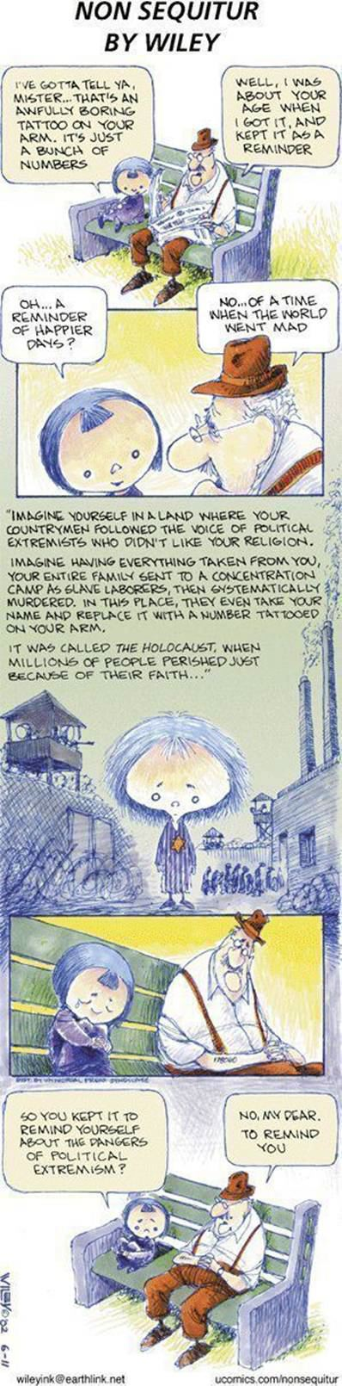

Slide 61
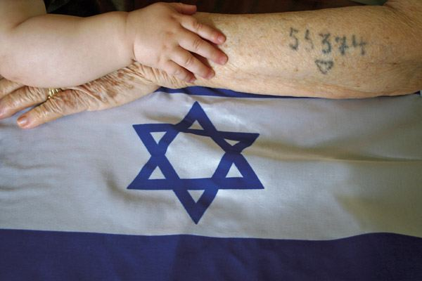

Slide 62
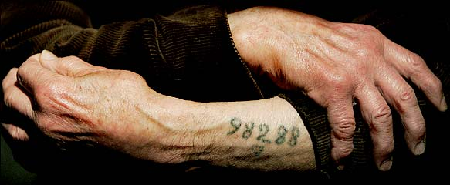

Slide 63
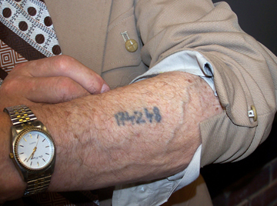

Slide 64
Genocide – The Process
You are the source of all our problems, therefore:
You may not work among us.
You may not work.
You may not live among us.
You may not live.

Slide 65
Medical Experiments
Altitude experiments
Freezing experiments
Genetic Experiments
Gynecological experiments

Slide 66
Other Genocides
Armenian Genocide (1915)
Cambodia (1975-79)
Srebrenica (1993)
Rwanda (1994)
Darfur? (2003-2009)
Indigenous Peoples in the Americas (ie. Beothuk)

Slide 67
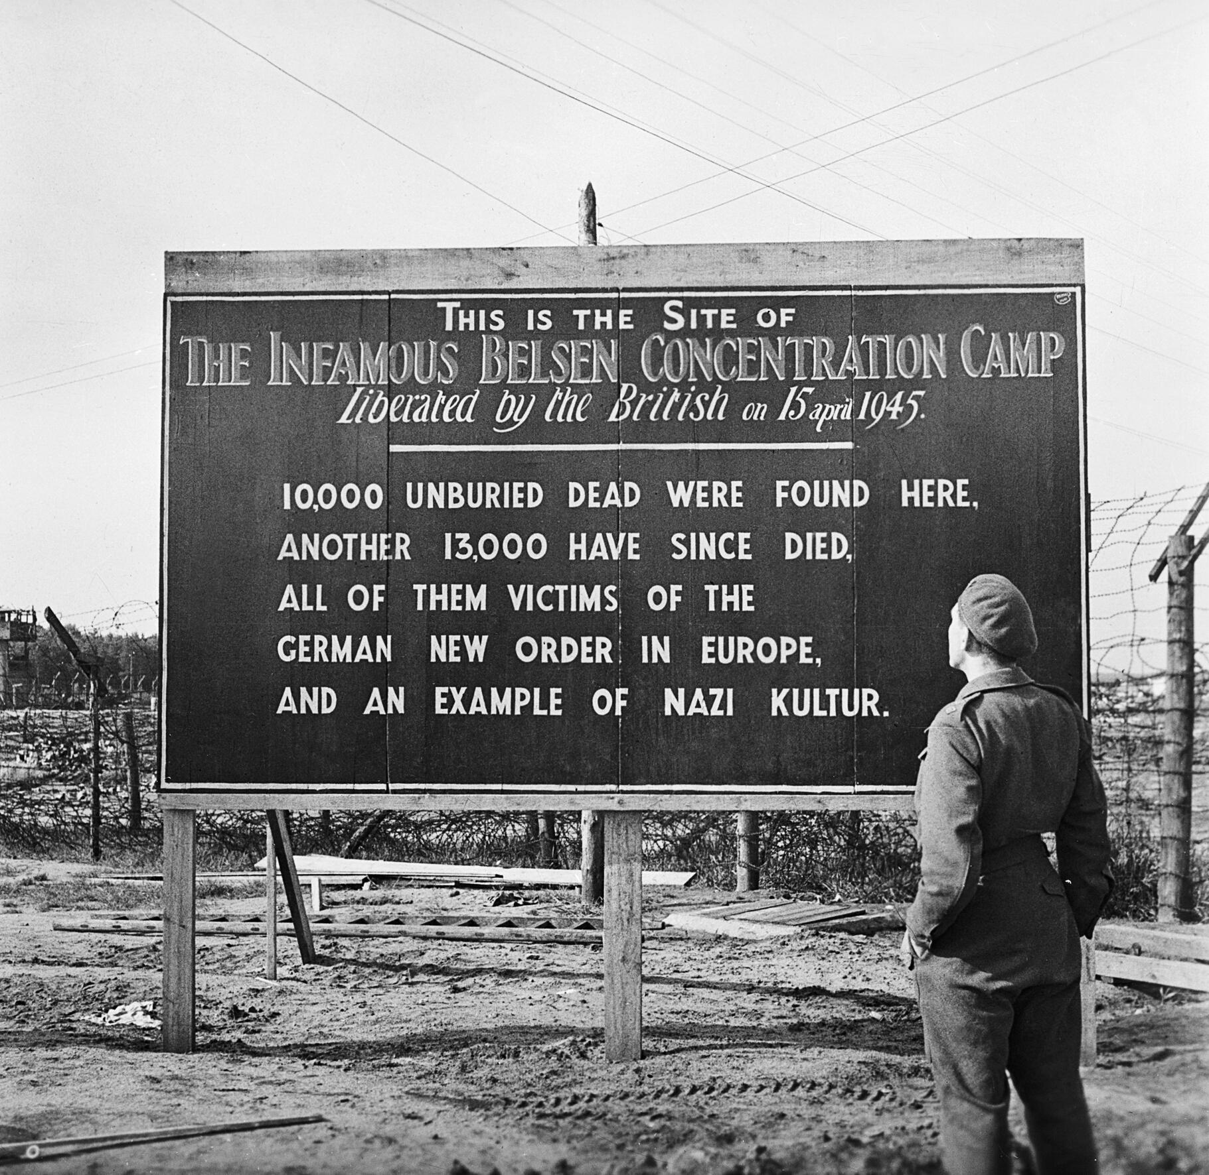
Belsen Concentration Camp’s Liberation
Warning: Distressing and Graphic Footage
British Soldier recalls…

Slide 68
Reading
Read pages 876-878 of the text to gain a better understanding of the scope of this travesty.
Question: How did the Holocaust impact Europe and the rest of the world? What lessons does the Holocaust have for us today?

