Slide 1
The Particle Theory of Matter
Section 2.1

Slide 2
The Particle Theory
More than 2000 years ago a Greek philosopher named Democritus suggested that matter was made of tiny particles too small to be seen.
He thought that if you kept cutting a substance into smaller and smaller pieces, you would eventually reach the smallest possible particle – the building blocks of matter.

Slide 3
Democritus “the Laughing Philosopher” 400 BCE

Slide 4
4 Principles of the particle theory
All matter is made of tiny particles
All particles of one substance are the same. Different substances are made of different particles
The particles are always moving. The more energy the particles have, the faster they move.
There are attractive forces between the particles. These forces are stronger when the particles are closer together.

Slide 5
Using the Particle Theory, we can understand two categories of substances that are encountered in chemistry:
Pure Substances
Mixtures

Slide 6
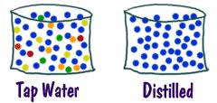
Two Categories of substances
Pure Substances
Contain only one kind of particle
Types: Elements and Compounds
Examples: aluminum, oxygen, carbon dioxide, sugar
Mixture
Contains two or more different pure substances (ie two or more different types of particles)
Types: Homogeneous and Heterogeneous Mixtures
Examples: milk,
cookie, pizza, raisin bran

Slide 7
Pure substances
Elements
Pure substances which cannot be broken down into simpler substances
Examples: hydrogen, nitrogen …(anything having its own box on the periodic table)
Compounds
Pure substances that contain two or more different elements in a fixed proportion (bonded together)
Examples: Water (H₂O), table sugar (C₁₂H₂₂O₁₁)

Slide 9
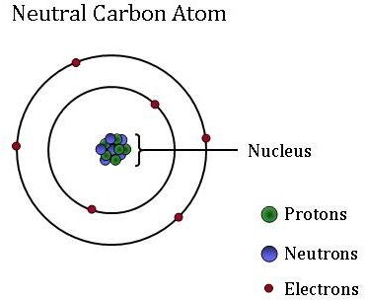
Elements
An atom is the smallest piece
(particle) of matter.
Each element is made of only one kind of atom (ie only one type of particle).
The periodic table has roughly 118 elements, therefore there are 118 kinds of atoms.

Slide 10
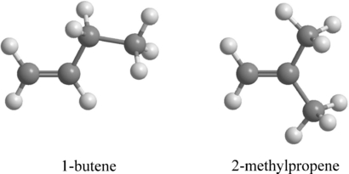
Compounds
Compounds are composed
of molecules
Molecules are units that contain two or more atoms bonded together in a fixed ratio
Examples:
C₄H₁₀ - contains 4 carbon atoms bonded with 8 hydrogen atoms. This combination produces butane
H₂0 - contains 2 hydrogen atoms bonded with 1 oxygen atom. This combination produces water

Slide 11
Mixtures
Homogeneous (also known as solutions)
This looks the same throughout (it has one phase)
May be made up of solids, liquids or gases
Examples: air, alloys, kool aid
Heterogeneous
Made up of two or more parts you can identify easily
These parts can be separated physically
More than one phase
Examples: pizza, salad, beach sand, raisin bran, cookie

Slide 12
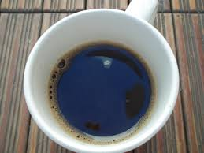
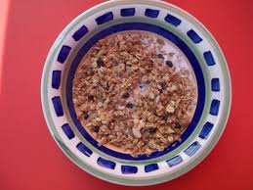
Mixtures
Homogeneous (also known as solutions)
This looks the same throughout (it has one phase)
May be made up of solids, liquids or gases
Examples: air, alloys, kool aid
Heterogeneous
Made up of two or more parts you can identify easily
These parts can be separated physically
More than one phase
Examples: pizza, salad, beach sand, raisin bran, cookie

Slide 13
Assignment
Complete the drawings indicated on your handout
Textbook page 44 – 47, # 3, 4

Slide 14
