Slide 2
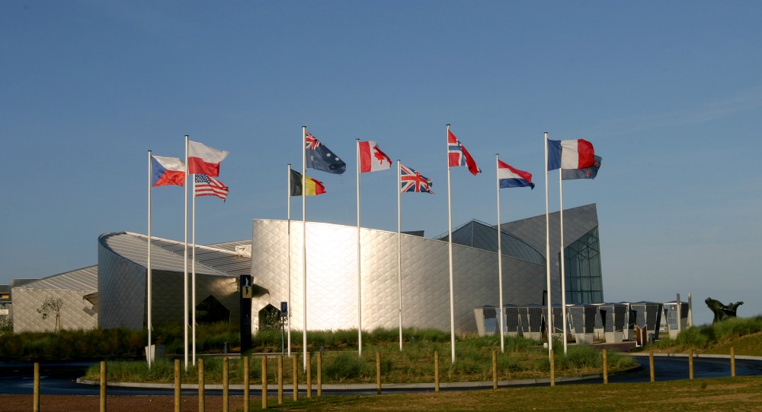
Historians generally agree that the Second World War was a major event that helped shape Canada’s identity as a nation as they made a significant contribution to the war effort.
Nearly 1 in 10 Canadians served in the armed forces and millions were involved in the war effort at the home front.
The Juno Beach Centre opened in 2003
Notes:
Home front is the informal term for the civilian populace of the nation at war as an active support system of their military. Military forces depend on "home front" civilian support services such as factories that build materiel to support the military front.

Slide 3
The Road to War
In the summer of 1939, nearly 12 million Canadians anxiously watched events unfold in Europe. It was nearly 20 years to the day when The Treaty of Versailles was signed by Germany which essentially ended the first World War.
While many factors led to growing tensions in places around Europe Asia also experienced increasing conflict between Japan and China. It is debatable to what exactly lead to the outbreak of WW2 rather it is a combination of issues.

Slide 4
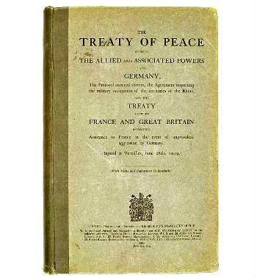
The Treaty of Versailles
The Treaty of Versailles was signed between the Allied Powers and Germany on June 28, 1919. This officially ended World War I.
The treaty was extremely harsh on Germany. It forced Germany to "accept the responsibility for causing all the loss and damage" of the war. Germany was forced to disarm, give up land to France, and to pay reparations of 132 billion Marks (around $442 billion today).
Notes:
At the beginning of the 1930s, Adolf Hitler’s Nazi Party exploited widespread and deep-seated discontent in Germany to attract popular and political support. There was resentment at the crippling territorial, military and economic terms of the Versailles Treaty, which Hitler blamed on treacherous politicians and promised to overturn.

Slide 5
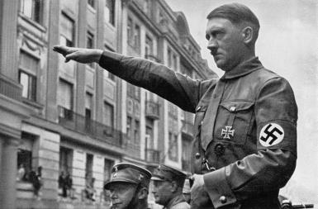
Rise of the Nazi Party in Germany
According to some, Adolf Hitler and the National Socialist party (the Nazi Party) were elected to power in 1933 by using growing anger over the Treaty of Versailles to fuel his push for leadership over the German people. After Hitler was elected he outlawed other political parties, therefore he became the dictator, or only ruler.

Slide 6
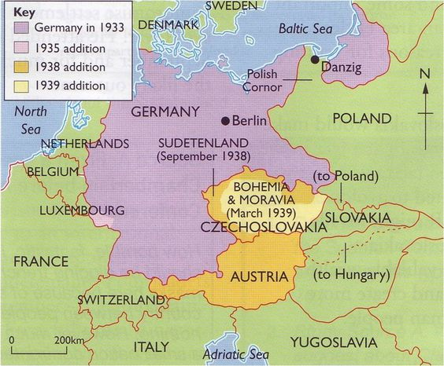
Problems Arise
After he seized power, Hitler looked to break the Treaty of Versailles and began to annex, or reoccupy, territories that were taken away from Germany after the first World War.
Rhineland, Austria, Sudetenland, Czechoslovakia and Poland all fell to Germany in the lead-up to WW2

Slide 7
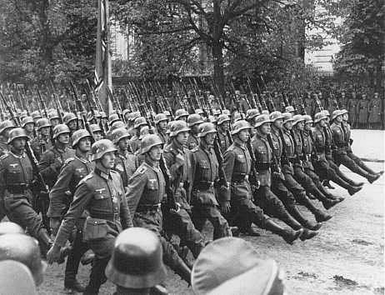
Appeasement = Failure
Leaders from Britain, France and the United States, who had written the treaty, did not take a stand against these violations in hopes to avoid another global conflict.
They adopted a policy of appeasement where they relaxed the terms of the treaty in hopes of satisfying German demands and allowing peace.

Slide 8
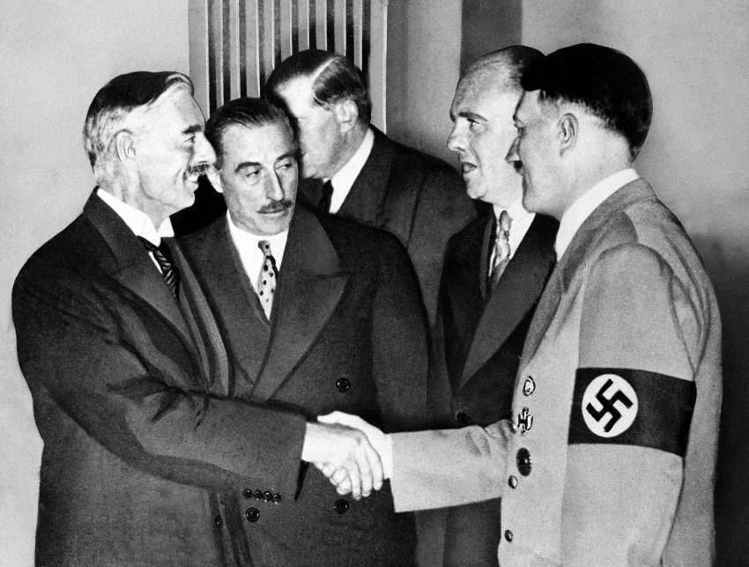
Adolf Hitler and British Prime Minister Neville Chamberlain shake hands on Sept. 30, 1938 -- the day they signed the Munich Agreement, sealing the fate of Czechoslovakia.

Slide 9
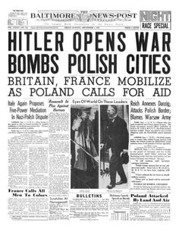
Poland Invaded
On 1 September 1939, 62 German divisions supported by 1,300 aircraft began the invasion of Poland.
At 8pm on the same day, Poland requested military assistance from Britain and France.
Two days later, in fulfilment of their April 1939 pledge to support the country in the event of an attack, Britain and France declared war on Germany. World War II had begun.

Slide 10
Questions – Writing Activity
What made the Treaty of Versailles such a common reason that historians give as a cause for the outbreak of WW2? (cause & consequences)
In 1914, when war was declared, there was widespread celebration. There was no celebration in 1939. Why not?

Slide 11
Poster Activity – Assessment (using visuals to relay understanding)
Propaganda played a large role in recruiting volunteers to join Canada’s overseas army, navy and air force. Posters were a key tool for recruiters.
Part 1
Analyze the posters on page 107 and answer the questions found on the same page.
Part 2
Create your own poster for the WW2 homefront. Use colour to make your poster appealing to your target audience. These posters will be displayed.

Slide 12
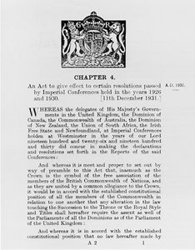
Flashback
In 1914 when Britain declared war in the First World War Canada was automatically included as it was still a part of the British Empire. During the 1920s and 30s this relationship changed as The Statute of Westminster (1931) made Canada independent of British foreign policy.
During the start of WW2 Canada had the choice to go to war or not.
Notes:
The Statute of Westminster, of 11 December 1931, was a British law clarifying the powers of Canada's Parliament and those of the other Commonwealth Dominions. It granted these former colonies full legal freedom except in those areas where they chose to remain subordinate to Britain.

Slide 13
Flashback
During the First World War Canada was faced with a possible crisis that many struggled with: Conscription.
Conscription, or drafting, is the compulsory enlistment of people in a national service, most often a military service.
While conscription never became a reality PM Mackenzie King compromised and offered a volunteer army in WW1.
Notes:
As the threat of a new war in Europe became acute, the question of military conscription again caused lively political debate in French Canada. The federal Liberals, sensitive to strong francophone feelings on this issue, repeatedly pledged not to resort to compulsory enlistment for overseas military service.
War broke out in September 1939, and by the spring of 1940 the government had adopted the National Resources Mobilization Act providing for enlistment only for home defense.

Slide 14
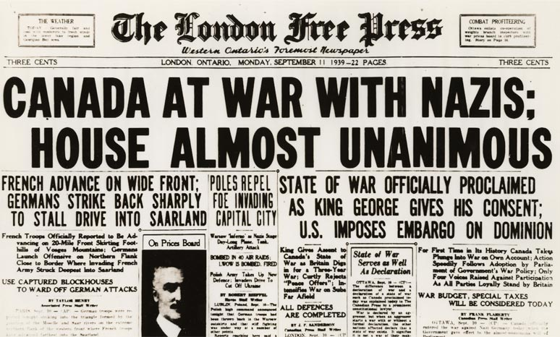
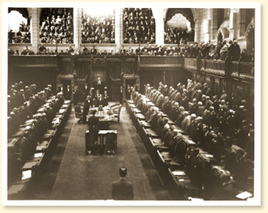
After two days of debate in Parliament, Canada formally declared war on Germany on Sept.10, 1939.

Slide 15
4 Phases of WW2
Phase 1: Sept ’39 – June ‘40

Slide 16
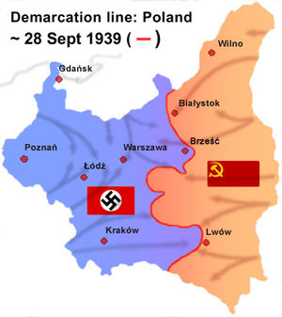
As Germany entered Poland from the west the Soviet Union decided to invade from the east as they now understood that the Polish government had ceased to exist.
The Germans and Soviets had a non-aggression pact and had agreed to divide Poland between them.
Notes:
More on Soviet occupation of Poland.

Slide 17
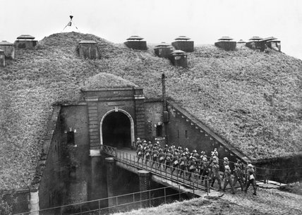
Global Context
Since 1937 China and Japan had been involved in the Second Sino-Japanese War.
Poland was invaded by Germany and the Soviet Union.
Britain and France had mobilized their troops in fear of a German attack.
France was relying on the Maginot Line of fortifications built after WW1 to defend against another German invasion…it failed.
Notes:
The Maginot Line was not a continuous line of forts as some believe. In parts, especially in the south from Basle to Haguenau, it was nothing more than a series of outposts as the steep geography of the region and the River Rhine provided its own defence between France and Germany. The Line comprised of over 500 separate buildings but was dominated by large forts which were built about nine miles from each other.

Slide 19
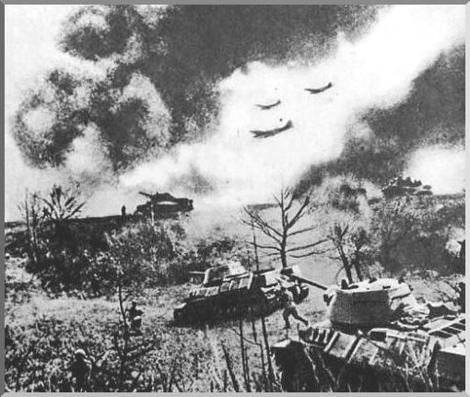
Blitzkrieg
A German term for “lightning war,” blitzkrieg is a military tactic designed to create disorganization among enemy forces through the use of mobile forces and locally concentrated firepower.
German forces tried out the blitzkrieg in Poland in 1939 before successfully employing the tactic with invasions of Belgium, the Netherlands and France in 1940.
Notes:
The Maginot Line was ineffective against the Blitzkrieg and the Germans were able to break through French and other Allied defensive lines in Belgium and Holland and in 1940 the French Govt surrendered.

Slide 20
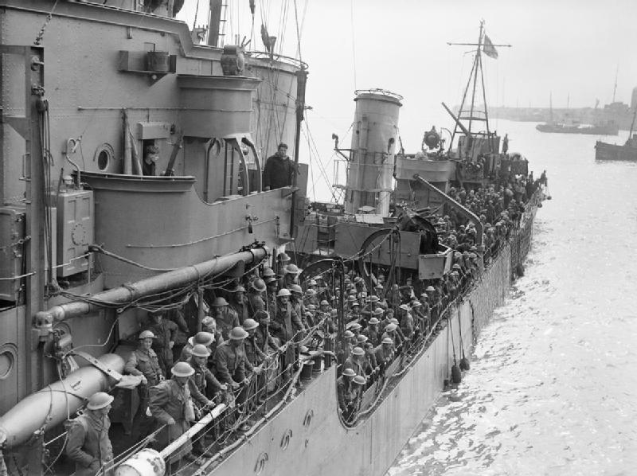
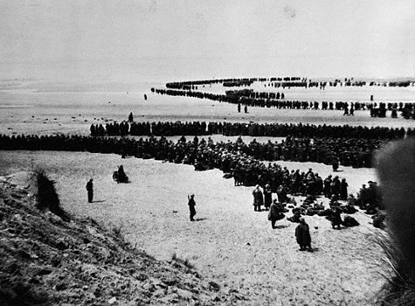
Operation Dynamo
As German troops poured into Holland, Belgium, and France many survivors were evacuated from the beaches of Dunkirk.
Notes:
The Dunkirk evacuation, code-named Operation Dynamo, also known as the Miracle of Dunkirk, was the evacuation of 338,226 Allied soldiers from the beaches and harbour of Dunkirk, France, between 26 May and 4 June 1940, during World War II. The operation was decided upon when large numbers of Belgian, British, and French troops were cut off and surrounded by the German army during the Battle of France. In a speech to the House of Commons, British Prime Minister Winston Churchill called the events in France "a colossal military disaster", saying "the whole root and core and brain of the British Army" had been stranded at Dunkirk and seemed about to perish or be captured

Slide 21
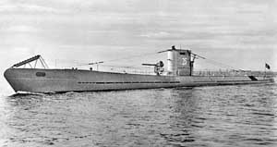
Canada’s Contribution
As PM Mackenzie King had promised, Canada’s small volunteer army was dispatched to Britain in December 1939. Remember that Canada’s army was significantly reduced following the events of WW1.
Canada’s merchant marine ships (39 total) were being used to transport troops and war goods to Europe. The first ship was sent out in ‘39 and was sunk by German U-boats almost immediately.

Slide 22
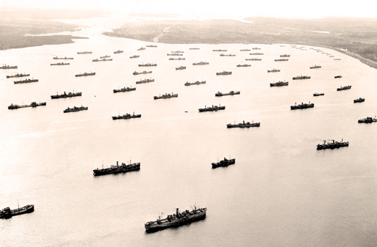
Merchant ships assemble in Bedford Basin, Halifax, April 1942

Slide 23
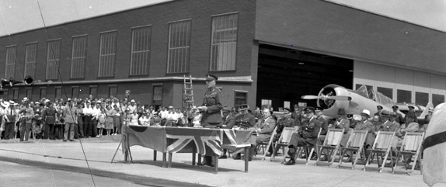
At Home in Canada
In 1939 the British Commonwealth Air Training Program (BCATP) was put into place as Allied pilots and crews would train for the war. Over the span of the war more than 131,000 aircrew were trained and dozens of airfields were built across Canada, some remained in use after the end of the war.

Slide 24
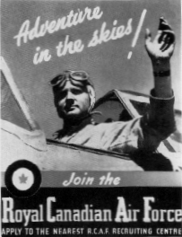
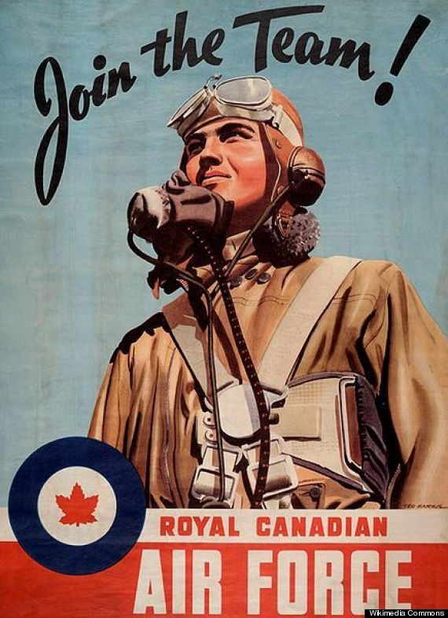
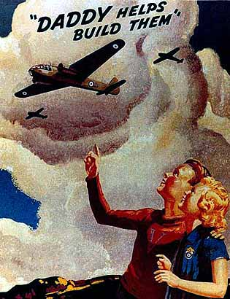
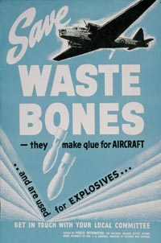

Slide 25
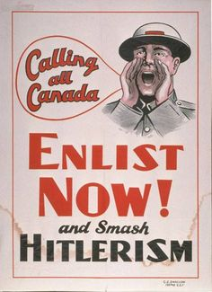
In 1940 Mackenzie King and the Liberal govt won the Federal election with a large majority, they focused on maintaining a small volunteer army overseas and have large-scale production at home.
King’s govt wanted to avoid large causalities and conscription, however, after the German victories over Holland, Belgium and France left the British alone to face Hitler, Canada had to step up.

Slide 26
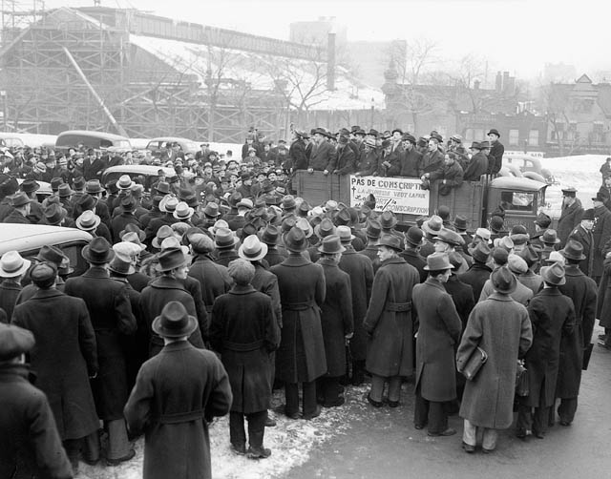
While many English Canadians supported conscription if necessary many French Canadians opposed it fully. Protests appeared in places around Quebec to oppose this
Notes:
In Quebec, 72.9% of the population vote "no," whereas across the other provinces, 80% of the residents vote "yes." The government then passes a law authorizing conscription for overseas service, if it is deemed necessary. Given the overwhelming support of English Canada, the federal government felt that it no longer could keep its anti-conscription promise.

Slide 27
Canada Goes “All In”
After Germany managed to experience key victories in Europe, Canada and other Commonwealth allies, were forced to make some tough decisions.
Canadian Parliament soon passed the National Resource Mobilization Act (NRMA), which moved Canada from a limited role in the war to a total commitment to the war effort.
Notes:
From 1940 to 1944 close to 60 000 NRMA soldiers ("zombies") volunteered for general service, and several thousand more were sent to the front after the use of conscripts for overseas service actually began late in 1944.
In June 1940, the government adopted conscription for home service in The National Resources Mobilization Act, 1940 (NRMA), which allowed the government to register men and women and move them into jobs considered necessary for wartime production, but did not allow them to be conscripted for overseas service.^{[citation needed]}
By the late summer of 1944, the numbers of new recruits were insufficient to replace war casualties in Europe, particularly among the infantry.^{[3]}

Slide 28
Questions - Complete in your notebooks
How did the first phase seem to be working for the Allied forces?
Look up the Ribbentrop-Molotov Non-aggression Pact. What did it say? (use you phones)
Was the Soviet Union doing anything else (invading, annexing…) during Germany’s first moves towards WW2? (see Figure 7.3 on page 106 in the text book)

Slide 29
Phase 2
June 1940 to July 1943

Slide 30
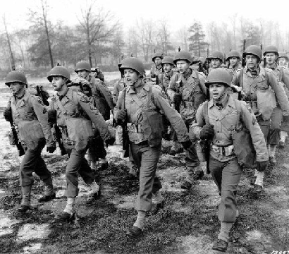
Not If But When?
While the beginning of 1940 went badly for Britain and it’s allies in the war with Germany it started to become clear that it was simply a matter of time before the allied forces would be victorious against the axis powers.
Two major events were responsible for turning the war against Germany.

Slide 31
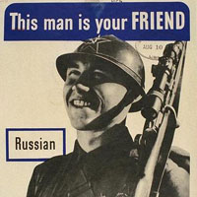
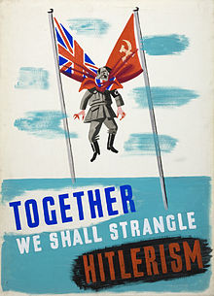
Don’t poke the Bear!
In June 1941, Germany went against their non-aggression pact and invaded the Soviet Union. While the Soviets would suffer over 30 million causalities in its war against the Germans the unprovoked attack on the Soviets would cause them to become allies with Britain for the remainder of the war.

Slide 32
Press Start to Join the Fight
The second event that can be seen as a main reason for the downfall of the Axis Powers and the Nazi Party was the American entering the war.
On December 7th, 1941Japan attacked a U.S. peacetime fleet at Pearl Harbour in Hawaii. Japan was attempting to assert itself as a dominate power in Asia and tried to flex its muscle against the US.
The U.S. officially declared war on Germany and Japan following this attack on Pearl Habour which was a date which will live in infamy.
Notes:
There were numerous historical precedents for unannounced military action by Japan. However, the lack of any formal warning, particularly while negotiations were still apparently ongoing, led President Franklin D. Roosevelt to proclaim December 7, 1941, "a date which will live in infamy". Because the attack happened without a declaration of war and without explicit warning, the attack on Pearl Harbor was judged by the Tokyo Trials to be a war crime.

Slide 33
Pearl Harbor

Slide 34
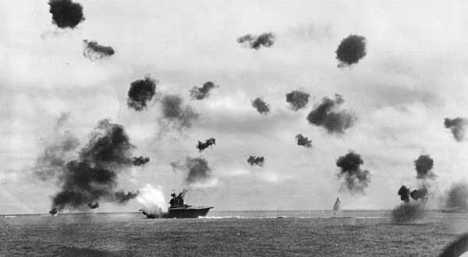
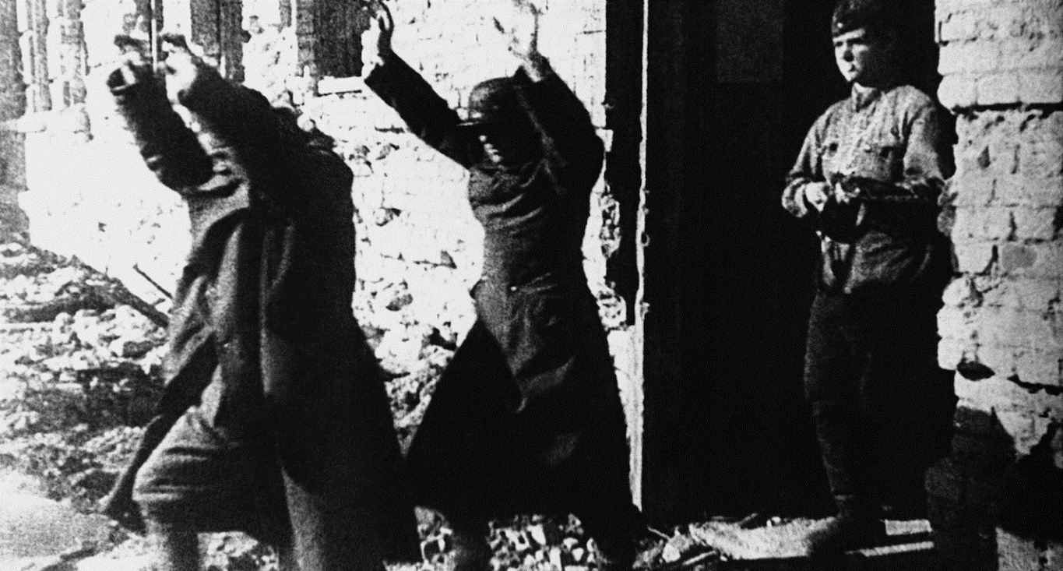
By June 1942 the Americans destroyed much of Japan’s naval and air forces at the Battle of Midway.
In Oct 1942 the German Army were handed a massive loss while fighting the Soviets outside the city of Stalingrad, in the Soviet Union.
Notes:
The Axis suffered 850,000 total casualties (wounded, killed, captured) among all branches of the German armed forces and its allies; 400,000 Germans, 200,000 Romanians, 130,000 Italians, and 120,000 Hungarians were killed, wounded or captured.
The USSR, according to archival figures, suffered 1,129,619 total casualties; 478,741 personnel killed or missing, and 650,878 wounded or sick. On the material side, the USSR lost 4,341 tanks destroyed or damaged, 15,728 artillery pieces, and 2,769 combat aircraft.
In all, the battle resulted in an estimated total of 1.7–2 million Axis and Soviet casualties.

Slide 35
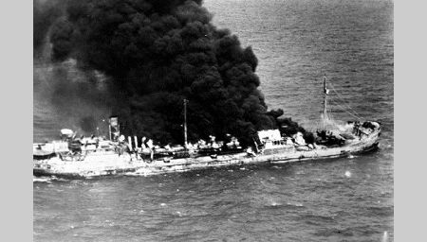
Canada’s Contribution
During the time of WW2 Canada had both successes and failures. One of Canada’s contributions was to escort convoys of merchant ships carrying was material to Britain and the Soviet Union. While many boats were lost to German u-boats new anti-submarine tactics dramatically decrease the number of lost ships by 1943.

Slide 36
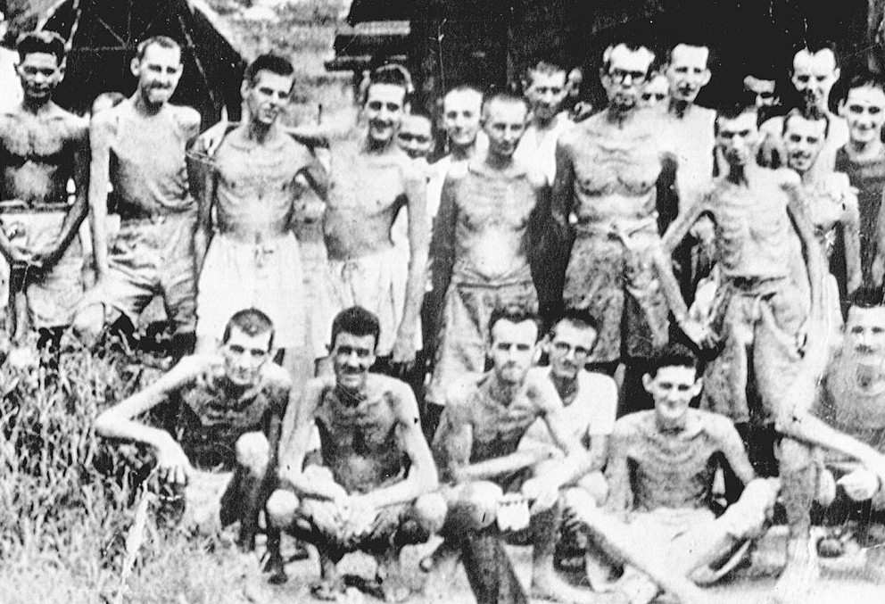
Canadian Losses
Canada suffered two major defeats in Phase 2 of WW2.
The first major defeated happened in 1941 as Canadian and British troops were defeated in Hong Kong despite their best efforts. 290 Canadians were killed and 1685 were captured to become POWs.
Notes:
Of the 1685 POWs 260 died in captivity

Slide 37
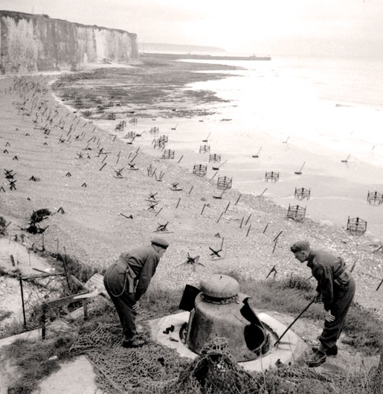
The second major defeat for the Canadians was the 1942 attack on Dieppe, a port in France. More than 6000 Allied troops participated including 4963 Canadians. This disaster resulted in 900 Canadian deaths and 1900 POWs.
The Dieppe Raid was designed for an Allied force to take a defended port, establish and hold a perimeter around the town, destroy the harbour facilities, and then withdraw by sea. It failed.
Notes:
Operation Jubilee was the first Canadian Army engagement in the European war, designed to test the Allies' ability to launch amphibious assaults against Adolf Hitler's "Fortress Europe." The raid was a disaster: More than 900 Canadian soldiers were killed, and thousands more were wounded and taken prisoner. Despite the bloodshed, the raid provided valuable lessons for subsequent Allied amphibious assaults on Africa, Italy and Normandy.

Slide 38
Questions to Answer
With the two major defeats at Hong Kong and Dieppe what do you think the people in Canada were thinking? (cause & consequence)
What was significant about the Battle of the Atlantic to the outcome of WW2?

Slide 39
Phase 3
July ‘43 – june ‘44

Slide 40
Global Context
After major victories at Midway, El Alamein(North Africa), and Stalingrad, the balance of the war shifted in favour of the Allies.
After 1943 the Allied forces were on the offensive on all fronts.
The American forces continued to dominate the Pacific and helped reclaim the Philippines from the Japanese.
The Soviet forces gained momentum and forced the Germans to retreat back to Berlin.
In addition to this the aerial bombing of Germany increase as more bombers were being supplied by the US and Canada forces.

Slide 41
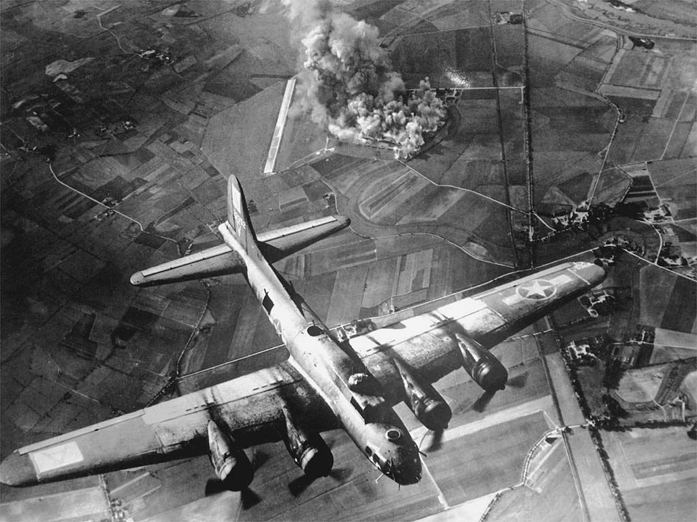
Canadian Contribution
As WW2 continued so did Canada’s air force achievement. At the beginning of the war many Canadian pilots were assigned to other Allied bomber groups but by ‘43 the Canadian Ai Force had its own bomber group.
Canadian, and Allied Forces, focused bombing runs on German industrial sectors on a 24 hour schedule.
What do you think the Allies were thinking with deciding these targets?
Notes:
The goal of the industrial sector bombing runs was to weaken and destroy the German ability to wage war.
After the war these bombing runs were viewed as controversial as many civilians were killed. Ultimately, the goal was to end the war and the loss of civilian lives was unfortunate by necessary.

Slide 42
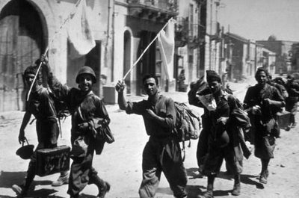
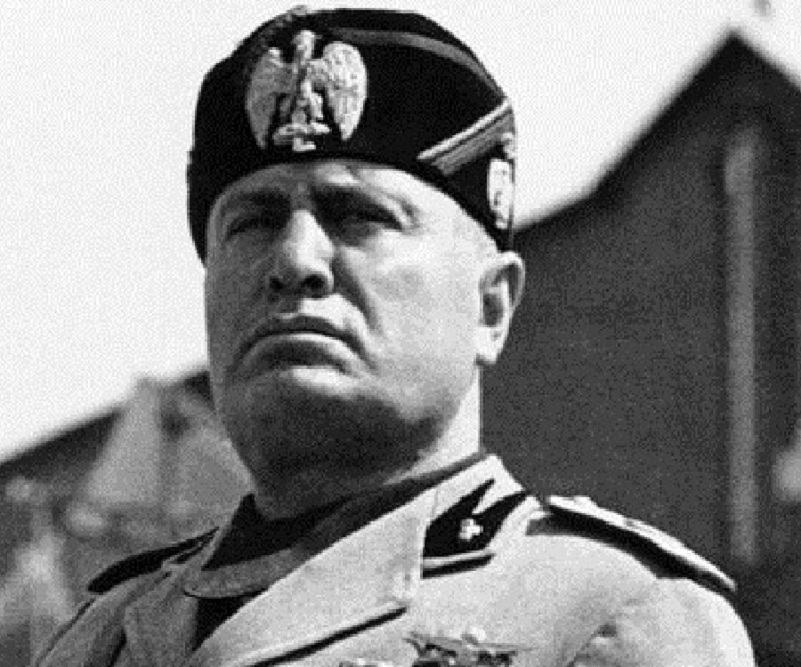
Italian Surrender
The First Canadian Division, along with other Allied forces invaded Sicily, off the coast of Italy, in 1943. After this successful invasion the Allies moved onto Italy, one of Germanys main military supporters.
The Allies defeated Italy and in 1943 overthrew the govt and Benito Mussolini was arrested. The new government surrendered and its troops withdrew.
Notes:
In 1940, Mussolini took his country into World War II on the side of Nazi Germany but soon met with military failure. By the autumn of 1943, he was reduced to being the leader of a German puppet state in northern Italy and was faced with the Allied advance from the south and an increasingly violent internal conflict with the partisans. In April 1945, with the Allies breaking through the last German defences in northern Italy and a general uprising of the partisans taking hold in the cities, Mussolini's situation became untenable. On 25 April he fled Milan, where he had been based, and tried to escape to the Swiss border. He and his mistress, Claretta Petacci, were captured on 27 April by local partisans near the village of Dongo on Lake Como. Mussolini and Petacci were shot the following afternoon, two days before Adolf Hitler's suicide.

Slide 43
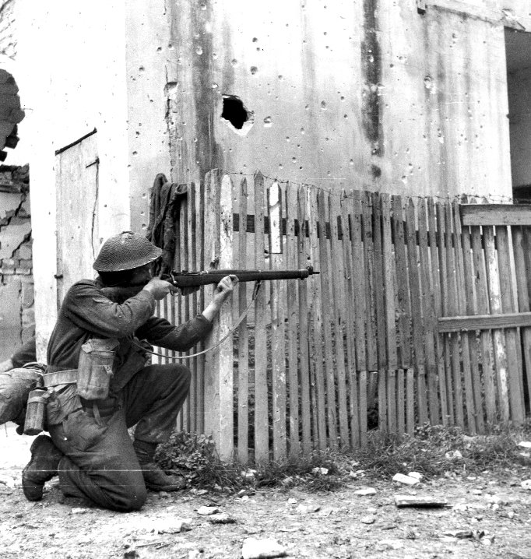
Canadians in Italy
After the Italians pulled out of its alliance with Germany the Nazi party sent reinforcement to Italy to continue the campaign.
One of Canada’s shining moments were in the battle for the city of Ortona in 1943.
Canadian troops battled house-to-house and hand-to-hand against the German military until the city fell to the Allies in December of ‘43.
Canadians also played a major role in the victory in Cassino in 1945 before they were sent back to Northwestern Europe.

Slide 44
Phase 4
June ‘44 – Sept ‘45

Slide 45
The Final Push – D-Day
This final year of the war began with the Allied invasion of Europe.
Germany was forced to fight battled on two front: the Soviets from the east and the British, Canadians and Americans from the west.
In addition to this European battle, the Americans were closing in on the Japanese and developing a weapon that they hoped would shorten the war and, ultimately, change the face of war forever.

Slide 46
Canadian Troop Movement ‘44-‘45

Slide 47
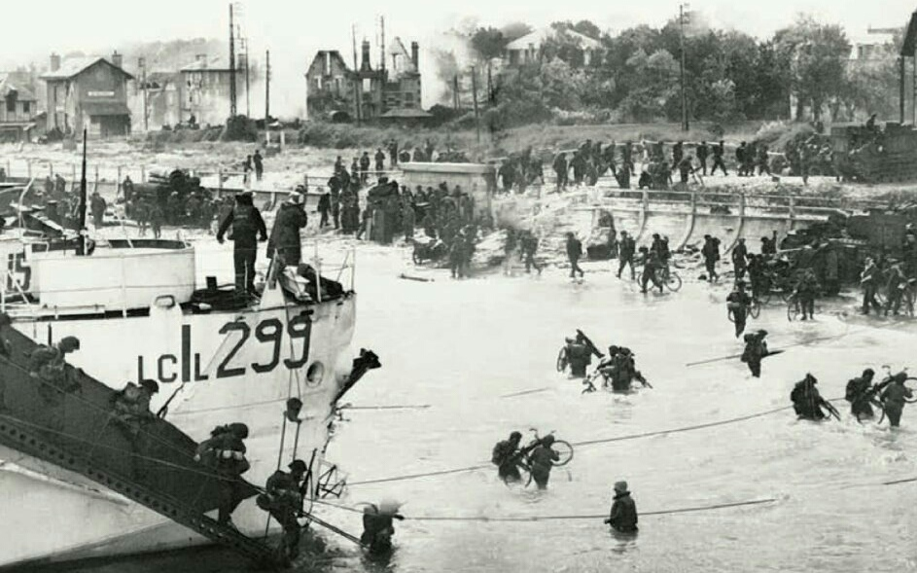
Canadian Contribution
On June 6, 1945 Allied troops landed in Normandy to begin their final assault against Germany. Canada landed at Juno Beach while other forces landed at other beaches along the coastline.
The Canadian landings on the Juno Beach Sector of the Normandy coast were one of the most successful operations carried out on D-Day.
Notes:
Another amphibious assault was questionable as Canadian troops suffered huge causalities at Dieppe in 1942.
Most of the elaborate fire-support plan failed, leaving the infantry, combat engineers, and armoured troopers to overcome the enemy by direct fire. It took incredible courage just to keep going; words cannot do justice to the individuals who rose to the challenge and led assaults on deadly enemy positions.

Slide 48
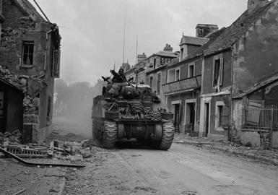
Victory in Caen
Suring the last phase of WW2 the British, Canadian and American troops worked meticulously to take position after position.
First the Allies captured the city of Caen, a major rail center for the German army and in doing so defeated some of Germany's best fighters.

Slide 49
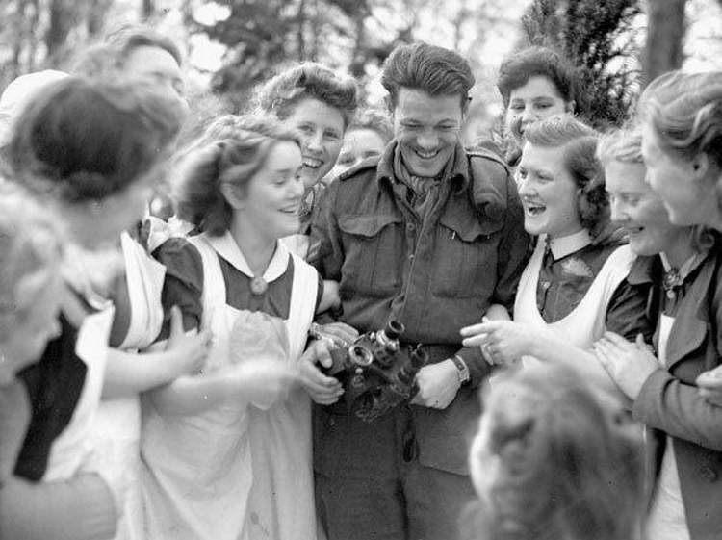
Victory in Falaise
After the victory in Caen the Allied forces went on to capture Falaise which forced Germany to retreat to Belgium and the German border.
This victory help liberate Paris and most of France. As more troops arrived in France to push back the Germans the issue of supplies and resources became a logistical nightmare.
Capturing ports were vital to the chain of supply and Canada were called upon to make this happen.

Slide 50
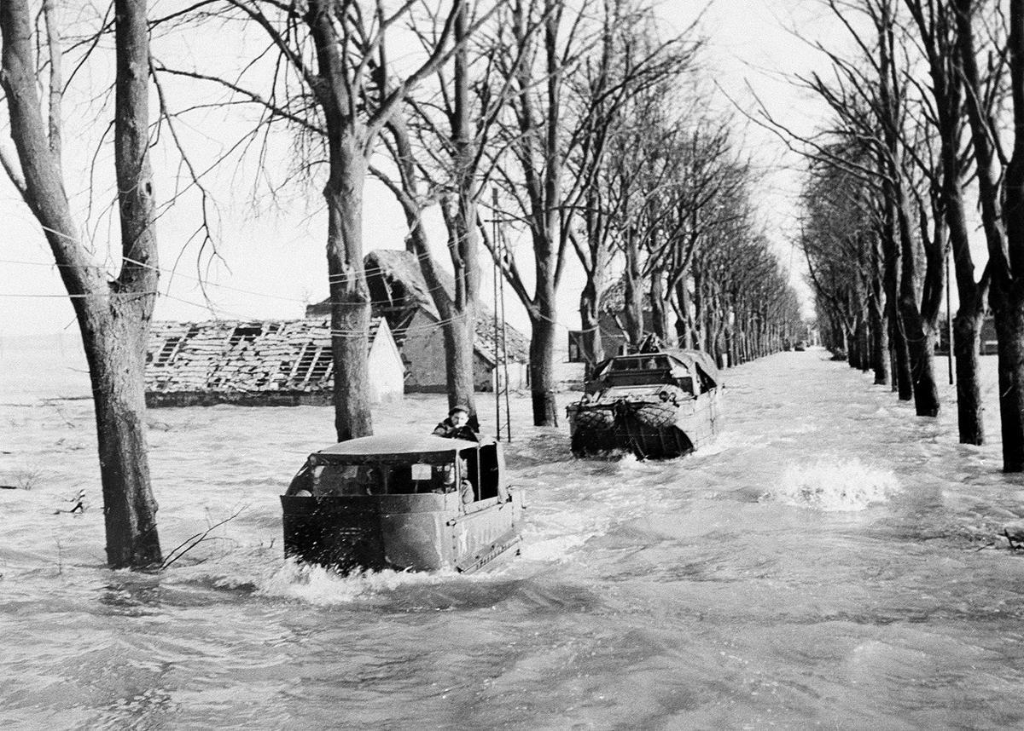
Belgian Liberation – Battle of the Scheldt
The First Canadian Army were sent to Antwerp, Belgium, a major shipping port in Europe. The city was liberated by the Canadian troops but the actual port was 80 km away.
While approaching the port German soldiers opened the dikes and flooded to low-lying region where the Canadians were traveling.
Notes:
Canadian troops were nicknamed “water-rats” after this successful push into Belgium.
The First Canadian Army lost nearly 13,000 men killed, wounded or missing during the Scheldt fighting, including more than 6,300 Canadians. However, by 8 November the estuary and its large islands had been secured. The river was then cleared of mines, and on 28 November the first convoy of Allied cargo ships entered the port of Antwerp.

Slide 51
Belgium to the Netherlands
In the final months of the WW2, Canadian forces were given the important and deadly task of liberating the Netherlands from Nazi occupation.
From September 1944 to April 1945, the First Canadian Army fought German forces on the Scheldt estuary —opening the port of Antwerp for Allied use — and then cleared northern and western Netherlands of Germans, allowing food and other relief to reach millions of desperate people.
Today, Canada is fondly remembered by the Dutch for ending their oppression under the Nazis.
Notes:
Canadians are fondly remembered by the Dutch as both liberators and saviors who rescued millions from sickness and starvation in 1945. The joyous "Canadian summer" that followed forged deep and long-lasting bonds of friendship between the two countries.
Every year since the war, the Netherlands has sent thousands of tulips to Ottawa, in appreciation for Canada's sacrifice and for providing safe harbour to the Dutch royal family, which lived in exile in Canada during the war.

Slide 52
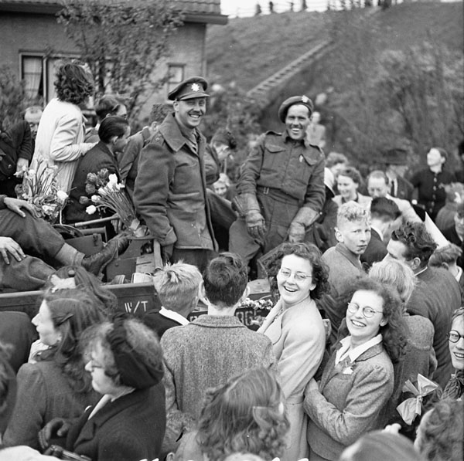
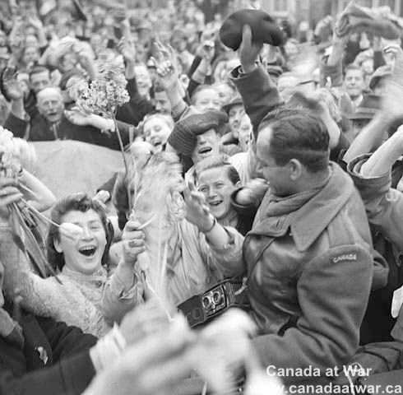

Slide 53
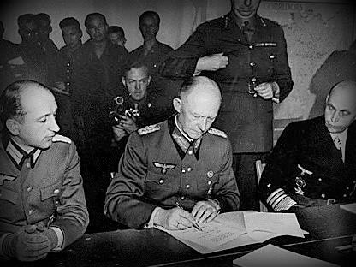
The End of WW2
General Charles Foulkes, commander of the 1st Canadian Corps, accepted the surrender of German forces in the Netherlands on 5 May 1945. Two days later, Germany formally surrendered and the war in Europe came to an end.

Slide 54
Japan Continues to Fight
While Germany and Italy had fallen in Europe, Japan continued to fight in the Pacific, refusing to give up despite being warned about an upcoming disaster.
Hiroshima, a manufacturing center of some 350,000 people located about 500 miles from Tokyo, was selected as the first target and was devastated when struck by the first atomic bomb on Aug 6, 1945.
3 days later, Nagasaki received the second atomic bomb. Emperor Hirohito finally surrendered, officially ending the Second World War.
Notes:
In late July, Japan’s militarist government rejected the Allied demand for surrender put forth in the Potsdam Declaration, which threatened the Japanese with “prompt and utter destruction” if they refused.
Emperor Hirohito, by request of two War Council members eager to end the war, met with the Council and declared that “continuing the war can only result in the annihilation of the Japanese people…” The Emperor of Japan gave his permission for unconditional surrender.

Slide 55
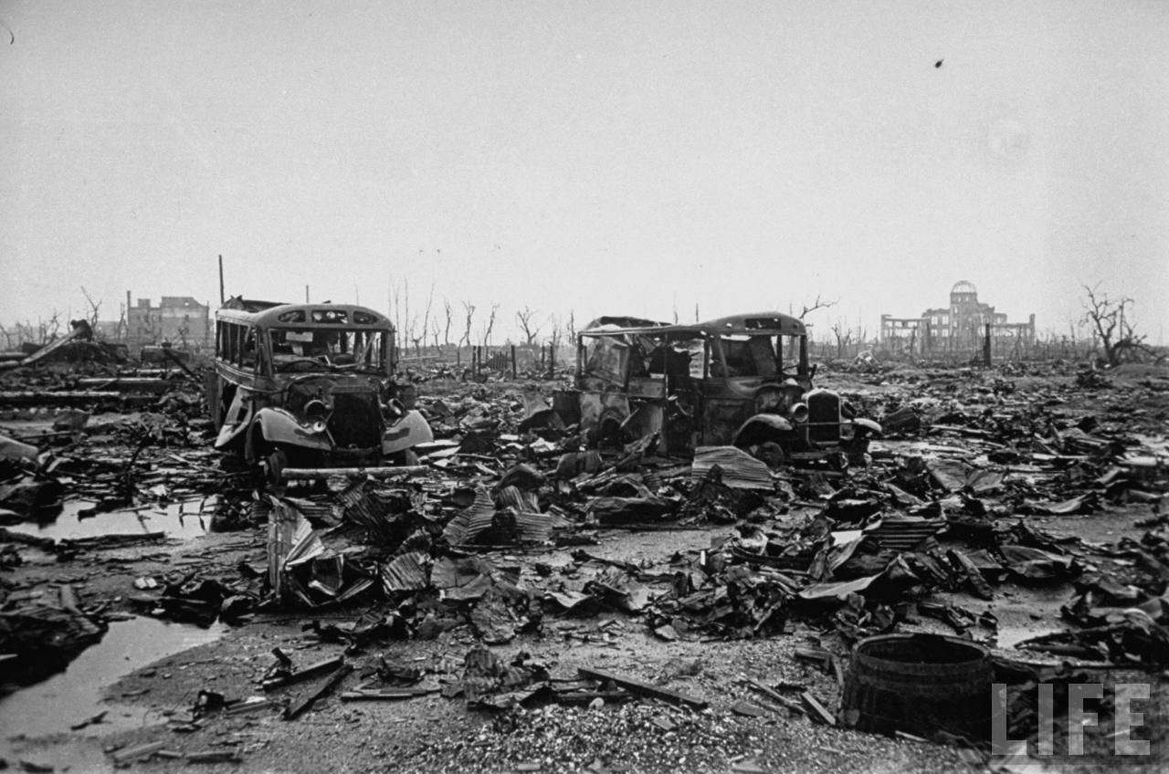

Slide 56
The Holocaust and more
Although the war has ended many other stories of atrocities surfaced. Stories of war crimes, cruelty and mass killings.
The Holocaust was a genocide in which Nazi Germany and its collaborators killed about six million Jews.
The victims included 1.5 million children and represented about two-thirds of the nine million Jews who had resided in Europe.
Killings took place throughout Nazi Germany, German-occupied territories and territories held by allies of Nazi Germany.
Notes:
You will learn more about this terrible historical event in future History classes. If you are interested in more information there are tremendous amount of literate and media available about this topic.

Slide 57
Readings and Tasks
To gain some additional information on Canadians in WW2 read the Canadians in Profile found on page112.
Divide your page into three columns. Use these columns to identify the key contributions of Canada’s army, navy and air force in WW2. When you are done, share your thoughts with classmates and discuss.

