Slide 1
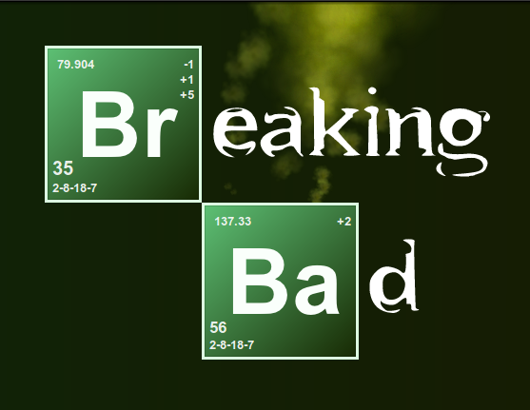
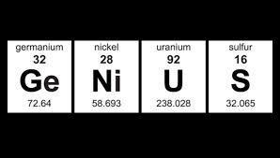
Chemical Symbols and Formulas
2.7

Slide 2
Chemical Symbols
A Chemical symbol is an abbreviation of a name of an element.
Capital letter if only one letter.
Only first letter capital if more than one letter
Element | Chemical Symbol
Oxygen | O
Nitrogen | N
Hydrogen | H
Sodium | Na

Slide 3
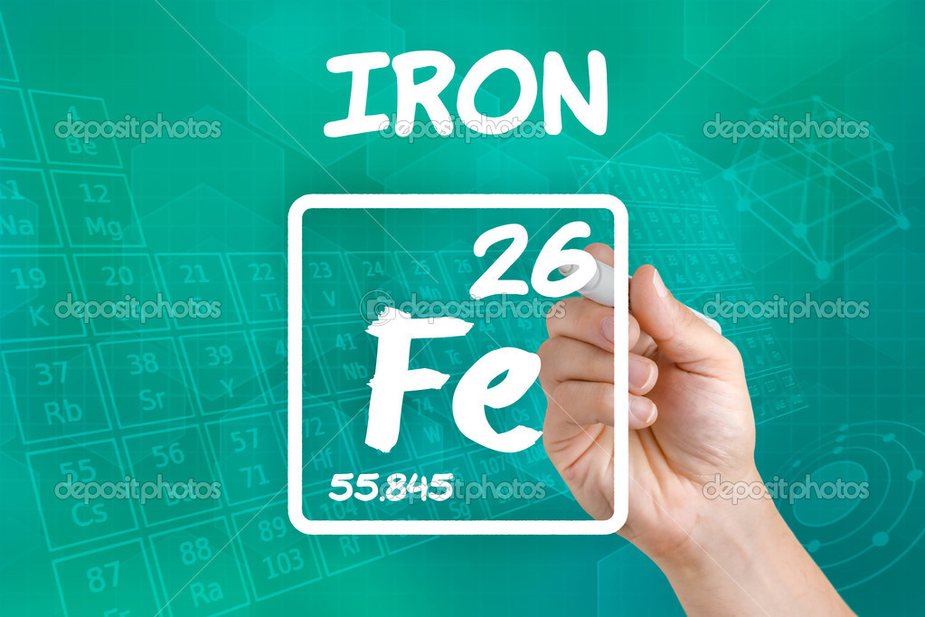
Chemical Symbols
Using standardized chemical symbols is important as each country, and language, have different words for each element.
Fe – iron (English)
- fer (French)
- fier (Romania)

Slide 4
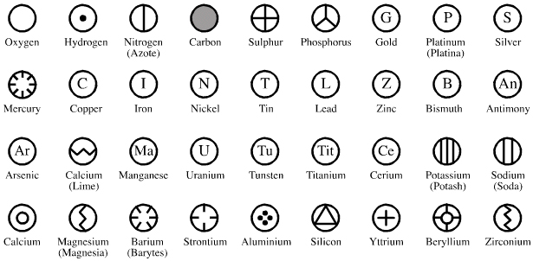
John Dalton, an English Chemist, represented some elements with symbols in 1908. China also had a set of symbols that were used for identifying the elements.
Dalton’s Symbols

Slide 5
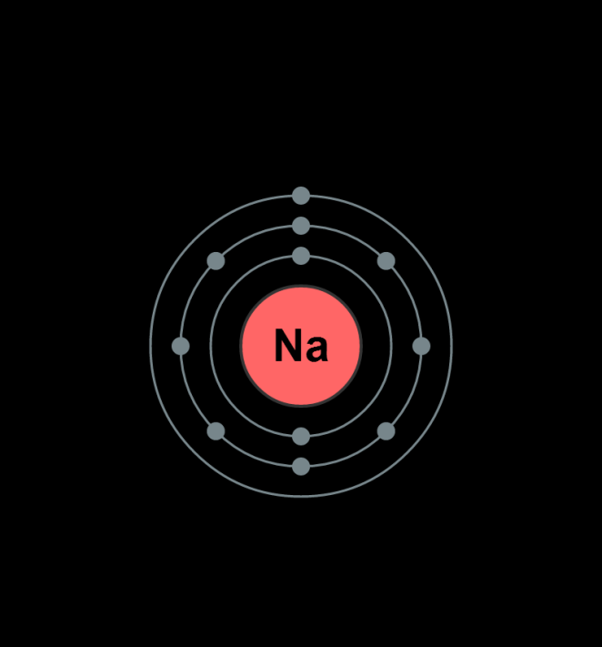
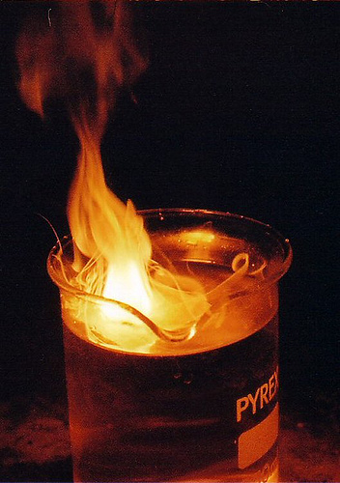
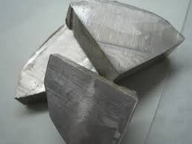
Sodium comes from the word sodanum, a headache remedy, and it’s symbol (Na) comes from the Latin word Natrium.

Slide 6
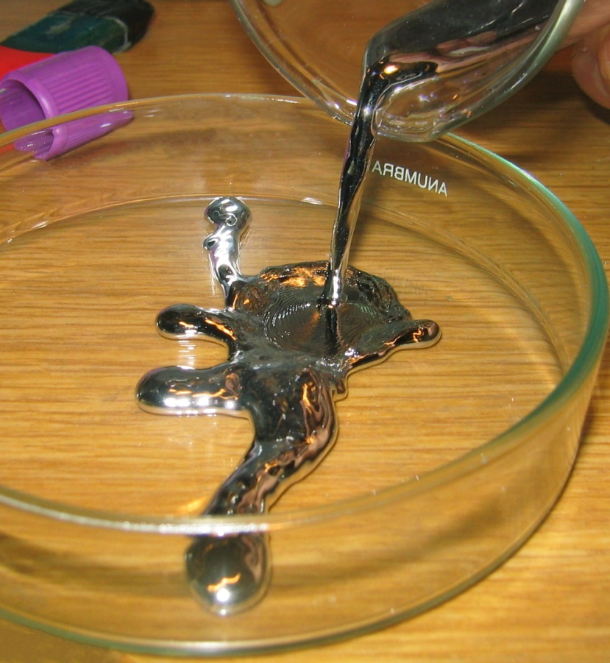
Hydrogen comes from the Greek word for “water-former”.
Mercury was named after a Roman god but its symbol, Hg, comes from the Latin word meaning hydrargyrum.
Impt: When writing the symbol down, the first letter is always capitalized and the second is in lower case. ie). Hg, Na, Ca, O
Mercury

Slide 7
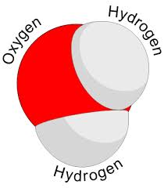
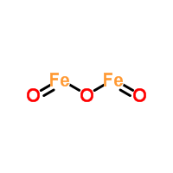
Chemical Formulas
A chemical formula is the combination of symbols that represent a particular compound.
The chemical formula indicates which elements are present in the compound and in what amounts.
Ex. 1: Water molecule
H₂O: 2 atoms of hydrogen, 1 atom of oxygen
Ex. 2: Iron Oxide molecule
Fe₂O₃: 2 atoms of iron, 3 atom of oxygen

Slide 8
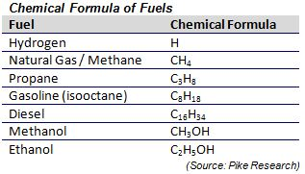
Examples of Chemical Formulas

Slide 9
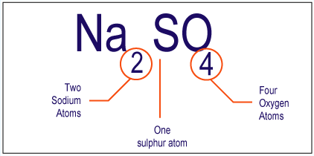

Slide 10
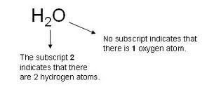
Each chemical symbol in a formula represents an element. If only one element is present in a compound, no number is included.
If there is more than one atom of that element in the compound, the symbol is followed by a number written below the line. This number is called a subscript.

Slide 11
Classwork/Homework
Use your textbook page 58-59 to help you answer questions 1-5, page 59. You may also use your periodic table.
Complete the handouts on counting atoms.
1. Why are chemical symbols useful in describing chemicals?
The same symbols of the elements are used internationally. Therefore, the symbol can be recognized by another language.

Slide 12
2. What are the symbols for the following elements:
a) calcium, b) iron , c) chlorine, d) phosphorus,
e) copper.
Ca
Fe
Cl
P
Cu

Slide 13
3. Write the chemical formula for the following:
a) A molecule of hydrogen gas that is made up of two atoms of hydrogen:
H₂
b) A molecule of propane gas that is made up of three atoms of carbon and eight atoms of hydrogen:
C₃H₈

Slide 14
4. For each of the compounds in table 2, state the number of different elements present and the number of atoms of each element. What is the total number of atoms in each molecule?
Sodium bicarbonate (baking soda): NaHCO₃
1 sodium atom, 1 hydrogen atom, 1 carbon atom, 3 oxygen atoms
Calcium carbonate (chalk): CaCO₃
1 calcium atom, 1 carbon atom, 3 oxygen atoms
Sodium nitrate (fertilizer): NaNO₃
1 sodium atom, 1 nitrogen atom, 3 oxygen atoms
Calcium phosphate (fertilizer): Ca₃(PO₄)₂
3 calcium atoms, 2 phosphorus atoms, 8 oxygen atoms
Sodium chloride (salt): NaCl
1 sodium atom, 1 chlorine atom
acetylsalicylic acid (ASA or aspirin): C₉H₈O₄
9 carbon atoms, 8 hydrogen atoms, 4 oxygen atoms
Acetic acid (vinegar): C₂H₄O₂
2 carbon atoms, 4 hydrogen atoms, 2 oxygen atoms

Slide 15
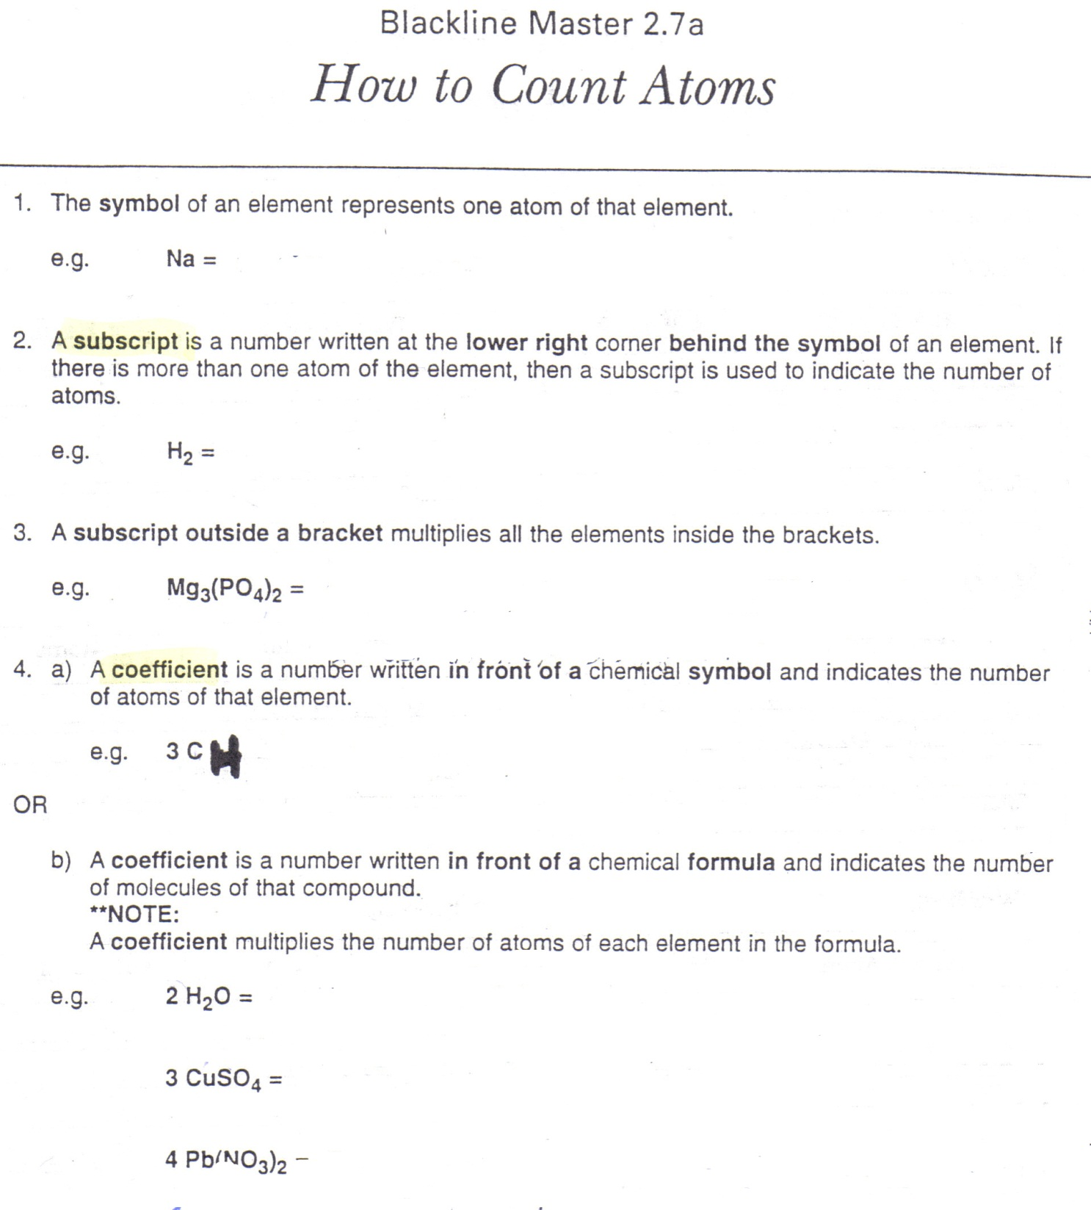
1 atom of sodium
2 atoms of hydrogen (in a hydrogen molecule)
3 atoms of magnesium
2 atoms of phosphorus
8 atoms of oxygen 13 total atoms
3 carbon atoms

Slide 16
