Slide 1
Electric Potential (Voltage)

Slide 2
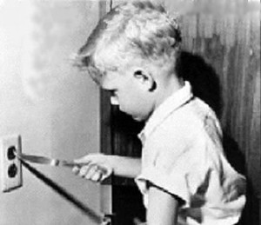
Why is it safe to touch a 1.5 volt battery at both ends but it is not safe to stick a metal object into a 120 volt outlet?
In both cases, you are completing a circuit. But in the case of the 1.5 volt battery, the amount of energy each electron has is much less than that of the electrons leaving the outlet.
The amount of potential energy is higher in the 120 volt outlet. About 80 times higher!

Slide 3
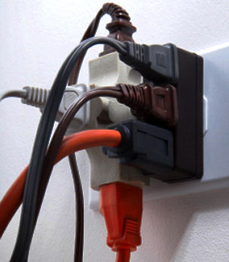
Potential Electric Energy
The potential energy of a power source is very important to consider. The potential energy is the energy stored that can be released.
The greater the potential energy of a power source, the greater the force applied to the electrical load in the circuit.
This is why a 1.5 volt battery will not light a 60 watt bulb. The electrons leaving the battery do not have enough energy to create light.

Slide 4
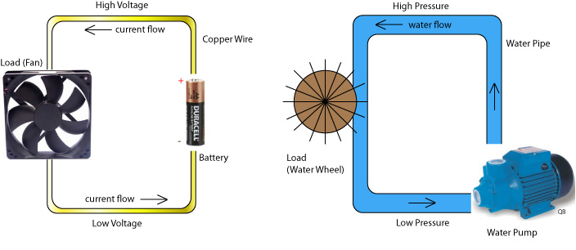
Model of Electric Potential
When thinking about a what happens in a circuit it is sometimes easier to compare it to a water wheel.

Slide 5
Electric Potential
As water falls onto the water wheel from above it has gravitational potential energy that turns the wheel.
Batteries (dry cells) also have this potential energy to move wheel. The flow of water is similar to the flow of electric charges from the dry cell.
With the water wheel, the higher the water falls from the greater the potential energy, just like the higher the voltage of a dry cell the greater the potential energy.

Slide 7
Electricity for Chemical Reactions
Cells (what we often call batteries) always have potential energy, even if they are not connected to a circuit, the stationary electrons at the negative end of the terminal have electric potential energy right from when they are made.
These stationary electrons are ready to be released when they are connected to a circuit. When that connection is made the electrons flow from the negative end to the positive end of a cell.

Slide 8
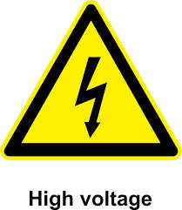
The energy each electron has is called the electric potential of the electron.
Electric potential is commonly called voltage.
The common unit of measurement of electric potential is the volt. The symbol of the volt is V.

Slide 9
Source of Electric Potential | Voltage (volts)
Human cell | 0.08
Microphone | 0.1
Photocell | 0.8
Electrochemical cell | 1.1 to 2.9
Electric eel | 650
Portable generator | 24, 120, 240
Wall outlet | 120, 240
Generator in power stations | 550

Slide 10
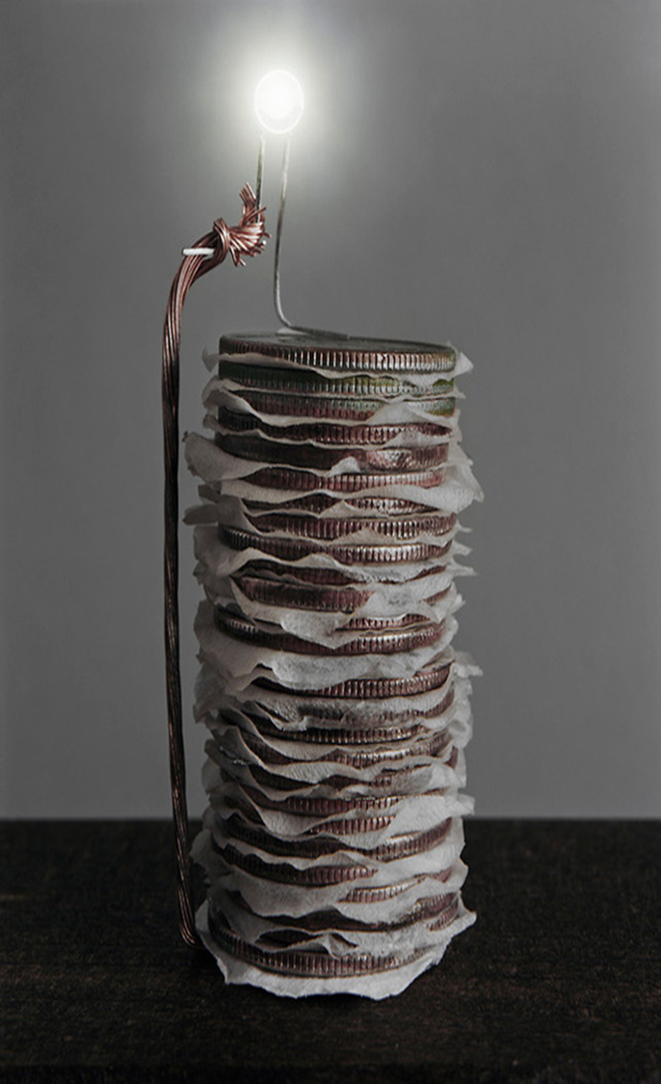
Electrochemical Cells

Slide 11
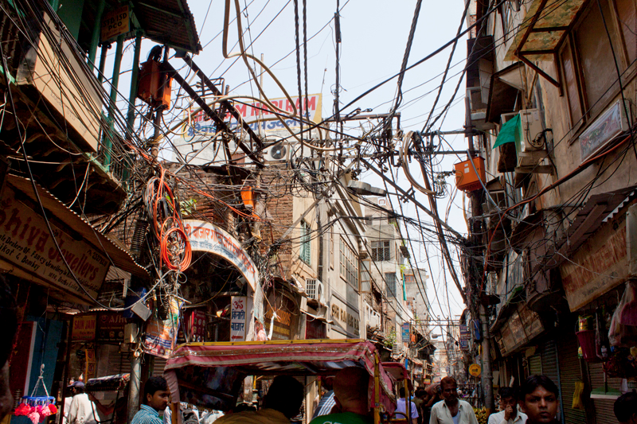
Imagine a world where everything that used electricity had to be plugged in.
Flashlights, hearing aids, cell phones and other portable devices would be tethered to electrical outlets, rendering them awkward and cumbersome.

Slide 12
Cars couldn't be started with the simple turn of a key. Wires would be strung everywhere, creating a safety hazard and an unsightly mess.
Thankfully, batteries provide us with a mobile source of power that makes many modern conveniences possible.

Slide 13
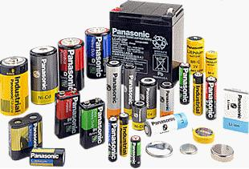
Primary Cells
There are two types of primary cells: the primary wet cell(voltaic cell) and the primary dry cell.
In a primary cell, chemical reactions use up some of the materials in the cell until they are depleted or what we call discharged.
These cells cannot be recharged.

Slide 14
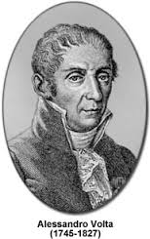
Primary Wet Cells
In 1799 an Italian scientist, Alessandro Volta, created a simple battery from metal plates and brine-soaked paper. This was the first wet cell.
The metal plates, usually zinc or copper, are called electrodes.
The liquid in in the cell is called an electrolyte. Electrolytes are any liquids that conducts an electric current.

Slide 15
In a typical wet cell the zinc electrode reacts with the electrolyte(sulfuric acid) and the chemical energy released separates the electrons from the zinc atoms and they rest on the plate, or negative terminal.
The copper plate also reacts and releases its positive charges from the copper atoms and they collect on the copper plate, or positive terminal.
These charges remain static until they are connected to a closed electric circuit.

Slide 16
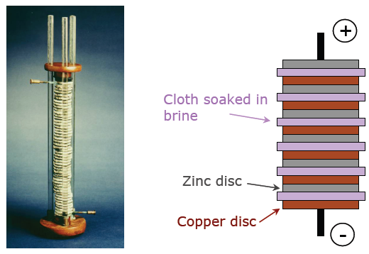
Volta Wet cell

Slide 17
Primary Dry Cell
Dry cells are very similar to wet cells but instead of a liquid the electrolyte is a moist paste.
When most of the negative electrode has been used up the electrons stop flowing and the cell is discharged.
A group of cells make up a battery.

Slide 25
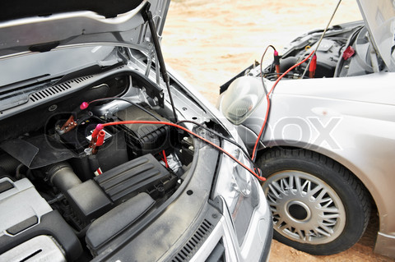
Secondary Cells
Unlike a single-use, disposable primary cell, a secondary cell can be recharged after it has been discharged, or used up.
It’s called a secondary cell because it has two chemical reactions, one to discharge the energy and one reaction to recharge it to its original state.
Car batteries are good examples of secondary cells.

Slide 26
Questions to Tackle
Use you text book, pages 306-307 to answer questions: 2ab, 3, 4, 6

