Slide 1
Electric Current, Resistance and Ohm’s law

Slide 2
Comparing shocks from static electricity and electric currents is like comparing apples and oranges, they are similar but quite different at the same time.
Every year many people are injured and sometimes killed from electrocution as even small amounts of electric current can be lethal.

Slide 3
Recap
An electric current is made up of moving electric charges.
In solids, it is only the negative electric charges on electrons that move through the circuit. The positive charges on protons remain in a fixed position in the atoms.
Electric current is a measure if the rate at which electric charges move past a given point along a circuit.

Slide 4
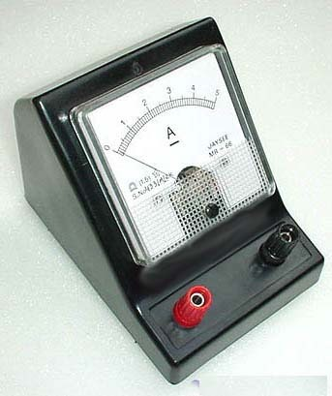
Ampere
The metric SI (International System of Units) unit used to measure electric current is the ampere.
Current is measured using an ammeter connected to the circuit in series.
The symbol for ampere is A.

Slide 5
Electric Current Ratings of Common Electric Loads
Electrical Device | Amperes (electric current)
Wrist watch | 0.00013
Electric clock | 0.16
Light bulb (100 W) | 0.833
television | 4.1
vacuum | 6.5
Stove element | 6.8
toaster | 11.4
Water heater element | 27.3
Car starter motor (V-8) | 500.0

Slide 6
Comparing Static and Moving Electric Charges
Static electricity is an electric charge that remains in a fixed position on an insulator and distributes itself over the entire surface of a conductor. This charge can be transferred by friction, contact and induction.
Current electricity is electric charge that moves from a source through a controlled path through an electric current. This charge can be used to power lights, create heat and other things.

Slide 7
Human Responses
Light a 100-W bulb and suffocate 50 adults | 0.833 A
Severe burns, no breathing | 0.200 A
fatal | 0.050 A
Convulsions | 0.016 A
Max safe amount | 0.005 A
Muscles tingle | 0.002 A
People have misconceptions about the amount of electricity we are able to withstand.
It only takes a small amount of electrical current to kill a person.
*it takes the same amount of amperes to light a light bulb and kill 50 people.

Slide 8
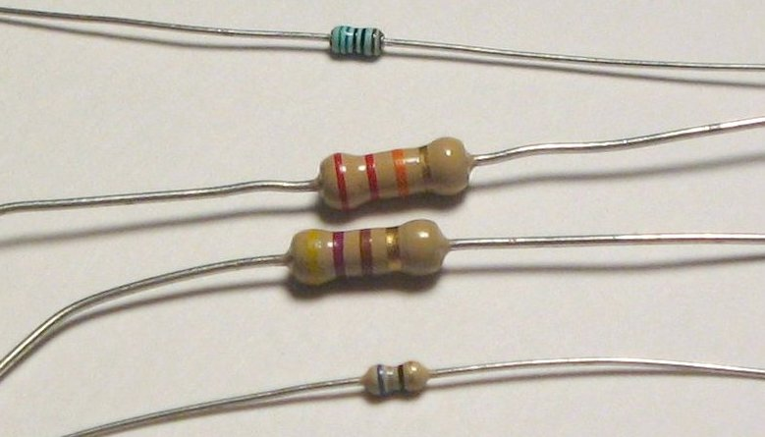
Electrical Resistance
The molecules of all types of conductors impede, or resist, the flow of electrons to some extent.
The ability to impede the flow of electrons is called electrical resistance.
Some types of electrical devices used in circuits are designed to impede the flow of electricity, these devices are called resistors.

Slide 9
The symbol for electrical resistance is R, and the SI unit is the ohm Ω.
When electrons flow through a conductor, the electrical resistance causes a loss of electrical potential (voltage).
The difference between the current voltage at the beginning and at the end of its journey through a conductor is called the potential difference, or voltage drop.

Slide 10
In 1827, the German scientist Georg Ohm discovered a special relationship with the loss of electric potential across a conductor.
Ohm’s Law states that the potential difference between two points on a conductor is proportional (directly related) to the electric current flowing through the conductor.
This law is used when designing new electrical devices.

Slide 11
Factors that Affect Electrical Resistance
The flow of charge through wires is often compared to the flow of water through pipes.
First, the total length of the wires will affect the amount of resistance. The longer the wire, the more resistance that there will be.
Second, the thickness of the wires will affect the amount of resistance. Wider wires have a greater area. Water will flow through a wider pipe at a higher rate than it will flow through a narrow pipe.
A third variable that is known to affect the resistance to charge flow is the material that a wire is made of. Not all materials are created equal in terms of their conductive ability.

Slide 12
Ohm’s Law
We use the following formula when determining the potential difference, or voltage lost.
Potential difference = electric current x electrical resistance
V = I X R
In most cases potential difference is measured in volts (V), electric current (I) is measured in amperes and resistance is measured in ohms (Ω).

Slide 13
Resistance of Some Electrical Loads
V | = | current | x | resistance
Electrical Load | Voltage Drop (V) volts | Current (I) Amperes | Resistance (R) ohms
Flashlight bulb | 6.0 | 0.25 | 24
Light bulb (60 W) | 120 | 0.50 | 240
Coffee grinder | 120 | 1.20 | 100
Toaster oven | 120 | 14.0 | 8.6
Water heater | 240 | 18.75 | 12.8

Slide 14
A Short Circuit
It is important that you are safe when dealing with electricity and sources of electrical potential energy.
Make sure you always avoid carrying loose batteries in your pocket or book bag as they may make contact with keys or loose change and complete a very short but complete circuit. This short circuit may cause enough heat to build up and start a fire.

Slide 15
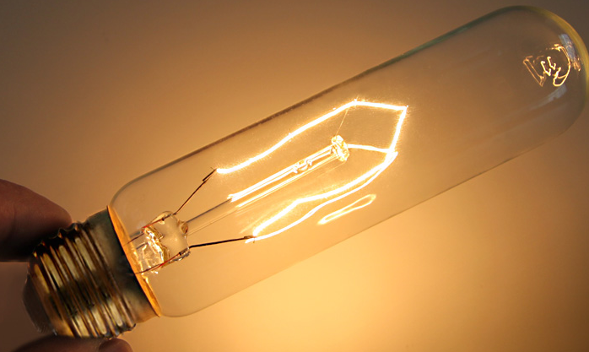
Many household appliances use resistors to help control the amount of electrical energy entering them. Companies design electrical devices with this in mind to ensure that they are safe to use.
For example: the tiny coil of tungsten wire used inside a 100-W light bulb is just long enough to handle the amount of energy flowing through it.

Slide 16
Class Activity/Homework
Review page 318-319 in your test book. Pay close attention to the sample problems and how they solved the examples using Ohm’s Law.
Answer questions 3, 5, 6 and 7 on page 319.

