Slide 1
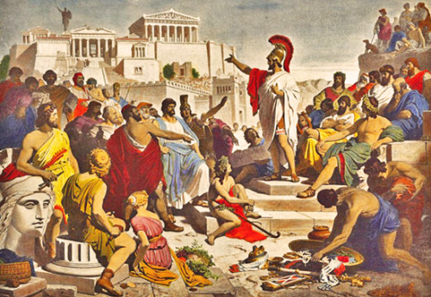
Greek Government and Development of Democracy in Athens
How did these men aid in bringing about democracy in Athens?

Slide 2
The ancient Greeks were particularly concerned with such fundamental questions as who should rule and how?
The Greeks give us most of our modern political terms:
Autocracy: Auto – Krates (Self to rule)
Monarchy: Mono – Arkhos (One Ruler)
Oligarchy: Oligoi – Arkhos (Few Rulers)
Democracy: Demo – Kratia (People to rule)
Anarchy: An – Arkhos (Without Ruler)
Notes:
Should sovereignty lie in the rule of law, the constitution, officials, or the citizens? Not settling on a definitive answer to these questions Greek adopted many forms of govt to satisfy their struggle for the solution for who should rule.
Over centuries different city-states experimented with political power which could rest in the hands of a single individual: (monarchies and tyrants) or in a select few (the oligarchies) or in every male citizen: democracy - widely regarded as the Greeks' greatest contribution to civilization.

Slide 3
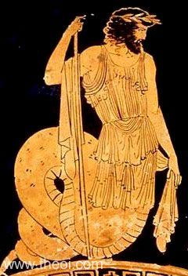
750 BCE and onwards
These Greek city-states, or Polis, consisted of citizens with political rights (adult men), citizens with no political rights (women and children), and noncitizens (including agricultural labourers, slaves, and foreigners).
Most earlier city-states were ruled by a monarch or king.
Notes:
While many city-states had kings that were hereditary positions, Athens actually had a king that was elected by a council of elders. These kings were not thought of as divine or as living gods.

Slide 4
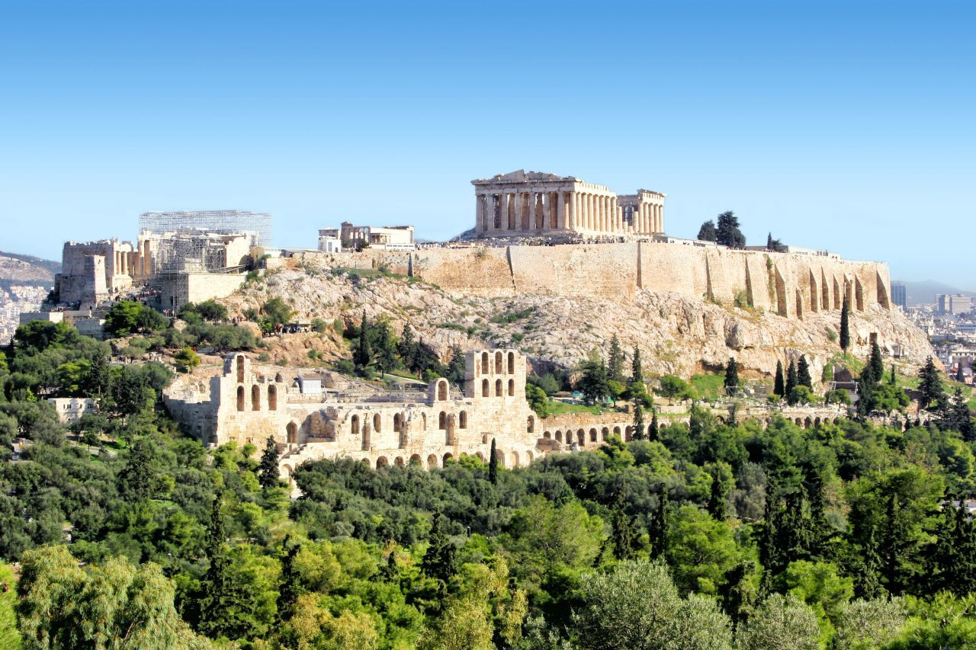
Notes:
Acropolis – “highest point”

Slide 5
Athens and Oligarchy
Kings eventually lost their power to wealthy land-owning aristocrats as the aristocrats gained wealth through trade.
The position of Archon was created which allowed the wealthy to be appointed to office for life. This position was changed in 682BCE to allow for a length of one year only.
Power was divided up into three departments: Administration, War, and Religion.

Slide 6
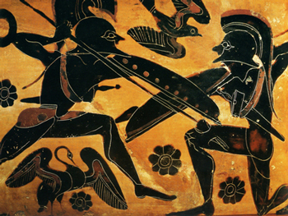
Colonization and increased trade led to a rise of the middle class and eventually a feud between the aristocrats and merchants.
The merchants wanted greater political power and used their newfound wealth to equip soldiers to fight for them.

Slide 7
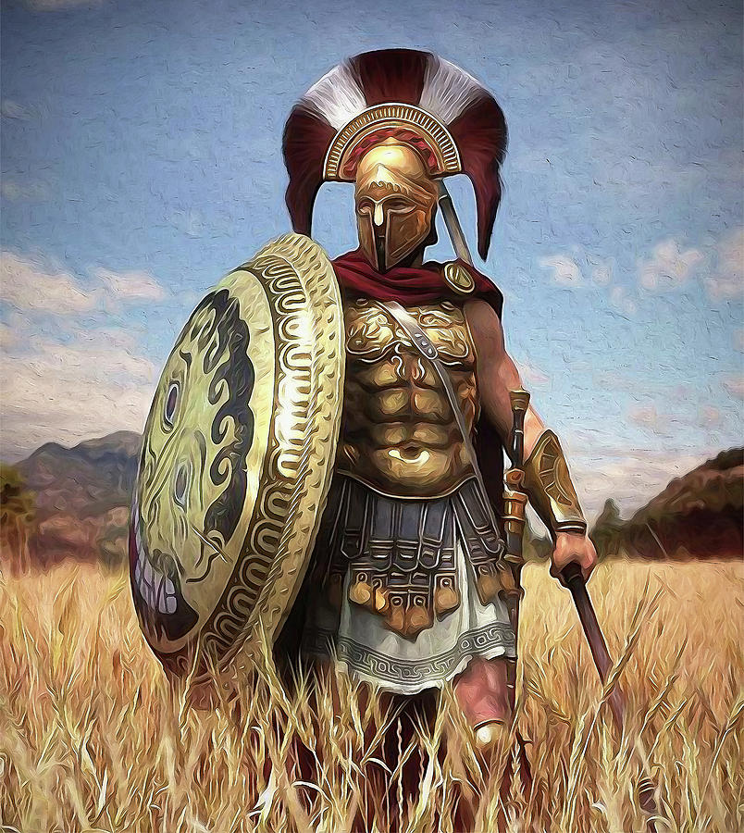
Hoplites: the core of Greek Politics
Hoplite – free citizen-soldiers that were equipped with bronze armor and weapons.
Usually was a small-time farmer – but owned his own land.
They could afford armor - thus they could afford to fight.
If you could afford to fight – you had a stake in politics

Slide 8
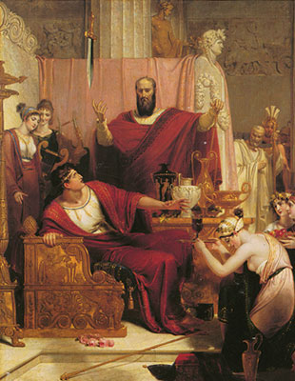
Tyrants
Tyrants – individuals who seized power unconstitutionally, they usually had the backing of the middle and lower classes.
For the period between 650-550 BCE tyrants rose and fell.
Many of the tyrants were good administrators who encouraged trade and carried out public works projects.
Notes:
Tyrant today is seen as a negative characteristic and often associated with a cruel and unjust ruler.

Slide 9
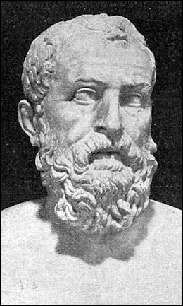
Draco – Tyrant or lawgiver?
In 621 BCE he wrote down Athenian Laws and made them apply to all citizens.
Although still favouring the rich his code offered more protection laying the foundation for universal legal rights.
Notes:
Draco was appointed by the archons in 621 BCE. His goal was to offer fairness to the Athenian people. His code is seen as being pretty severe as minor offences led to capital punishment for the defendant.
Under Draco many commoners didn’t have political rights.

Slide 10
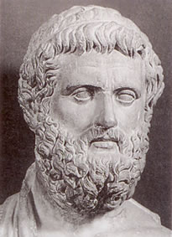
Solon – Liberator or Hypocrite?
In 594 BCE he cancelled the debts of farmers who had borrowed seeds from wealthy landowners and freed those who were forced into slavery.
Changed the criteria for holding office. All wealthy men were eligible (gave the landless a say in the assembly).
Increased the number of Archons from 3 to 9, who enforced Athenian law.
Set up Council of 400, who drafted legislation for the citizen assembly to vote on.
Notes:
After Solon left office Athens was in turmoil. The wealthy felt too much was lost and commoners felt not enough was gained.

Slide 11
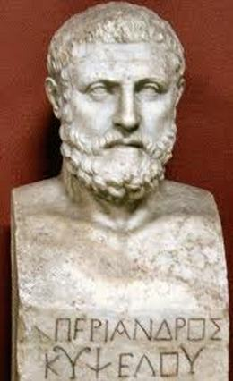
Pisistratus – Populist or equalizer?
Drove out wealthy landowners of Attica and divided up their land among the landless.
Created a system of state loans for small farmers.
Encouraged large scale expansion of commerce.
Created 30 circuit judges that
superseded local authorities controlled
by aristocrats.
Notes:
His sons took over when he died and ruled very harshly, leading to the murder of Hipparchus in 514 BCE and the exile of Hippias in 510 BCE. Cleisthenes, a Athenian noble seized power shortly after.

Slide 12
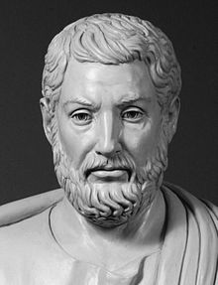
Cleisthenes – Democrat or Legalist?
Reorganized the Assembly of tribes and the council of 400 (now 500) – better cross section of Athenian society with fairer representation of classes.
Gave all citizens membership in the assembly (who did not have to own land).
Believed above all in Isonomia: equality before the law.
Began the Practice of ostracism.
Notes:
In the year 507 B.C., the Athenian leader Cleisthenes introduced a system of political reforms that he called demokratia, or “rule by the people.” This system was comprised of three separate institutions:, a sovereign governing body that wrote laws and dictated foreign policy; the boule, a council of representatives from the ten Athenian tribes; and, the popular courts in which citizens argued cases before a group of lottery-selected jurors. Although this Athenian democracy would survive for only two centuries, Cleisthenes’ invention was one of ancient Greece’s most enduring contributions to the modern world.

Slide 13
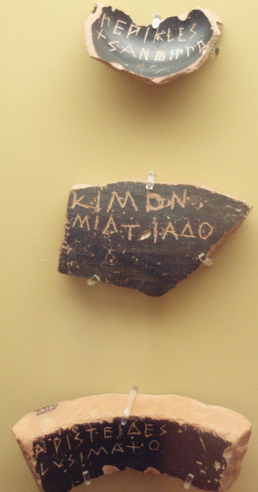
Ostracism
This was a procedure in which any citizen could be expelled from the city-state of Athens for ten years. While some instances clearly expressed popular anger at the citizen, ostracism was often used as a way of exiling someone thought to be a threat to the state or potential tyrant.
If over 6000 people scratched someone’s name onto a piece of pottery they would be exiled.
Notes:
Ostracism was about accountability.

Slide 14
Democracy in Action
What should your unit test be?
Option A: Traditional Test
Option B: “The Greek Gazette” Newspaper project
Option C: Any other suggestions? (Must be an actual assignment)

Slide 15
Class Reading Activity
Read Innovations on page 156 to see what a typical meeting of the Athenian Assembly would look like.
Skim and Scan pages 155 to 158 and, in your notebook, compare the govt. of Athens to the govt. of Sparta. What are the advantages and disadvantages of both? (make note of the term oligarchy)
Read Law and Justice on page 159-160, answer questions 2 on page 160.

Slide 16
Journaling Guiding Question
During class we learned about the growth of democracy in ancient Greece. With information to back up your opinion, which of the leaders that we learned about made the most significant contribution to democracy in ancient Athens?

