Slide 1
Parts of an Atom

Slide 2
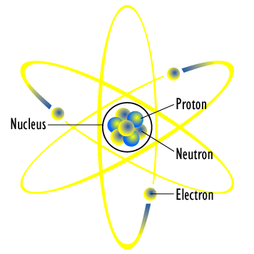
Atoms
We know that most of the atom is actually empty space filled with quickly moving electrons.
The positive nucleus is so small it actually only takes up a tiny fraction of the size of the atom. Ironically, almost all of the atom’s mass is concentrated in this nucleus, which contains Protons and Neutrons.

Slide 3
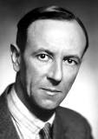
The Atom
The parts of the atom -the particles of which an atom is composed- are called subatomic particles.
Electrons and protons are subatomic particles.
In 1932, James Chadwick, an English scientist, discovered a third subatomic particle with no charge: the neutron.

Slide 4
Subatomic Particles
Protons are positively charged particles with a relative mass of 1, located in the nucleus.
Neutrons are neutral particles with a mass of 1, also located in the nucleus.
Electrons are negatively charged particles with a mass of approximately 1/2000th of the mass of a proton or neutron, these travel in regions of space around the nucleus.

Slide 5
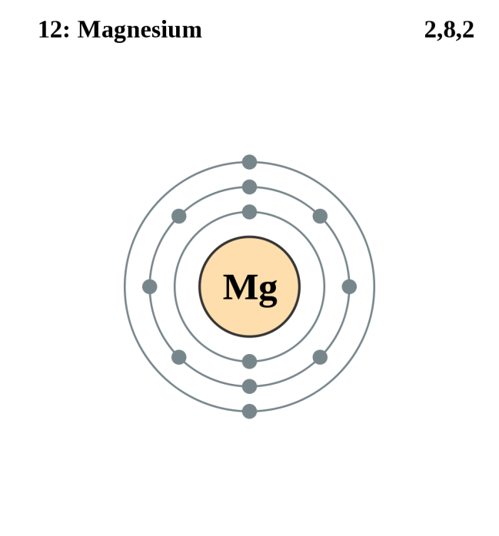
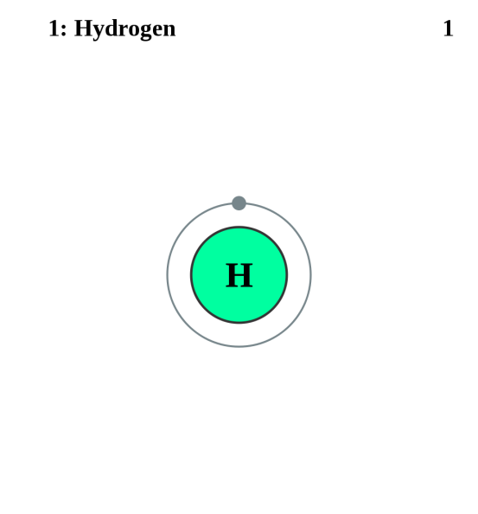
Protons are especially important as the number of protons in an atom determines what the atom is.
For example: an atom with one proton is a hydrogen atom (H), and any atom whose nucleus contains 12 protons is magnesium (Mg).

Slide 6
Atoms themselves have no electrical charge as the negative electrons and positive protons balance each other out.
Remember that the number of electrons and protons in an atom are the same.
The number of protons in an atom is also the atomic number. If you know the atomic number you also know the number of electrons and the number of protons.
The atomic mass is the sum number of protons and the number of neutrons. The mass of the electrons is insignificant because they have so little mass compared to the other subatomic particles.

Slide 7
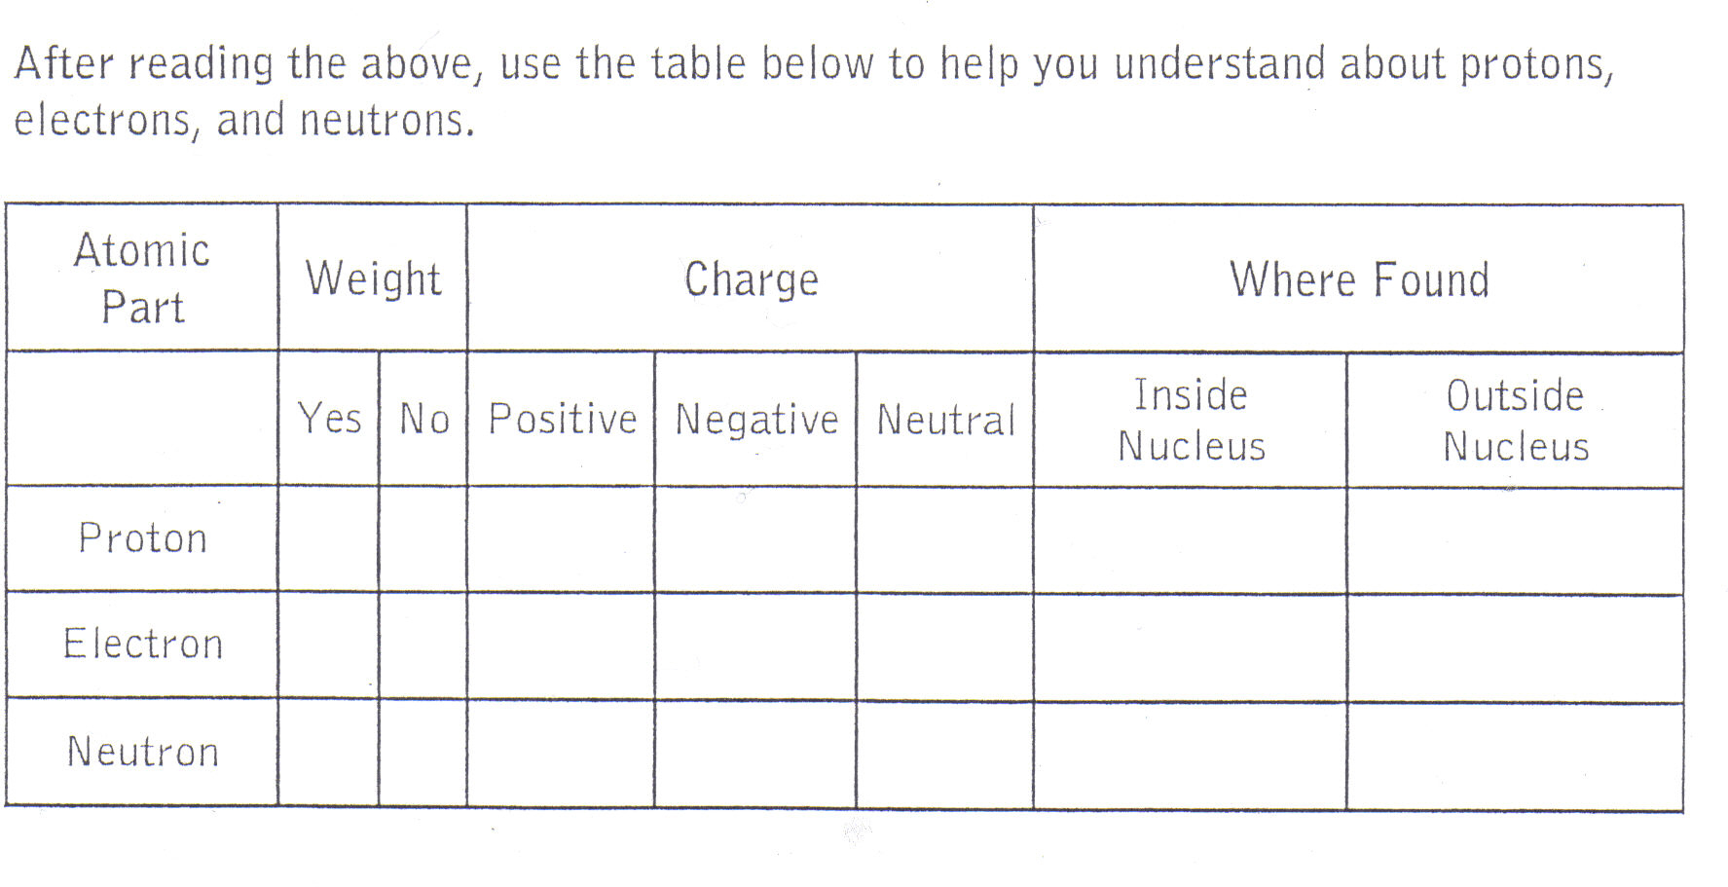
Proton, Electron, and Neutron chart

Slide 8
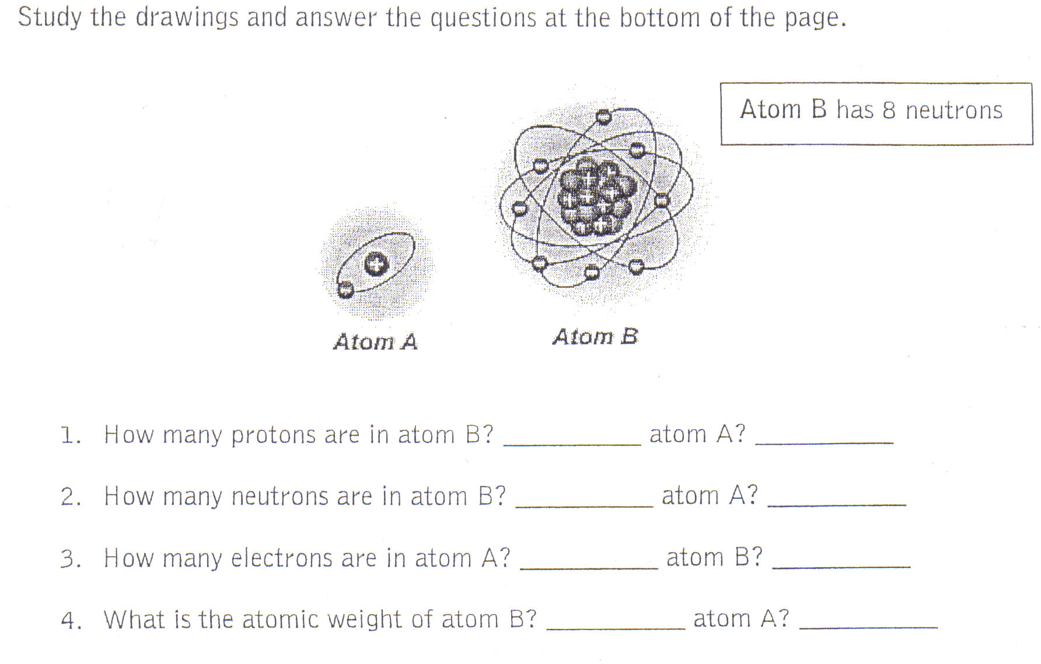

Slide 9
What is the name of atom A?
Hydrogen
What is the name of atom B?
Oxygen
8
1
8
none
1
8
16
1

Slide 10
Subatomic Particles - Recap
1. The number of protons in an atom is called the atomic number.
If you know the atomic number of an atom, you know how many protons – and how many electrons – the atom contains.
# of protons = # of electrons (e⁻)
2. The mass number is the sum of protons and neutrons in the atom.
3. So, if you know the atomic number (the number of protons) and the mass number (the sum of protons and neutrons), you can easily calculate the number of neutrons.
Number of Neutrons = mass number – atomic number

Slide 11
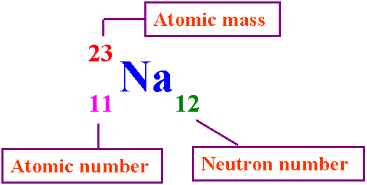
Standard Atomic Notation
We represent the numbers of subatomic particles by using standard atomic notation.
# of protons =
# of electrons (e⁻) =
# of neutrons =

Slide 12
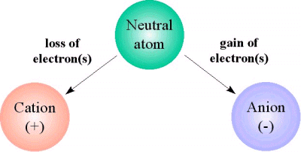
Charged Atoms - Ions
It is possible for atoms to gain/lose and share electrons. When negatively charged electrons move from one atom to another the atom then become ions.
When an atom gains electrons (-) the ion that is formed has a negative charge.
When an atom loses electrons (-) that newly formed ion now has a positive charge.
Salt water contains charged ions which give it the ability to conduct electricity.

Slide 13
Counting Atoms Review
CaCO₃
NaNO₃
NaCl
C₉H₈O₄
C₂H₄O₂

Slide 14
Handout BLM 3.3 Subatomic Particles worksheet

