Slide 1
Cells in Series and Parallel

Slide 2
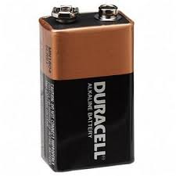
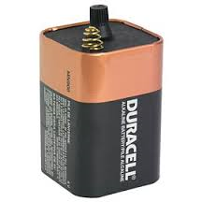
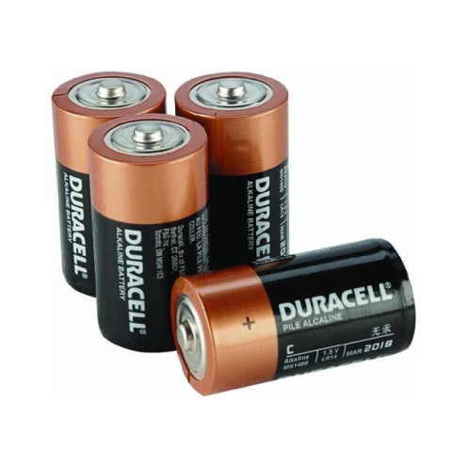
Looking at the collection of batteries below you can probably guess that each type of battery and cell produces different voltages.
Using the right battery or cell is essential for the safe and proper use of electronics.
9-V battery
6-V Battery
four 1.5-V cells

Slide 3
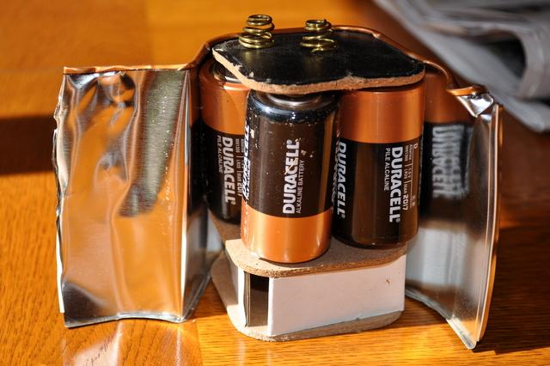
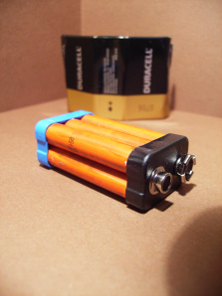
Inside Cells and batteries
Most people don’t realize what is inside the metal or plastic covering of some larger cells and batteries.
The 6-V battery is actually made up of four 1.5 V cells that are connected in a series that allows it to last longer than other types of batteries.
A 9-V battery actually contains six 1.5-V cells.

Slide 4
Cells in Series and Parallel
Dry cells can be connected together in two basic types of circuits: series circuits and parallel circuits.

Slide 5
Cells in series
The electrical potential of dry cells are limited and can only provide a maximum amount of voltage unless they are connected in a series circuit.
When compared to a water wheel, the only way to double the power of the water flow is to double the height at which the water falls.
As the electrons travel through consecutive batteries, they get an additional boost of energy therefore increasing the voltage.

Slide 6
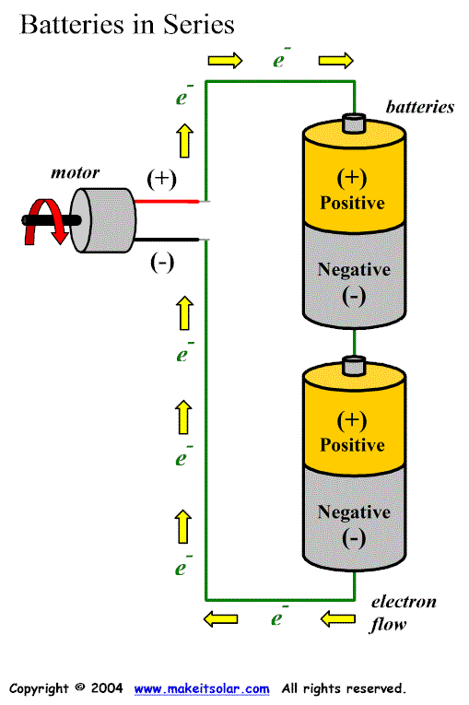
As electrons flow from cell A to cell B they experience a chemical reaction that gives them an electrical potential of 1.5 volts.
When those electrons moving into cell B they then get another boost from the second chemical reaction. These electrons now have a total electrical potential of 3.0 volts.
For each cell we add to the series the electrons gain an addition 1.5 V of electrical potential.
A
B

Slide 7
Increasing the electrical potential is one situation but what if we increase the number of bulbs(loads)?
When the demand on the cells are elevated due to increasing the number of bulbs we notice that the brightness of each bulb decreases.
This observation is an indicator that the current within the circuit is decreasing with an increase in number of bulbs.
i.e. Resistance is increasing leading to current decreasing

Slide 8
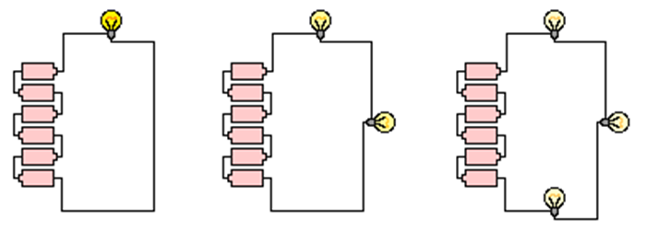

Slide 9
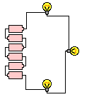
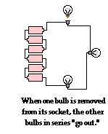
If one light bulb in a series circuit is removed or burns out, then the other bulbs in the circuit will also immediately go out.
In order for the devices in a series circuit to work, each device must work. If one goes out, they all go out.

Slide 10
Example: Some Christmas Lights

Slide 11
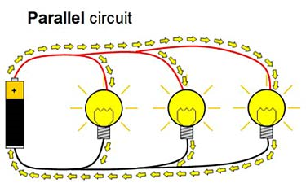
Parallel Circuits
A parallel circuit is when there is more than one pathway for electrons to flow.
Connecting cells in parallel does not affect the voltage as electrons will only pass through one pathway.
The duration of time the load will operate will increase in relation to how many cells are in the circuit.

Slide 12
For example, with two cells available there is twice as much electric energy available, therefore the load can operate twice as long before it runs out of energy.

Slide 13
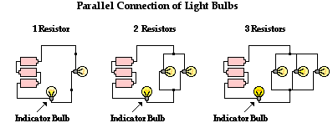
As more bulbs are added in parallel (on a separate branch) the current actually increases in the circuit. This means there is actually a decrease in overall resistance within the circuit. This action will drain the cell or battery quicker.

Slide 14
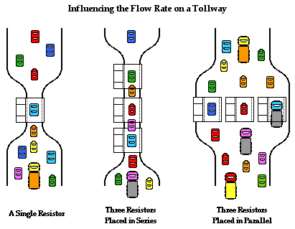
Toll Booth Analogy
http://www.physicsclassroom.com/class/circuits/Lesson-4/Two-Types-of-Connections

Slide 15
Benefit to Parallel Circuits
One of the possible benefits to a parallel circuit is if one light bulb in a parallel circuit is removed or blows out, the other bulbs remain unaffected due to being on their own branch circuit.

Slide 16
Do You Think The Circuit Will Work?
Look at the following circuits and determine if you think the bulb will light or not.
In your notebook, write the numbers from 1 – 7 and next to each number record either YES or NO. Provide a brief explanation for your choice.

Slide 17
Question 1
This symbol represents the load – in this case the light bulb

Slide 18
Question 2

Slide 19
Question 3

Slide 20
Question 4

Slide 21
Question 5

Slide 22
Question 6

Slide 23
Question 7

Slide 24
Class Questions
To better understand the material covered take a moment to complete the questions 1,2 and 3 found on page 311

