Slide 1
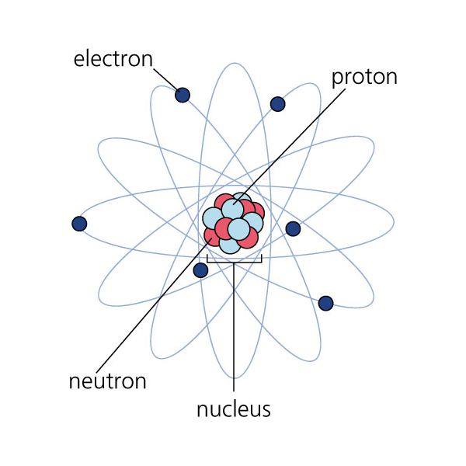
Models of the Atom

Slide 2
A Boy and His Atom- The World’s Smallest Movie by IBM

Slide 3
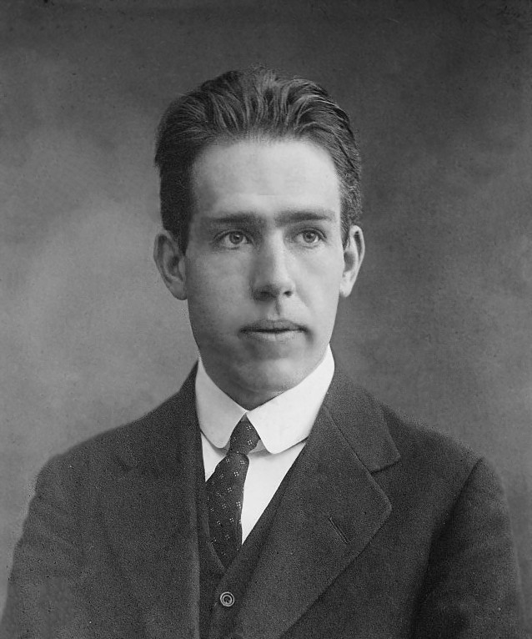
Niels Bohr
Niels Bohr, a Danish Physicist developed the “planetary” model of the atom.
Electrons travel around the nucleus in orbits, much like how planets travel around the Sun.
Electron
Nucleus
Orbit
He

Slide 4
Important Points that Bohr Suggested
The order of filling the electrons is: 2 in the first orbit, maximum of 8 in the second orbit, and maximum of 8 in the third… (2,8,8)
Electrons are more stable closer to the nucleus.
The further away the electrons are from the nucleus, the greater the energy they have.
Electrons can move from one orbit to another, but they don’t exist in between.
Heat, light, or electricity can allow electrons to jump from one orbit to another.

Slide 5
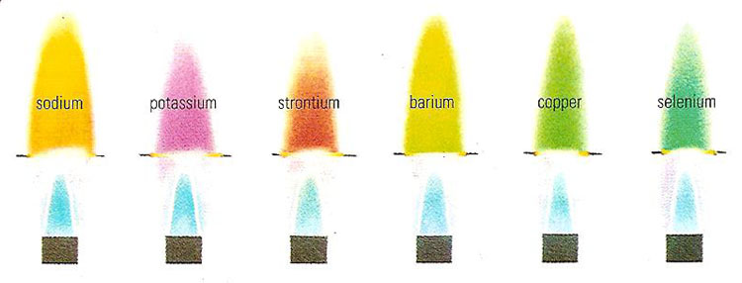
Bohr’s model attempts to explain how electrons move between orbits or energy levels when they are energized by heat, electricity or light. When the electrons are jumping into a higher orbit we say they are in an excited state.
The light omitted by an element when placed in a flame differs for each element because they have electrons that are at different distances to the nucleus.

Slide 6
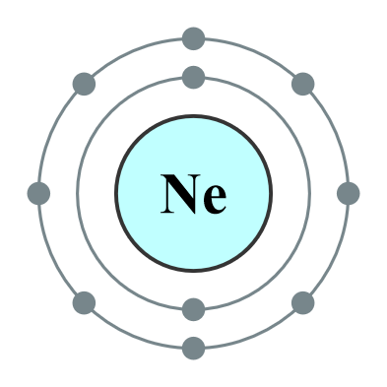
Bohr Diagrams
The symbol is in the centre (nucleus) and the electrons orbit around it:
Ex. Hydrogen
Ex. Nitrogen
Ex. Phosphorus

Slide 7
Hydrogen
1 e-
H
Chemical Symbol
in the center

Slide 8
Nitrogen
7 e-
N

Slide 9
Phosphorus
15 e-
P

Slide 10
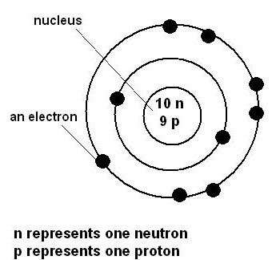
Bohr-Rutherford Model
Rutherford developed the “nuclear” model of the atom and when combined with Bohr’s diagram, we can see the numbers and position of all 3 subatomic particles: protons, neutrons, electrons
The number of protons and neutrons are written in the centre (nucleus) and the electrons are still represented on the orbits:

Slide 11
Bohr-Rutherford Model

Slide 12
Class Work
Review page 93 in the text to learn about Ions and their electrons. Be sure to read the section carefully.
Complete p 93: 4-5

Slide 13
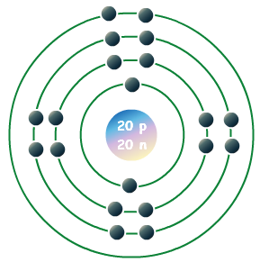
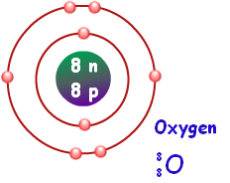
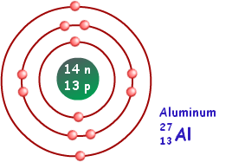
Page 93: 4
Oxygen Aluminum Calcium

