Slide 1
Reproduction in Flowering Plants

Slide 2
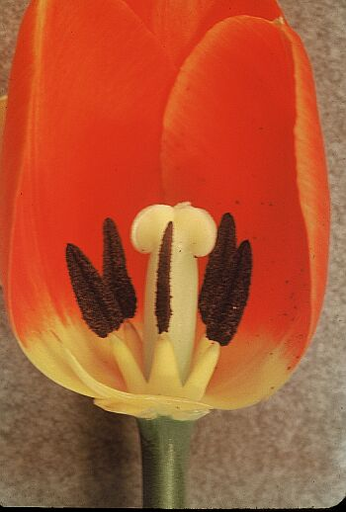
In many plants, sexual reproduction occurs in the flower.
Unlike humans, the male and female sex cells in many plants are found in the same individual.
Organisms, like many flowers, that have both sets of sex organs are hermaphrodites.

Slide 3
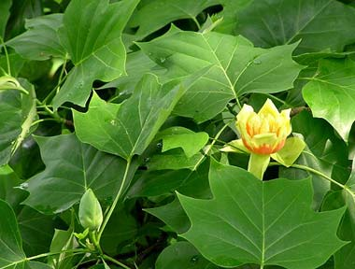
While many plants have both sex cells some plants, such as the poplar tree have separate sexes. Each tree has a “gender”.

Slide 4
Plant Sex Organs
Male Sex Organs:
Pollen – male sex cells
Stamen - Anther, where pollen is produced
- Filament, holds anther away from plant
Female Sex Organs:
Eggs – female sex cells
Pistil – Sticky surface for the pollen to land on
Style – travelling chamber from stigma to ovary
Ovary – holds the egg

Slide 5
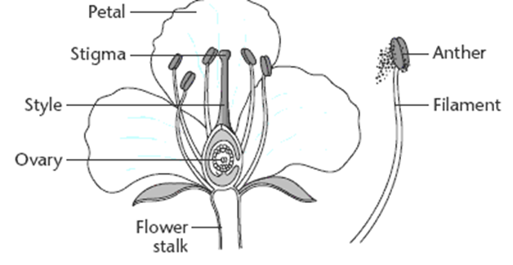

Slide 6
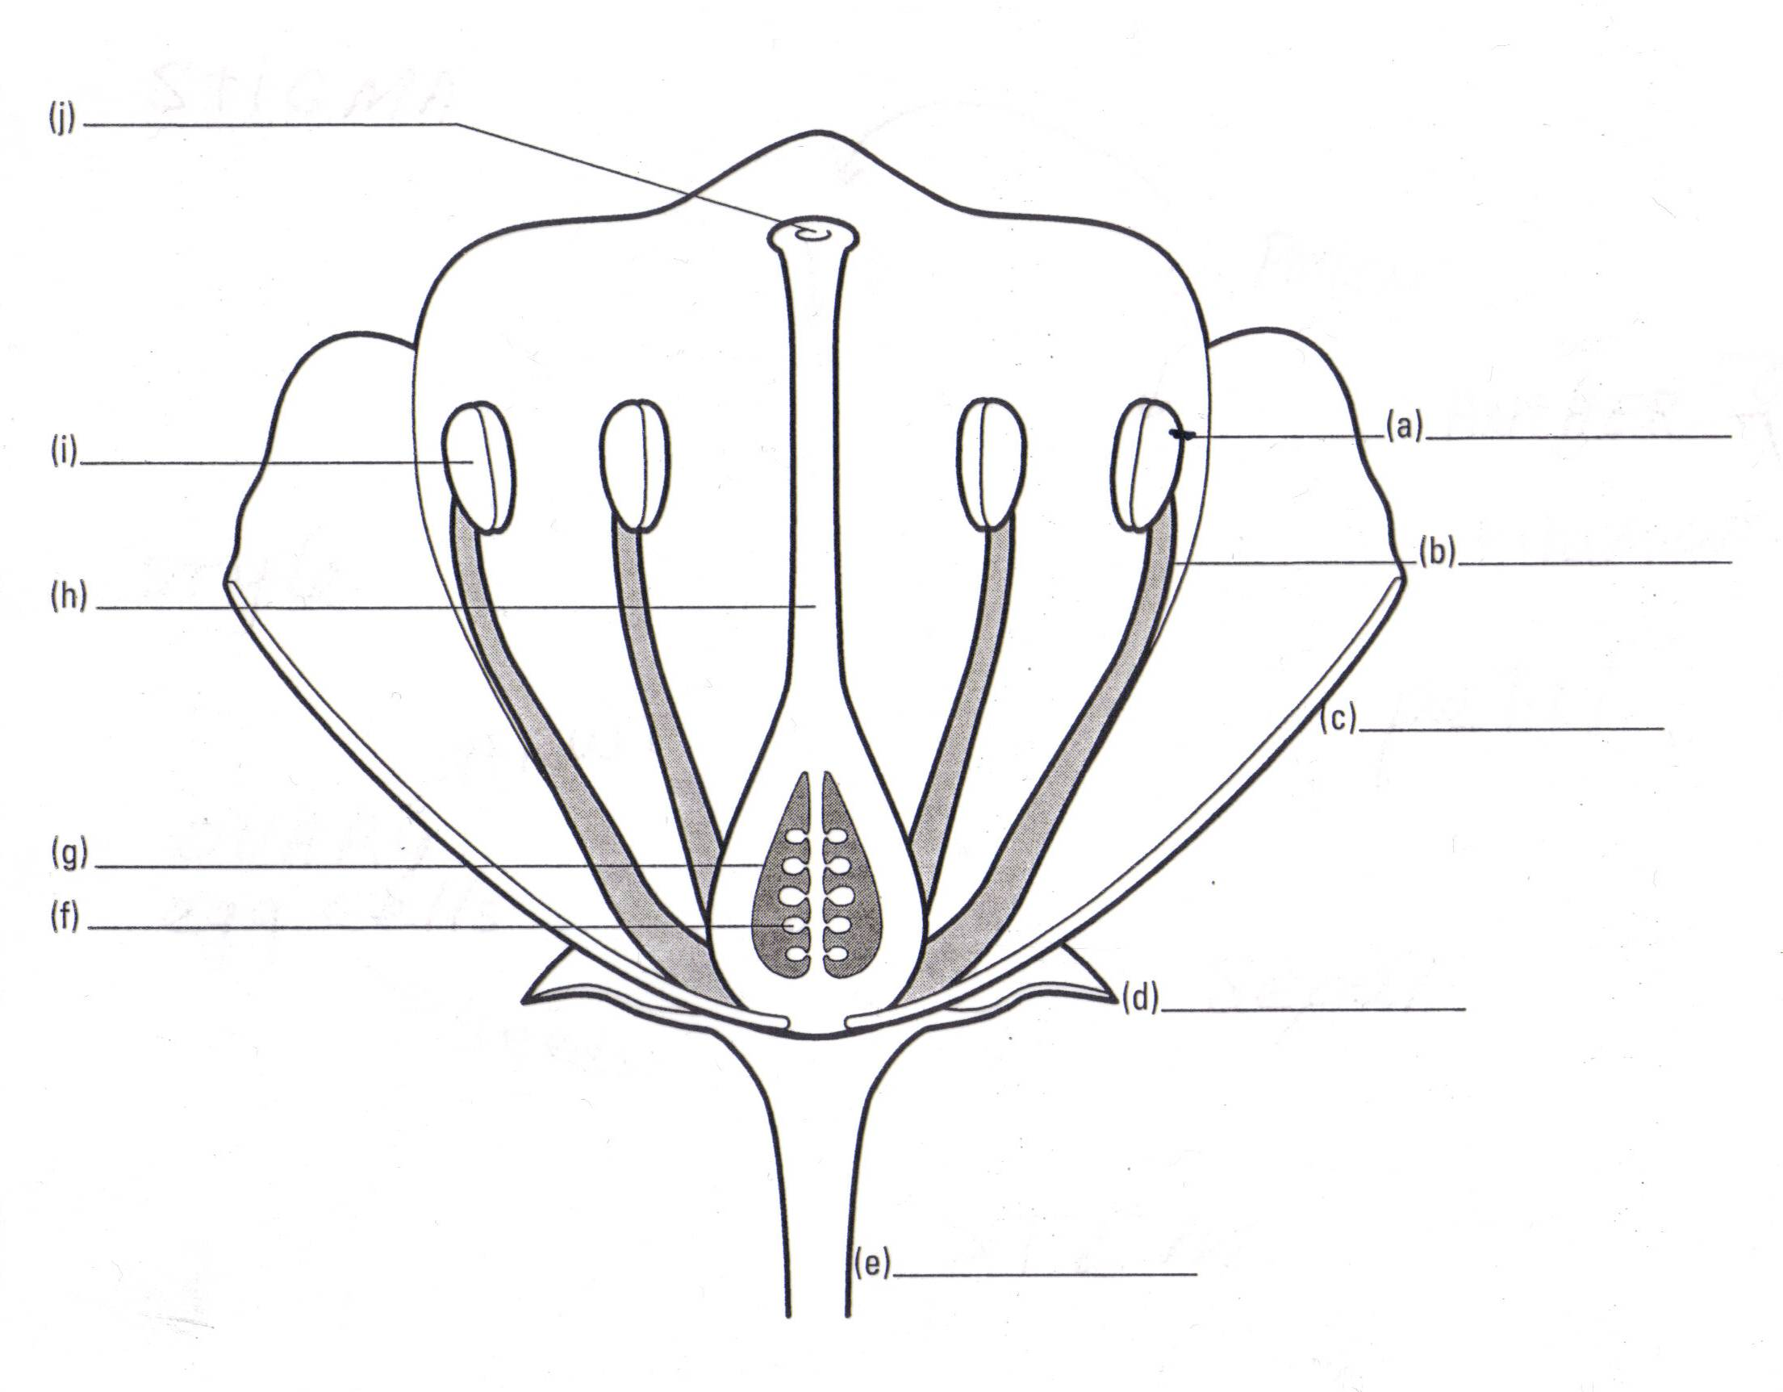

Slide 7
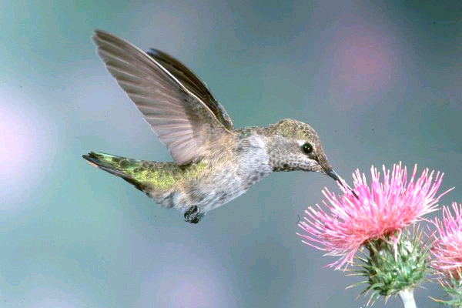
Pollination
This is the process by which the pollen is moved from an anther(male) to the stigma (female eggs cells) and fertilizes those cells.

Slide 8
Fertilization
Is the process of pollen and eggs combining to produce a zygote.
Some plants eggs can be fertilized by the same flower but most plants need to have pollen from another plant for fertilization to occur.

Slide 9
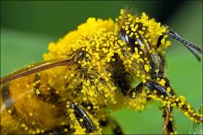
Plants have brilliantly coloured, fragrant flowers with sugary nectar in order to attract animals and insects to help pollinate them.
As creatures attempt to collect the sweet nectar they get covered in pollen, as these creatures move to other flowers they distribute the pollen to new flowers.

Slide 10
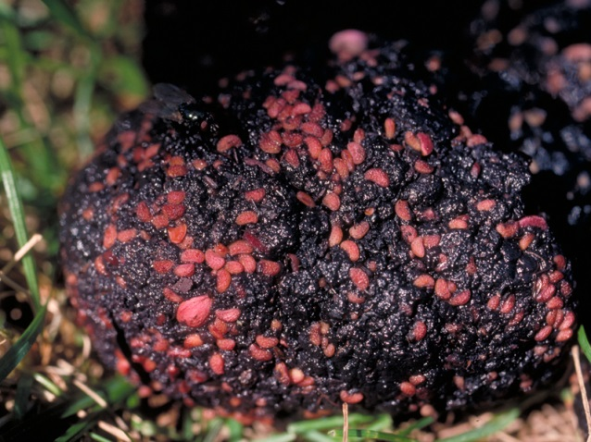
Seeds and Fruits
Pollen and eggs combine to produce a zygote (a fertilized egg).
In plants , the zygote is better known as seeds.
In some plants the ovary enlarges into fruit, therefore we are actually eating ovaries.
Fruit is used for protection and disbursement of the new seeds.
ex. A bear eats berries and scatters the seeds through its droppings.

Slide 11
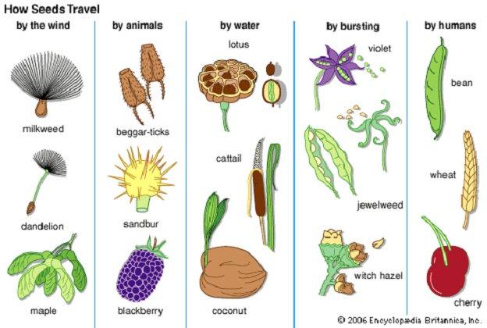

Slide 12
Question to Consider
Discuss with your neighbour about how fruit formation helps plants spread their seeds. Record your discussion and thoughts using several different fruits as examples.

