Slide 1
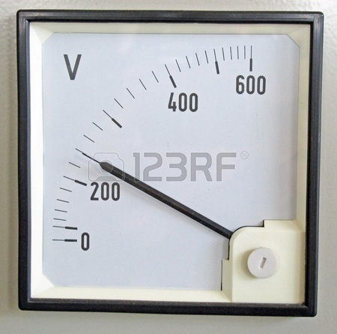
Measuring Electrical Energy

Slide 2
3 Important Terms
Energy: the ability to do work.
Electrical Energy: energy transferred to an electrical load by moving electric charges. (symbol is E)
Joule (J): unit for measuring energy.
Because a joule is so small, energy is also measured in much larger units such as the watt hour and the kilowatt hour.

Slide 3
Calculating Electrical Energy
Electrical Energy = Voltage x Electrical Current x Time Interval
E = V x I (amps) x t (sec)
E = V x I x t
E = V x I x t

Slide 4
A Question to try
Calculate the energy released from a battery in a flashlight bulb that was switched on for 4.5 hours, in which the voltage drop was 6V and the current flowing through the bulb was 0.35A.
Volt = 6V (volts)
Current = 0.35A (amperes)
Time = 4.5 Hours
Where is the problem with our numbers and the formula?
We need t (time) in seconds
E= V x I x t

Slide 5
Converting hours to seconds
1 hour has 60 minutes
1 minute has 60 seconds
60 x 60 = 3600 seconds
So 1 hour has 3600 seconds (1 x 3600).
2 hours would have 7200 sec (2 x 3600).
Multiply each hour by 3600.

Slide 6
Back to our question
E = ?J
V = 6V
I = 0.35A
T = 4.5 hours
4.5 x 3600= 16200 sec
E = V x I x t
E = 6V x 0.35A x 16200sec
E = 34020 joules
The energy released from the flashlight is 34 020 joules.

Slide 7
The Rate at Which Energy is Used
Electrical power is used by people every day.
Electrical power is a measure of the rate at which electrical energy is being used.
Ex. A 300w bulb uses up 3 times as much electrical energy as a 100w bulb.

Slide 8
Calculating Electrical Power (P)
The symbol for electrical power is P and the unit for power is the watt (W).
Power = Voltage Drop x Current
P = V x I

Slide 9
Another Triangle
P = V x I
V = P
I
I = P
V
P
V
I

Slide 10
Calculate the Power of a vacuum cleaner if the operating voltage is 120V and the current flowing through it is 7.90A.
P= V x I
P= 120V x 7.90A
P= 948 Watts (W)
The power used by the vacuum cleaner is 948 Watts.
Calculate the Voltage of a computer that has 600W of power and 1.9A flowing into the monitor.
V= P / I
V= 600 W / 1.9 A
V= 315.8 volts
The voltage of the computer is 315.8 volts.

Slide 11
Class Work
Take a moment to review pages 334 - 339 to make sure you understand the concepts.
Complete questions 2 ,3 and 4 on page 336
Complete question 3 on page 339

