Slide 1
A Changing Economy

Slide 2
Importance of Population Growth
Why do you think that population growth is important to Canada?
Do you think that Canada has a healthy population growth?
Is it good for a nation to have a high population growth? Why or why not?

Slide 3
Over many years Canada’s population was growing, sometimes rapidly and sometimes slowly.
In 1960, with the baby-boom in full swing, Canada recorded a record level of natural increase of 339,000. That year, Canadian women had given birth to 479,000 children.
In 2005, Canada registered more births (342,176) than deaths (230,132). Its natural increase was therefore positive at 112,000.
Statistics Canada predicts that this growth rate will actually be negative by 2030.
Notes:
With Canada's population steadily growing from year to year, the number of deaths has understandably increased over time, and it will continue to do so in the future. When the baby-boom generations reach the ages of high mortality, this trend is expected to accelerate. Around 2030, this could lead to a situation where there would be more deaths than births. If fertility increases to 1.7 children per woman, the point when the deaths start to outnumber births could be postponed by some fifteen years. If fertility declines, that point could instead be reached by approximately 2020.

Slide 4
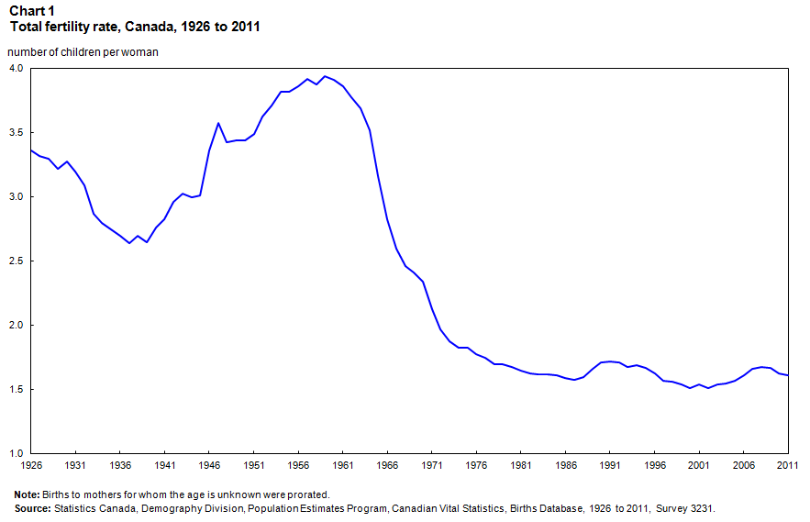

Slide 5
Birth and Death Rates
The Birth Rate is the number of births each year per 1000. In Canada, and other developed countries, the birth rate is fairly low. In 2006 Canada’s birth rate was 11 babies per 1000 people. How does the rest of the world compare?
The Death Rate is the number of deaths per year per 1000 people. In 1921, it was 12 per thousand, in 1959 it was 8 and in 2006 it was 7. A declining death rate increases a countries population.

Slide 6
Coming and Going
The Rate of Natural Increase is the difference between the birth rate and the death rate. In some countries the rate is negative, which means that the number of deaths exceeds the number of births.
Net Migration is the difference between the number of people who immigrate to Canada and the number of people who emirate from Canada.

Slide 7
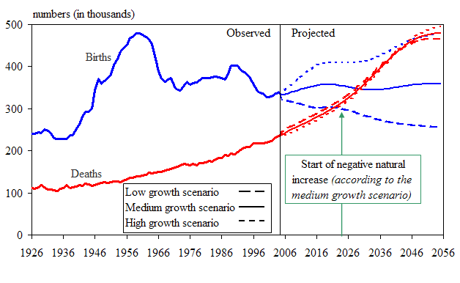
Birth Rate vs Death Rate

Slide 8
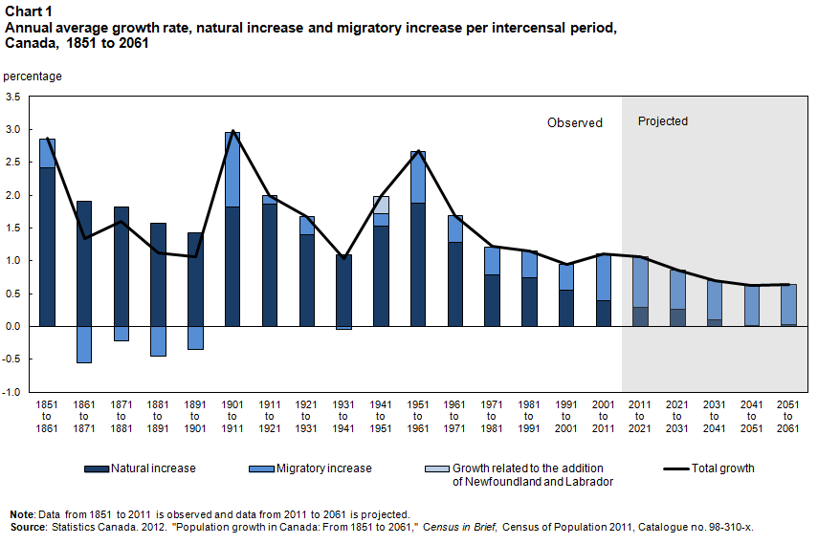

Slide 9
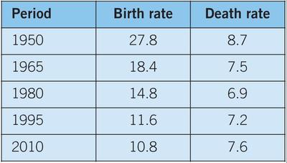
Activity – Using Visuals to Convey Ideas
Use the following charts to graph the birth rate and death rates in Canada. Be sure to use appropriate numbers in order to best represent your numbers. What observations can you make from this data?

Slide 10
Questions
Using your chart and other resources(internet: Statscan) answer the following:
During what periods did Canada’s population experience rapid growth?
During which periods did Canada’s population experience slow growth?
What trends will Canada’s population likely show in the future?
How can these trends be explained? Use your past knowledge to help understand these trends.

