Slide 1
Acadia
1621-1755

Slide 2
Criteria
I can identify who the Acadians are
I can identify where the Acadians lived
I can analyse the Acadians’ alliances & collaborations
I can evaluate the Acadians’ fate

Slide 3
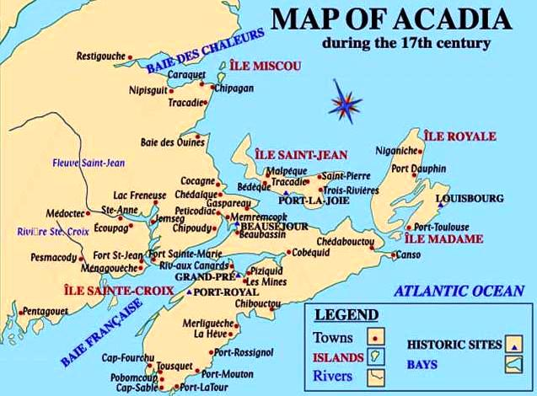
What Is Acadia?
It was a colony of New France in Northeastern North America, comprising what is now the Canadian Maritime provinces of N.B, N.S, P.E.I, Gaspe , and includes parts of eastern Quebec.
They called it L’Acadie which was believed to come from a native Miqmac word meaning “ Land of plenty”.

Slide 4
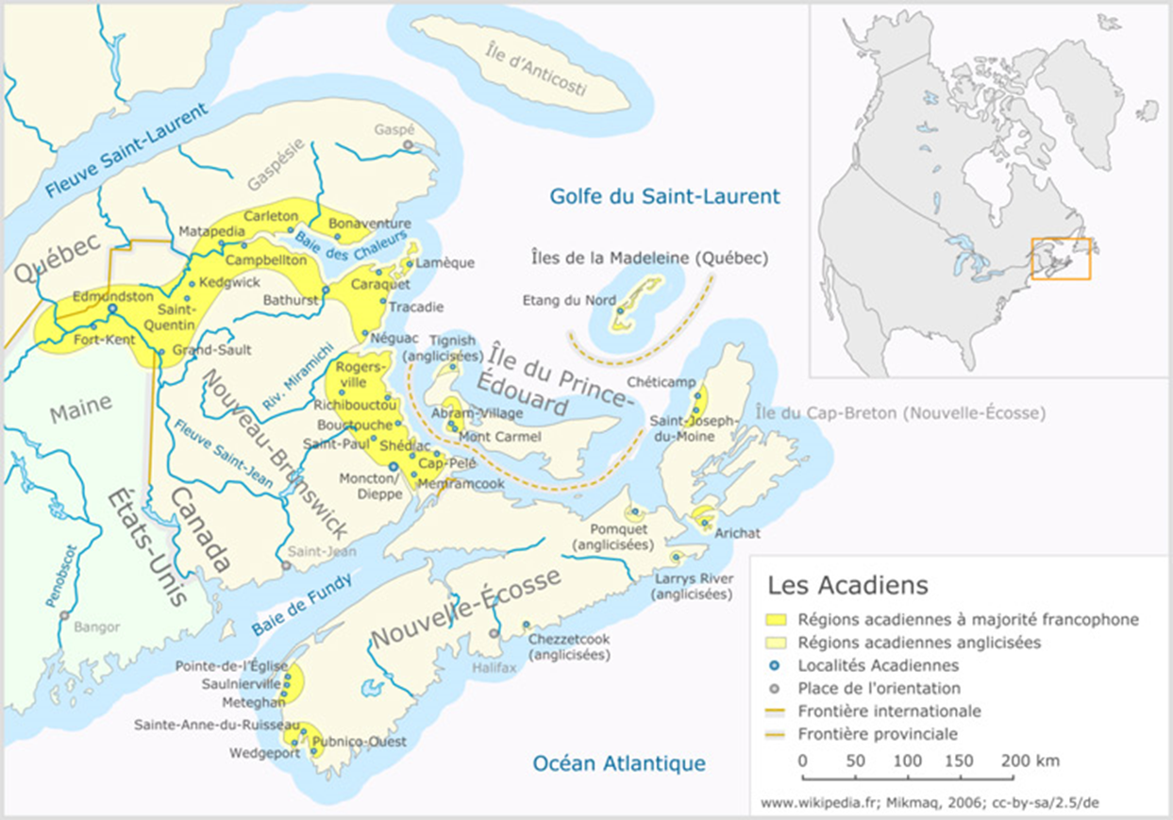

Slide 5
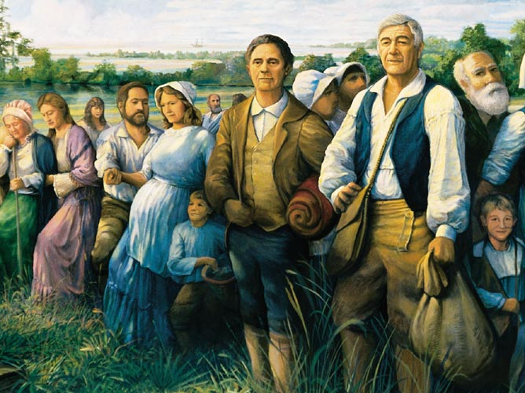
Who are the Acadians?
Acadians are the decedents of French colonists who settled in Acadia during 17-18th centuries. Some of them are also from the Indigenous people of the region. They are French speaking Canadians not French Canadians.

Slide 6
Daily Lives
The Acadians would usually get household items. Things they needed such as sugar, molasses, and machinery.
Over the winter, the men and older boys would cut firewood, and timber. Men made household furniture. They also devoted plenty of time to their farming.

Slide 7
Acadia’s Turbulent History
In the early 17th century, French families fought over access to the fur trade and territory in New France
Over Acadia’s history there was frequent conflicts with French aristocrats, the Dutch, English and English colonists.
Acadia was an important colony for cod –fishing. It was an important part of Frances imperialistic economy.

Slide 8
Acadia’s Turbulent History
Acadians became less dependent on France
The bonds and trust grew strong between the Acadians with Maliseet and Mi’kmaq
Acadia’s culture grew a lot over the years and it became distinctly different from other French colonies.
From 1635-1645 was controlled by two French families who did not get along.

Slide 9
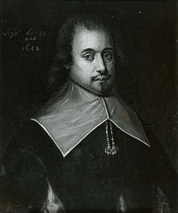
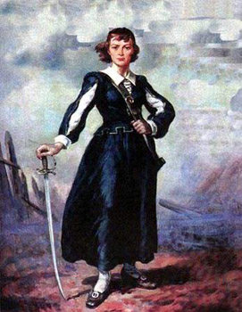
Acadia’s Turbulent History
These families where the La Tour family and the d’Aulnay family.
D’Aulnay gained control of Acadia by taking fort la tour while La Tour was away.
It was controlled by his wife but she had died and La Tour fled.
In 1650 D’Aulnay died, from 1650-1651 La Tour was the governor of Acadia once again until it fell to the British.

Slide 10
Outside Threats
Between 1627-1763, Acadia changed hands between warring French, the English and New Englanders a total of 14 times.
New England became a major trading partners with Acadia.
In 1713 France gave up its rights to Acadians with the signing of the treaty of Utrecht.
Acadians became subjects of the British
Consequently there were no boarders that they could both agree with , and in 1730 Acadians swore an allegiance to the British crown, but they insisted they would not fight either the French or the native.

Slide 11
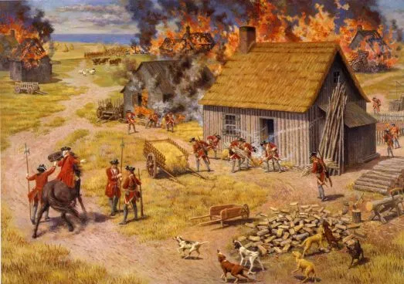
Expulsion
1754 was the beginning of the French and native war British insisted them to fight against the French, but most of them refused.
British could no longer trust the Acadians and they wanted them out. They took away the Acadians land, Burnt down their houses and ripped families apart and many lost everything they owned. 1755 was the start of the Acadian expulsion.

Slide 12
Facts
Approximately 10,000 Acadians where deported from 1755-1763
They speak chiac
There are Acadians in the USA called Cajuns
They make a dish called poutine rappee

Slide 13
Videos
https://youtu.be/Rnq6KxxEvOc
https://youtu.be/9F23fgzNbO4

Slide 14
Questions
What differs from New France and Acadia?
Why do you think the natives and Acadians got along so well?
From the British point of view why was the expulsion nessacary?

