Slide 1
Becoming Canadians (1783-1837)

Slide 2
Aftermath of the American Revolution
Not everyone in the 13 Colonies wanted revolution.
Tens of thousands of Loyalists fled from the States to Canada.
The British and the Americans failed to fulfill the terms of the Treaty of Versailles(not that one).
Brits to vacate forts in the west
Yanks to compensate the Loyalists for last land
Notes:
Many citizens of the 13 colonies were still loyal to the British crown. They became known as the loyalists and after the revolution they fled to Britain controlled Canada on the promises of land as well as persecution by the American states.
This rapidly changed Canadas demographics with the arrival of tens of thousands of loyalists from the south .
The treaty required the British to vacate their western forts, they did not as they said they were protecting the remaining loyalists. Each American state was supposed to compensate each of their loyalists for lost property due to the revolutionary war. The

Slide 3
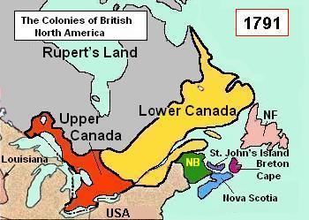
Constitutional Act of 1791
Due to the effects on Canada from the American Revolutionary war the constitutional act of 1791 was passed
Split the colony of Quebec into Upper and Lower Canada.
North America then had 5 colonies under British Control; Upper and lower Canada, New Brunswick, Nova Scotia, and Newfoundland.
Notes:
After the American Revolutionary war The parliament passed the act of 1791, this act split Quebec into upper and lower Canada.
Total colonies under British rule had then become 5. This act also gave lower and upper Canada their own elected legislative assemblies as well as a lieutenant governor.
On top of all this a governor general was established to have control over not just upper and lower Canada but all the other colonies as well.
In 1803, Napoleon agreed to sell the vast Louisiana territory to the US for $15 million, it essentially doubled the size of the US.

Slide 4
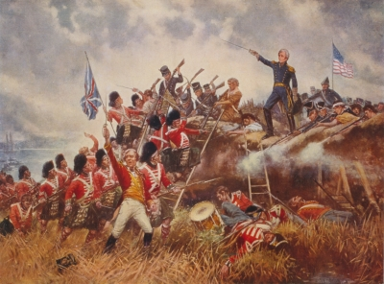
War of 1812 – Join Us (pt2)
The second war between the newly formed U.S.A and Great Britain.
Canadian soldiers primarily were the ones repelling the American Attack.
The war was largely started because Britain put forth a naval blockade on America, blocking their trade with Europe during the Napoleonic Wars.
Alliances were made with the Indigenous peoples to fight for the British.
Notes:
The War of 1812 was the second war between the US and Britain. It was fought in North America and mostly on upper and lower Canadian soils. The war started due to restriction and frictions between America and Britain. However one of the biggest causes was the blockage of ships from the states to Europe. Alliances were made between the aboriginals and the British. The Brits also boarded ships and forced any British citizens they found into military service.
Since the outbreak of war with Napoleonic France, Britain had enforced a naval blockade to choke off neutral trade to France, which the United States contested as illegal under international law. To man the blockade, Britain impressed American merchant sailors into the Royal Navy
The British supplied Natives who conducted raids on American settlers on the frontier, which hindered American expansion and also provoked resentment
War officially started on June 18. 1812 President James Madison signed the American Declaration of War into law. At this time the pop of the US was 7.5 million and Canada was less than 80,000.
Pg173 in Cdn History for Dummies

Slide 5
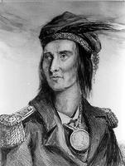
Tecumseh
Tecumseh, Chief of the Shawnee, had united many(12) Indigenous nations together in an attempt to prevent Americans from taking more land from his people.
Tecumseh proved to be a difficult adversary for the Americans and served as another catalyst to why the War of 1812 started.
These First Nations fought alongside the British, not for loyalty, but for tactical reasons. Tecumseh and Brock would save Upper Canada when the fighting came north.
Notes:
Major-General Isaac Brock was military commander of British Forces and of the Canadian militia. He stated about Tecumseh “A more…gallant Warrior does not I believe exist.”

Slide 6
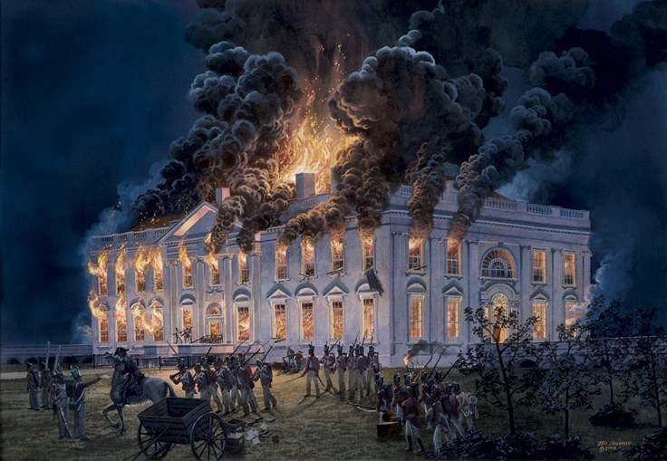
Course of the war
After many battles around the Detroit- York area the Americans surrendered Michigan and upper Mississippi to the British.
After losing two armies at Detroit and Queenston Heights their militia refused to cross into Canada and after the loss of another at Frenchtown the invasions of Canada in winter were abandoned.
On leaving the American militia burned down the town of Newark, in response the British burned Buffalo.
Notes:
The Canadians reinforced by first nations and British soldiers themselves continued to repel attacks and secured Michigan and upper Mississippi after the Americans surrendered at Detroit, despite outnumbering the Brits by at least 1000 men. The American General William Hull panicked and ultimately surrendered after few cannon shots.
After losing so many parts of their army the Americans refused to cross into Canada citing their constitutional guarantee that they wouldn’t fight on foreign soil. They also abandoned invasion attempts in the winter and the only remaining Americans in Canada were POWs.
Upon leaving the Americans burned the town of Newark causing retaliation in Buffalo. These incendiary warfare tactics would continue until the British used them on Washington itself. Major sir Isaac Brock was the generals who led the expedition of the lakes.
These defeats are the largest loss of territory in American History.

Slide 7
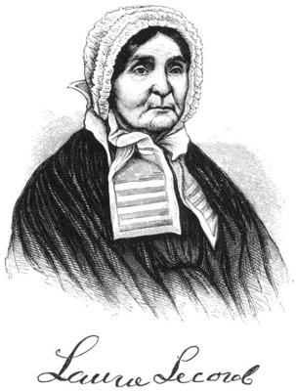
Laura Secord
It was during this fight for Upper Canada that Laura Secord made a name for herself.
She was a pioneer and mother of 5 who, while nursing her wounded husband back to health overheard invading Americans planning a surprise attack at a Upper Canadian village.
She set off on a 32-km trek across the war zone to warn the British. Mohawk sentries found her and took her to Lieutenant James FitzGibbon. He set up an ambush and captured over 500 Americans without a single shot fired.
Notes:
Secord’s husband was wounded at the Battle of Queenston Heights.

Slide 8
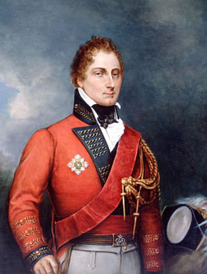
War in Lower Canada
Although the majority of fighting happened in Upper Canada there was an invasion in Lower Canada in autumn of 1813.
The first strike was from New York along the Chateauguay River and the second was along the Great Lakes and the St. Lawrence.
Both attacks failed and French Canada was saved from American invaders.
Chateauguay was a true Canadian victory as no British troops were involved. A small band of French Canadians with English-Canadian and Mohawk allies held off 4000 Americans.
Notes:
Charles de Salaberry convinced his allies to camouflage themselves in maple leaves and blow horns to create chaos which allowed the Canadians to cut down the invaders as they, in vain, attempted to flea.

Slide 9
So Who Won?
On the battlefield the Americans were handed lose after lose but…
…this war was more political than military.
In the Treaty of Ghent, signed on Christmas eve of 1814, the British and Americans agreed to end the war.
The Treaty reestablished the territories to their original position but the Americans were given free reign of the west and maintained their sovereignty.
This “victory” by the Americans led to the widespread war of extermination, displacement and assimilation against the First Nations.
Notes:
The strangest thing about the War of 1812 is that the American actually believe that they won. Their goal was The Conquest of Canada.
The Indigenous peoples were left out of the Treaty of Ghent, as were the Canadians, the Americans refused them to be included.
This “free reign” allowed Americans to take native land that was originally protected by the British.
Americans Won, Canadians broke even and the FN lost.

Slide 10
Final Thoughts
Pierre Berton wrote this quote about the war of 1812…
” It was as if no war had been fought, or to put it more bluntly, as if the war that was fought was fought for no good reason. For nothing has changed; everything is as it was in the beginning save for the graves of those who, it now appears, have fought for a trifle:...Lake Erie and Fort McHenry will go into the American history books, Queenston Heights and Crysler's Farm into the Canadian, but without the gore, the stench, the disease, the terror, the conniving, and the imbecilities that march with every army.“
Does this quote really accurately describe the war? Was anyone really victorious?

Slide 11
Questions
Did the War of 1812 really help solidify a Canadian identity? If so, how?

