Slide 1
Canada 1919-1929
A Quest for Change and Stability in an Era of Ambiguity

Slide 2
Change is coming…
Following WW1 Canada was faced with challenging tasks; confront the trauma of war and look to build a secure future for it citizens.
Canadians had to confront a series of new political movements that attempted to reform regional grievances, adapt to new technologies that were transformational to society, and learn how to nurture and protect a growing Canadian culture.
As Canada become increasingly urban and industrial, reformers sought to improve society on all fronts: education, regional disparity, religion, poverty, health, and government policy.

Slide 3
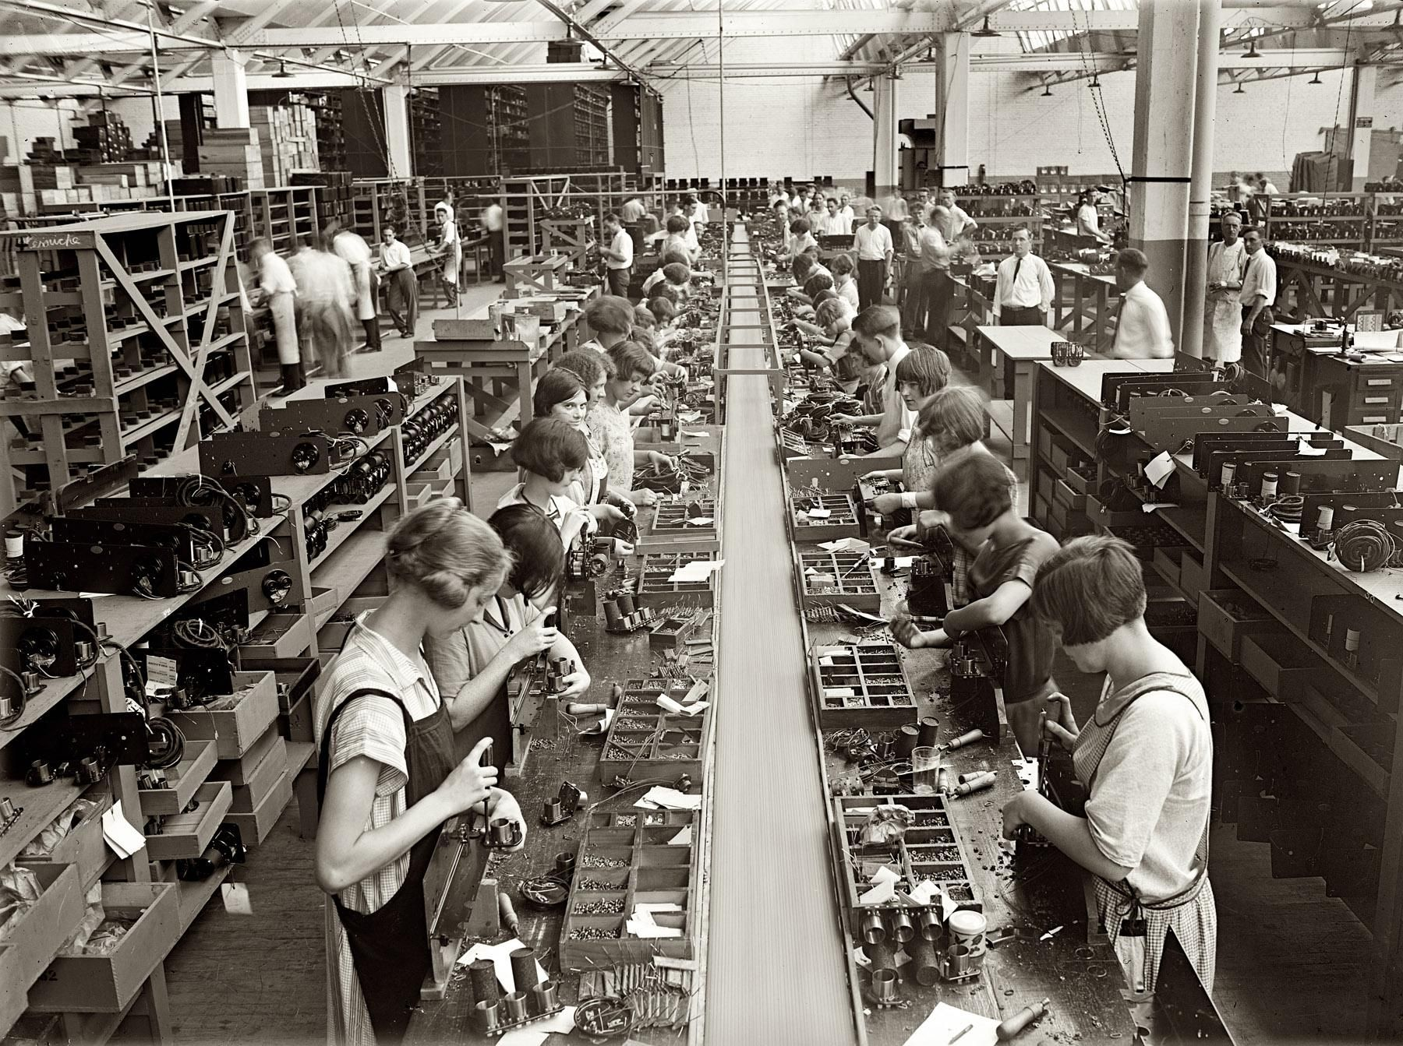
The Labour Movement
During the Great War labour shortages were a constant problem. The shortages helped improve bargaining power for workers and led to soaring wages but so did the cost of living.
At the end of WW1 500,000 men returned from Europe and faced unemployment and inadequate resources to ease them back into the world of work.
During this time assembly-line factories were undermining the historical importance of higher-paid skilled workers which led to rapid growth of labour unions across Canada.
Notes:
Many of the young men returning from overseas became frustrated with the lack of employment and found themselves caught up in the revolutionary theories of Marx and Engels and found themselves joining unions. Many of these unions became fairly radical with demands in comparison to more moderate unions.
The radicalization of many unions, predominately in the west, led to threats of strikes that seemed more of a political weapon and less of a bargaining tool.

Slide 4
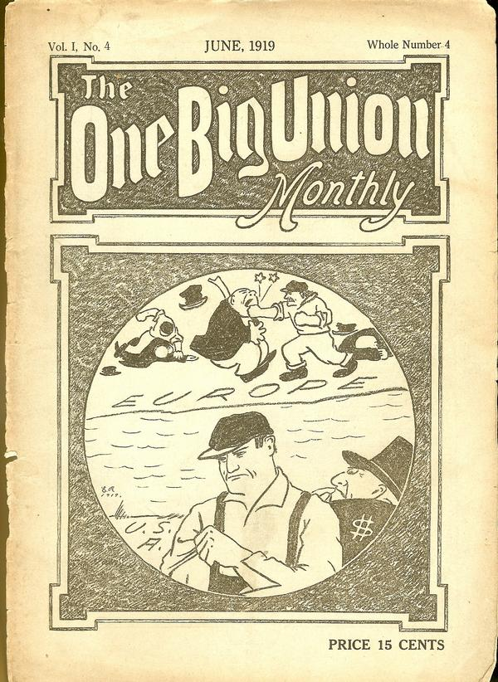
One Big Union
Government, under the near constant threat of strikes, clamped down on workers’ groups, banning several organizations altogether and prohibited newsletters and pamphlets in an attempt to de-radicalize this first “Red Scare”.
Led mostly by British emigrants fresh from the socialist hotbed that was Europe a radicalized and increasingly militant group of members of the Trades and Labour Congress(TLC) broke off and created One Big Union(OBU) in 1919.
This Marxist union favoured general strikes that would shut down entire towns and cities in a show of worker solidarity.
Notes:
A notable syndicalist union was the Industrial Workers of the World (IWW). It was based in the United States and had chapters in the Canadian West. In 1911, the IWW outlined its philosophy in a pamphlet titled One Big Union. That phrase also became the IWW’s slogan.
The One Big Union (OBU) was a radical labour union formed in Western Canada in 1919. It aimed to empower workers through mass organization along industrial lines. The OBU met fierce opposition from other parts of the labour movement, the federal government, employers and the press. Nevertheless, it helped transform the role of unions in Canada.
OBU were a self-declared “revolutionary industrial union”.

Slide 5
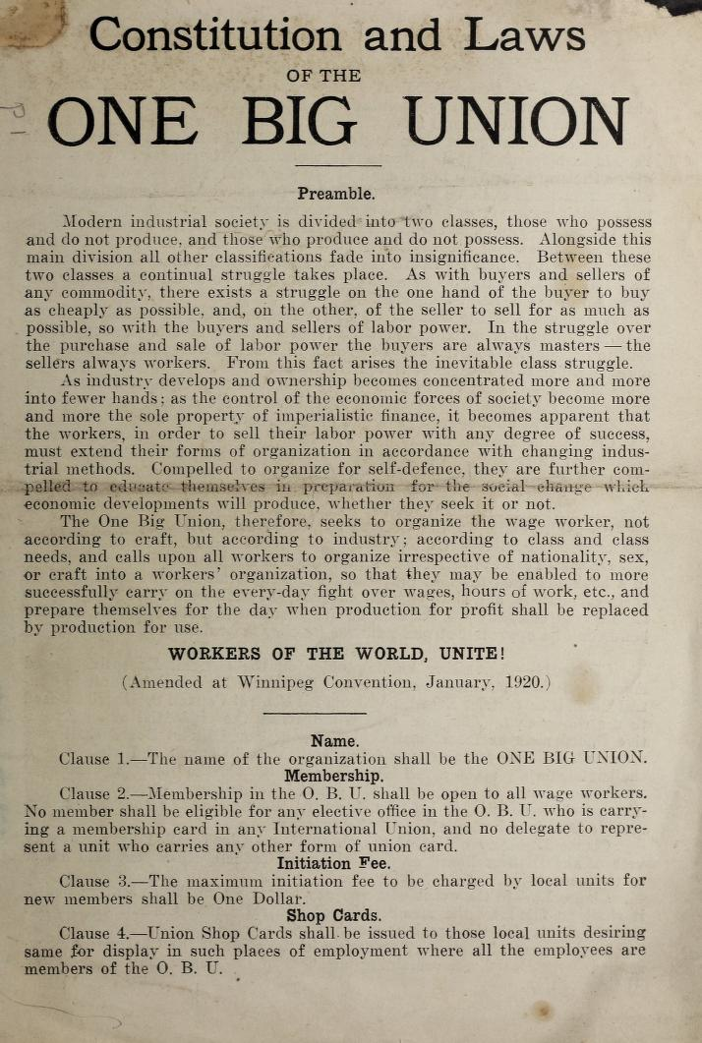
Primary Source Doc
Excerpt from the One Big Union charter The One Big Union . . . seeks to organize the wage worker not according to craft but according to industry; according to class and class needs; and calls upon all workers irrespective of nationality, sex, or craft to organize into a workers’ organization, so that they may be enabled to more successfully carry on the everyday fight over wages, hours of work, etc. and prepare themselves for the day when production for profit shall be replaced by production for use.
Notes:
Excerpt from the One Big Union charter The One Big Union . . . seeks to organize the wage worker not according to craft but according to industry; according to class and class needs; and calls upon all workers irrespective of nationality, sex, or craft to organize into a workers’ organization, so that they may be enabled to more successfully carry on the everyday fight over wages, hours of work, etc. and prepare themselves for the day when production for profit shall be replaced by production for use.

Slide 6
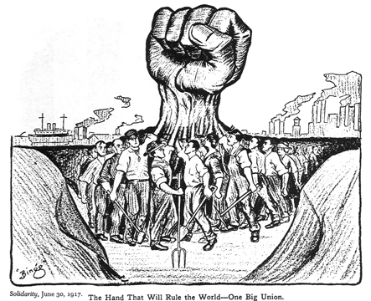
One Big Union Objectives
The objectives of this Union included but were not limited to:
Better wages
Legal recognition of the union
A six-hour workday and a five-day workweek
A repeal of earlier government restrictions on labour
At the height of its glory in 1920, the One Big Union movement counted nearly 50,000 Canadians among its ranks.
Notes:
While Western Canada is often the epicenter of Union action it was in Amherst, NS that had an earlier movement of workers. Perhaps it might be related to the fact that Leon Trotsky, a Soviet revolutionary, Marxist theorist, and Soviet politician was briefly detained at an internment camp in Amherst in 1917.

Slide 7
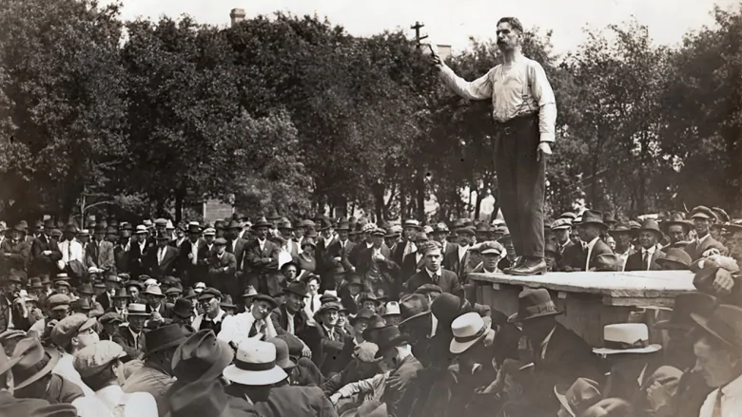
The Winnipeg General Strike
By 1911, Winnipeg was the 3rd largest city in Canada and it was one of the most unionized.
During the Conscription Crisis of 1917 many union leaders were talking about a general strike as many union leaders opposed conscription into a war overseas.
In 1918, when the city council outlawed the right to strike for civil employees, municipal workers walked off the job in protest and other unions joined in in support.
The city quickly reversed its decision as city services of every type had been disrupted. The city caved and the workers were granted their demands.
Notes:
Arthur Meighen, Minister of the Interior and acting Minister of Justice, believed that the strike was inspired by Bolsheviks bent on violent revolution and that this strike needed to be terminated before it spread to other cities.

Slide 8
The Winnipeg General Strike
In 1919 the Federal govt decided to get involved and it threatened to fire federal workers unless they returned to work immediately. Parliament changed the Immigration Act so that British-born immigrants could be deported. It also broadened the Criminal Code’s definition of sedition.
Police strikebreakers were brought into Winnipeg and the detachment grew from 27 to 272, machine guns were brought in and an assault tank was put on alert. Under Meighan the police swept the city and arrested a dozen men without any formal charges.
On Saturday, June 21, a riot broke out and police fired on the crowd, killing one striker and injuring at least 20 others(one other man died of his wounds).
In the end more than 80 demonstrators were arrested and at dusk the army ruled the streets of Winnipeg.
Notes:
The Winnipeg General Strike of 1919 was the largest strike in Canadian history. Between 15 May and 25 June 1919, more than 30,000 workers left their jobs. Factories, shops, transit and city services shut down. The strike resulted in arrests, injuries and the deaths of two protestors.
An ad hoc Citizens Committee of 1000 made up of manufactures, politicians, and bankers spearheaded an anti-union opposition and they consulted with Ottawa and advised them on actions to take.
94 of 96 unions joined the strike.

Slide 9
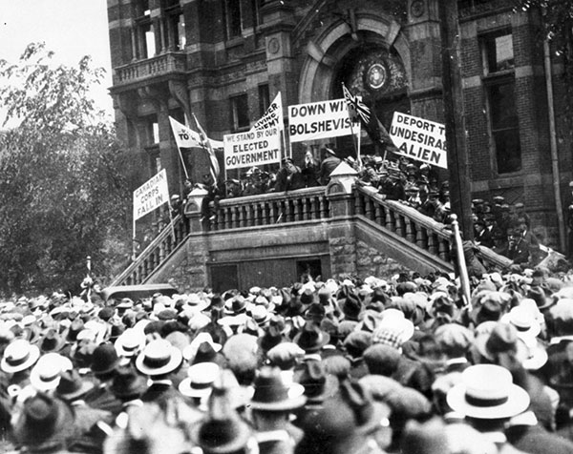
Notes:
Citizens Committee of 1000

Slide 10
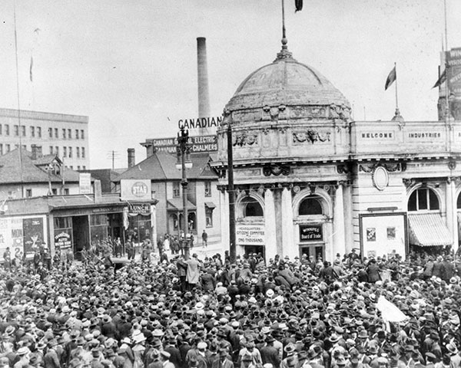
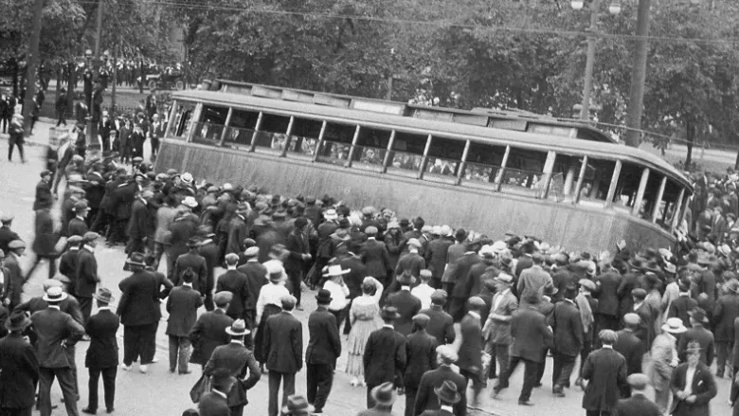
“Bloody Saturday”

Slide 11
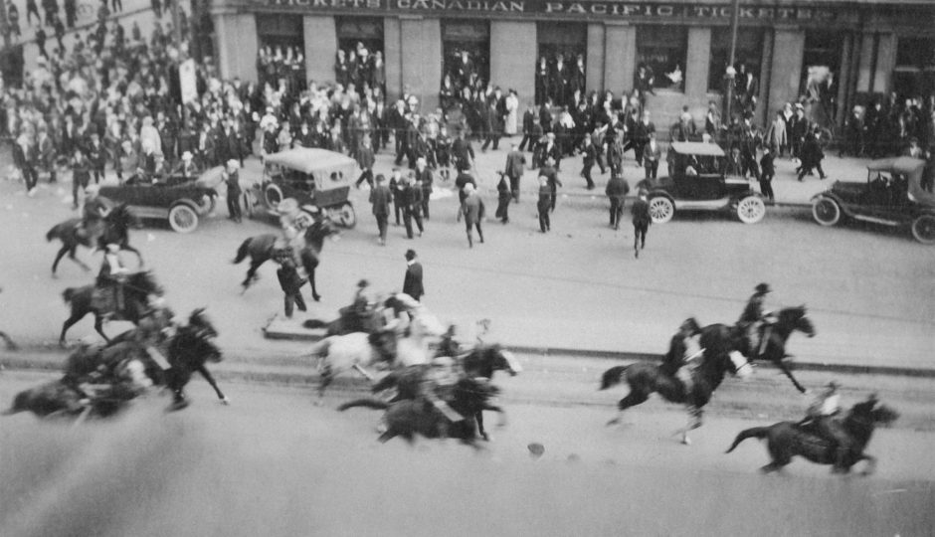
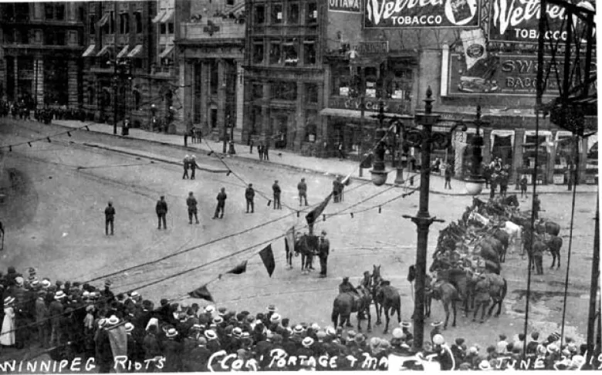

Slide 12
Notes:
This monument was unveiled on the 100th anniversary of the strike as a reminded of this momentous turning point in Canadian Union history as due to the outcome many union shrunk and non-union companies gained the upper hand in most strikes across Canada.

Slide 13
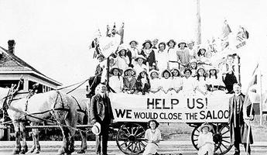
Women’s Movement
“Never retract, never explain, never apologize – just get the job done and let them howl.” - Nellie McClung
Women had been involved in many events in Canadian history. In post-Confederation times the two most evident places were in the prohibition of alcohol movement and the fight for voting rights.
The federal temperance movement of 1898 was overwhelmingly rejected but some provinces chose to prohibit alcohol and in 1918 PM Robert Borden brought in measures to prohibit “the manufacture, importation and sale” of alcohol…it was quickly rejected by most provinces in the next two years.
Notes:
Only PEI chose to continue to prohibit alcohol up until 1948.

Slide 14
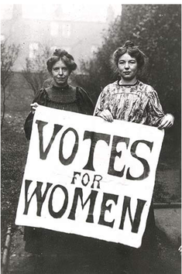
“Hyenas in petticoats” – Premier R. Roblin (Manitoba)
Great strides in women’s education were witnessed in great detail in the Maritimes but it was in Western Canada that the biggest breakthroughs would happen.
Best selling novelist and a leading member in the Woman’s Christian Temperance Union (WCTU), Nellie McClung, clashed with political leaders including Premier Roblin who would lose an election in 1915 partly due to the satirical attacks of suffragists including McClung.
Manitoba’s next ruling party, the Liberals, granted the right to vote in provincial elections in 1916 along with Sask and Alberta. In 1917, BC and Ontario added women’s right to vote followed by NB(‘19), PEI(‘22) and Newfoundland(‘25) over the next few years. Quebec was the last to follow suit in 1940.
Notes:
John A Macdonald attempted to extend the vote to women and Native Canadians in the 1880s but he was rejected.

Slide 15
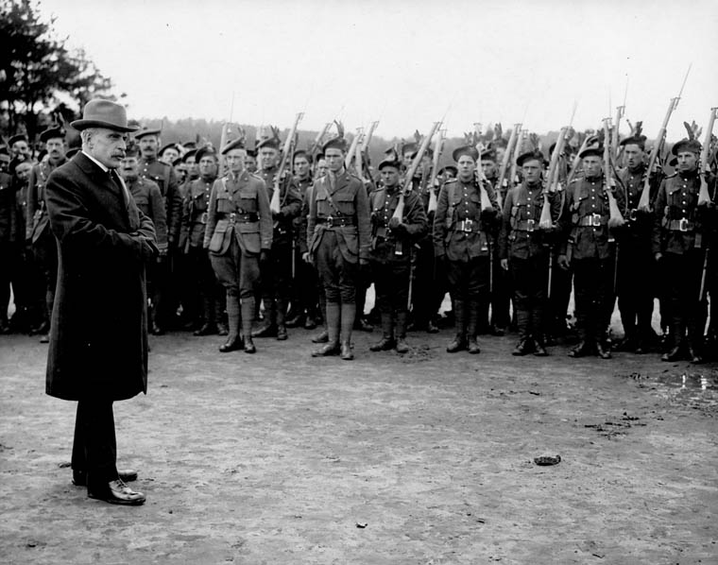
Federal Voting Rights for Women
In 1917, PM Robert Borden granted women a limited vote under the Wartime Elections Act. This act was very contentious as it was biased towards Borden and linked to extending military involvement in the Great War.
The Wartime Elections Act of 1917 gave the vote to female relatives of Canadian soldiers serving overseas in the First World War. It also took the vote away from many Canadians who had immigrated from "enemy" countries. The Act was passed by Prime Minister Robert Borden’s Conservative government in an attempt to gain votes in the 1917 election.
Notes:
Canada's most controversial franchise legislation was adopted by Parliament during the First World War. The Wartime Elections Act and the Military Voters Act of 1917 enfranchised female relatives of men serving with the Canadian or British armed forces as well as all servicemen (including those under 21 and status Indians); it disenfranchised conscientious objectors and British subjects naturalized after 1902 who were born in an enemy country or who habitually spoke an enemy language. Prime Minister Robert Borden's Conservative government openly admitted that the legislation was biased in its favour.
The 1917 election results proved that they were right. Such abuses and shifts in the policies governing the right to vote ended in 1920 with the adoption of the Dominion Elections Act, which established a standard Dominion-wide franchise.

Slide 16
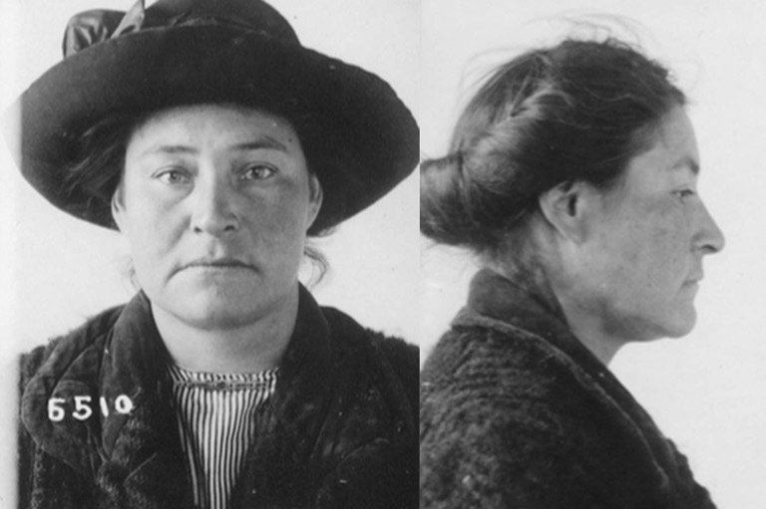
Lizzie Cyr
Nellie McClung, first female MP Agnes Macphail, Emily Murphy, Henrietta Edwards, Louise McKinney and Irene Parlby were all significant women in the fight for equality and voting rights but it was another women that served as the catalyst for true change in Women’s Rights in Canada.
It was a Metis prostitute named Lizzie Cyr and her lawyer, John McKinley Cameron, who finalized the push for equality in the eyes of the law.
Notes:
See page 297 of Canadian History for Dummies

Slide 17
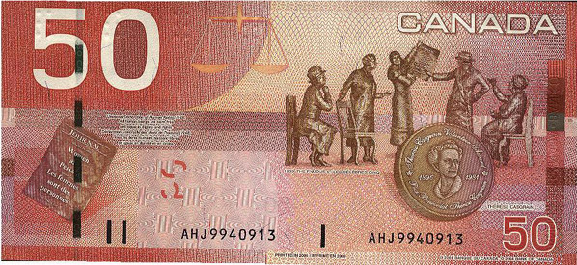
The Famous Five
“The exclusion of women from all public offices is a relic of days more barbarous than ours.” -Lord Chancellor Sankey of the Privy Council
Notes:
On April 24th, 1928 the supreme court of Canada announced that women were not legally persons. Canada had overruled the Alberta decision made back in 1917. The Famous 5 went over the heads of the Supreme Court and pursued the issue with the British Privy Council in London. In the following year they won. On Oct 18, 1929 Britain ruled against Canada and women were now recognized as persons.

Slide 18
The Roaring 20s

Slide 19
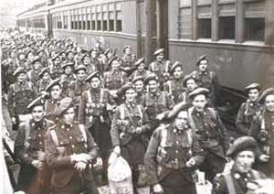
The Lead-Up
Remember that prior to the 1920s Canada struggled through a post WW1 slump where international demand for Canadian goods fell and the cost of purchasing items remained high.
Returning soldiers found difficulty seeking employment and without a war many factories closed down.

Slide 20
Post WW1
While many families were happy to have their loved ones home from the war others struggles to aid those who were injured and many still had to deal with the loss of loved ones
Morally speaking, many Canadians wondered about what is ‘good” and what is “bad”, especially after experiencing so much death and destruction in Europe.
America had similar struggles but nowhere near what we felt in Canada as the USA were only involved in WW1 for a single year.

Slide 21
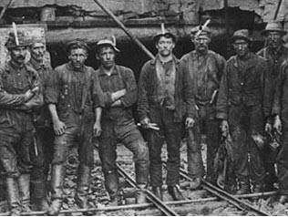
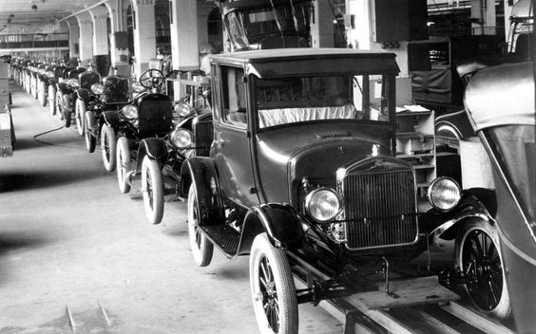
Some Hope - 1923
By the early 1920s some hope emerged as agriculture and mining increased. This was good for the Prairies(wheat), BC, Manitoba and Central Canada(mining).
Demand for pulp and paper in the US also helped boost the economy and car manufactures set up branch plants in Canada to avoid tariffs on importing goods to Canada.

Slide 22
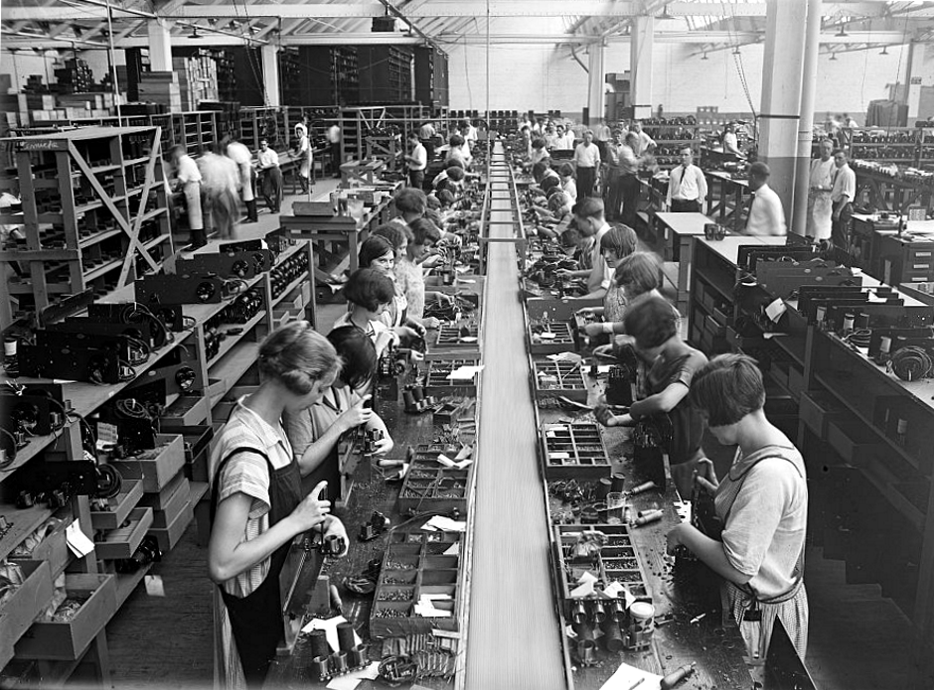
Good Times Ahead?
The introduction of the assembly line in factories greatly increased the number of products that could be made and new inventions, such as the electric range, improved the quality of life. It appeared that Canada has finally shaken off the post-WW1 slump…or at least some places in Canada did.

Slide 23
The Early Boom 1925-1929
During the mid to late 1920s many factories were redesigned to build new products and this created many new jobs.
The USA were rich from their experience in WW1 and they invested in and purchased goods from Canada.
People were now not as concerned about the struggle between what is “good” and ‘bad” and they started to loosen up and relax.
It was generally a happy time for Canadians as they were not scared anymore and the economy seemed to have rebounded for the post-war slump.

Slide 24
Questions and Thoughts
Possible Reading:
Page 384 of the text – Shameful Isolation – Q) What responsibilities did Canada have to foreign affairs as it fought for more autonomy?
Questions
1. Would you have joined the protest in the Winnipeg General Strike? Why?
2. What historical significance did the Winnipeg General Strike have?
3. Was Borden a feminist or an opportunist? Explain.
4. The 20s were fairly busy, how did technology enhance Canadian culture and identity?

