Slide 1
Canada And the Black Experience
Sam Leger

Slide 2
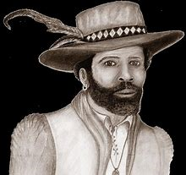
The Firsts
The first recorded black person to step into Canada was an African named Mathieu De Costa, who arrived in 1608. He helped translate the Mi’kmaq language for the governor of Acadia. He, as well, was an interpreter for Dutch and French explorers, but historians have a hard time finding evidence that he visited the St. Lawrence River, and who he arrived with. Many theories suggest he was with Samuel de Champlain or Pierre Dugua de Mons when he arrived, but many aspects of his life are unknown. He died in 1619 in Quebec City.

Slide 3
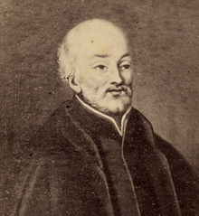
The Firsts
The first recorded slave to arrive in Canada (it was still named New France at the time) was a six-year-old boy named Olivier Le Jeune. He came from Madagascar and was bought in Quebec by commander David Kirke, from then on, he was passed down and bought by many others. First, commander Kirke gave him to a French clerk named Olivier Le Bailiff, when Quebec was given back to the French in 1632, his owner left that colony and gave him to local resident Gulliaume Couillard. Olivier went to a church for education under his Jesuit priest, Father Le Jeune, who baptized him and gave him the name he has today. He died on May 10th, 1654.

Slide 4
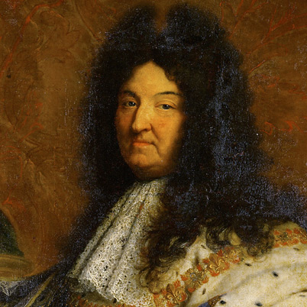
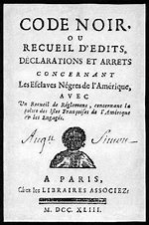
King Louis XIV and Code Noir
• Back in France, King Louis established Code Noir, a set of laws that allowed slavery only for “economic” purposes. The procedures for owning one and the treatment of the slaves was pretty severe and strict, it wasn’t officially used in New France until 1689, and even still it was limited. The residents of New France were complaining about the lack of workers, so King Louis let the crown give them black and Pawnee slaves.
• In 1709, he made slavery officially legal for his New France colonizers. Surprisingly there weren’t many people there who owned slaves than the original France, some even questioned the long-standing law.

Slide 5
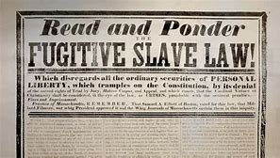
Underground Railroad/Fugitive Slave Act
• In 1793 in the southern part of the US, the Fugitive Slave Act made capturing escaping slaves a business. Most of these slaves going through the Underground Railroad came from Virginia, Kentucky and Maryland. This would be the primary reason the slaves made their way to Canada.
• The most used routes went through Iowa, Indiana and Ohio. Many people reached out to help them, nicknamed the “conductors”, leading them into churches, schoolhouses, the people who ran the safe houses were named “stationmasters”.

Slide 6
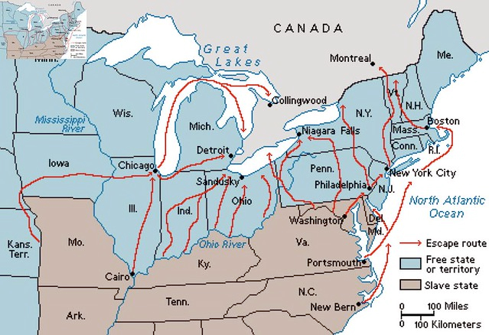
Underground Railroad/Fugitive Slave Act
• While the Fugitive Slave Act was being put into place, Canada was offering the freedom to live wherever they wanted, run for office, sit in juries, basic human rights, etc…
• Approximately 1,000 slaves every year escaped from their plantation using the railroad.
• Some parts of the railroad can be seen in New Brunswick today.

Slide 7
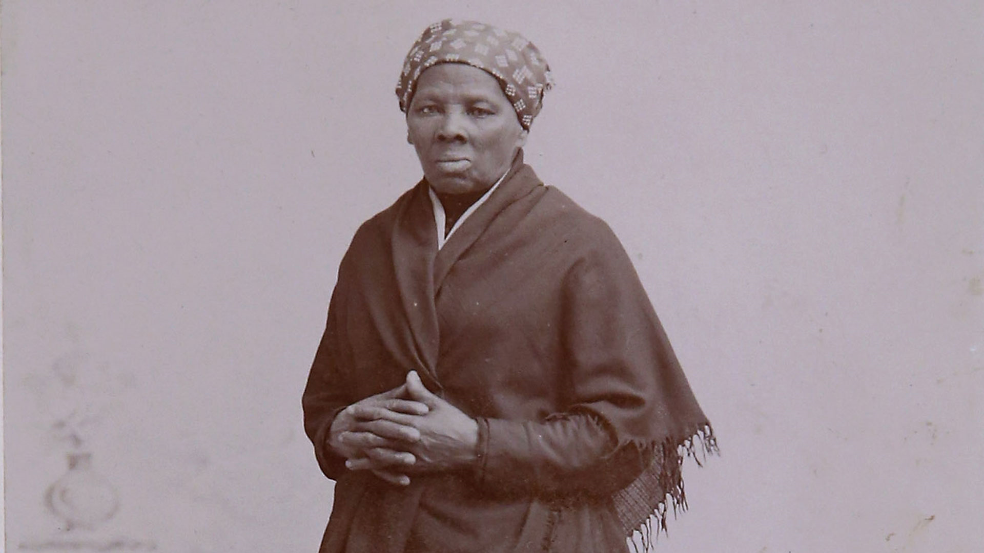
Harriet Tubman
• Originally named Araminta Ross, took her current name when she broke out of a plantation in Maryland with her two brothers in 1849.
• She then went back to get her husband, but he remarried and didn’t want to leave. Later that night, she had a vision from God, telling her she needed to join the conductors in the Underground Railroad to get the other slaves out of Maryland. And she succeeded, leading thousands of slaves to various parts of Canada. Harriet ONLY took them there, not trusting the US to treat them right
Notes:
I think there’s a movie about her coming out this year or the next, don’t quote me on that though.

Slide 8
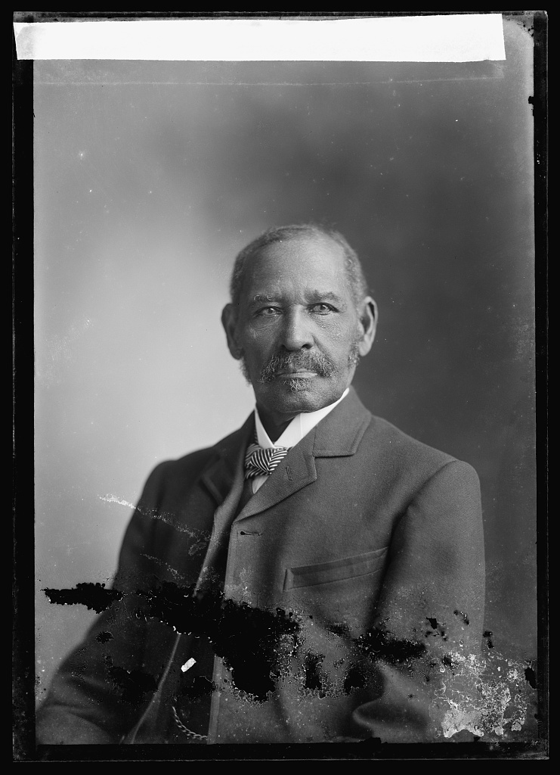
Mifflin Gibbs
• The first black politician in Canada, born in Philadelphia on April 17th, 1823.
• Grew up a free man in a poor family, he didn’t have as much access to education as the common Philadelphian, but with whatever book he managed to get his hands on, he’d read through them all, absolutely adored books. He continued his love for reading with his knowledge in Black literary societies.
• He didn’t have a lot of opportunities in Philly, so he moved to San Francisco. California was a free state for slaves at the time, but the government still treated black people like garbage. So, in 1855, he and hundreds of other black people made a collective agreement to go somewhere else. They received an invitation from Governor James Douglas, allowing them to settle down in Vancouver Island. There was going to be a slew of American immigrants coming through soon (Fraser River gold rush) and the governor needed people who weren’t American to balance things out.

Slide 9
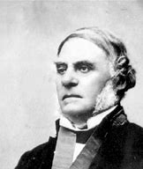
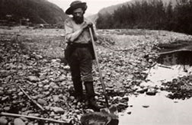
Mifflin Gibbs
• Mifflin easily made money from the real estate market at the time, bought some property for $3000. He made a living selling equipment and nutrition to the miners to the people coming through the goldfields of the Fraser River.
• In 1866, he became the first black person in office after running multiple times. He paid off the debt in the city, supported Confederation when British Columbia was thinking joining the Dominion of Canada, and lead the coal-mining plan in Haida Gwaii (now called the Queen Charlotte Islands).

Slide 10
Questions
• Do you think slavery in Canada is overlooked, compared to slavery in the US?
• Surprisingly, a lot of the slaves did not want to be freed (Quote from Harriet Tubman “I freed thousands. I could’ve freed a thousand more if only they knew they were slaves”) Why is that?
• Why do you think Canada accepted the slaves with open arms with little to no complaining?

