Slide 1
Canadian Identity in the 21st Century
Emma Nicholson

Slide 2
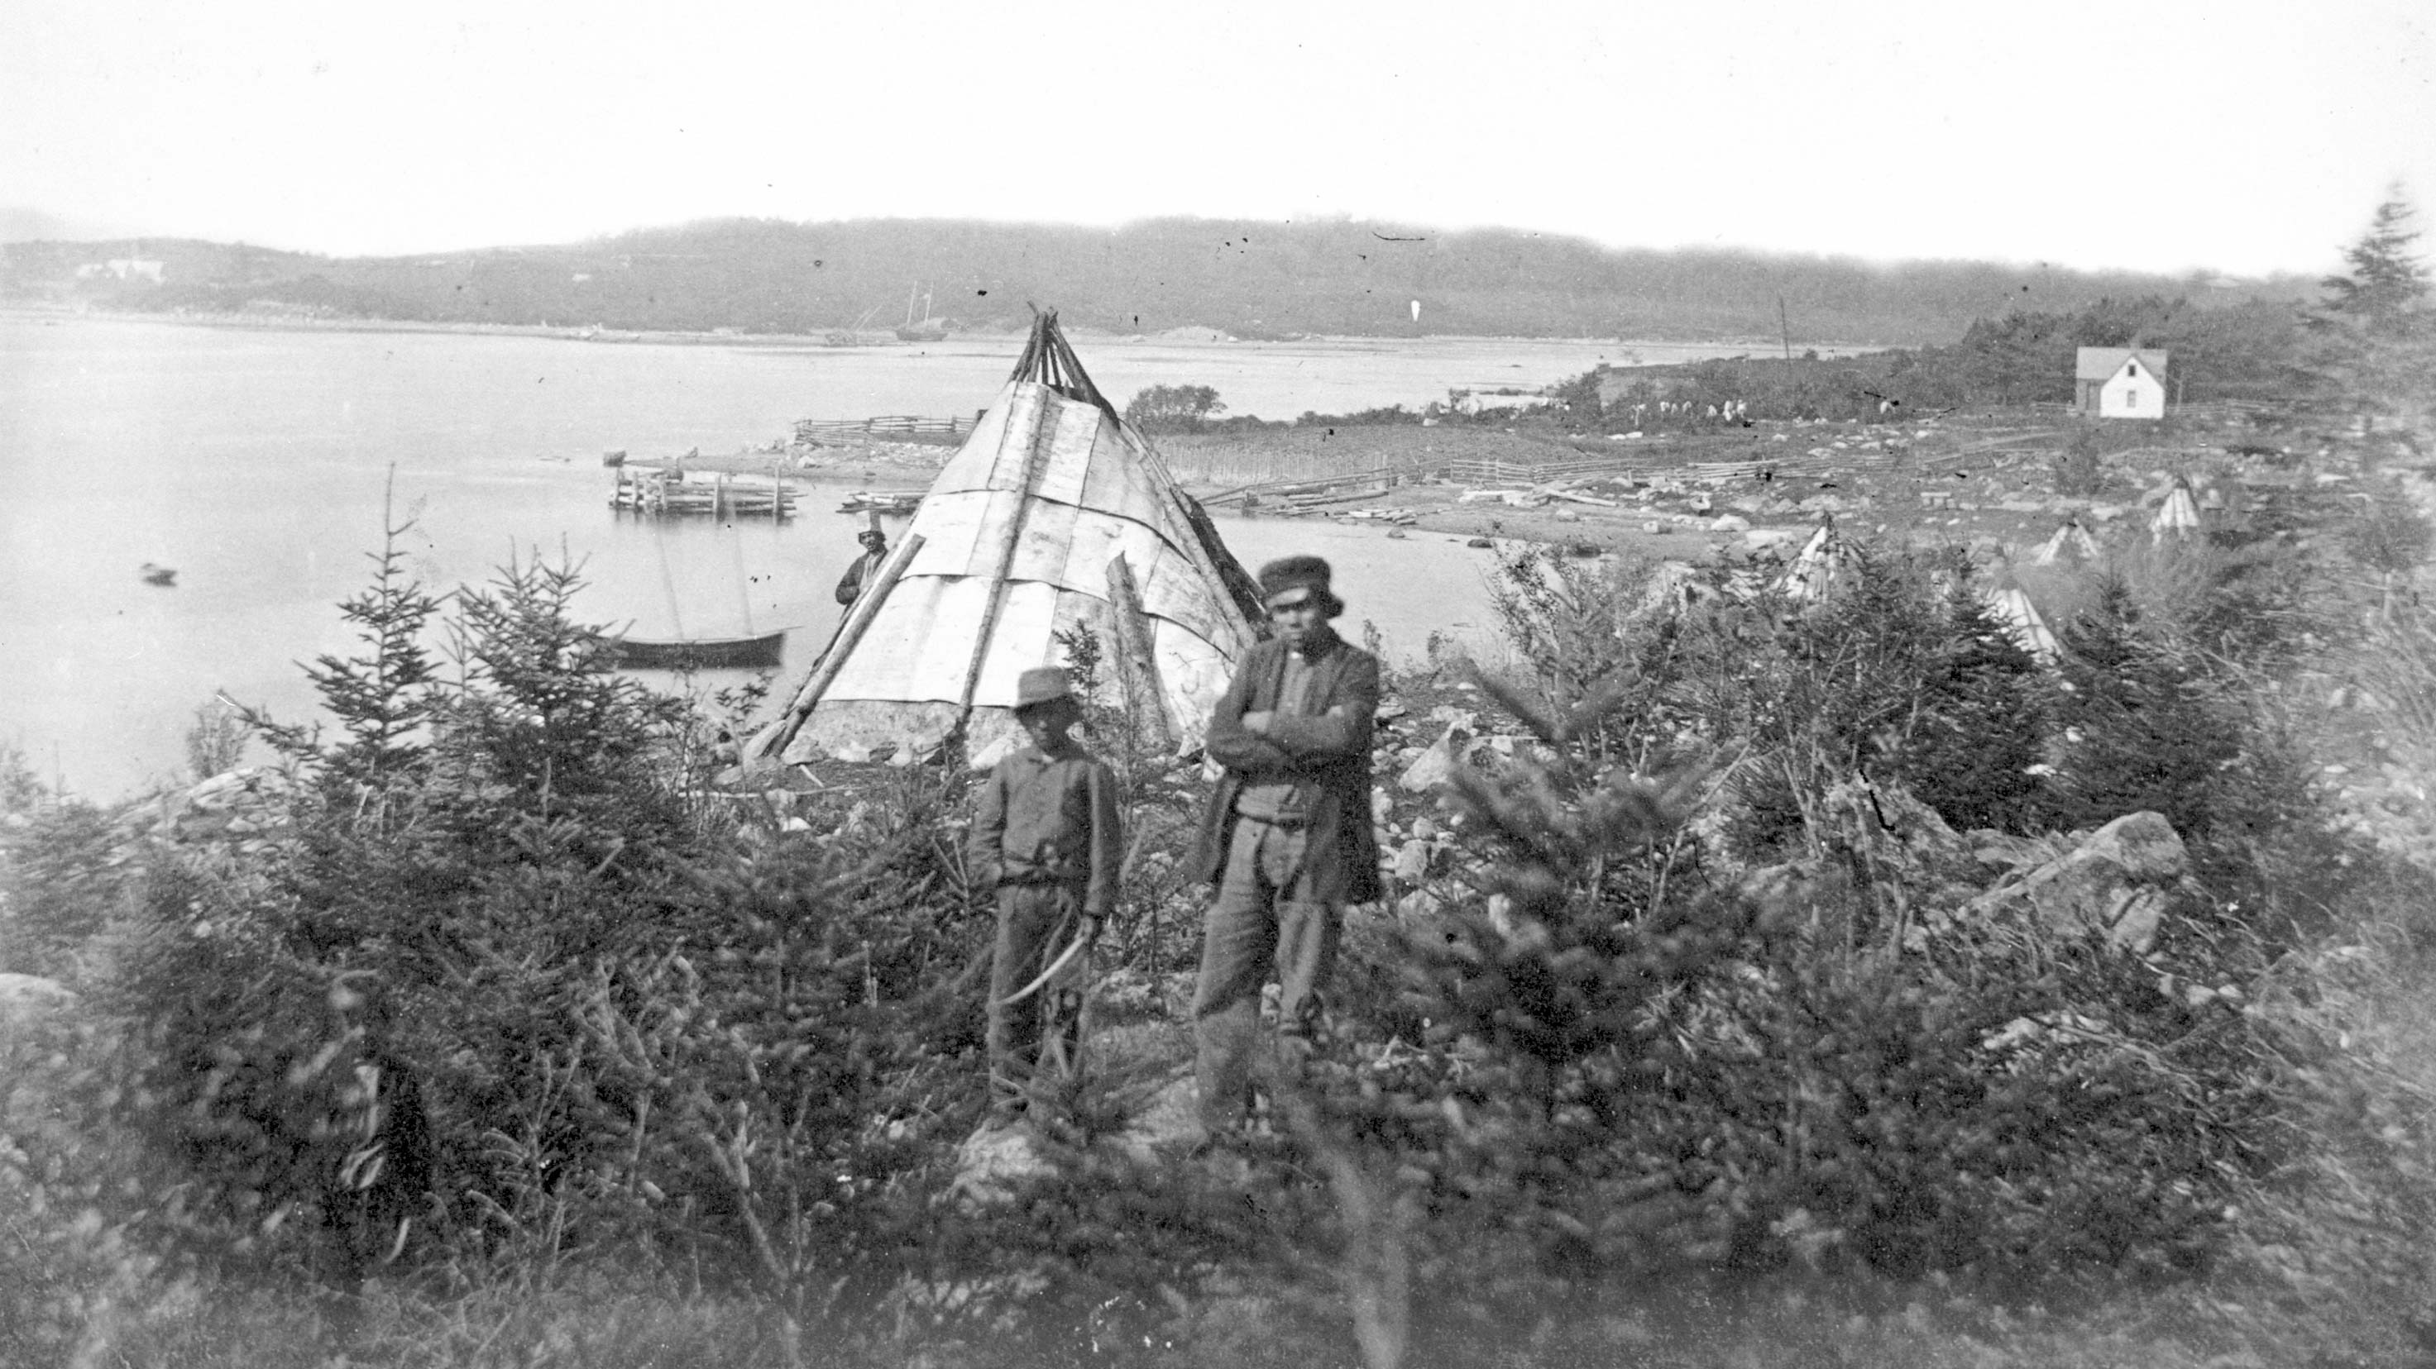
The Early Beginnings of the Canadian Identity

Slide 4
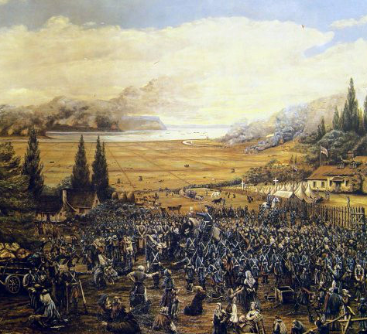
Conflict in Early Identity
Acadian Expulsion (1755-1764)
Indigenous assimilation
French and English conflicts
Canadian and American disputes

Slide 5
Going into the 21st Century

Slide 6
Uncertainty

Slide 7
French Canadians
Official Languages Act (1969)
Quebec separatism

Slide 8
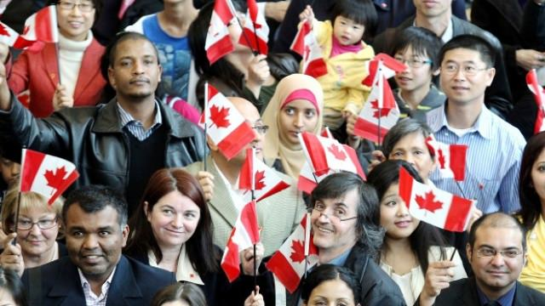
Multiculturalism
Canadian Multiculturalism Act (1988) > Promoting the idea of multiculturalism > Equality rights > Protection of heritage > Protection and preservation of cultures
More than 200 ethnic groups in 2001, more than 250 in 2016
By the 21st Century, more ethnic people in Canada than those of English or French heritage

Slide 9
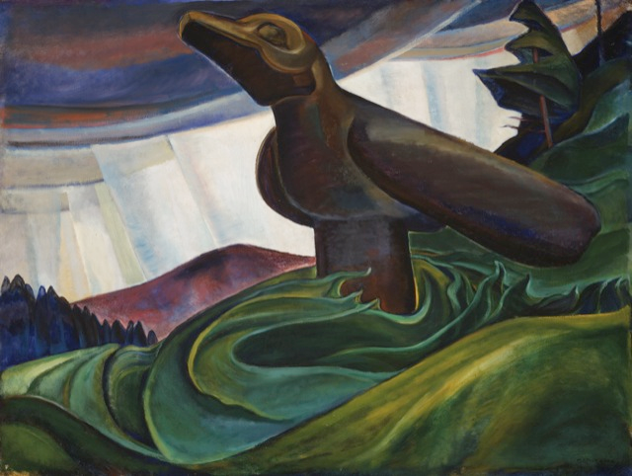
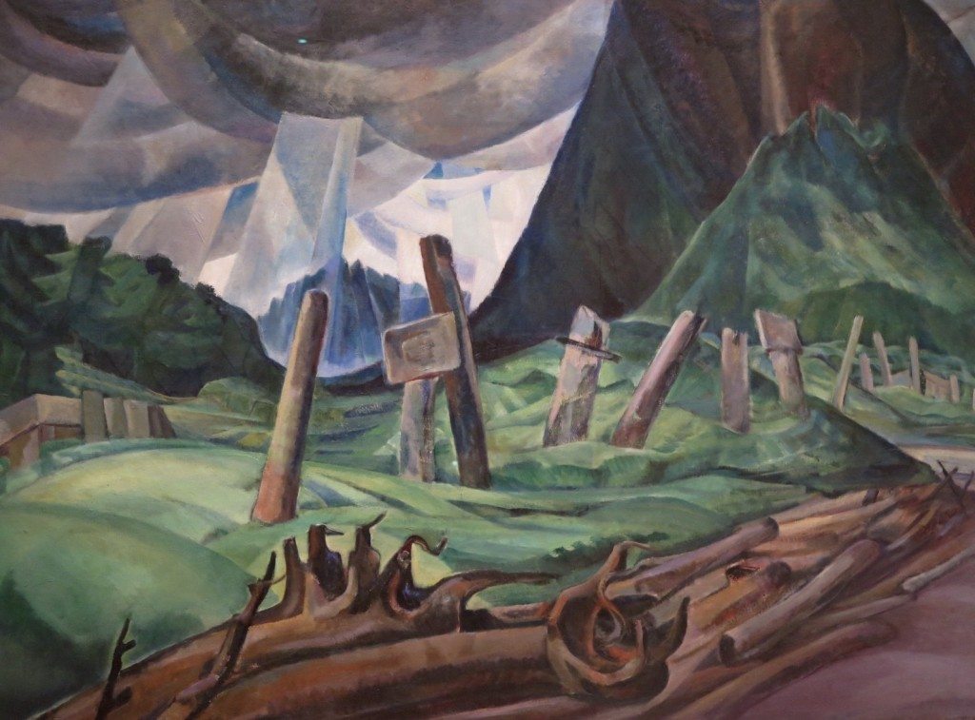
Indigenous People in the 21st Century
1 in 4 Indigenous people live in poverty
Half of Indigenous children living on reserve in poverty

Slide 10
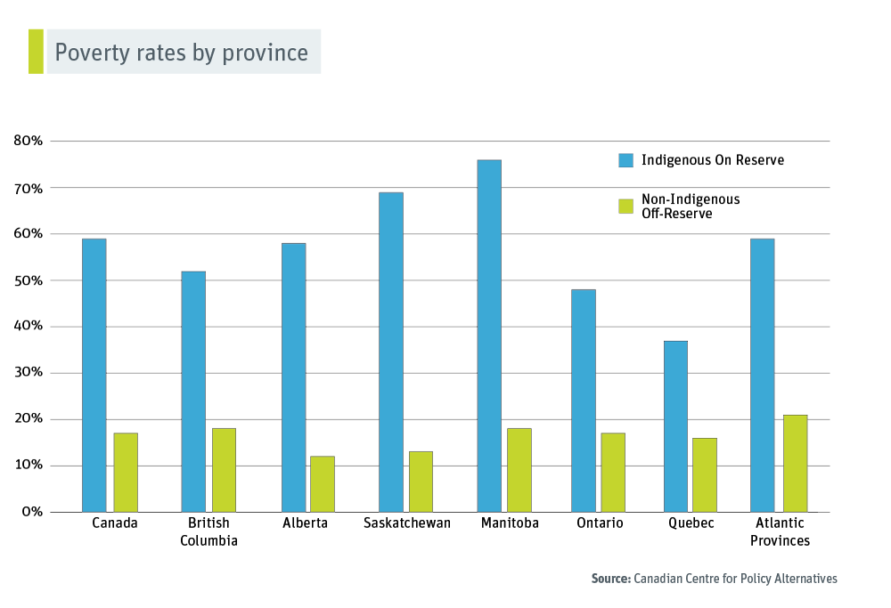

Slide 11
Values
Same-sex marriage
Assisted suicide
Health care
Capital punishment
Cannabis
Gun control

Slide 12
Geography

Slide 13
Outside Perspectives

Slide 15
Is it correct to say that there is no distinct Canadian culture or identity? Why or why not?
Do you think Canada will begin to develop more of an identity as it ages, or will it remain unclear?
Is there a problem in lacking a distinct identity?

Slide 16
References
http://option.canada.pagesperso-orange.fr/geography-identity.htm
https://www.theglobeandmail.com/news/national/canada-150/canadian-expats-what-people-think-of-canada150/article35487638/
https://www.researchgate.net/publication/283311600_Indigenous_Peoples_and_Identity_in_the_21st_Century_Remembering_Reclaiming_and_Regenerating
https://www.culturalsurvival.org/publications/cultural-survival-quarterly/being-indigenous-21st-century
https://www12.statcan.gc.ca/census-recensement/2016/as-sa/98-200-x/2016016/98-200-x2016016-eng.cfm
https://www.thecanadianencyclopedia.ca/en/article/official-languages-act-1969
https://www.cbc.ca/news/canada/how-canada-is-perceived-around-the-world-1.3132343
https://www.thecanadianencyclopedia.ca/en/article/official-languages-act-1969
https://www.international.gc.ca/trade-agreements-accords-commerciaux/topics-domaines/ip-pi/canculture.aspx?lang=en

