Slide 1
Changed Society, Altered Identity
By Kate Carleton

Slide 2
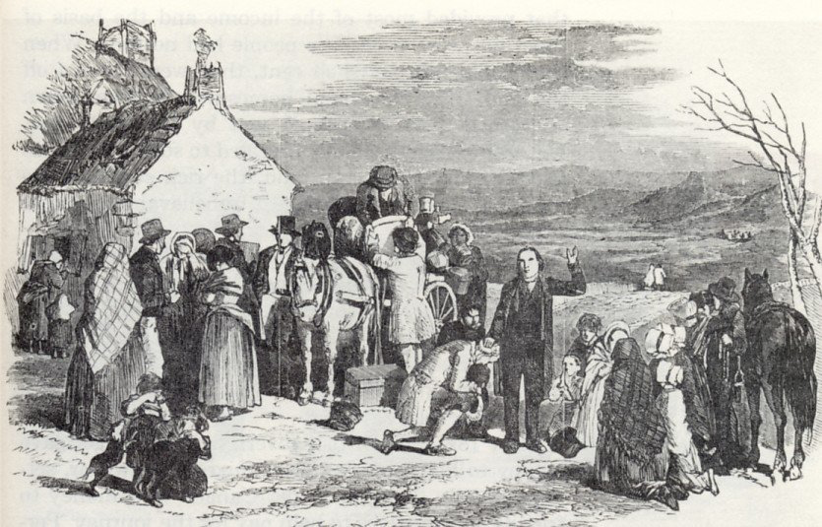
Early Demographics and Censuses
Births and deaths were often registered only at the parish level.
Census takers had to do their work on foot and were not always welcomed by local residents (for fear that being surveyed meant being taxed).
People sometimes just simply lied.
Some similar issues that may present even today.

Slide 3
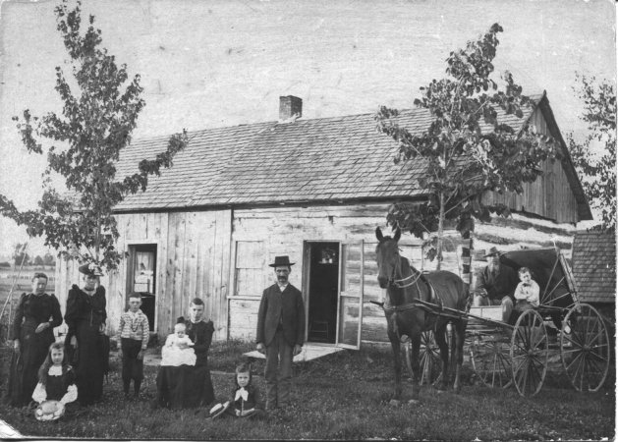
Canadian Society:
Early 1800s
Canadian society was structured in a similar fashion to that of the British
Especially in the sense of social classes and hierarchy.
Different classes were arranged by Upper class, Middle class, and Lower class.
Different levels within those classes.
Differences in social class became more widely felt, especially with the middle class and the upper class.

Slide 4
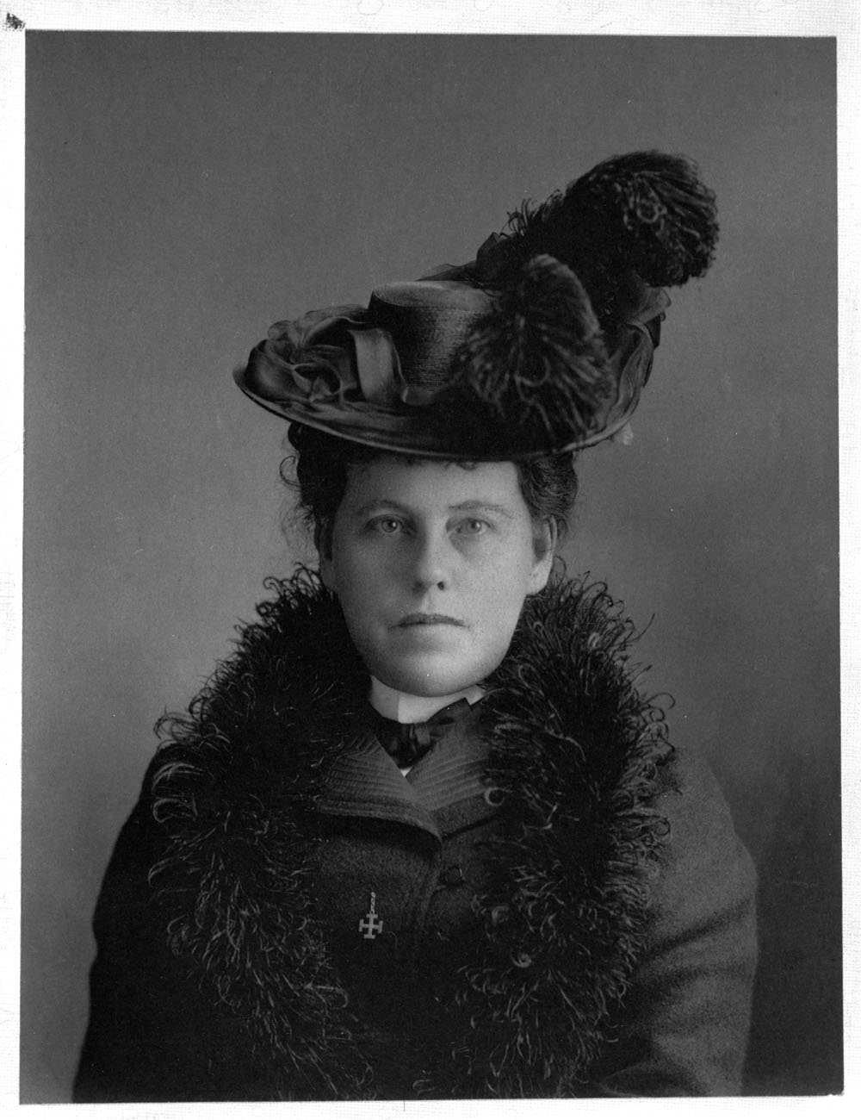
Gender Roles
Patriarchal society, less so in Indigenous communities
It was strongly believed during the 19th century that women and men lived in different worlds.
A woman's place was in the home.
Also believed that a woman's job was to create a calm and welcoming home environment as an escape from the cold world.
Though many women were working hard on being taken seriously in the farming world.

Slide 5
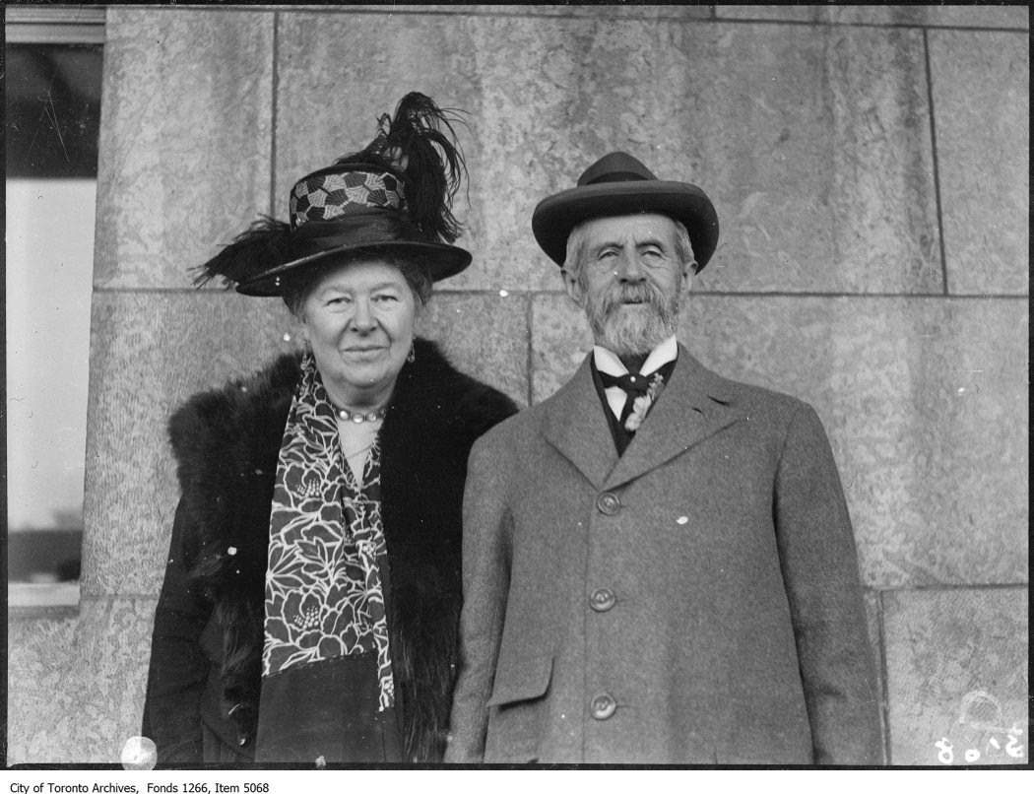
Gender Roles
The roles of men and boys were equally gendered.
The ideal man was seen as one who believes that hard work and ambition he would be rewarded with wealth and success.

Slide 6
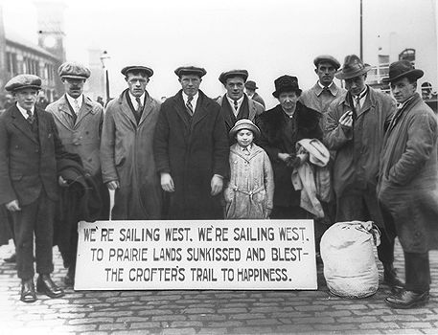
Immigration
In many respects the Irish were Canada's first enormous wave of foreign immigrants
Ireland made the largest waves of emigration of any European country during the 19th century.
This can directly be associated with the Irish Potato Famine during the 1840s.
A great deal of the 19th century immigrants were refugees from poverty, famine, and the lack of owning land.

Slide 8
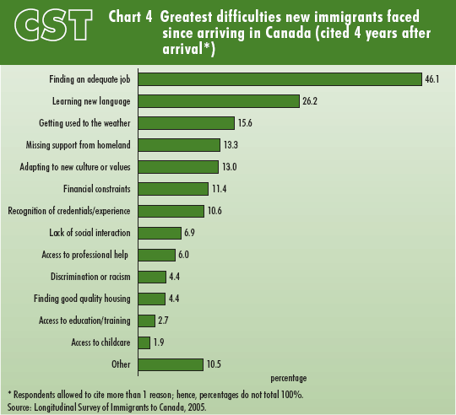
Source: Statistics Canada

Slide 9
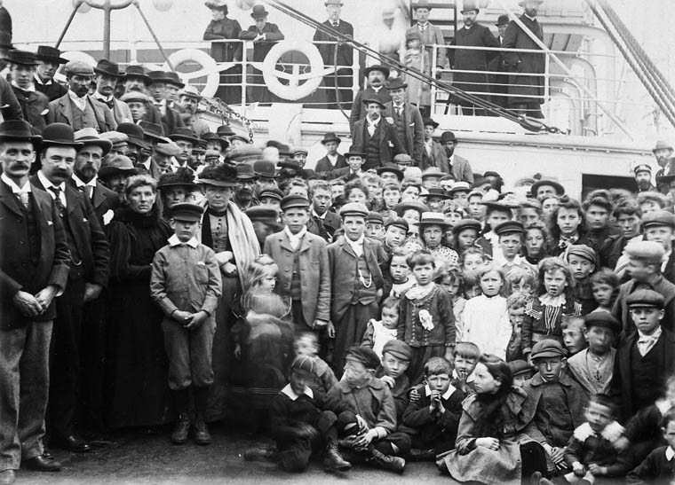
Immigrants in Canadian Society
Conditions for immigrants were typically poor and worsened by the epidemic diseases, such as Cholera.
Although the Irish generally spoke English, they did not share the social, cultural or religious values of the majority in Canada.
Living and hygiene conditions were poor, but it was like that for most of the population.
All of these issues combined would create generations of poverty for immigrants.

Slide 10
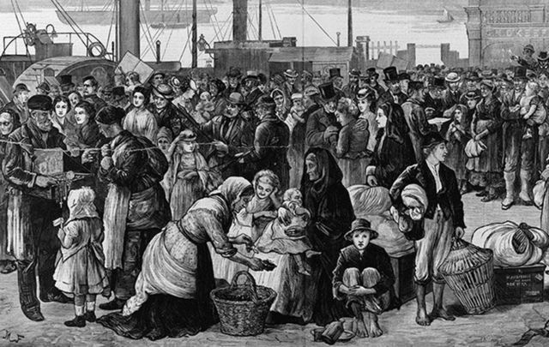
Grosse-Île and Cholera Epidemics
During the 1820s, cholera morbus spread from India, through russia, and eventually to Irish sea ports.
Grosse-Ile was the port where ships were i inspected.
Despite 42 people dying from cholera, the first ship was cleared was clear for entry in Quebec.
Health clearances stopped

Slide 11
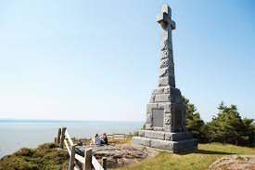
Grosse-Ile and Cholera Epidemics
In 1832, more than 4500 people died in Lower Canada.
Almost 2000 people died in Montreal alone
Around 1500 in Upper Canada died, 800 n the city of York.
Total number of Irish immigrants who died at Grosse-Ile is unknown.

Slide 12
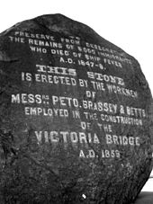
Grosse-Ile
100,000 Irish immigrants waited to come to North America.
In 1847, the first “coffin ship” arrived.
9 people died, 84 put in hospital on Grosse-Ile.
Many more ships followed and more people were ill and detained.
Hospitals became too full, workers overwhelmed.
20,000 to 30,000 people died.
Many victims lie in unmarked graves.

Slide 13
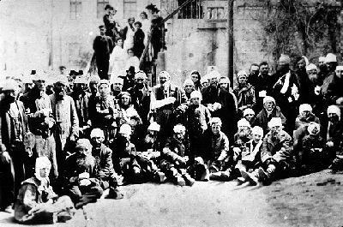
Division in Race & Religion
Irish immigrants were viewed by established settlers as competing for jobs, compromised by cholera, heavily addicted to alcohol, inclined to brawling, etc.
Nativists would purposely cause panic about new immigrants, most of whom were unskilled and badly connected to the local society.
Canadiens often found themselves at the sharp end of prejudice in English Canada.
British law forbade Jewish people to enter political life unless they took an oath to the Christian god.

Slide 14
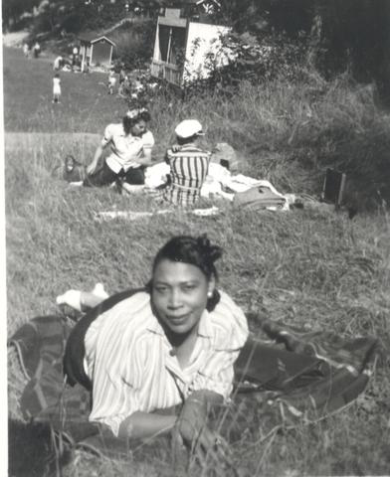
Racism
Scientific racism became popular (Race Biology)
Postulated measurable differences in intelligence, barbarity, and morality.
Argued that the more numerous and less valuable “races” needed managing by superior peoples.
The diversity of the immigrant community continued to expand through the 19th century provoking further instances of systemic and formalized racism.

Slide 15
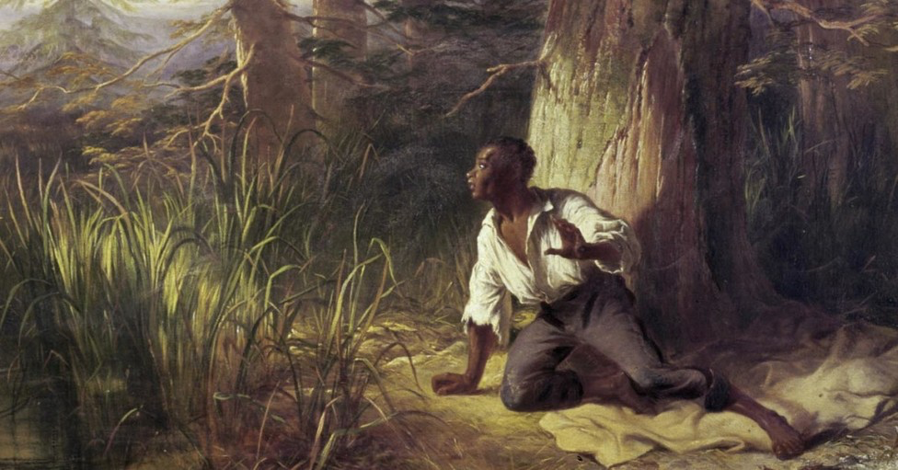
The Underground Railroad
The road to freedom for escaped African American slaves.
More than 30,000 people used the trail to escape.
Created by those who had a hatred of slavery and craved freedom.
Harriet Tubman led over 2,000 slaves to freedom.
A bounty of $40,000 was then placed on her head by American authorities.
The Underground railroad created routes into Upper Canada.
Many former slaves settled in Lake Erie, Windsor, Amherstburg, Toronto, etc.

Slide 16
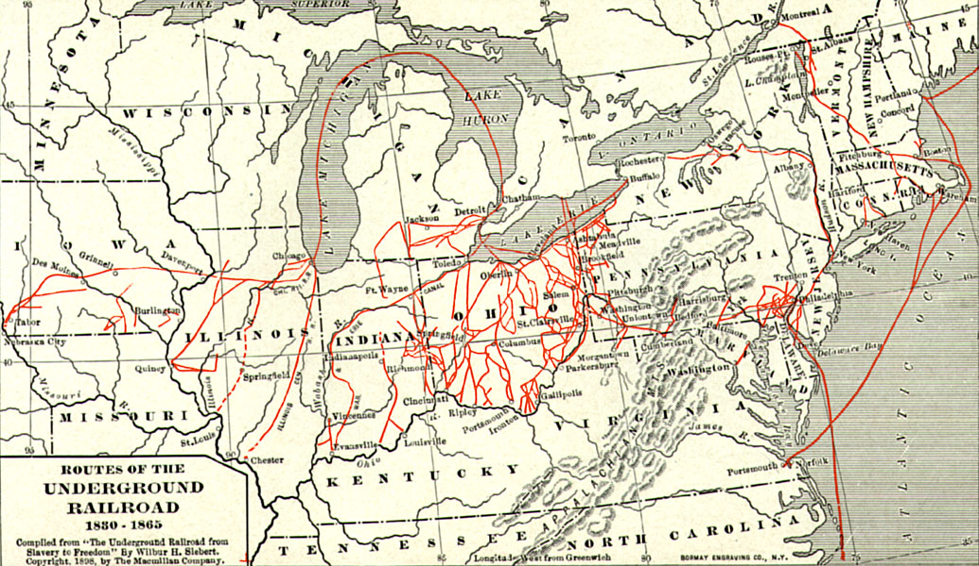

Slide 18
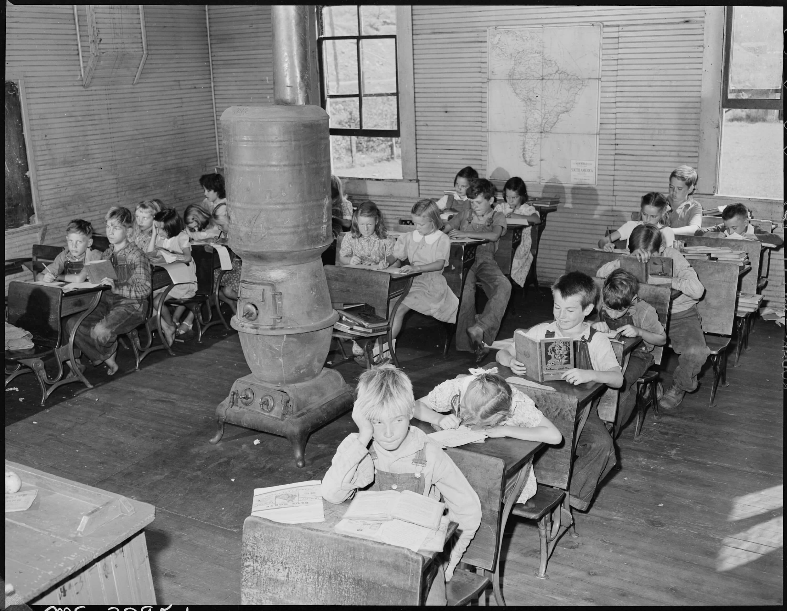
Education
Protestant and Catholic Churches had control over education in Atlantic colonies.
Private schools for Upper class.
Sunday school was the main educational forum.
Most people did not want a public system.
Mount Allison, StFX, Acadia, and St. Marys were all founded between 1838 and 1855, all religious.
Upper Canadians thought that schools should be controlled by governments.

Slide 19
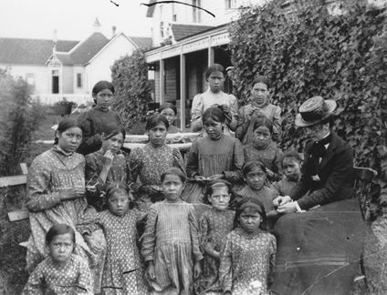
Aboriginal Peoples
Number of Aboriginal peoples was noticeably decreasing.
British believed that they should either be moved into reserves or assimilate into Canadian colonies.
The estimated number of Indigenous peoples in settled in Upper and Lower Canada were roughly 18,000.
Reserves were established to civilize Aboriginal peoples.
The British taught them how to take care of the land.

Slide 20
Discussion
What connections can we make to the social structures during 1800s Canada and the ones we still have today? Do we have similar mindsets?
In what ways do you think that the concept of Nativism is still prevalent in modern day canada?
Do we still see a divide between immigrants in Canada and Canadians when it comes to forming relationships or sharing culture?

Slide 21
References
https://www150.statcan.gc.ca/n1/pub/98-187-x/4064809-eng.htm#part1
https://www.youtube.com/watch?v=cX02bJ1pyw4
https://www.youtube.com/watch?v=HrtDgSntUXg
https://www150.statcan.gc.ca/n1/pub/11-008-x/2007000/c-g/4097864-eng.htm
https://www.thecanadianencyclopedia.ca/en/article/immigration#ImmigrationandRacism
https://www.irishcentral.com/uploads/article/64311/cropped_Famine-Irish-canada-Grosse-ile-and-the-Irish-Memorial-National-Historic-Site.jpg?t=1559329124
http://www.bytown.net
http://www.uppercanadahistory.ca/tt/tt1.html

Slide 22
More References
https://www.thecanadianencyclopedia.ca/en/article/scots
https://en.wikipedia.org/wiki/Grosse_Isle
https://canadac3.ca/en/expedition/the-places/grosse-ile-and-the-irish-memorial/
https://www.thecanadianencyclopedia.ca/en/article/jewish-canadians
https://en.wikipedia.org/wiki/Underground_Railroad
https://www.wearelatinlive.com/article/12949/underground-railroad-to-mexico-us-slaves-escaped-to-freedom-south-of-the-border
https://opentextbc.ca/preconfederation/

