Slide 1
Changing Times
Economics, Industrialism, and Urbanization
1869-1909

Slide 2
It is we who plowed the prairies; built the cities where they trade;
-International Workers of the World Labour Song

Slide 3
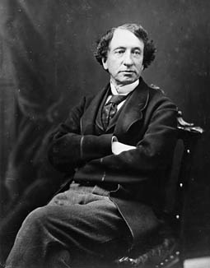
From Sea to Sea
After the Pacific Scandal, which led to John A. Macdonald resigning on the grounds of unethical behaviour, the Canadian political landscape was wide open.
Liberal Alexander Mackenzie becomes the 2nd Prime Minister after he mops the floor with the Tories in the 1873 election.
Notes:
The Pacific Scandal (1872–73) was the first major political scandal in Canada after Confederation. In April 1873, Prime Minister Sir John A. Macdonald and senior members of his Conservative government were accused of accepting election funds from shipping magnate Sir Hugh Allan in exchange for the contract to build the transcontinental Canadian Pacific Railway.
Tories = Conservative Party

Slide 4
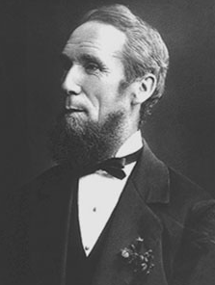
“Honest Sandy”
“Honest Sandy” Mackenzie, was a sincere, hardworking man who ushered in several important institutions:
The Secret Ballot
The Supreme Court of Canada
The office of the Auditor General
Notes:
Supreme Court of Canada intro was already happening b/c of John A Macdonald but Mackenzie pushed it through.
The Office of the AG was an independent body set up to investigate govt spending.

Slide 5
“Pay As You Go”
While Alexander Mackenzie was a much respected PM he legacy was tarnished as the transcontinental railway plan fell apart and he opted for a “pay as you go” approach. BC was furious as this railroad would connect them with the rest of Canada.
Pro-Confederation MP, Amor de Cosmos, called for BC to leave the Confederation; Canada now faces a second separatist movement in less than 10 years.
Notes:
In 1871, British Columbia was lured into Confederation with the promise of a transcontinental railway within 10 years. The proposed line — 1,600 km longer than the first US transcontinental — represented an enormous expenditure for a nation of only three and a half million people.
Not only did Mackenzie have to deal with the railroad issue but he also became PM just as a worldwide economic slump hit, he pursued a free trade deal with the US but nothing came of it.

Slide 6
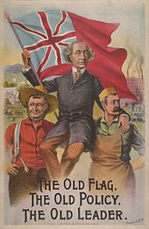
The National Policy… and the Rebirth of John A Macdonald
In the midst of the global recession Macdonald led his party back into power with a protectionist system of internal trade and a high “tariff wall” to keep out American imports. This policy would be expanding to include:
Protective Tariffs – higher taxes charged on imports
A transcontinental railway along an all-Canadian route
Increased immigration and western settlement
Notes:
Mackenzie attempted to promote free trade but Canadian Manufacturer felt that Canada couldn’t compete.
Prime Minister Alexander Mackenzie's Liberals, in office from 1873-78, had previously adhered to a policy of tariffs strictly for revenue purposes — around 20 per cent of customs duties on manufactured goods. They'd remained faithful to this non-protectionist policy, despite the economic depression of the 1870s and the failure of the Liberals' 1874-75 attempt to negotiate a reciprocity or free trade agreement with the United States.

Slide 7
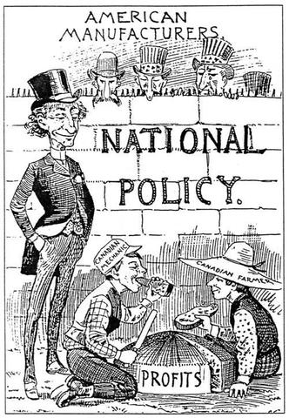
The National Policy
The National Policy was some-what successful as Canada did experience immigration but they also faced a net loss of immigrants.
Tariffs did protect Canadian Industry but ultimately resulted in an increase to the cost of living.
The most ambitious aspect of the policy would solidify Macdonald into Canadian history was the completion of the transcontinental railway.
Notes:
This tariff system was largely the work of NB’s Leonard TiIlley, formerly the Premier of NB and now Macdonald’s minister of Finance.
Over time the National Policy took on a broader meaning in Conservative Party rhetoric, which tended to equate the Policy with its larger development strategies: the Canadian Pacific Railway (1880s); western settlement, including the Dominon Lands Act of 1872 and immigration policy; harbour development; and the subsidization of fast steamship service to Europe and Asia to facilitate the export of Canadian products. The Policy, and its many parts, became the centrepiece of Conservative Party policy for decades, even being espoused by Prime Minister R.B. Bennett in the 1930s as fervently as it was by Macdonald in the 1880s.

Slide 8
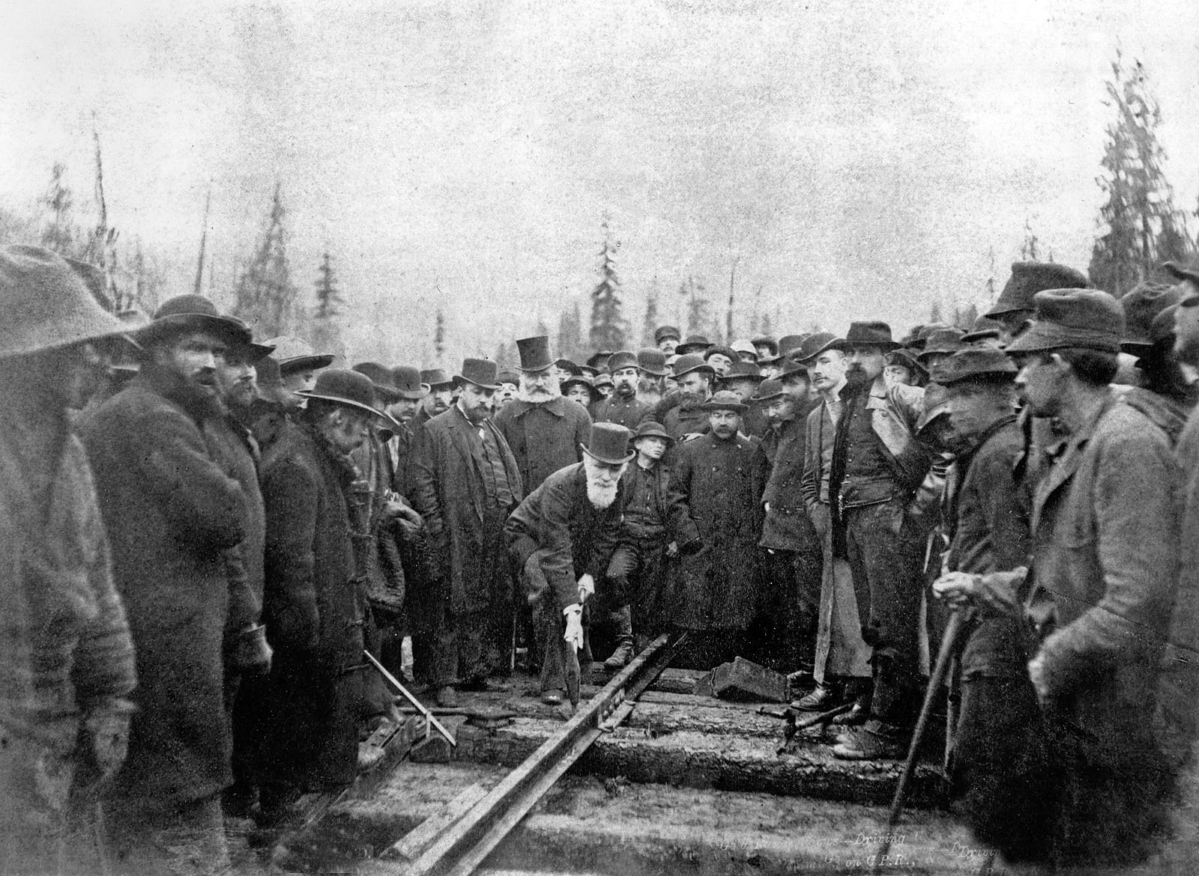
Notes:
The last, last spike of the Canadian Pacific Railway, Craigellachie, British Columbia, November 7, 1885

Slide 9
National Policy Regional Problems
Central Canada benefited greatly from this policy as investments in industry and a growing population.
The Maritimes suffered a severe economic downturn as they relied heavily on trade with the US and Britain. The Maritime region also did not receive much investment in industry and couldn’t adjust from the prosperous days of “wind, water, and wood”.
The geographic distance from larger populations also made it challenging to make a profit off sales of products and resources.

Slide 10
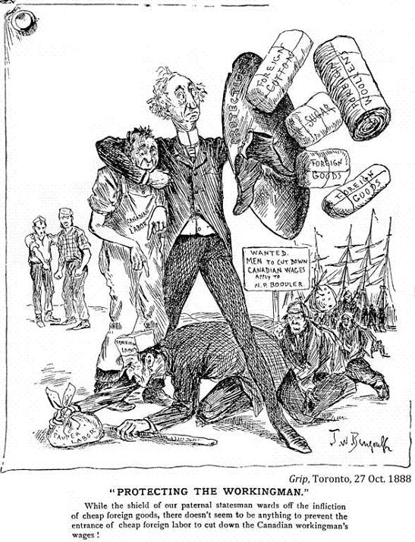

Slide 11
Western Canada
Western Canada also struggled. They too were far from larger populations found in central Canada and had very little political influence.
Population growth in the west was also stagnant as the population only grew to about 250,000 people.
Land in the Western US was available for favorable terms and appeared more attractive to immigrants.

Slide 12
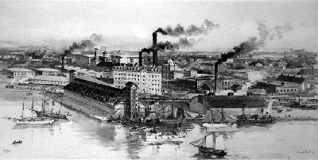
Radical Shift in Production
The Industrial Revolution (1760-1840) brought a fundamental reorganization of the nature of work. Previously, people produced hand-made products in their homes within a rural environment, but the introduction of machinery changed where and how people worked.

Slide 13
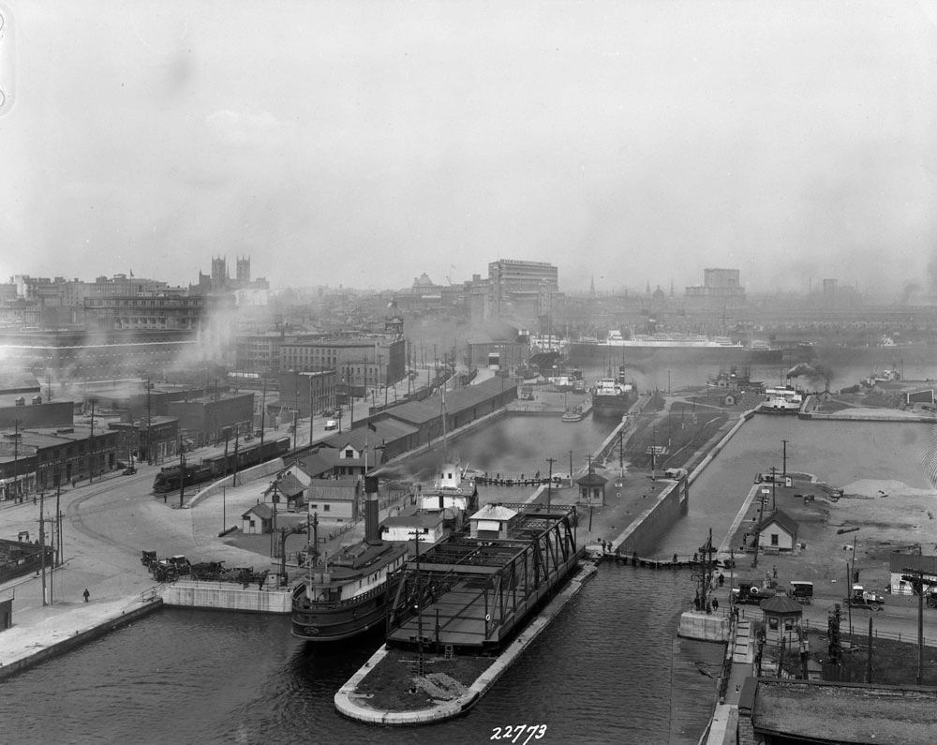
Factories could produce newer, cheaper products and provide thousands of jobs, but work conditions were rough. This was because factory owners wanted to acquire vast fortunes in the shortest interval of time, so they demanded a lot of work for low wages while under unhealthy working conditions.

Slide 14
Rise of Labour
Previously, the 1833 British Combination Act didn’t allow workers to discuss improving their work conditions or to form unions.
The Trade Union Act passed in 1872 legalized unions, even though the Prime Minister hardly supported them.
The Factory Act passed in 1884 prohibited boys under twelve and girls under fourteen to work in factories. It was a step in the right direction, but was poorly enforced.
Labour Day was made a federal holiday in 1894 to honour the contributions of all the working people.
Notes:
Labour Day, the first Monday in September, has been a statutory holiday in Canada since 1894. It originated in the first workers’ rallies of the Victorian era.
Labour organizations began to hold celebrations more frequently following a labour convention in New York in September 1882. Spurred on by this initial success, the American Federation of Labor and the Knights of Labor actively promoted workers’ celebrations on the first Monday in September in the United States. The Canadian chapters of these organizations did the same. Records show similar gatherings in Toronto (1882); Hamilton and Oshawa (1883); Montreal (1886); St. Catharines (1887); Halifax (1888); Ottawa and Vancouver (1890); and London (1892).
In Ontario, the paths toward improved workplace health and safety began in 1884 when the Ontario Factories Act was passed, establishing a system of inspections. In 1886, the Ontario Workman's Compensation for Injuries Act became the first workers' compensation legislation in Canada. It established the conditions under which a worker could take legal action against an employer for injuries sustained at the workplace.
The Royal Commission on the Relations of Labour and Capital reported in 1889 that many workers were being hurt on the job and condemned the state of working conditions in several industries. The commission made a number of recommendations but the federal government did not act on them, saying it was provincial responsibility. The federal government did pass the Public Works Health Act of Canada in 1899, however, regulating the supervision of health and safety of federal Public Works employees.

Slide 15
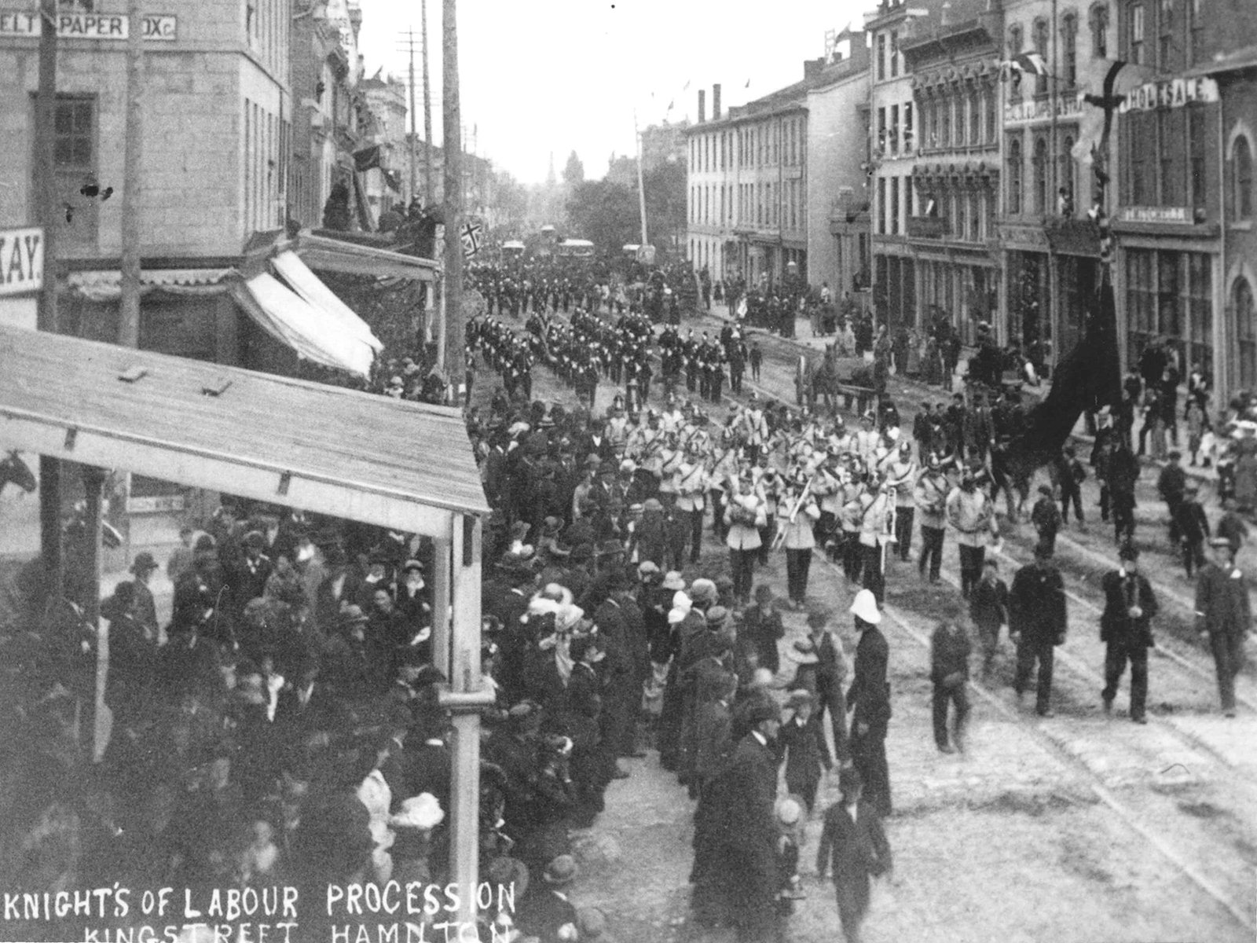
Notes:
In the mid-1880s, you might have come here to do your shopping. The Noble and Holy Order of the Knights of Labor ran its Co-operative Grocery and Provision Store here. The leaders of the Knights were firm believers in co-operation, rather than competition. In 1884, they acted on their principles and opened a co-op grocery.
One of their first managers was a young metalworker who had been blacklisted in a recent stovemounters’ strike. His name was Allan Studholme, future labour representative in the Ontario government.

Slide 16
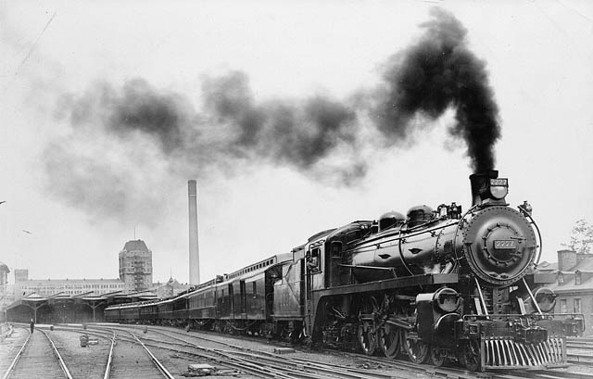
Changing “Times”
The introduction of the railway not only limited the influence of canals, it also demanded a new standard system of time.
Previously, while travelling on the railway, people would move their watches ahead a minute after every twelve miles (20 km) travelled west. This system was clearly very impractical and unworkable.

Slide 17
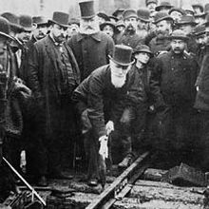
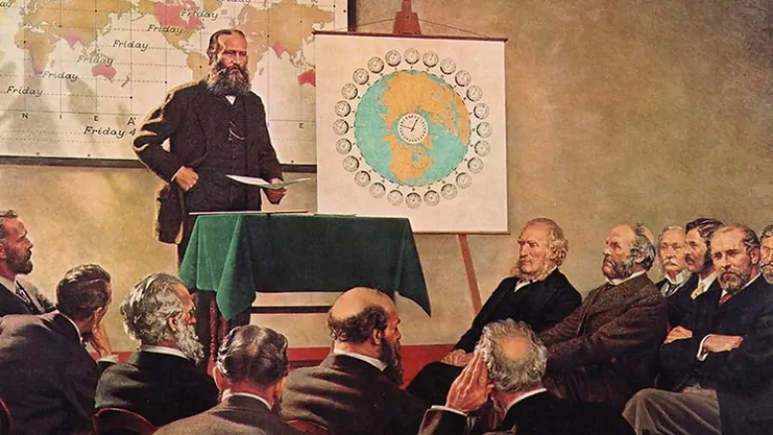
Sandford Fleming
Sir Sandford Fleming, a Scottish-born chief engineer of the CPR construction, found the solution to this, deeming him “the Father of Standard Time”.
He divided the earth into 24 equal time zones with one hour between each contiguous time zone. This concept was first introduced in 1879 and wasn’t put into effect until the beginning of 1885.

Slide 18
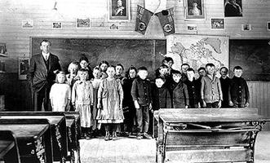
Culture
Education: By the 1870’s, school became a daily thing for most children. An 1871 Ontario law made it mandatory for all kids 7-12 to attend school four months a year. By 1905, all provinces except Quebec had free education.
The purpose of many early schools, especially in Western Canada, was to assimilate immigrant children to life in Canada.
Notes:
Changing parental strategies help explain why children were sent to school in increasing numbers and for longer periods during the course of the 19th century. The development of agrarian, merchant and industrial capitalism heightened perceptions of economic insecurity. Everyone became aware that while great fortunes could be made, they could also be lost just as quickly. The obvious insecurity of even well-paying jobs or successful businesses came to loom increasingly large in the minds of parents planning for their children. One response was to have fewer children and to invest more in their education.
Some resistance to schooling did develop, particularly from those reluctant to pay extra taxes, from those who did not approve of the local teacher, and from those who wished to maintain the connection between formal religious instruction and mass schooling. In cities, truant officers rounded up children (particularly from working-class and immigrant backgrounds) and sent them to residential "industrial" schools.

Slide 19
Culture
Literature: Canadian writing and poetry began to develop it’s own distinctive style. One author in particular, Thomas Haliburton, came up with phrases such as “the early bird gets the worm” and “it’s raining cats and dogs.”
Visual Art: It was painters who took the lead in promoting a sense of Canadian identity. The first pieces were still based on natural landscapes. As more artists gained confidence through studying in Paris, they attempted human form.

Slide 20
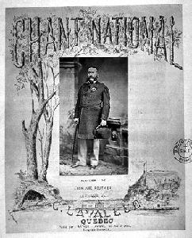
Culture
Music: Musical life was raised through both individual achievements and organized efforts. Calixa Lavallee composed the music for “O Canada”. The turn of the century also saw 1000-2000 seat opera houses and theatres. Domestic theatre—both writing and performing—was slowly beginning to establish itself.
Notes:
By 1880, “God Save the King” and “The Maple Leaf For Ever” were popular patriotic songs and de facto national anthems in English Canada, but a national song had long been desired by French Canadians. By the mid-19th century, several compositions had been made. One of the first, “Sol canadien, terre chérie,” with words written in 1829 by Isidore Bédard and music by Theodore Molt, was short-lived. “Ô Canada! mon pays! mes amours!” was composed by Sir George-Étienne Cartier, with music by J.-B. Labelle, for the founding of the St-Jean-Baptiste Society in 1834. Other songs, such as “La Huronne” by Célestin Lavigueur and “Le Drapeau de Carillon” by Octave Crémazie and Charles W. Sabatier, enjoyed some popularity.
However, none of these songs had connected sufficiently with the general populace. In Chansons populaires du Canada (1865), Ernest Gagnon wrote of “ Vive la Canadienne” that “the melody of this song and that of Claire Fontaine take the place of a national anthem until something better comes along.” In 1878, the St-Jean-Baptiste Society of Montréal officially adopted “À la claire fontaine” as a national song.
Quebec lieutenant-governor Theodore Robitaille appeared in the cover the the first edition of the words and music to “O Canada”

Slide 21
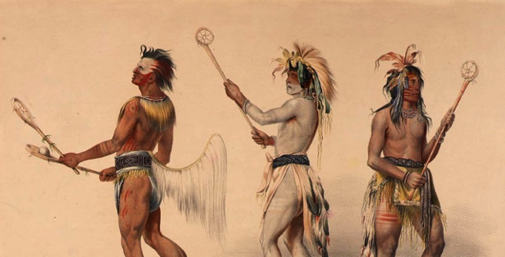
Sports: Sports grew in popularity in the later years of the nineteenth century. Most were imported except hockey and lacrosse. Lacrosse was originally an Aboriginal sport called “Baggataway” which was played by entire villages. Hockey developed largely as a rural participant sport. Once it gained popularity, it would become recognized as Canada’s national sport.
Notes:
Considered the original game, baggataway (also called tewaarathon) was known as 'The Creator's Game'. First Nations people believe the game was given to them by the Creator to play for his amusement. It was a recreational sport that also was used as a means of training young warriors for battle. The game also settled disputes between feuding tribes.
According to some sources, when French colonists arrived in Canada during the 17th century, they saw Mohawk playing baggataway. They adopted the game themselves and renamed it la crosse.

Slide 22
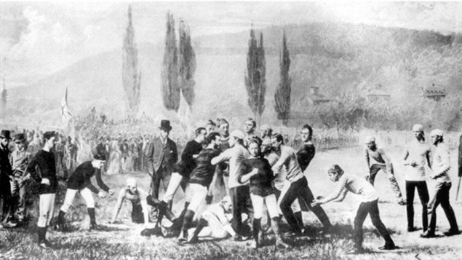
Football: McGill vs Harvard, 1874
Notes:
In the latter part of the 1800’s both the US and Canadian universities were playing a soccer-like rugby brought over from England. However the sport had evolved somewhat in the new world, and also evolved rather differently in the two countries.
In 1874, the American Harvard University team was seeking to play against another university team and invited McGill University in Montreal to play against them. However, by this time the American and Canadian versions of rugby-football were substantially different.
On May 13 and 14, in 1874 two games were played in the US. The first was played using Harvard’s rules, which was a game more like soccer and using a round ball, the second was played using McGill rules, with an oblong ball.
They Harvard team liked the Canadian innovations to the game such as running with the ball, downs, forward passing, goal posts for a try, or touchdown, and tackling. They adopted the Canadian rules and they then introduced them into a match with Yale the following year.
American sources tend to cite this all US game as the start of American football, ignoring the fact that Canada was the source of the Harvard game.

Slide 23
Questions
Was the National Policy really “national”? Was it fair to east and west Canada? What would you have changed?
Do you think the previous system of time was very conventional?
Did the railway have more of an impact on Canada’s economy or its society? Explain.

