Slide 1
Cold War Canada
And the rest of the World

Slide 2
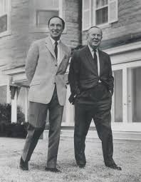
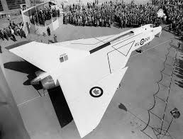
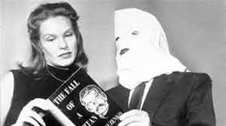
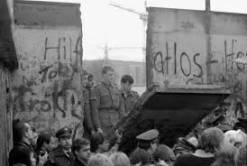
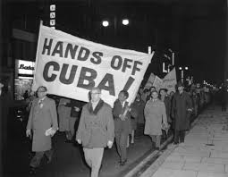
Table of Contents
Igor Gouzenko Affair
Kellock-Taschereau Commission
Security Panel
Marshall Plan
Hal Banks
Korean War
Suez Canal Crisis
Padlock Law
RCMP
Radar Lines
Diefenbunker
Internment
Cuban Missile Crisis
NORAD
AV-roe Arrow
Allan Memorial Institute
Vietnam War
American Draft Deserters
Operation Feather Bed
Cruise Missile
Squamish Five

Slide 3
Democratic and Communist Countries
During the early Cold War

Slide 4
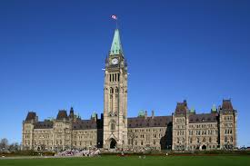
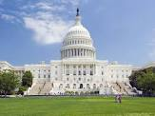
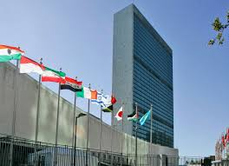
Democratic
Canada
United States
United Kingdom
France
Italy
Belgium

Slide 5
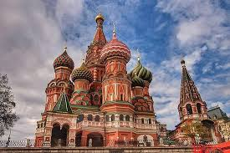
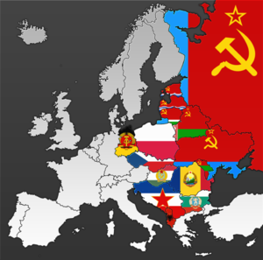
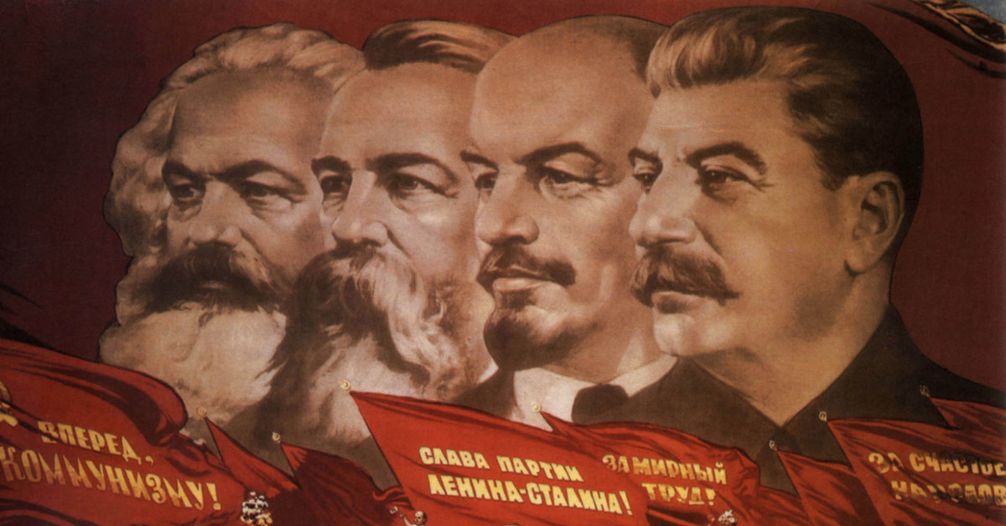
Communist
Union of Soviet Socialist Republics
Albania
Bulgaria
Czechoslovakia
The German Democratic Republic (East Germany)
Hungary
Poland
Romania

Slide 6
Cold war information
For Basic Understanding

Slide 7
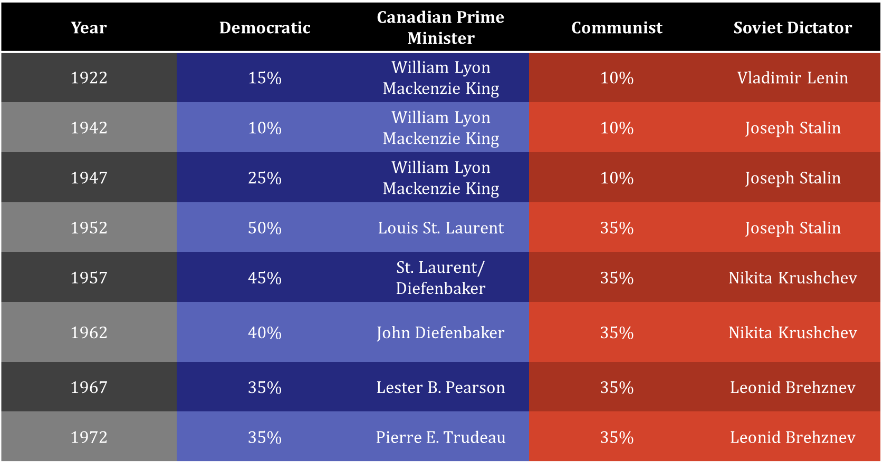

Slide 8
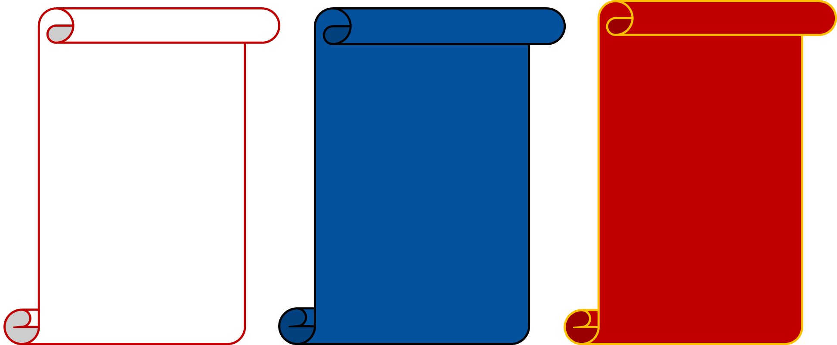
Intentions
Ensure the security of the Soviet Union
Spread communist ideologies throughout the world
Form a Soviet Empire
Maintain structure in matters surrounding internal affairs
Subtly detain any sympathizers
Assist in the foreign peacekeeping across the globe
Isolate the Soviet Union from spreading communist ideologies
Encourage democracy
Promote open markets to prevent another depression
CA
USA
USSR

Slide 9
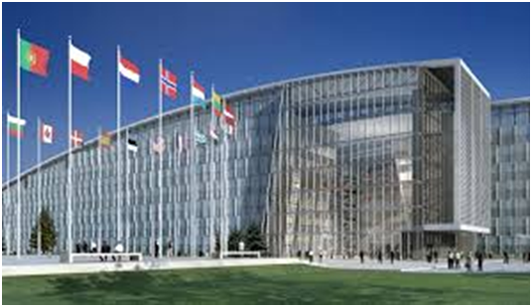
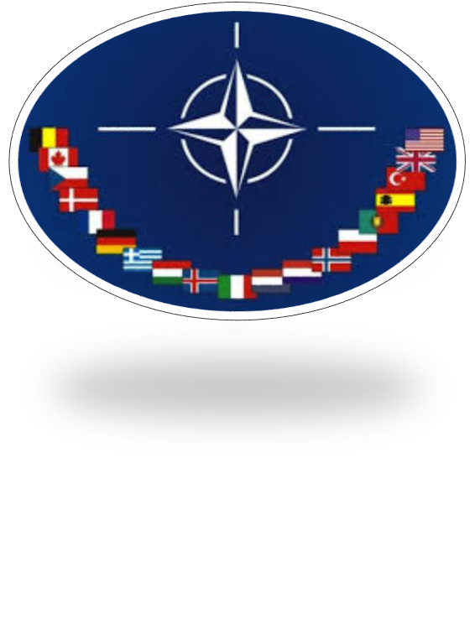
North Atlantic Treaty Organization
The North Atlantic Treaty Organization included Belgium, Canada, Denmark, France, Iceland, Italy, Luxembourg, the Netherlands, Norway, Portugal, the United Kingdom, and the United States at its formation in 1949.
Original purpose to help defend each other from Soviet invasion.
Unify the Western nations in Europe and the Americas.
NATO used the American nuclear power as their cover from vastly superior ground forces of Warsaw Pact countries.
NATO is the only remaining peacetime military alliance.
NATO Headquarters
Brussels, Belgium

Slide 10
Warsaw Pact
Originally ‘Warsaw Treaty of Friendship, Cooperation, and Mutual Assistance.’
Included East Germany, Czechoslovakia, Poland, Hungary, Romania, Albania, Bulgaria, and the Soviet Union at its formation in 1955.
It was a counter maneuver by the Soviet Union to symbolize a growing and strong communist influence in Europe.
The Soviets wanted to keep these states loyal to use them as a buffer zone between the themselves and western countries.
Collapsed with the dissolution of the Soviet Union.
Union for Peace and Socialism

Slide 11
1945-1991

Slide 12
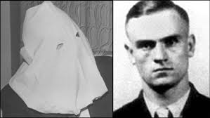
Igor Gouzenko Affair
Cipher clerk at the Soviet Embassy to Canada
Gathered documents incriminating the USSR (September 5, 1945)
Turned to the Ottawa Journal but was rejected; also turned away by the Justice Department
Home was ransacked but RCMP watch team caught intruders mid act
First defector of the Cold War era – in Ottawa
Became an instant celebrity after the arrests and would not let it go
Caused some struggles between HUAC and the Canadian Government
Cipher Clerk: A person who frequently encrypts and decrypts messages

Slide 13
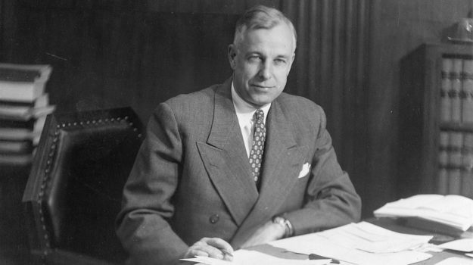
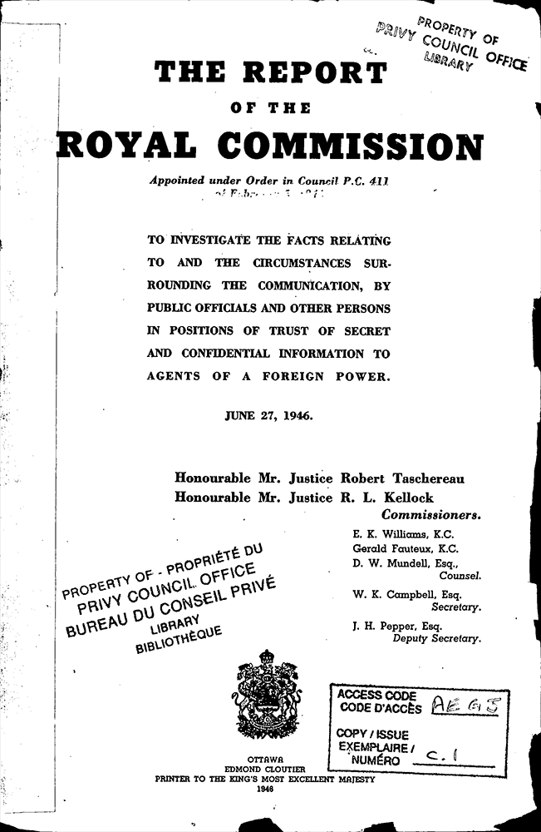
Kellock-Taschereau Commission
3 members of Cabinet organized a secret and extensive investigation under the ruling of the War Measures Act (despite this being 1946)
This involved numerous pre-dawn raids to retain and interrogate suspects
Many detained without charge, bail or legal representation. All detainees were required to answer all questions regardless of self incrimination
Almost 24 detained half were convicted all by self incrimination
All public servants and one Member of Parliament

Slide 14
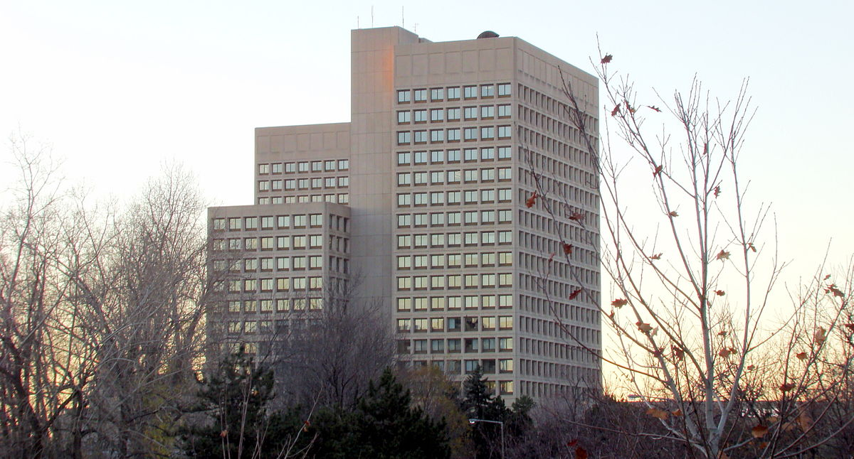
Security Panel
Government interdepartmental internal security panel
Cabinet Secretary, Senior Joint Chiefs of Defense Staff, RCMP, and External Affairs
First order to create a screening program for bureaucrats and civil servants, moved to seamen in the Great Lakes at the request of the U.S. then on to immigrants seeking Canadian citizenship
Program allowed the investigators to gain access to the past, relatives, associates, personal habits, and political beliefs
All while not disrupting their everyday job
RCMP was involved while the Cabinet Ministers made the final decisions
The discovery of any clearance issues were deliberately kept classified
Much of the documentation was only declassified and released in the 1970’s and 80’s
Defense Headquarters of Canada

Slide 15
Economic recovery act of 1948; Marshall Plan
Canada piggybacked and assisted in supporting the Marshall Plan

Slide 16
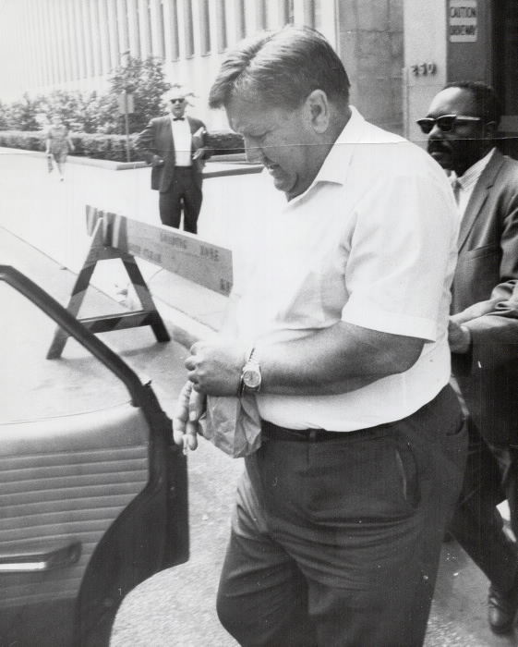
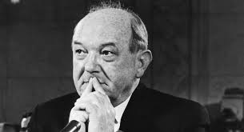
Hal Banks
And the SIU v. CSU
SIU: Seafarers International Union
CSU: Canadian Seamen’s Union
AFL: American Federation of Labor
As a hired mobster, he was imported to Canada illegally with encouragement from the Federal Government
Ship owners despised the CSU because it worked for minimum working conditions and better pay; it was also communist led
The SIU was heavily influenced by the AFL in their strong-arm anti-communist intimidation tactics
1949 – CSU strike reached foreign ports and local Unions urged workers to not unload Canadian ships
Strike outlawed and SIU violently destroyed CSU protests
SIU controls Canadian seaways for coming years
Corruption and violence was left unchallenged for too long and Hal Banks had an iron fisted hold on the area
Anyone who stood up against him was dubbed a communist and most were beaten
Fun Fact: His application form to become a landed immigrant did not include the question involving criminal record checks

Slide 17
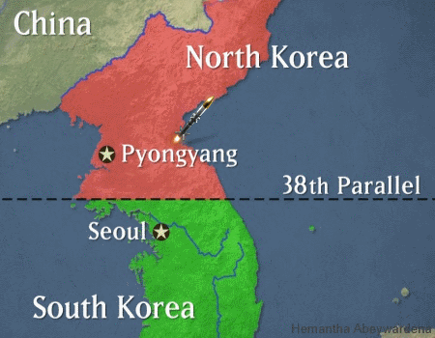
the Korean War
The People’s Republic of Korea stormed across the 38th parallel on June 25, 1950 sweeping almost all of the South into their control
UN voted in support of military assistance to the South and the U.S. pushed for help from allies
Canada reluctantly agreed to send troops in August of 1950
The American counter attack pushed the North back to the Yalu river, on the border with China (newly communist country)
Minister of External Affairs, Lester Pearson and the British warned of drawing China into the war but the warnings were brushed off
The Chinese forces poured across the border pushing the western forces back across the 38th parallel
The war continued on the border for two and a half more years until the Korean Armistice in 1953

Slide 18
Suez canal crisis
Canada’s Role in Diplomacy
In July of 1956, Egypt claimed control over the Suez Canal
Britain and France both called them out with the comparison to Nazi invasions in the 1930’s
October 29, 1956 Israel invaded Egypt with support from the English and French
The Canadian Minister of External Affairs, Lester Pearson devised a plan to maintain peace in the region.
The United Nations voted 57 for 0 against and 19 abstained from voting
300 Canadian support troops were sent rather than front line forces
UNEF: United Nations Emergency Force
Pearson Won the Nobel Peace Prize in 1957 for his work in the affair

Slide 19
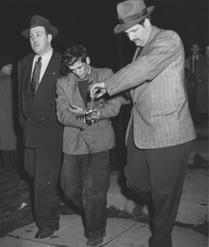
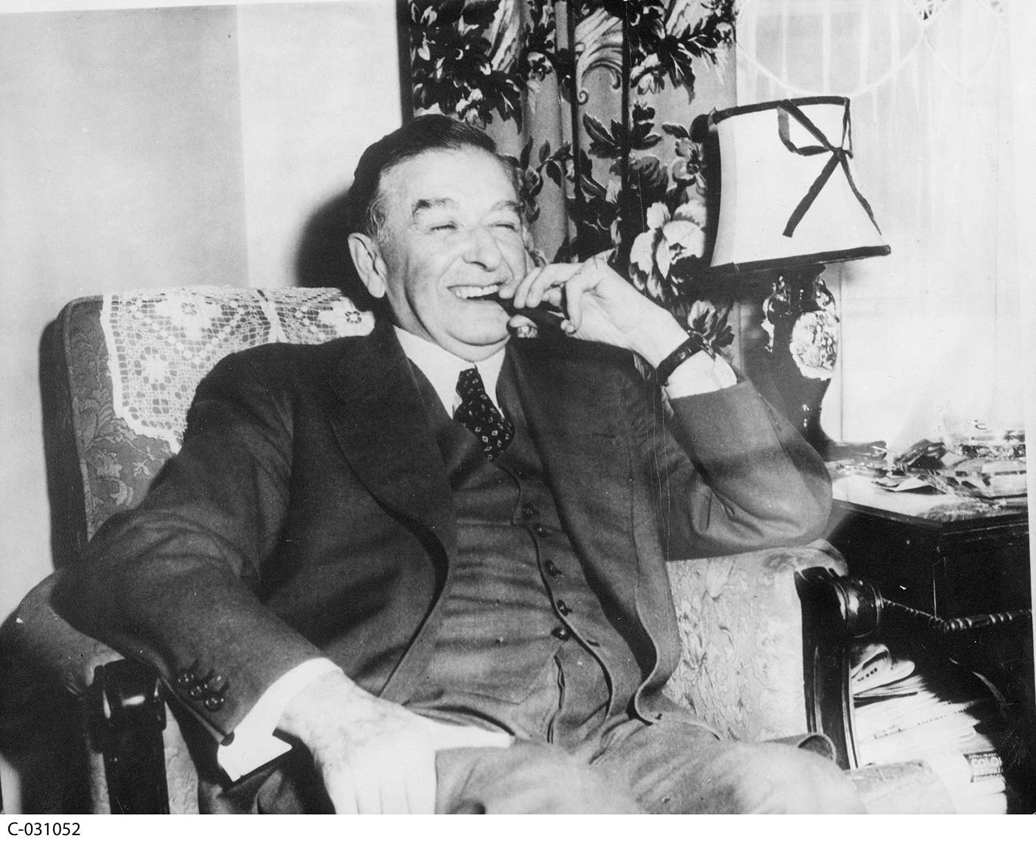
Act Respecting Communistic propaganda (padlock law) And Maurice duplessis
Maurice Duplessis: 5 term Premier of Quebec (Union Nationale)
Manipulative and authoritarian
Considered Liberalism to be almost as bad for Quebec as Communism
Padlock Law passed in late thirties
Quebec in this time was seen to be one of the strictest regions on civil liberties in the western hemisphere.
Named the Padlock Law because RCMP padlocked libraries which held copies of Karl Marx’s work.
The Padlock Law:
Limited areas for congregation of communists
Outlawed communist propaganda
Targeted Jehovah's Witnesses, Unions, Jews, and Protestant missionary groups as well as communists.

Slide 20
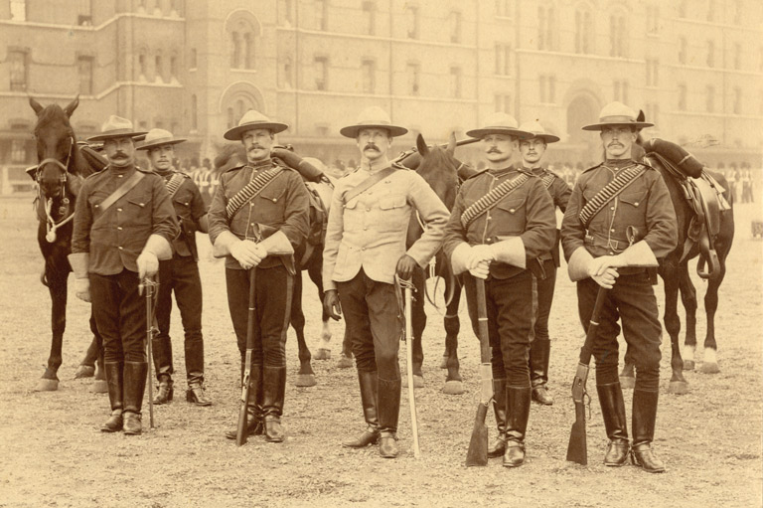
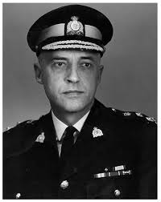
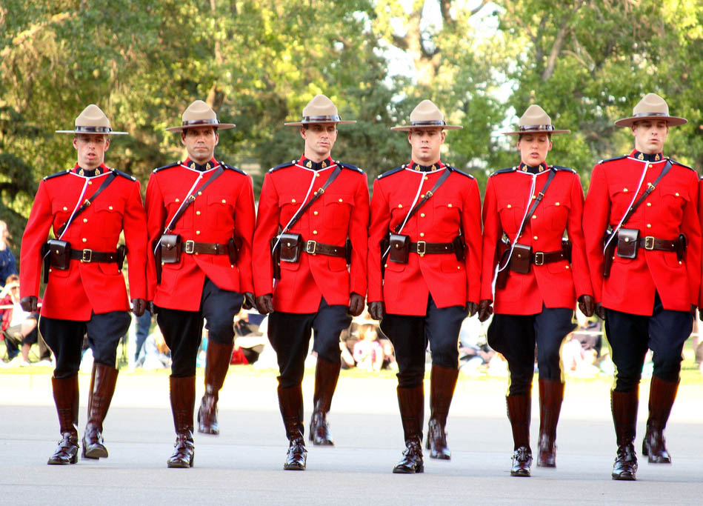
RCMP
Assigned to internal and external security threats
Had essentially free reign over the nation held accountable only by the RCMP commissioner
Saw themselves as loyal servants to the crown
Worked mainly against the threat of the communist Soviet Union and the Communist Party of Canada in early years of the Cold War
After the Gouzenko affair they were led to chasing communist subversives full time
Spied on political parties, trade unions, universities, social, cultural and ethnic associations and church groups.
Unlike Joe McCarthy and HUAC in the U.S. the RCMP were seen as the champions of Canada fighting its enemies.
Charles Edward Rivett-Carnac

Slide 21
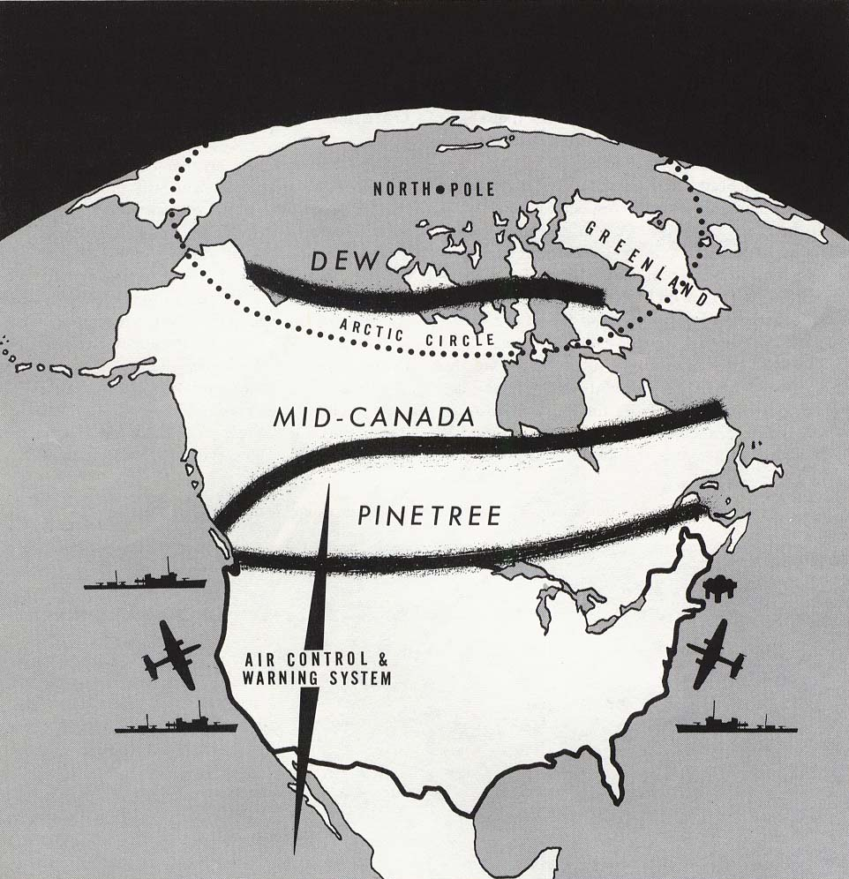
Radar Lines
Three radar lines were set up on Canadian soil at the request of the United States military.
Pinetree Network: 1954: Radar stations stretching from Vancouver Island to Newfoundland
Mid-Canada Line: 1957-65: 98 manned and unmanned radar stations stretching across the 55th parallel
Distant Early Warning Line: 1959-(62): 42 radar stations stretching across the 70th parallel
Controversy over payments and control
15 000 U.S. soldiers in Canada in the mid 1950’s

Slide 22
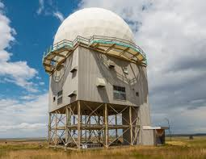
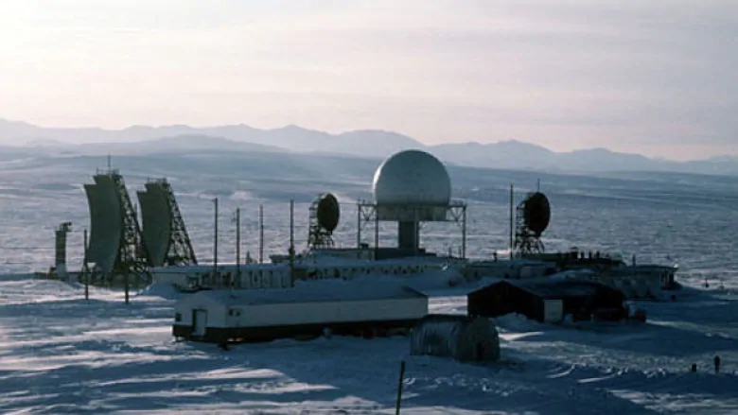
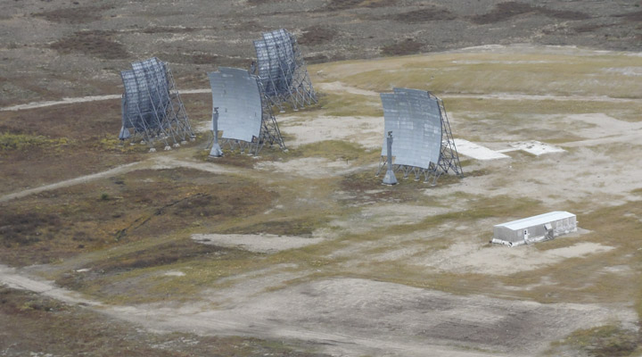

Slide 23
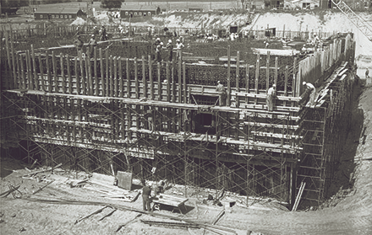
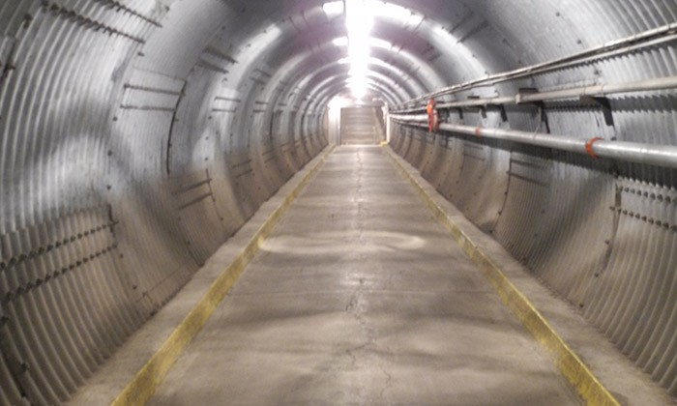
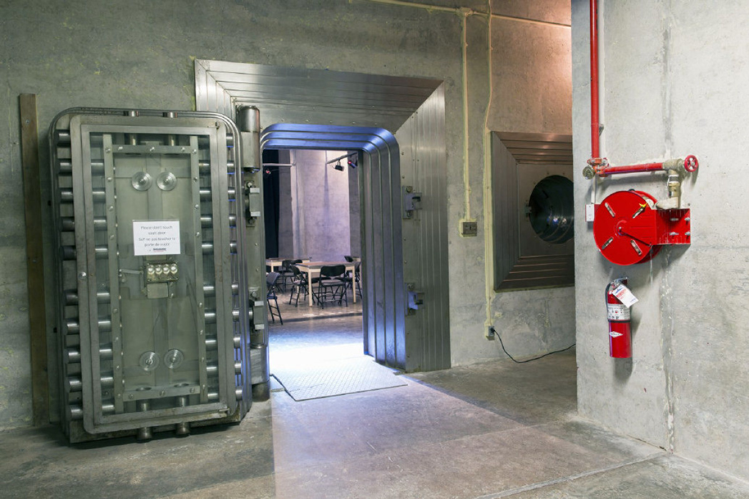
Diefenbunker
100 000 square feet over four levels. It is made of 32 000 cubic yards of hand poured concrete and 5 000 tons of steel
built to house key members of government and military for 30 to re-establish the country after a nuclear attack
Designed to withstand 5-megaton nuclear weapon from 1 mile away
Contained CBC radio studio, hospital, Bank of Canada vault
The cupboards and pantries were stocked with enough fresh food and rations to feed 535 people for 30 days
Operational in 1961 and officially decommissioned and given national historic site statues in 1994

Slide 24
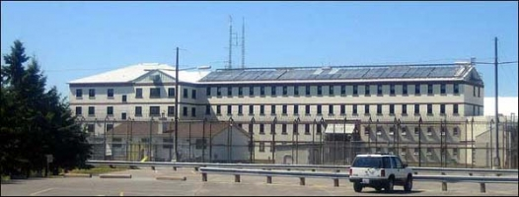
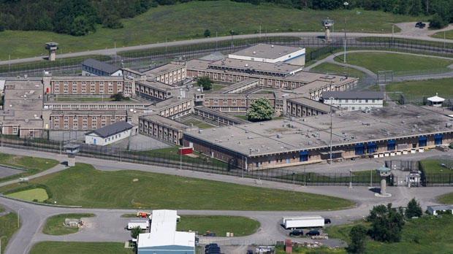
Internment Plans
Preparations were made that in the event of a Third World War the suspected communists and other subversives would be detained
Lengthy lists of names and address were kept on record as well as many “hideouts” for the wanted in the war broke out
List contained 762 names mostly from southern Ontario
In the case of internment, disobedience would have led to Punishment Diet Number One.
Joyceville Penitentiary
Millhaven Institution

Slide 25
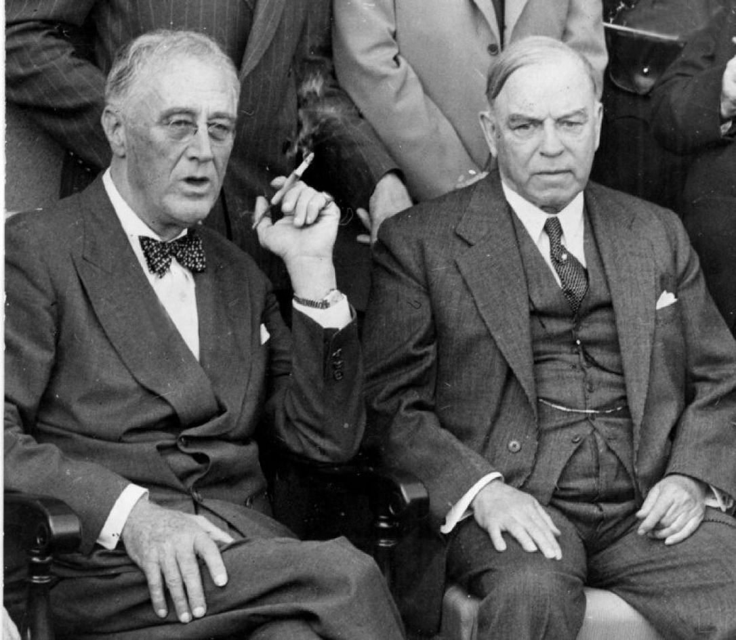
North American Aerospace Defense Command
August 1st 1957 Prime Minister John Diefenbaker announces an “integrated operational control of air defense forces.”
Mackenzie King met with Roosevelt in 1940 to discuss a military partnership
PM’s Louis St. Laurent and John Diefenbaker gave permission to the U.S. to attack Soviet planes in Canadian airspace
Pressured by the U.S. for their own safety and many Canadians believed it to be infringing on sovereignty
Diefenbaker tried to link this new agreement to NATO to ensure that people would be satisfied
The agreement was passed with both Liberals and Conservatives voting in favor

Slide 26
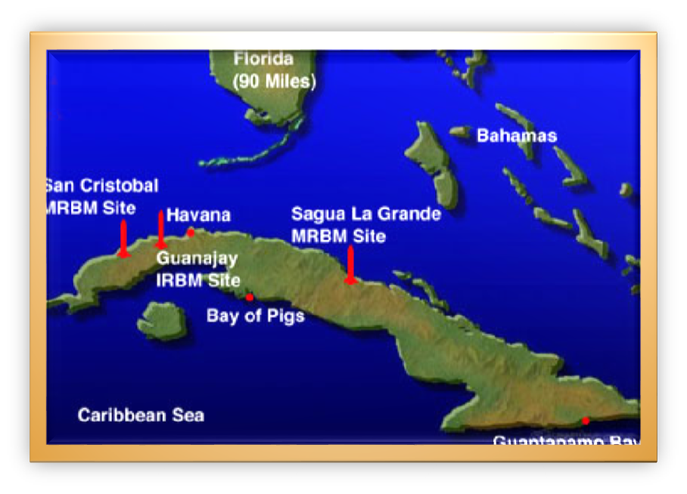
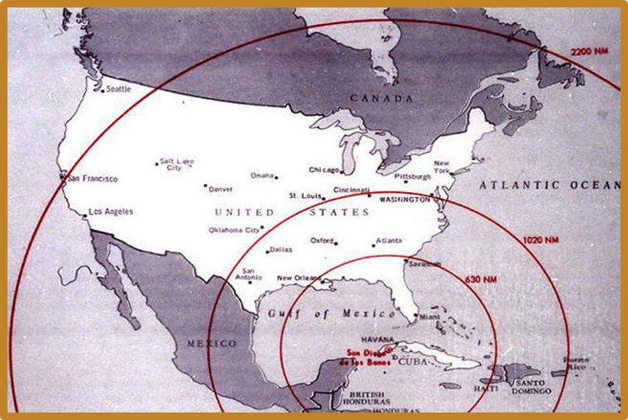
Cuban Missile Crisis
October 14th – 27th ,1962
Approximately 160 nuclear warheads were stationed in Cuba.
The USSR had medium and long range ballistic missiles in Cuba.
Khrushchev and Kennedy lead the USSR and U.S.
Jupiter missiles had been in place in Turkey and Italy beginning in 1959.
Khrushchev knew the U.S. had thousands more missiles than he did. This contributed to his acceptance of the Cuban request for nuclear warheads.
The United States had already been allowing the USSR to ship in non-nuclear missiles to Cuba to prevent any further invasions.
He clearly stated that he would remove all missiles if the U.S. promised not to invade Cuba and would remove the Jupiter missiles from Turkey and Italy.

Slide 27
AV-roe Arrow
A.V Roe Air company in Malton, Ontario was given government funding under St. Laurent
Supersonic fighter jet (CF-105 Arrow) for intercepting Soviet bombers over the Arctic
High ranking military officials thought the project to be wasting time and resources.
Focus was shifted from airspace to outer space and the 1.1 billion dollar project was shut down costing 25 000 direct and indirect jobs.
Many of these jobs were well educated and salaried engineers and aircraft technicians
These aircraft were replaced with cheaper American made Voodoo fighters and briefly with Bomarc missiles

Slide 28
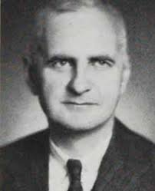
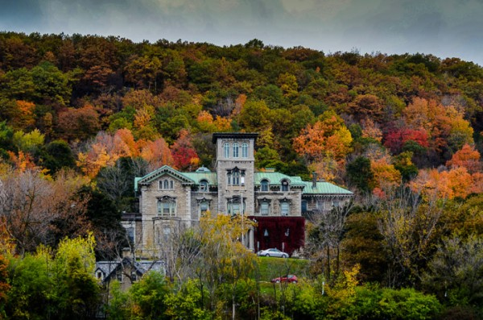
Allan Memorial institute and dr. ewen Cameron
Founded in 1940 on the McGill University campus
In 1953 the CIA channeled millions of dollars into an operation under code name MKULTRA
“Brainwashing” is the process of breaking down a mind using certain sensory deprivation methods and inserting new ideas
Methods
Sleep Therapy
Electroshock
LSD
Curare
His patients were people coming for mental assistance
Many left with more wounds to heal than before
Dr. Cameron suddenly retired in 1964 and died three years later after scaling a mountain
Curare: Competitor with acetylcholine, a chemical that carries information between nerve and muscle cells, and blocks transmission of the information.

Slide 29
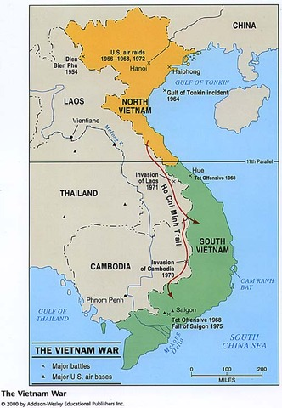
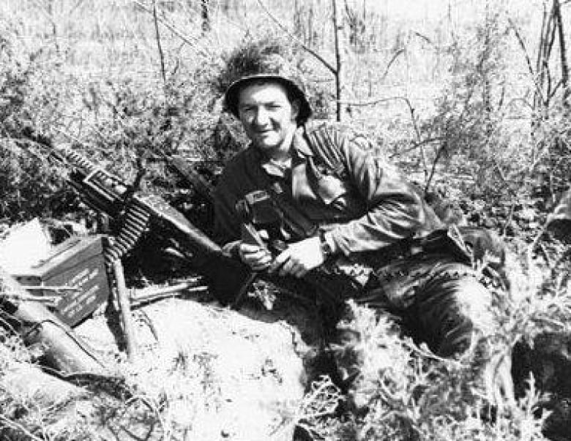
Vietnam War 1955-1975
Canada supplied France with weapons and Ammunition in the early 50’s until France abandoned when the Geneva Agreements in 1954 temporarily cut Vietnam at the 17th parallel
Canada selected as one of three countries to internally monitor happenings and violations of Geneva Agreements by Vietnam, Cambodia and Laos
Canada kept the militarily inclined United States aware of Northern Vietnamese movements
Lester Pearson took up the requests of Canadians to request the U.S. halt the bombing raids of Operation Rolling Thunder
Upwards of 40 000 Canadians served directly in the U.S. military to Vietnam

Slide 30
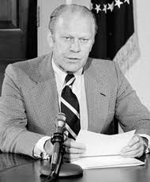
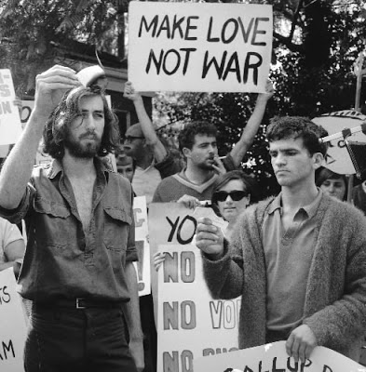
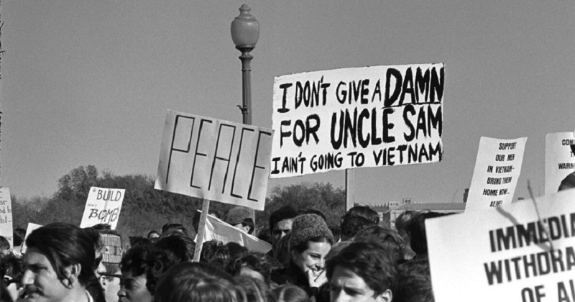
American draft deserters
Many young men and their families ventured north to avoid being drafted to Vietnam or the consequences of deserting the military
Organizations were formed to assist the war resistors such as Toronto Anti-Draft Programme
Many families were torn apart by the heavy strain of the exile and children grew up without sufficient family
50 000 – 125 000 war resistors made their way to Canada from the United States between 1965 and 74
This was an issue for Canadian society because many refugees were well educated and taking jobs at universities leading to Americanization
1968 and 1969 the RCMP issued measures to limit the new influx of Americans

Slide 31
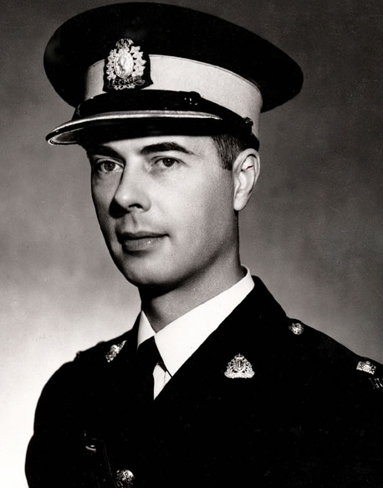
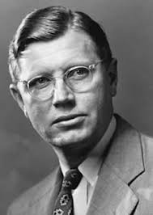
Operation Feather bed
Canadian attempt to uncover spies within the higher ranks of the government
Semi-constructed in the image of the FBI’s “Red Hunting” nature
Early 50’s by Counter-Espionage investigator, Terry Guernsey
Early beginnings of profiling
Before the death of Herbert Norman this operation was not authorized but was permitted afterwards
Early 1958 a file was opened to classify “suspect or know communist sympathizers”
At its height it contained over 1000 files and 16 on senior public servants with potential communist backgrounds
Analysis of a person's psychological and behavioral characteristics, so as to assess or predict their capabilities in certain fields or to assist in identifying a particular subgroup of people

Slide 32
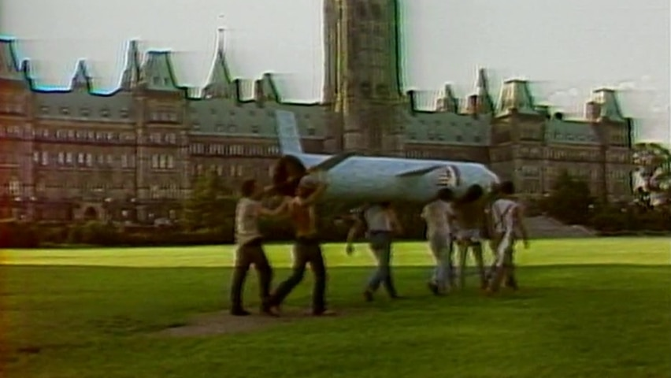
Cruise missile
April 1981, a letter was received by P.E. Trudeau from American Secretary of Defense, Caspar Weinberger.
Asking to test a medium range ballistic missile which had been in construction since the 70’s
20 foot, 3 200 pound ship or plane released rocket, code-named “Tomahawk”
U.S. wanted to test in Canada to simulate the Russian climate
Opportunity for economic success but also a possibility for internal conflict and political divide
Possibility for a nuclear warhead
Increasing public anxiety for international security was rising and Trudeau was openly against the use of these weapons
Under pressure from the Reagan Administration Trudeau agreed to the tests secretly, until a leak was made in March of 1982
Canada-U.S Testing and Evaluation Program (CANUSTEP) was brought before the House in February 1983
https://www.cbc.ca/archives/canada-s-cruise-missile-testing-controversy-of-1983-1.4744435

Slide 33
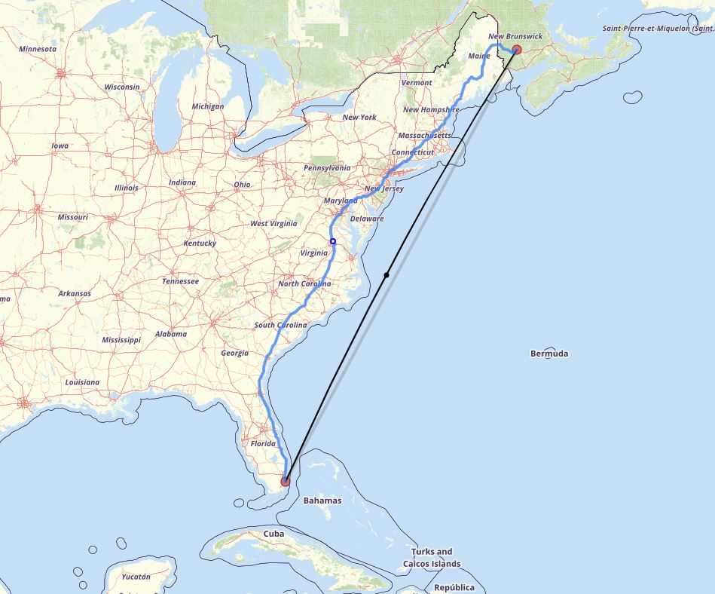

Slide 34
Squamish Five “Direct Action”
Attack against plant No. 402 of Litton Systems of Canada
Company built the guidance system parts for the cruise missile
The attackers were five anarchist and far left activists Ann Hansen, Brent Taylor, Juliet Caroline Belmas, Doug Stewart and Gerry Hannah.
The Head of “Operation Dismantle” was contacted to give information on the suspects
The suspects were caught by police who were undercover as a road block for construction.
They were brought into trial and found guilty with little remorse

Slide 36
Bibliography
Whitaker, Reginald, and Steve Hewitt. Canada and the Cold War. Toronto: Lorimer, 2003.
Einstein, Albert. Nassau Point Peconic, Long Island, Washington D.C, n.d.
Kennedy's Inaugural Address (1961) Citation: Inaugural Address, Kennedy Draft, 01/17/1961; Papers of John F. Kennedy: President's Office Files, 01/20/1961-11/22/1963; John F. Kennedy Library; National Archives and Records Administration.
http://www.rcmp-grc.gc.ca/en/former-rcmp-commissioners
https://www.thecanadianencyclopedia.ca/en/article/premiers-of-quebec
https://diefenbunker.ca/about-the-diefenbunker/
https://www.thecanadianencyclopedia.ca/en/article/avro-arrow
https://www.friends-amis.org/index.php/fr/document-repository/english/fact-sheets/36-the-bomark-missle-and-missle-crisis/file
https://www.history.com/this-day-in-history/geneva-conference-begins
https://www.canada.ca/en/department-national-defence/services/military-history/history-heritage/past-operations/asia-pacific/international-commission-supervision-control.html
https://www.thecanadianencyclopedia.ca/en/article/operation-dismantle-case
https://www.history.com/this-day-in-history/u-s-jets-bomb-ho-chi-minh-trail
https://www.atlasobscura.com/places/pentagon-hot-dog-stand
http://natoassociation.ca/canada-and-the-suez-canal-crisis-a-new-perspective/

