Slide 1
Confederation Postscript
1869 - 1885

Slide 2
To Join or Not to Join
After the initial push for confederation many members of the newly formed nation realized that they had far to go to convince the remaining territories to join but also they had to convince the newly joined to stay and not repeal its decision.
Anti-confederates were still campaigning across the colonies, economic troubles persisted and the constant threat of annexation by the US gave the colonies something to consider.

Slide 3
Nova Scotia
Nova Scotia wanted out of the deal pretty much right away.
Many Atlantic colonies felt that they were distant and isolated and had been dragged into confederation to address the needs of central Canada.
The Maritimes also felt that joining Canada would mean losing their identity founded on British roots and losing their sense of independence.
Notes:
PEI and Newfoundland had rejected confederation out of the gates and New Brunswick who were in had switched governments and Sir Samuel Tilley, a pro-confederate was voted out of office.
Having a pop of around 600,000 many maritimers felt they would always be outvoted on issues in the House of Commons in Ottawa,

Slide 4
Nova Scotia
The fear that taxes from the east coast would be used to stimulate the Northwest and not used to benefit the people of Atlantic Canada.
The economy was already weak as steam replaced sail and the boat building industry was a challenge to keep up-to-date and competitive.
Tariffs from the US also looked to kill any remaining trade with New England.
They had agreed to join confederation in return for an annual per capita subsidy of 80 cents, but after the deal many, including Joseph Howe, felt they sold themselves for too little.

Slide 5
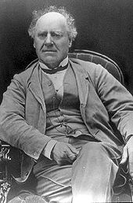
Joseph Howe
Howe was a stanch anti-confederate journalist who felt that NS should keep closer ties with Britain rather then Ottawa.
He felt that NS was “tricked into this scheme” of confederation. His articles swayed many people and under that banner of the Nova Scotia Party he and his fellow delegate captured 18 of 19 federal seats. On the provincial election his party won 36 of 38 seats.
He considered open rebellion but realized the futility of it and abandoned the idea. He also dismissed joining the US.
Notes:
Using this momentium Howe travelled to London in 1868 to request a repeal from Confederation only to be rebuffed twice in his attempts and was told “repeal is not even a matter of discussion” by the Duke of Buckinham.

Slide 6
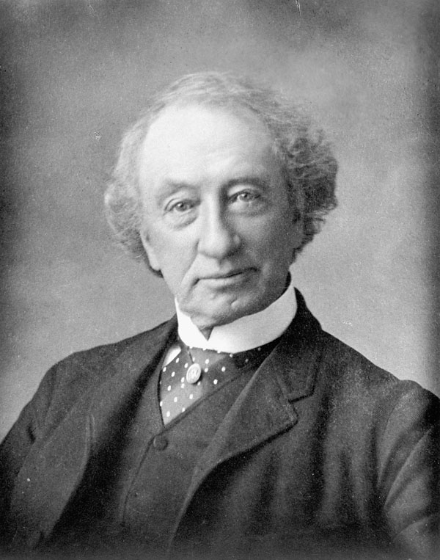
Sir John A Macdonald’s Response
Macdonald realized that Howe was the linchpin to keeping the confederation going.
In 1868 Macdonald travelled to Halifax with an olive branch for Howe, he offered to increase the annual subsidies by 30% over the next ten years* and he offered Howe a cabinet position in Ottawa.
This deal was better in Howe’s eyes, and he probably didn’t any other options, so NS stayed in Confederation and Howe was turned.
Notes:
* This change simply made adjustments to the financial terms offered to NB and would’ve been introduced eventually anyway.

Slide 7
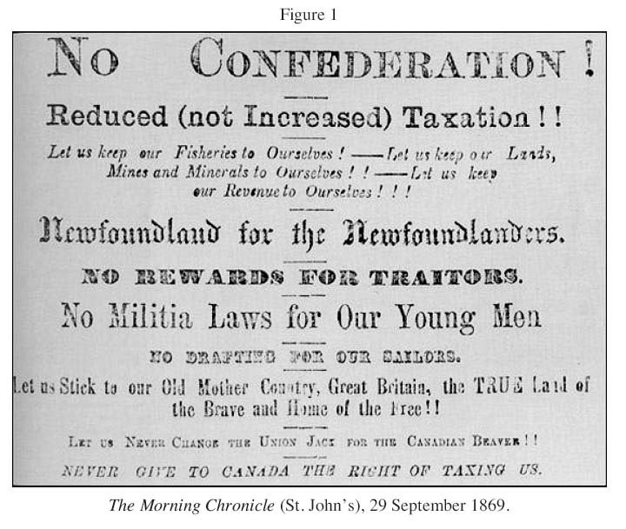
Newfoundland
The 1869 election in Newfoundland was basically a referendum on Confederation.
A strong upswing in the economy and a powerful propaganda campaign turned most voters against Confederation.
As the anti-confederation song from 1864 had declared, they were not willing to sell their birthright for a few Canadian dollars.

Slide 8
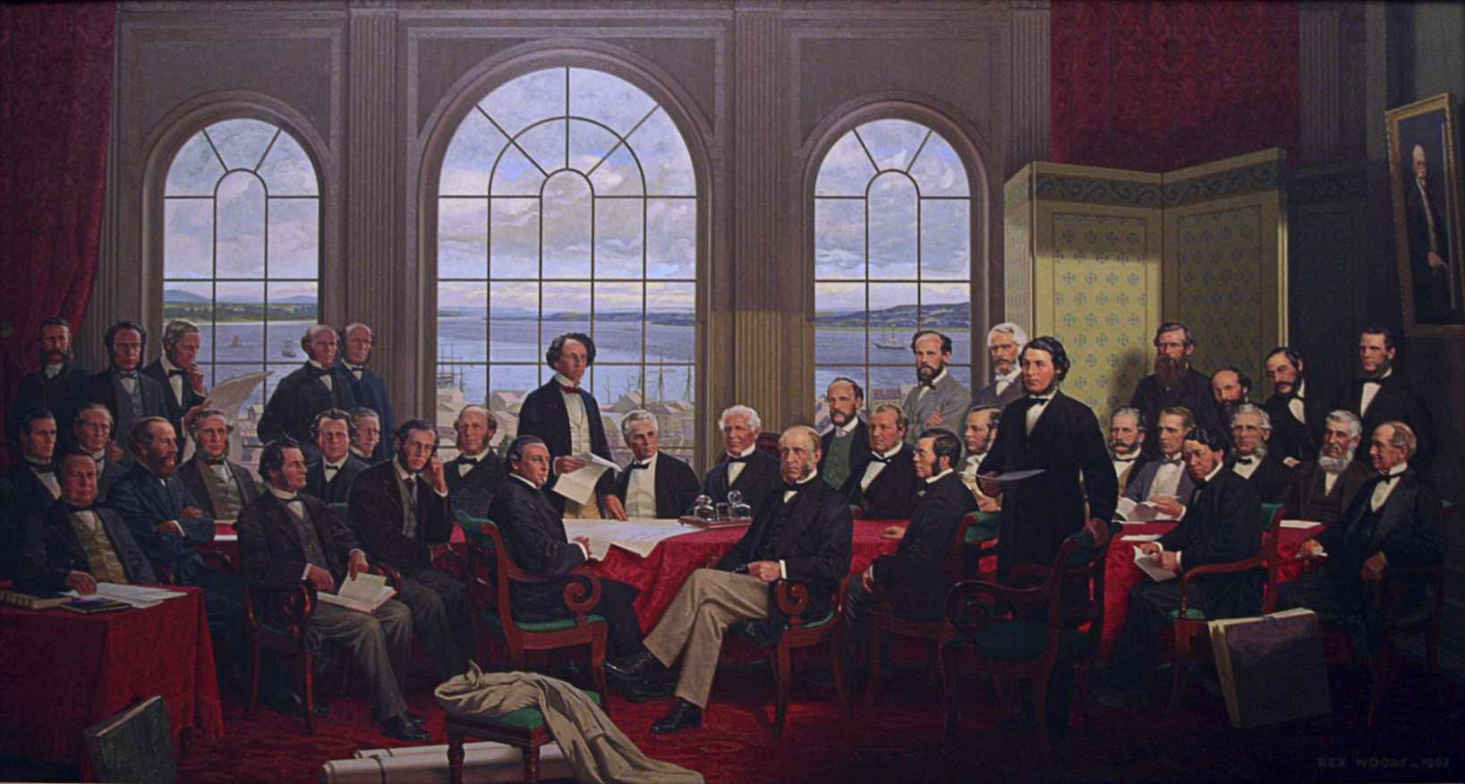
PEI Enters…Reluctantly
The tiny island of PEI also struggled with joining as they too feared loss of identity and lifestyle.
The citizen of PEI declined confederation in 1864 even when the premier, John Gray, had been elected as chairman of the Charlottetown Conference.
Notes:
The debt in PEI was $250,000 in 1863 and $4 million in 1873, it wasn’t looking good.

Slide 9
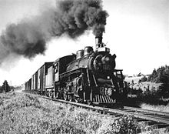
Financial Troubles
As the 1870s started the economic conditions on the island were dire, global economies were suffering in general but an attempt by the province to build their own railway was disastrous.
This railway cost and other failures with British investments led PEI to reconsider, especially when John A Macdonald agreed that Ottawa would assume the island’s debt and payout the absentee landowners.

Slide 10
Rupert’s Land Act
For years the HBC owned an enormous plot of land in Canada that was highly profitable for many years. In 1863 the company underwent some business shifts and entertained offers for Rupert’s Land.
The deal, brokered by the British, granted land to the HBC around their outposts, $1,500,000 from the Canadian government and 1/20th of the land was to be retained by the HBC.
The deal resulted in Canada getting 6 times larger.
Notes:
The HBC had complete control of the territory. Almost no thought was given to the sovereignty of the many Aboriginal peoples that had lived there for centuries. The HBC established forts and trading routes through much of the territory. The Cree, Assiniboine and other groups who supplied the Company with furs, or who acted as middlemen for other Aboriginal fur suppliers, were incorporated into the growing trading economy or directly employed by the HBC. The fur trade changed the Aboriginal economy. Rather than hunting and trapping for subsistence, people now trapped in exchange for trade goods, including guns and alcohol.

Slide 11
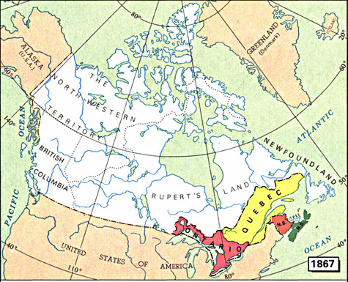

Slide 12
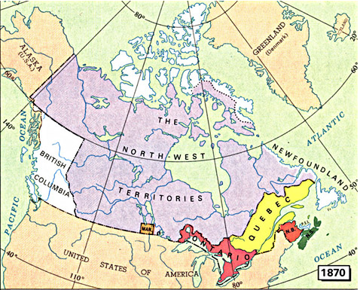

Slide 13
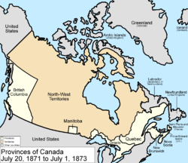
Manitoba: “The Postage Stamp” Province
The Rupert's Land purchase prompted the Canadian government to negotiate seven treaties with Aboriginal nations within the territory, acquiring their consent to the Crown's sovereignty.
The metis had settles, cleared and farmed the land owned by the HBC and now this newly acquired land by the Canadian govt changed everything.
Notes:
The federal govt sent surveyors into the land and began dividing up the land into townships and sections ahead of the anticipated influx of new settlers. This action infuriated the metis as they were not even considered or

Slide 14
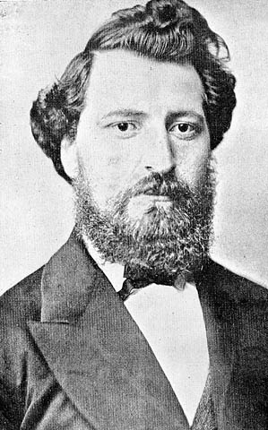
The Red River Rebellion
The 1869–70 uprising in the Red River Colony was sparked by the transfer of the vast territory of Rupert's Land to the new nation of Canada.
The colony of farmers and hunters, many of them Métis, occupied a corner of Rupert's Land and feared for their culture and land rights under Canadian control.
The uprising led to the creation of the province of Manitoba, and the emergence of Métis leader Louis Riel — a hero to his people and many in Quebec, but an outlaw in the eyes of the Canadian government.
Notes:
Riel was an educated literate and zealous defender of aboriginal rights

Slide 15
Acts of Defiance
Riel and his supporters stopped surveyors from entering the west. They also prevented the newly appointed Lieutenant-Governor William McDougall from entering the region and they finally seized Fort Garry(Winnipeg) and declared a provisional government.
Riel squashed a counter-rebellion from some “Canada Firsters” and imprisoned 48 of them. One prisoner was sentenced to execution for insubordination and despite some pleading from a representative from J.A. Macdonald he was shot to death by firing squad.
Notes:
He actually put his foot on the survey chain and declared “You shall go no further.”
A provisional government, also called an interim or transitional government, is an emergency governmental authority set up to manage a political transition, generally in the cases of new nations or following the collapse of the previous governing administration.
This execution enraged many in Ontario who now saw Riel as a savage while the French and native people saw him as a hero fighting for his rights.

Slide 16
Riel and the Provisional Government

Slide 17
The Manitoba Act and Riel
J.A. Macdonld had not choice but to recognize the demands of these Metis people. On July 15, 1870 Manitoba was created as a 1.5 million acres area for the Metis.
French language rights and the Catholic religion was protected with this new act and a second French-Canadian strong-hold was created within Confederation.
Riel was still seen as a fugitive in Canada and was forced to flee. He lived in Montana for some time and suffered from mental breakdowns.
He returned 15 years later amidst another rebellion after which he was caught and tried for treason.

Slide 18
The Execution of Louis Riel
Against Riel’s wishes, his counsel defended Riel on the grounds of insanity, pointing to the time he spent in asylums in the late 1870s. Riel, however, understood that by casting him as insane, his lawyers would discredit his people’s legitimate grievances against the Canadian government.
Riel ended his trial with an eloquent speech that systematically dismantled his lawyers’ insanity-defense strategy. This speech proved Riel’s sanity — it also all but assured that he would hang.

Slide 19
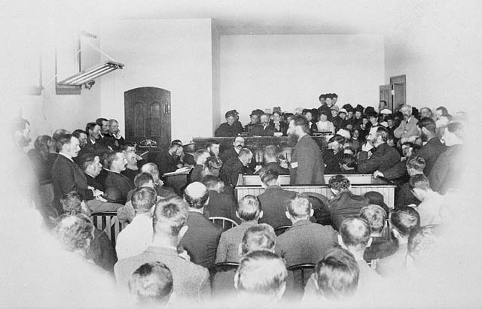
The Trial
J.A. Macdonald – “He will hang, though every dog in Quebec barks in his favour.”
Notes:
Riel was executed on a public gallows in Regina on 16 November 1885. His body was transported to Saint-Boniface, where his remains were taken to the cathedral’s cemetery at the head of a massive procession made up of the leaders of French Manitoba. His grave, as well as his home, remain well-visited historic sites to this day.
While it might seem like cruel justice for Riel we must keep in mind that his actions led to the death of over 200 people and he caused a rift in the relationship between the French and English that still is clear today.

Slide 20
Other Notable Points of Interest
The creation of the North West Mounted Police to help control the new western lands and people.
BC joins confederation in 1871.
The national anthem was introduced in 1880.
The Canadian Pacific Railway was well underway.
Ottawa was chosen as a site for the national capital by Queen Victoria.

