Slide 1
First Contact
The effects of first contact on aboriginal peoples.

Slide 2
Jacques Cartier arrives in North America.
The Norse arrive in North America
1497
1000 CE
1534
John Cabot arrives in North America.

Slide 3
The Norse

Slide 4
The Norse
- People from northern europe.
- Made contact approx 900 years ago (1000 CE)
-Contact was made near L’Anse aux Meadows Newfoundland/Baffin Island.
- Developed a trading relationship with the indigenous peoples.

Slide 5
Norse Contact with Indigenous Peoples
- Largely peaceful.
- Did not last long.
- Happened in multiple locations across eastern Canada.
- Baffin Island
- L’Anse aux Meadows

Slide 6
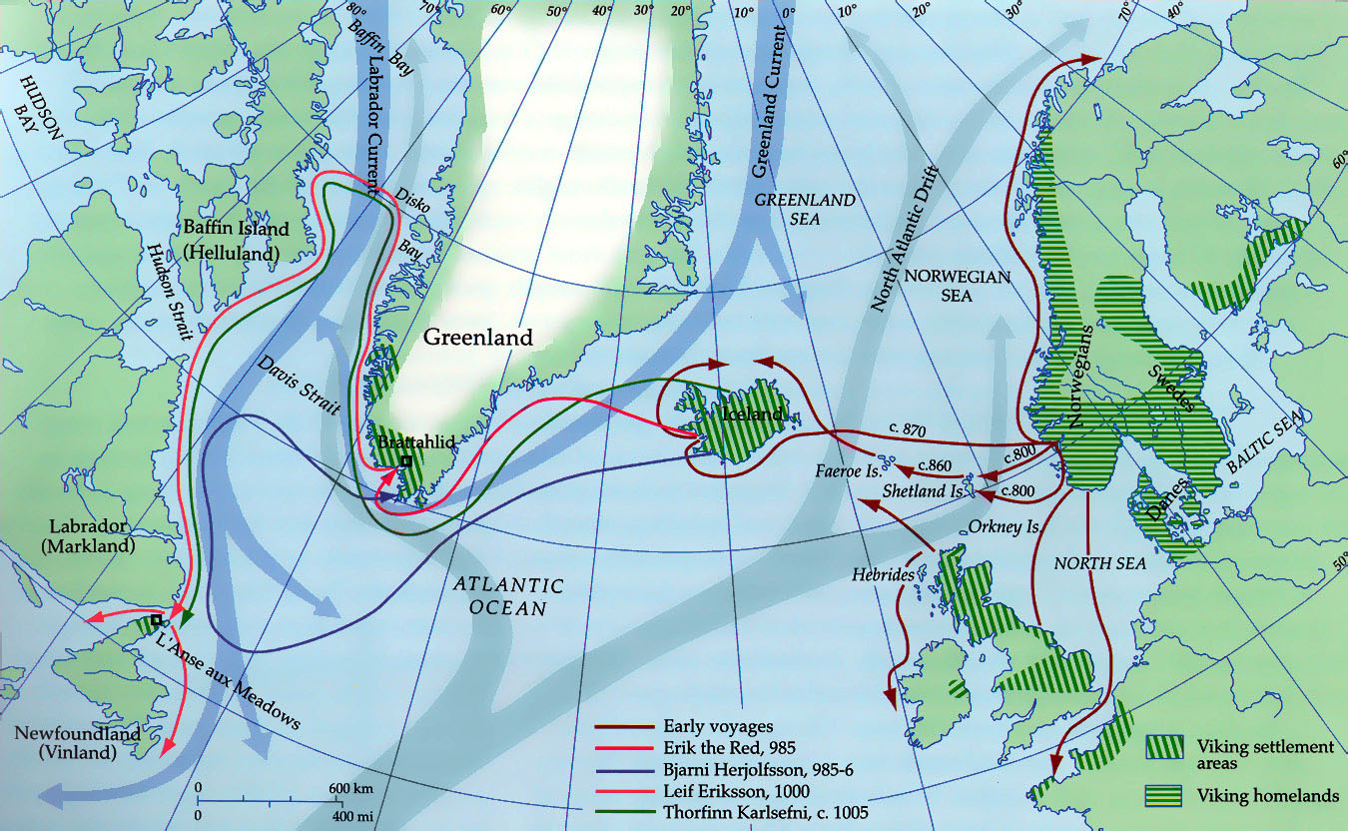

Slide 7
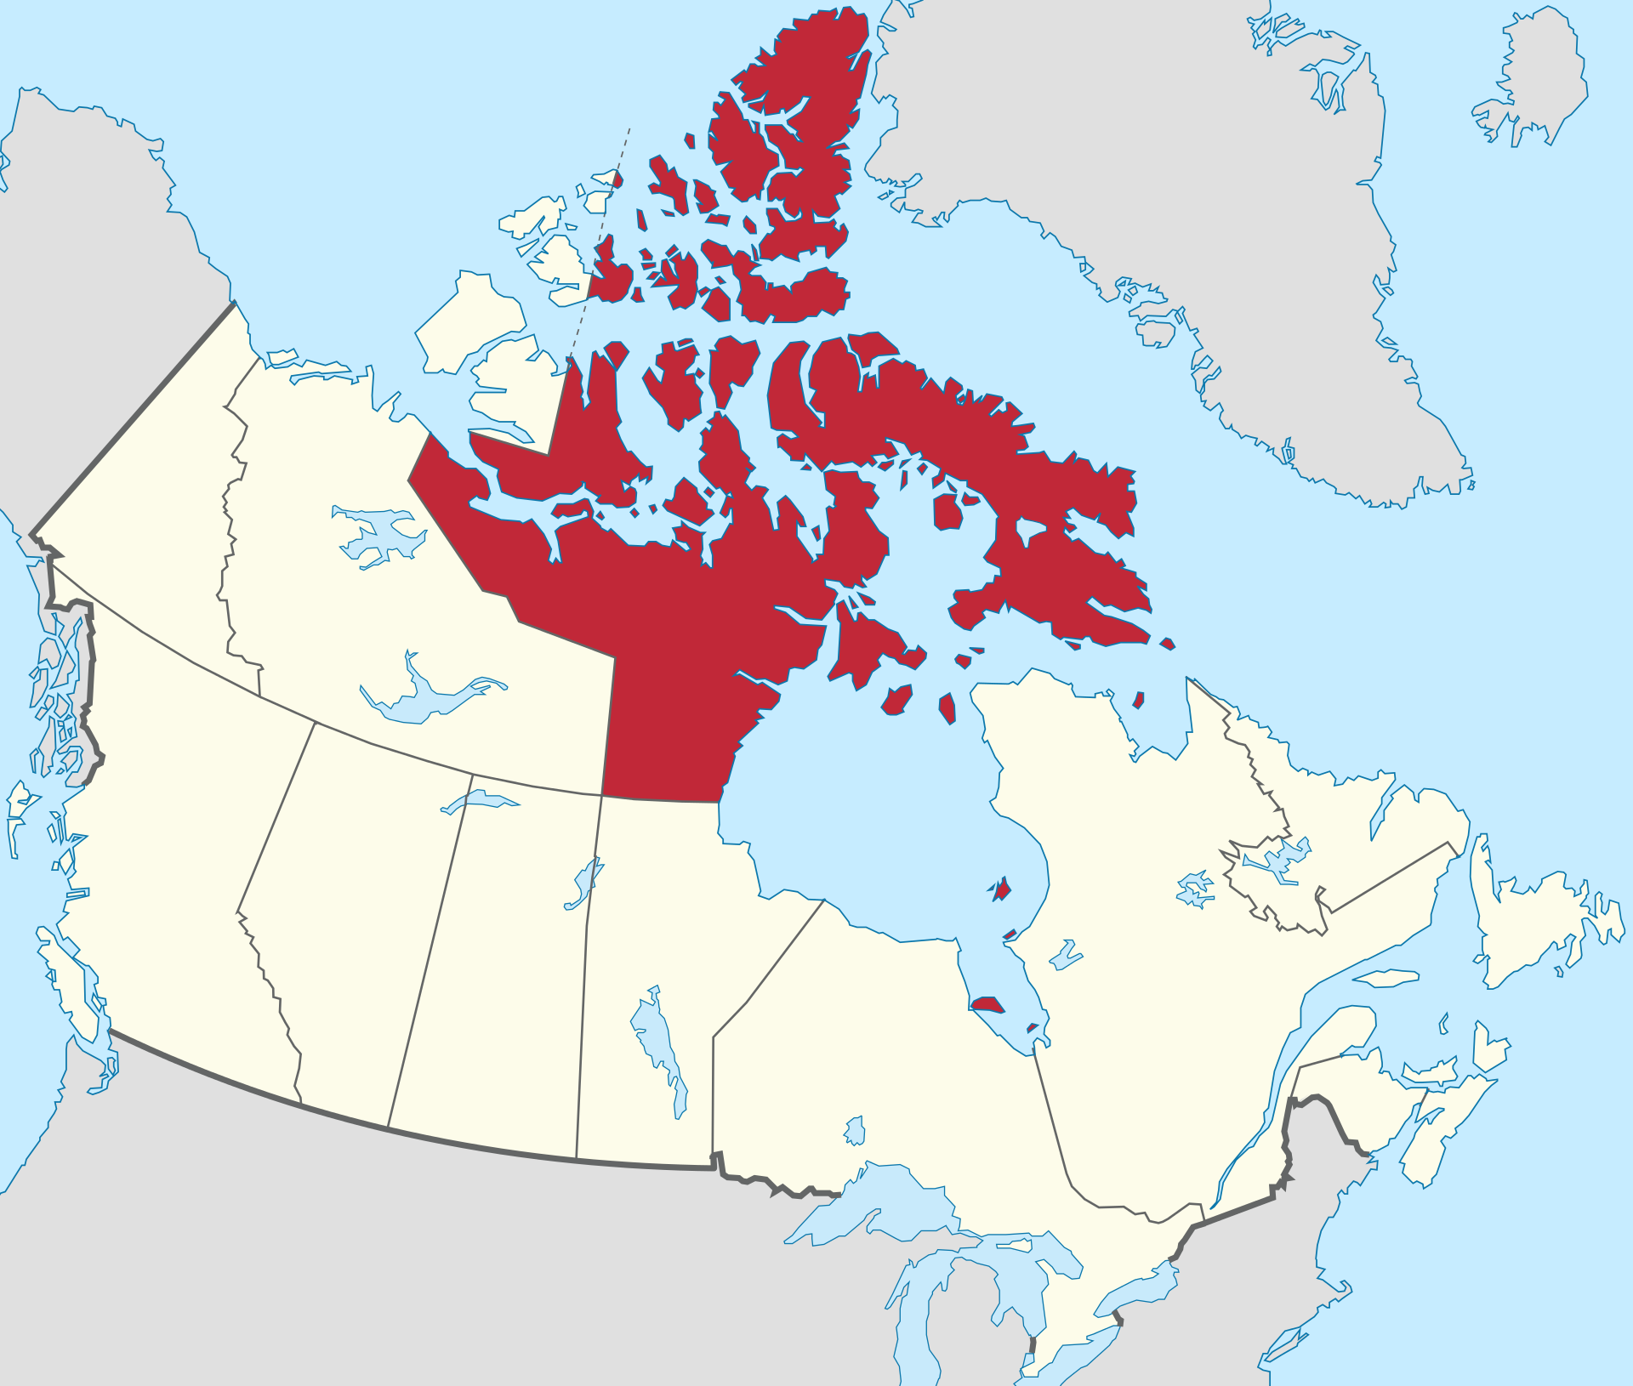
Baffin Island
L’Anse aux Meadows

Slide 8
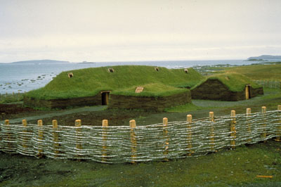

Slide 9
John Cabot and the Beothuk

Slide 10
John Cabot, (Giovanni Caboto)
- Arrived in North America in 1497, 500 years after the Norse.
- Claimed North America for the King of England.
- Began European contact with the Beothuk.
- Introduced Europe to the exploitation of North America.
John Cabot Heritage min

Slide 11
Beothuk and European Interaction
- Largely hostile
- European advantage
- Food shortages led to raiding
- European diseases
- Slavery
- Europeans became synonymous with death

Slide 12
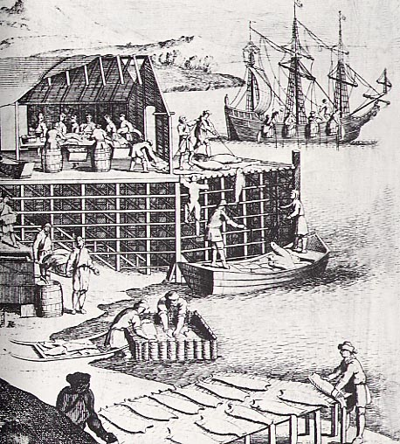
Early exploitation of Resources in North America.
- Cod fishing - Slavery
- Whaling

Slide 13
Jacques Cartier

Slide 14
Jacques Cartier
- French mariner
- Commissioned by the King of France.
- Arrived in Newfoundland on May 10th, 1534
- Cautious about meeting indigenous people

Slide 15
Jacques arrives in Newfoundland
Jacques arrives in Newfoundland and begins trade with the indigenous peoples (mainly Mi’kmaq).
Jacques returns to Newfoundland.
Jacques returns to Newfoundland with the two sons of Donnacona and begins to explore the Saint Lawrence River as far as present day Montreal.
+5 weeks
1541
1535
1535
Jacques returns to France
Jacques returns to France bringing the two adult sons of Donnacona with him.
Jacques returns to Newfoundland again.
Jacques returns to Newfoundland on his final voyage this time with the intent to setup a settlement.

Slide 16
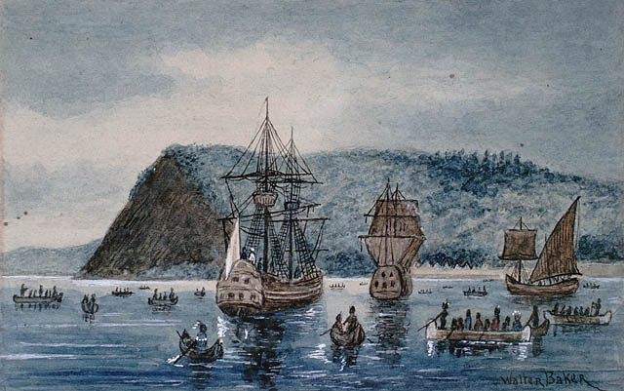
Jacques’s Arrival in Newfoundland
- He described the land as “the land God gave Cain” on arrival.
- Began trade with the Mi’kmaq and St, Lawrence Iroquois.

Slide 17
Jacques’ Second Expedition
- Began to integrate more with the St. Lawrence Iroquois.
- Wrote the only detailed description on the St. Lawrence Iroquois.
- Built several structures at Stadacona for shelter during the winter.
- Explored the St. Lawrence river.
- Upon leaving, captured 10 St. Lawrence Iroquois including their leader Donnacona.

Slide 18
Jacques’ Final Expedition
- Least successful expedition.
- Most elaborate.
- Ended the next spring after retaliation of the St, Lawrence Iroquois and the harsh winter.

Slide 19
Questions
How do we value different societies?
What effect did colonialization have on the Indigenous peoples of Canada?
Why did misunderstandings lead to violence during colonialization?

