Slide 1
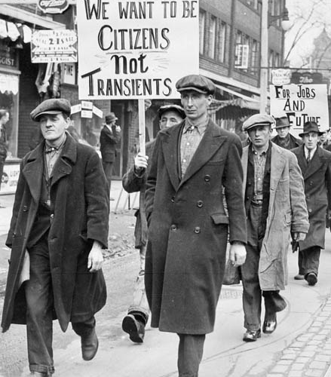
Canada and the Great Depression
History 122
Mr. McCormick

Slide 2
“The Roaring Twenties”
Canada’s economy transformed by World War I.
Depression of 1920
New energy sources, technologies, consumer products.
This was followed by a period of unprecedented prosperity and consumerism.

Slide 3
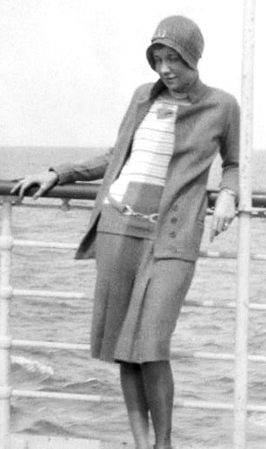
Urban Life in the Roaring 20s
With near full employment, and a continued manufacturing and industrial boom, the number of (often high-tech) consumer goods increased.
Newly-available products
New forms of entertainment
Culture of consumerism
New fashion
Notes:
Telephone, automobile, radio
Movies, Spectator Sports, Jazz
Deparment stores and credit
Flappers

Slide 4
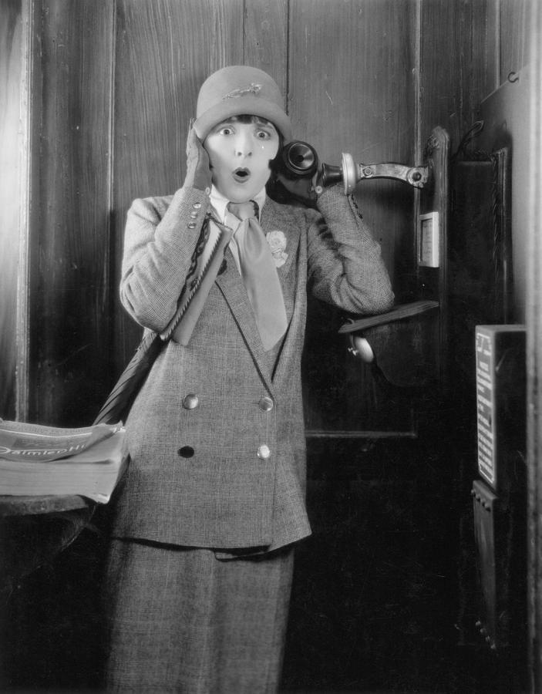
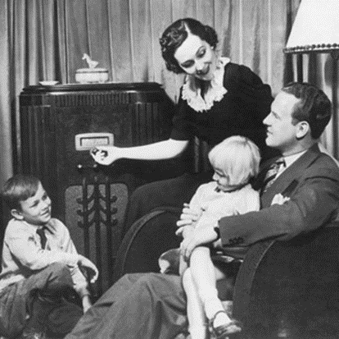
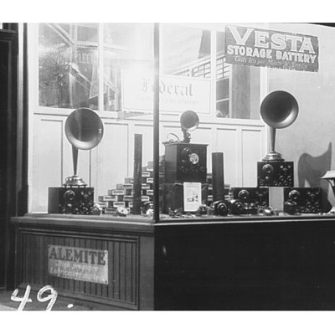
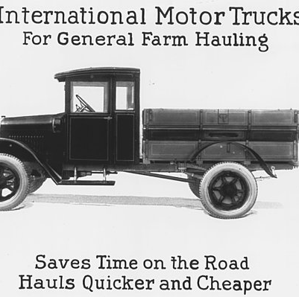
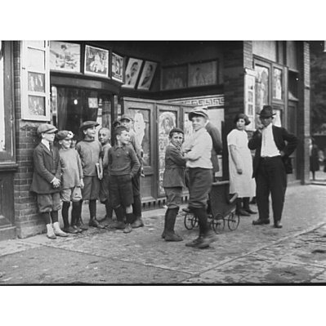
Notes:
Radio, radios for sale

Slide 5
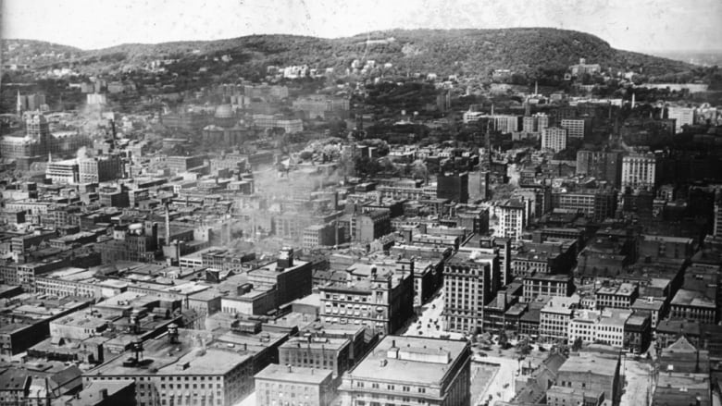
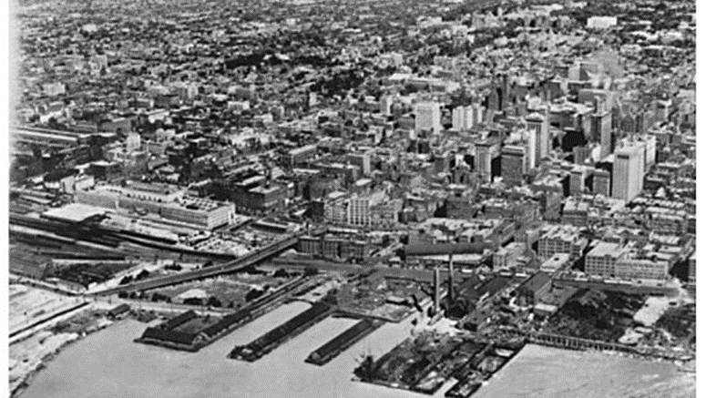
Urban Life in the Roaring 20s
By the 1920s, most Canadians urban.
New transportation technologies allow cities to expand beyond their core
Notes:
- Cities attract migrants from the countryside and immigrants.
Many jobs in infrastructure and manufacturing
- While the working class areas remained crowded and relatively unhealthy, new middle class suburbs developed.

Slide 6
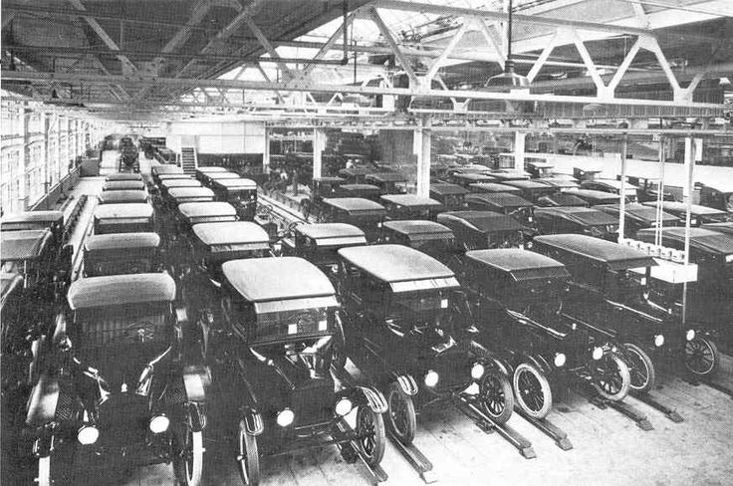
Causes of the Great Depression
Overproduction
Overextended credit
Weak regulations on banks and stock markets
Notes:
- In order to meet overheated demand during the 1920s, companies hired more labour and produced more goods.
- As companies grew, their worth went up – the price of shares went up and up. Too much stock bought on credit.
- Banks granted credit and made loans that could not be repaid.
- Eventually there were more goods produced than could be bought.
- Companies needed to sell off inventory at any price.
- Companies began to lay people off.
- People recognized that companies were not making money and began to sell shares.

Slide 7
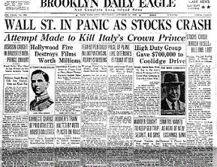
The Stock Market Crash
October 29, 1929: Stock prices collapsed. Fortunes evaporated overnight.
Companies began to lay off more people, many went bankrupt. Banks eventually went under.
Those who had purchased on credit, found themselves with no way to pay off the bills.

Slide 8
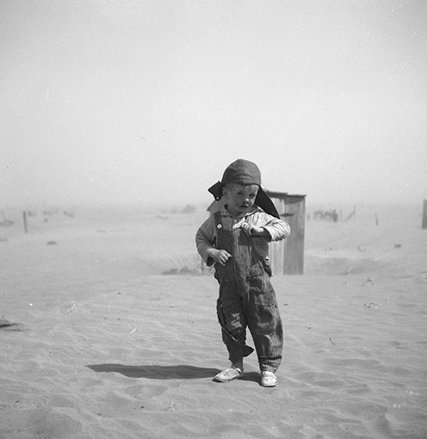
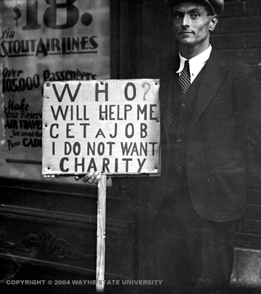
The Great Depression
1929-1939
Worst global economic crisis in history.
Canada among worst-hit countries.
27% unemployment.
Spurred political upheaval and formation of new parties.
Redefined the role of government in the economy.
Notes:
- People lost businesses, farms, and homes.
- Poverty
- Hunger
- Low wages
- Hoboes

Slide 9
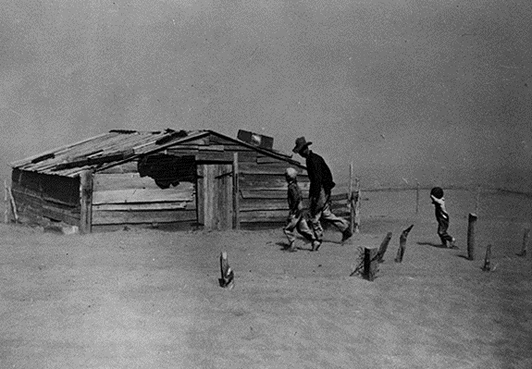
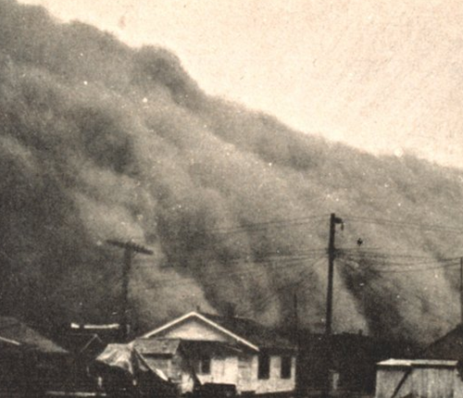
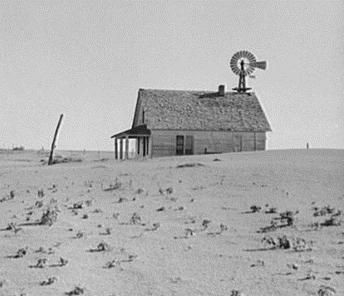
The Dust Bowl
Conditions worse in the Prairies
Highest decline in income in Manitoba (49%), Saskatchewan (72%), and Alberta (61%).
Dust Bowl
Notes:
- Loose soil caused by years of over-farming and drought helped create huge dust storms whenever high winds blew.
- Also, hail storms and locusts
- Along with economic collapse, there was the in western Canada and the United States.

Slide 10
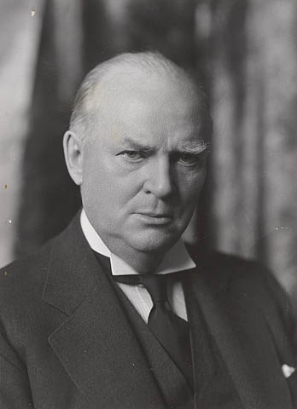
Prime Minister Bennett’s Response
Conservative Prime Minister R.B. Bennett felt that the economy would get better on its own (laissez-faire)
Direct relief strategies unpopular
Relief (work) Camps for young men.
Notes:
Eventually he decided to raise tariffs to protect Canadian industry. Unfortunately, every other country tried the same.
Bennett lost the election of 1935.

Slide 11
“Bennett Buggy”

Slide 12
Letters to Bennett
Campbellton, N.B. Nov. 29, 1932 Dear frend I am taking the pleasure in rinting you a few lines to ask you if you would healp me out in some way for I am sick and I can[t] work and the Dotor wount halp me out in anny way witeout money I toat you would halp me wite a treamen for I tink you are the onny one would halp me out I vouted for you so trie halp me out in some way and I will never for get you I am yours very truly
Rufus snider

Slide 13
Letters to Bennett
Beeton Station, Quebec February 9, 1934 Honourable R. B. Bennett Ottawa Dear Sir Please forgive me for asking you for help. Since I have not been able to get anything from the council after several requests I thought of contacting you, maybe you won’t say no. I worked for you a few years ago and I will work again in the future. I have been sick for the past 5 years, 4 years ago, I spent 6 months in the hospital and since then I’ve always done what I could to give my family what they need today I can’t do anything at all. I need to go back to the hospital right away, the doctor told me that I can’t live much longer without care. I have 6 young children, I’m 42 years old I don’t have money, we don’t have any more food, no clothing all we are — think about it my dear Mr. R.B. Bennett a cold winter like we’re having. The children complain because they’re hungry and cold I can’t give them what they ask for to tell the truth it’s very sad. I hope my letter will be considered and to receive a reply soon Respectfully Arsene Gaudet

Slide 14
Letters to Bennett
How did the authors of these letters characterize the role and purpose of the government?

Slide 15
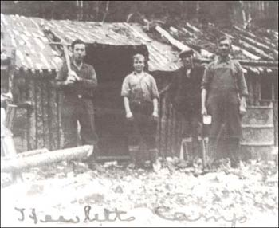
Work Camps
Established to keep growing number of unemployed men out of trouble and off the streets.
Terrible living and working conditions.
Breeding grounds for political radicalism
Notes:
- They were placed far from society to keep them out of the public eye
(out of sight, out of mind).
- Hot, dirty, cramped shelters; lousy food…
similar to prison camp life.
- Organized by the military: very strict rules (couldn’t leave without permission)
- often built roads to nowhere.

Slide 16
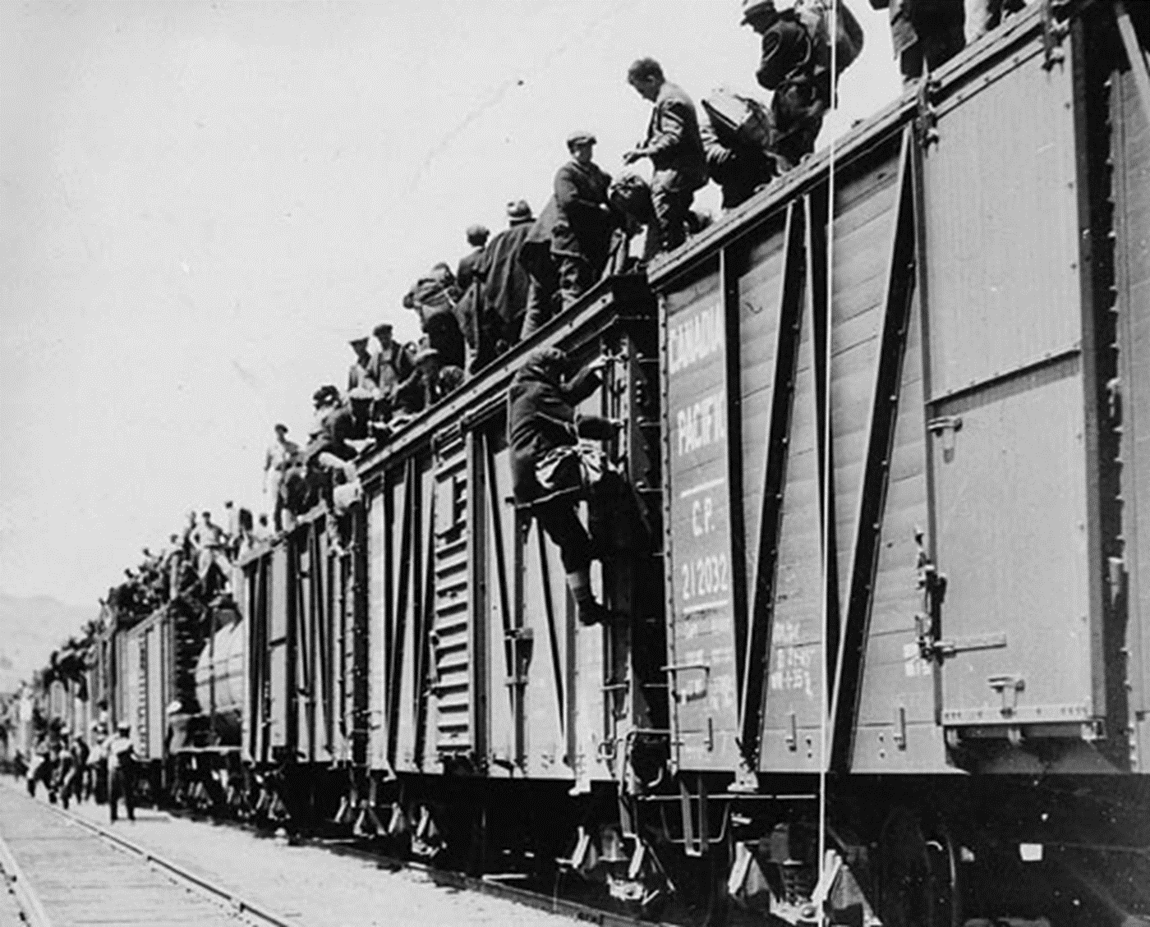
On-to-Ottawa Trek
Frustrated by the worsening conditions of the Great Depression, and the inaction of Prime Minister Bennett and the Federal Government, men in British Columbia work camps decided to deliver their demands to the federal government. They road the rails from B.C. towards Ottawa, but were intercepted by the R.C.M.P. in Regina.
Notes:
In April 1935, approximately 2,000 workers left the camps and congregated in Vancouver, beginning a general strike to protest
the low wages and camp conditions.

Slide 17
6 Demands of the Trekkers
1) Minimum wage of 50 cents/hour for unskilled labour. Union rates for skilled labour.
2) All workers in work camps should be covered by Compensation Act. First Aid services at camps.
3) Recognized and democratically-elected committees of workers and camps.
4) Work camps be taken out of the control of Department of Defense.
5) Social and unemployment insurance provided to camp workers.
6) All workers guaranteed right to vote.

Slide 18
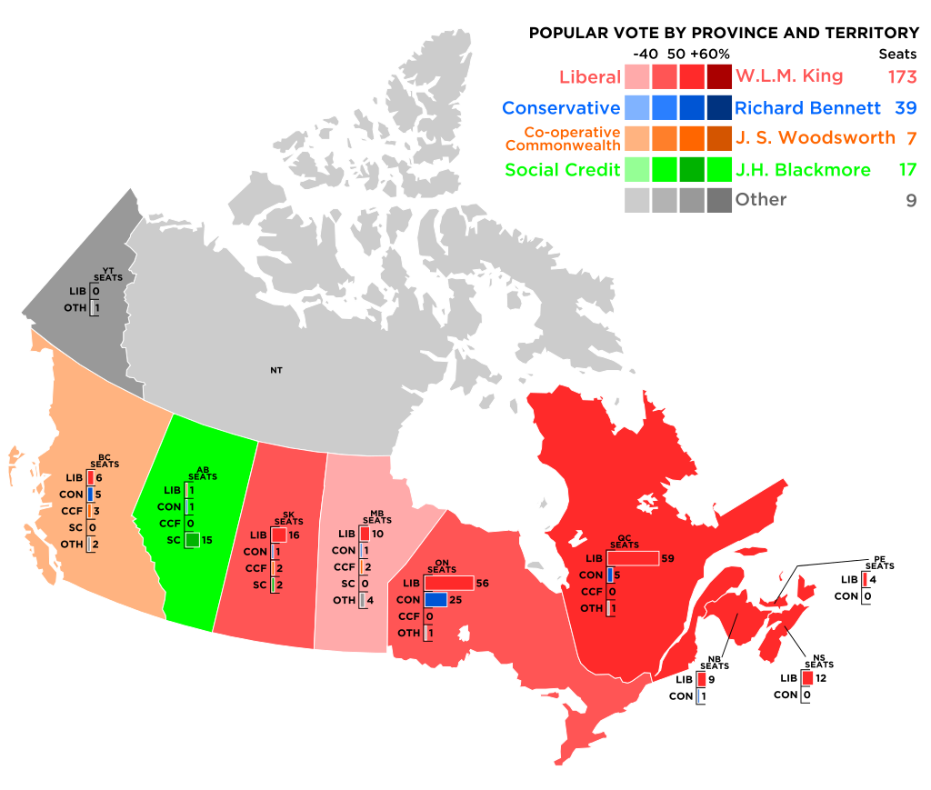
1935 Federal Election
As election approached, Bennett began to take more substantial action.
Too little too late.
Mackenzie King and Liberals sweep into power.

Slide 19
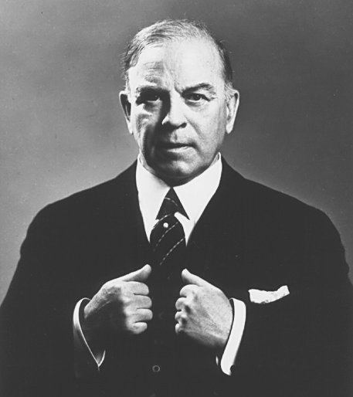
Prime Minister King’s Response
P.M. William Lyon Mackenzie King launched his “new deal”, modelled on that of American president, Franklin Roosevelt.
Increased Government Intervention in the economy.
Notes:
Massive public works
Crown corporations
Soup kitchens
Direct relief

Slide 20
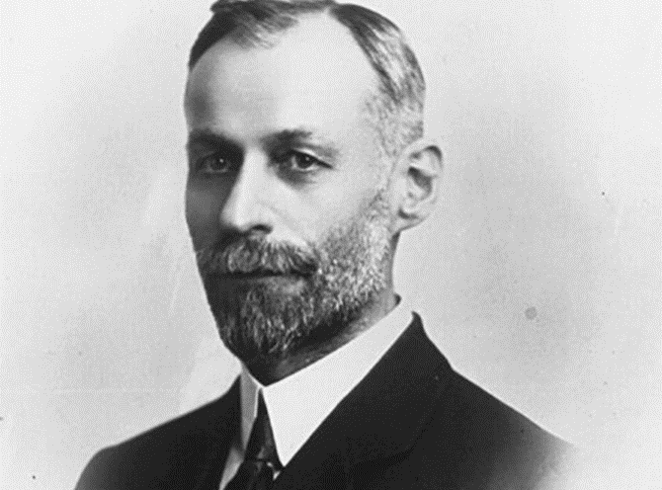
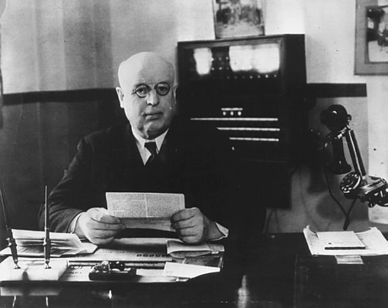
New Political Parties
Because of the problems of the Depression, many people felt that the old political parties and the old economic system had no solutions. New political parties were founded.

Slide 21
Election 1936!

Slide 22
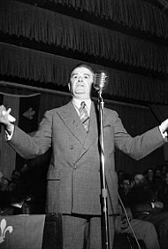
Discussion Questions
What does the emergence of these new political parties suggest about Canadians’ attitudes about:
The capitalist system?
The dominant federal parties (Conservatives and Liberals)?
The role of government?
What influence do you think these parties (and their ideas) had after the depression? What is their legacy?
Notes:
Welfare state
Provincial autonomy

Slide 23
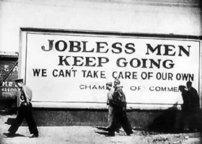
The End of the Great Depression
The Great Depression was only ended by the outbreak of World War II.
What lessons can we take from the causes and effects of the Great Depression?
What is the greatest legacy of the Great Depression?

