Slide 1
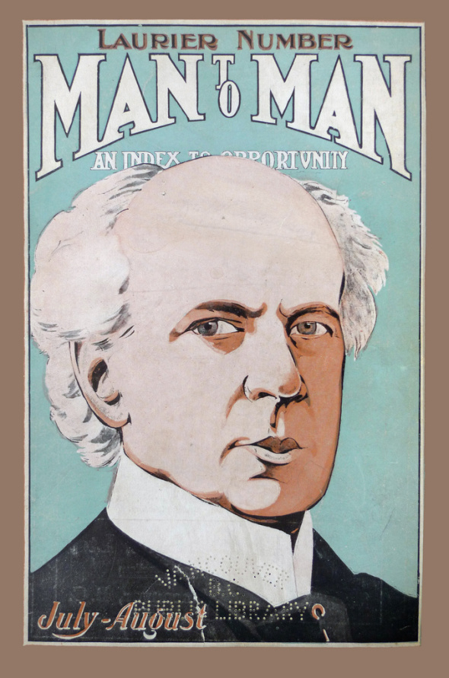
Laurier’s “Sunny Ways”
Canadian history 120
Tannisha Grimm
Mr Champion

Slide 2
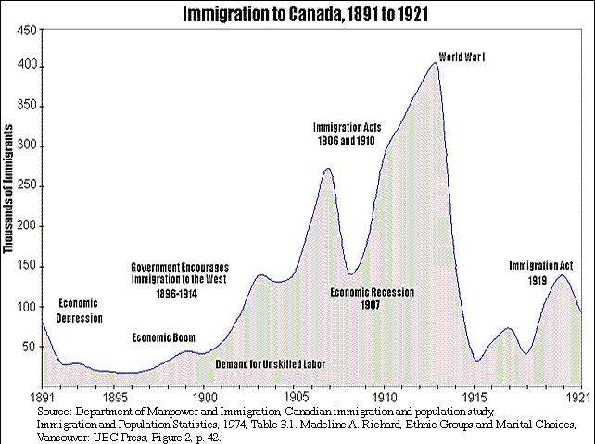
The Immigration Increase
Immigrants between 1896-1914 had a significant impression on Canadian history and overall world view
A steady flow began setting in after Canada’s depression in 1891
Population rose 2/3

Slide 3
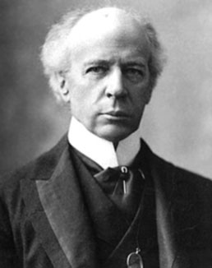
The Golden Years
Sir Wilfrid Laurier was the first French-Canadian Prime Minister
The 15 years in power were referred to as the “golden years”
Took the “sunny ways” approach
Canada grew in size and economically
The immigrants changed perspectives to a much more
Soft approach, disregarding the “two nations” concept

Slide 4
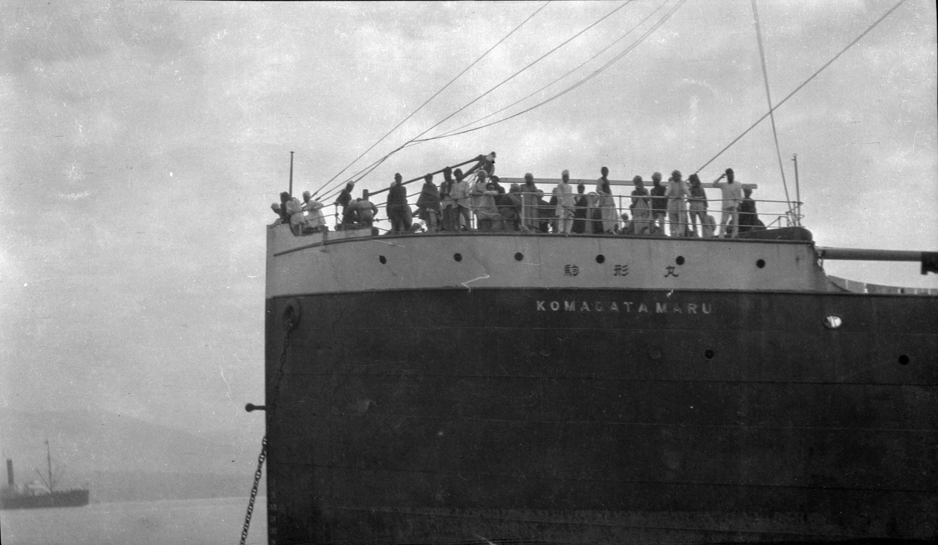
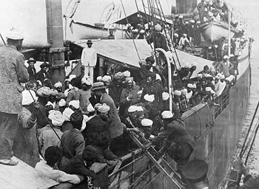
SS Komagata Maru
The Komagata Maru arrived in Vancouver in 1914
376 passengers from India
$200 fee
Detained on board 2 months in the blistering heat of the summer while decisions were being made on their arrival
Navy cruiser Rainbow escorted Komagata Maru out of waters (if they did not leave they threatened to explode it)
After this epidemic many Indian-Canadian’s left Canada

Slide 5
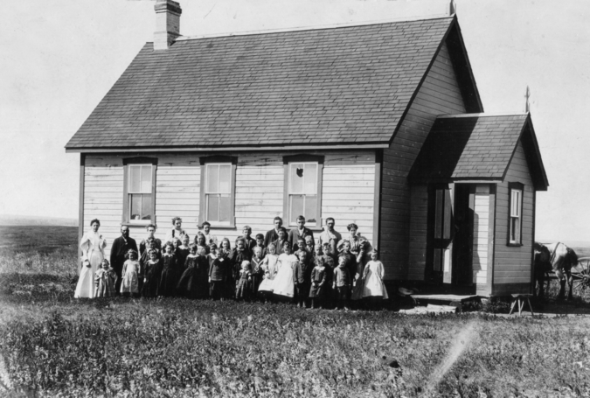
Manitoba School outcome
1890 Manitoba schools eliminated all languages excluding English
Stopped funding French Catholic schools in province
To lower education cost
1896 Laurier approached the issue with caution
Rights of minorities must be acknowledged to make a fair decision

Slide 6
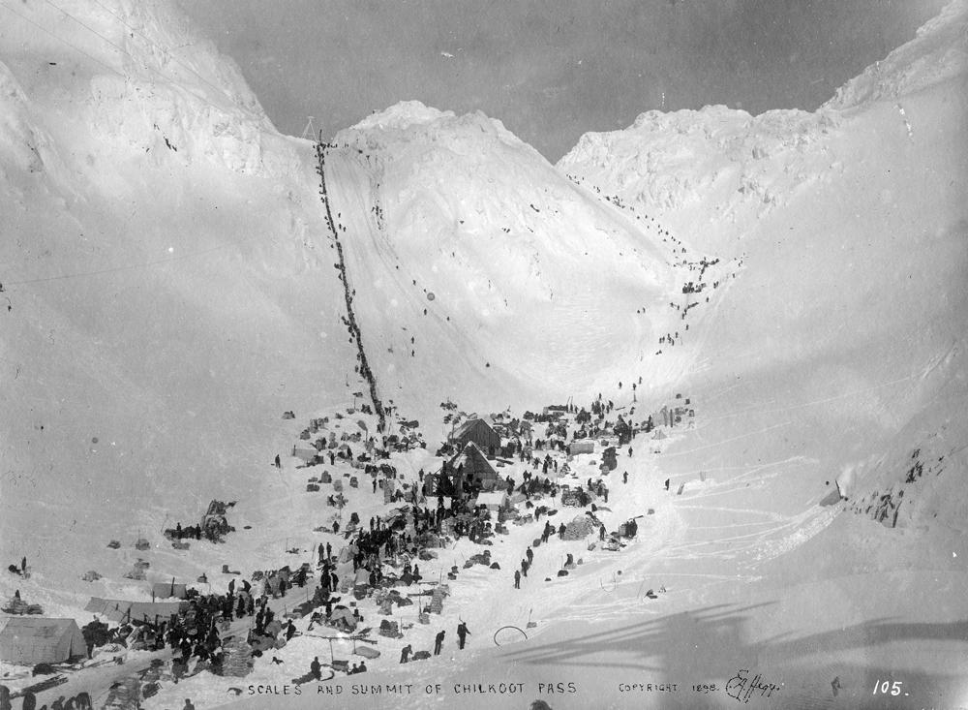
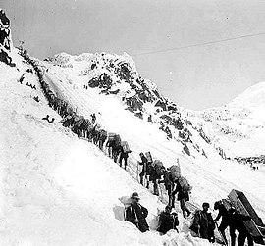
Klondike Gold Rush
Began when 3 Prospectors discovered Gold in Rabbit Creek which resides near the Yukon River
A small town of a few hundred grew to 25 000+ in hunt for gold
The process to get this gold was hard
As the gold died down so did the residents, it went back to housing a few hundred people

Slide 7
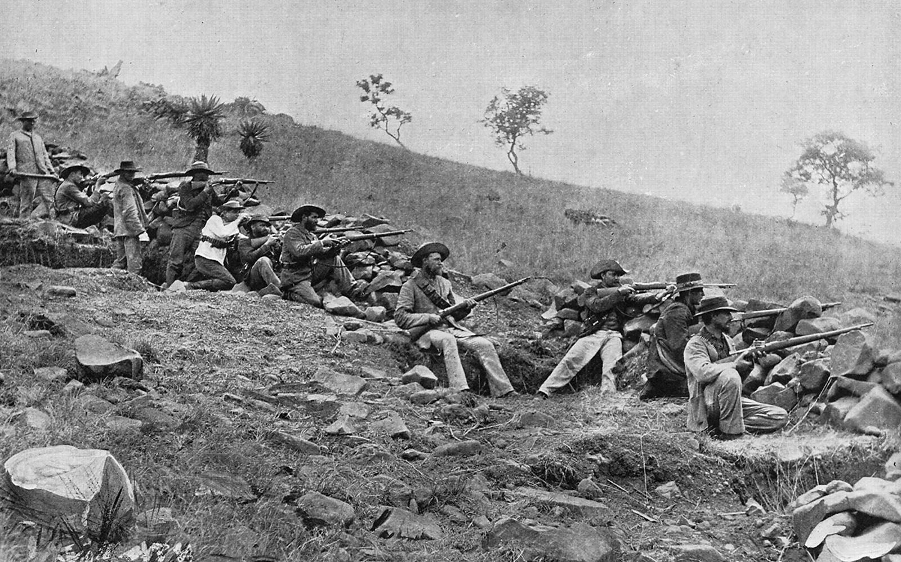
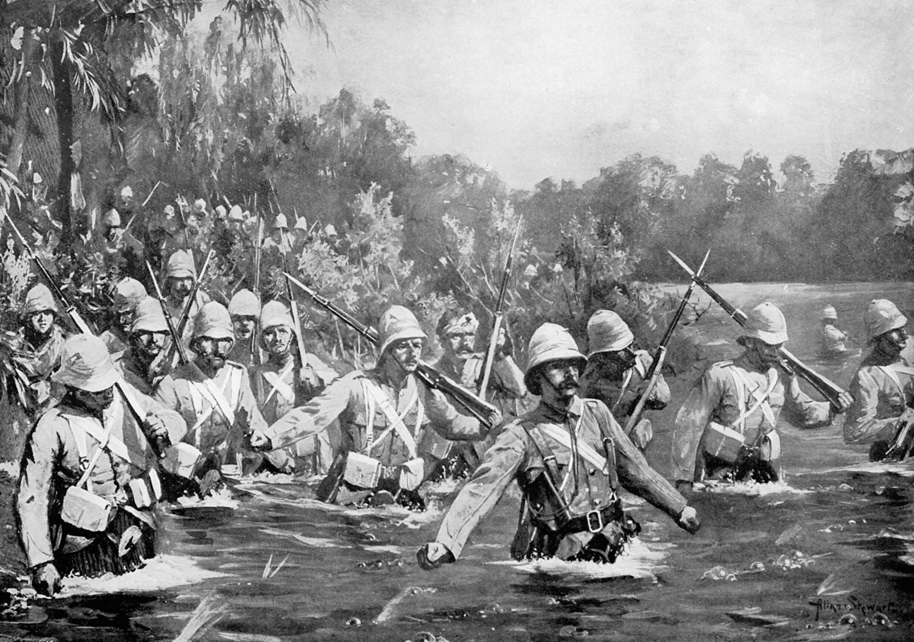
Boer war
1899 South Africa declared war against Britain and requested Canada’s assistance
This deeply divided the French Canadians and the English Canadians
Laurier approached with his “Sunny Ways” tactic, this neither upset nor did it please anybody.

Slide 8
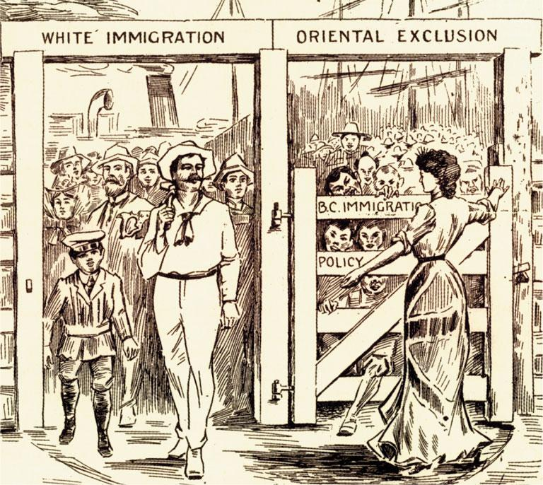
British Columbia
In 1901 price went from $50 to $500 for Asian immigrants to enter Canada
The fear of losing jobs and wages to the Asian immigrants overcame them
Vancouver gathered over 30 000 people to participate in an “anti-immigration Rally” in 1908
Laurier would later apologize for these actions and negotiate with Japan to ensure the annual limit for immigrants reside at 400

Slide 9
Discussion Questions
Do you believe the Sunny Ways approach is an effective way to be a leader?
Did Laurier effectively handle all the situations he had to stand for?
How do you feel about the PM mentioning this approach?

Slide 10
Videos:
https://youtu.be/Yjk1P4wEK9c
https://youtu.be/DPIqlu7NwZ4

Slide 11
Bibliography
Defining Canada, McGraw-Hill Ryerson
https://pier21.ca/explore/online/tell-me-more-about/komagata-maru
https://www.canadashistory.ca/explore/settlement-immigration/selling-the-prairie-good-life
https://www.britannica.com/biography/Wilfrid-Laurier

