Slide 1
The Haves and Have Nots
Canada in the Post War 20s

Slide 2
The late teens and the early 1920s
Munitions factories reduce production/close.
Vets return to work and women return to "domestic responsibilities"
Economic recession
21% of returning vets were unemployed.
Inflation: rise in prices accompanied by a drop in buying power.
1918: cost of living was nearly twice as much as it was in 1914.

Slide 3
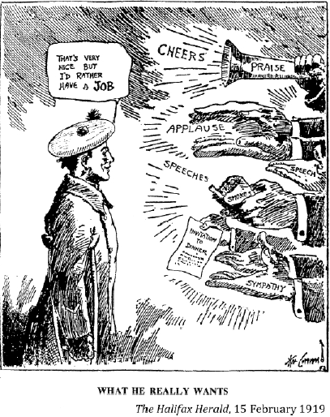
Veterans lobbied for improved benefits
They received:
A lump sum for their service
$35 to buy civilian clothing
A year of medical care
Allowances were paid to wives of those who died
Q. What could the Canadian Govt. have done to reintegrate veterans into society?

Slide 4
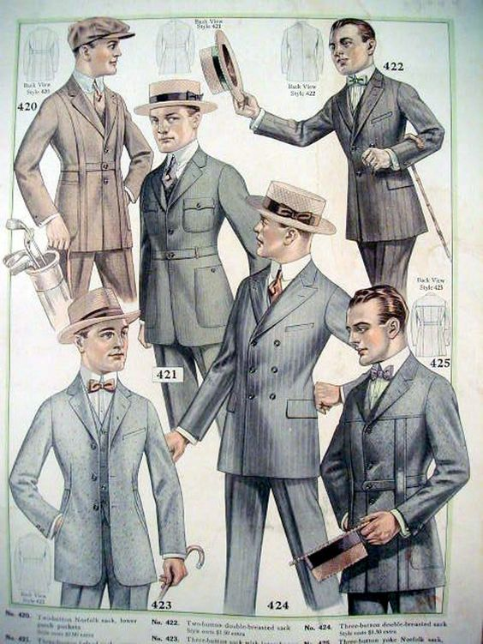
The Haves
For some the prosperity of the post war economic boom made life easier and more enjoyable than ever before.
New technology and inventions were readily available…for those who could afford it.

Slide 5
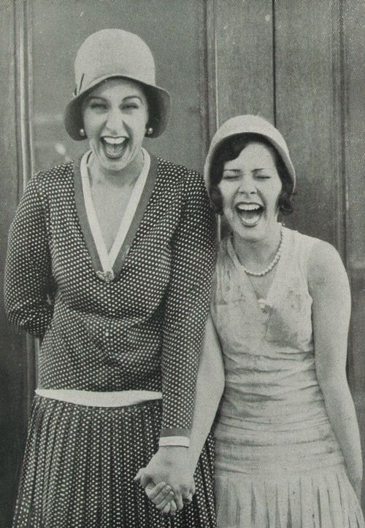
Living the High Life
As the economy in some parts in Canada flourished so did peoples spending habits. Instalment plans allowed some people to pay-off purchases over a set amount of time.
If farmers wanted to purchase new equipment they could borrow money in order to get the equipment now and make money to pay it off later on.
As the “good times” continued many families believed that going into debt to purchase a new car was no problem.
Notes:
1923: new Ford car was $440 ($5211 in todays money)

Slide 6
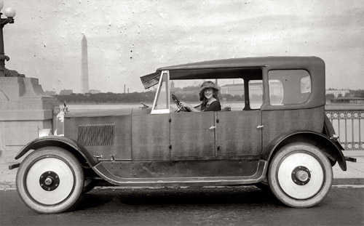
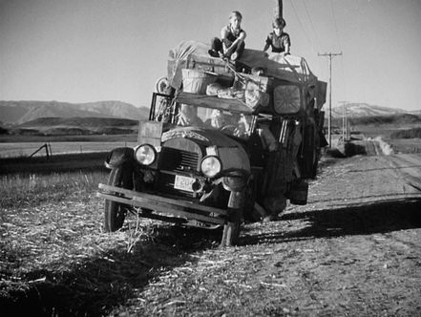
Question to Consider
The surge in new vehicles had a fairly large impact on the lives of Canadians. How do you think vehicles impacted Canadian society?
Notes:
Cars made travel much easier – city dwellers could travel into the country and those in the country could visit the city to shop and spend money.

Slide 7
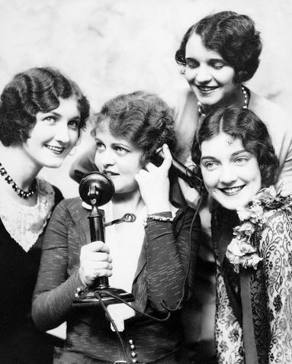
Can You Hear Me Now?
The 20s was when the telephone gained some popularity. In 1920 only 1 in 4 families had a phone but by 1929, in many regions in Canada, 3 in 4 families had a phone.
While long distance calls were expensive and unreliable being able to communicate with people in other regions was an incredible leap from other primitive forms of communicating.

Slide 8
Question
Many families in the 1920s started to go into debt from making purchases that they didn’t have the money to pay for. What problems do you anticipate may arise for some of these families?
Do people follow similar habits today?
Notes:
Canadians now owe $1.65 for every dollar of disposable income they have.
Disposable Income : income remaining after deduction of taxes and other mandatory charges, available to be spent or saved as one wishes.

Slide 9
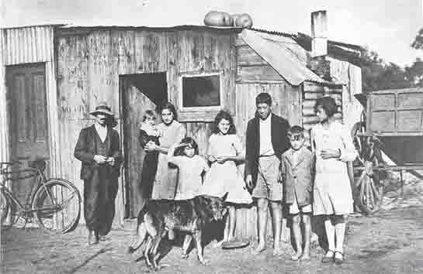
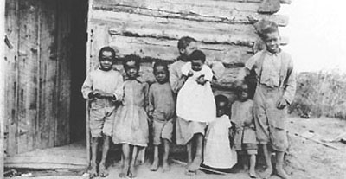
The Working Poor
While it appears that the 20s were great for many Canadians it isn’t so great for others.
In rural regions in Canada many families had to sell their products or barter with storekeepers for the basic necessities. In urban areas many poorer families struggled with day-to-day activities and often went with electricity and even food.
May African Canadians and Canadians of Asian descent found themselves among the working poor.

Slide 10
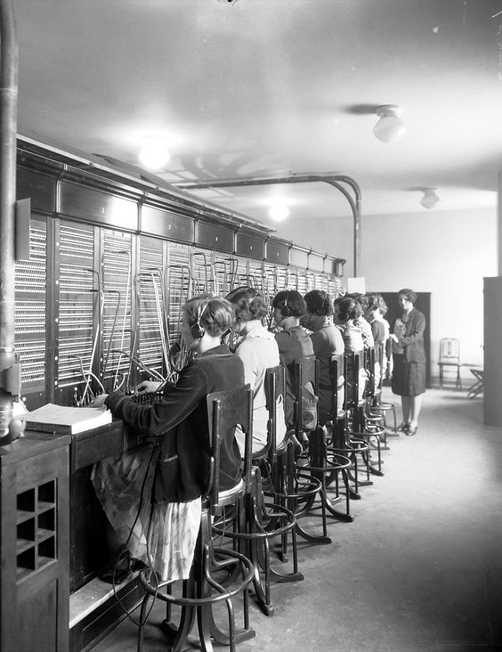
Women in the 1920s
During WW1 many women found themselves in factories and other sources of employment but that was short lived as returning soldiers forced women out of the workplace in many regions in Canada.
Most girls left school by grade 8 and were expected to help raise the family at home or work. However, when the time came, women were expected to leave jobs to become wives and mothers.
Women did find jobs as telephone operators.

Slide 11
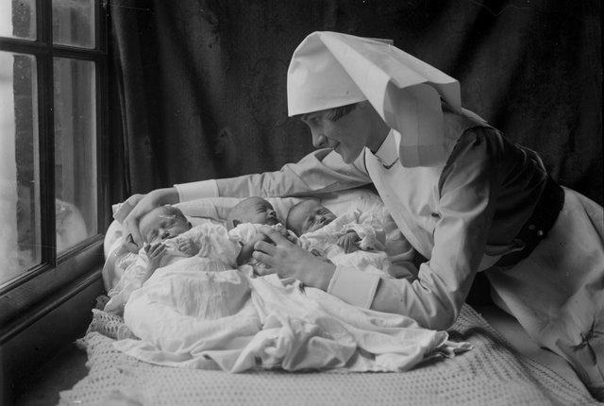
Women in the Workforce
In addition to telephone operators educated women found career opportunities as teachers, nurses, bookkeepers or secretaries. Those women without any skills training found employment as domestic help, or as clerks in offices, stores, or factories.
Women with university degrees were rare in the 20s but by 1930 women made up nearly a quarter (23.5%) of university graduates. Despite similar education backgrounds women were usually paid far less than men in similar jobs.

Slide 12
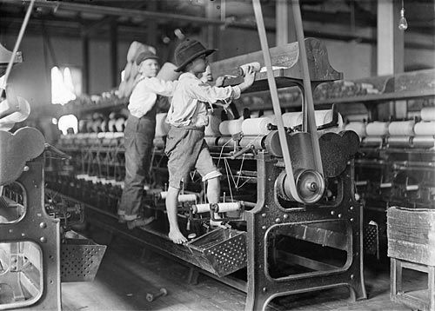
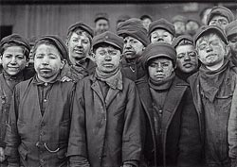
Children in the Workplace
Child labor laws have recently helped to improve conditions in most public workplaces but some children worked in family businesses in deplorable conditions. By 1929, laws were put into place that prevented children under the age of 14 from working in factories and mines in most provinces.

Slide 13
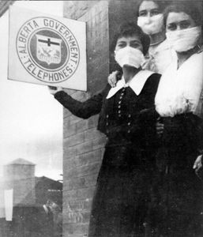
Influenza 1918 - 1919
Spanish Influenza (flu) spread quickly in the mud and filth of the trenches.
Wounded soldiers returning home carried the disease with them.
The flu became a global pandemic.
Public health department closed schools and public spaces (ex: theatres)
Some historians believe that as many as 50 million died from the Spanish flu (50 000 Canadians).

Slide 14
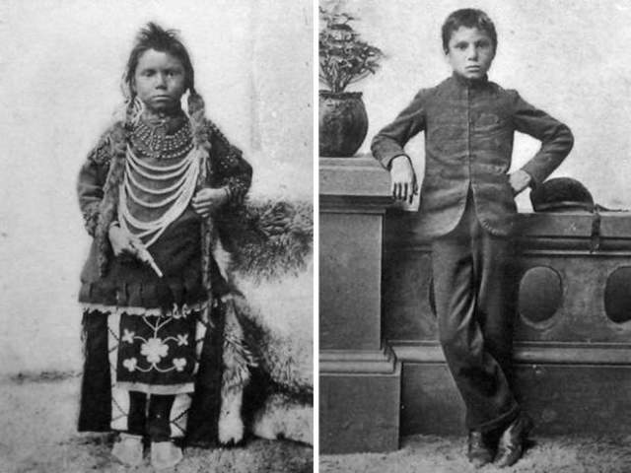
The First Nations
What messages would it send to First Nations and to other Canadians?

