Slide 1
Life in New France 1636-1740
Adam Cross

Slide 2
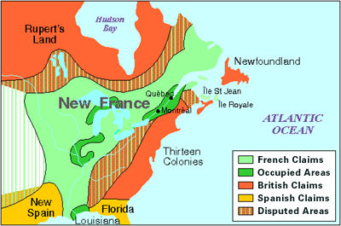
Geography
The French had claims that spread much farther than the area that they actually occupied.
The primary settlements surrounded Quebec City and Montreal. They also occupied what is now Toronto, chicago, Detroit, and New Orleans.
They were flanked by the British to the north and east, and the Spanish to the south.

Slide 3
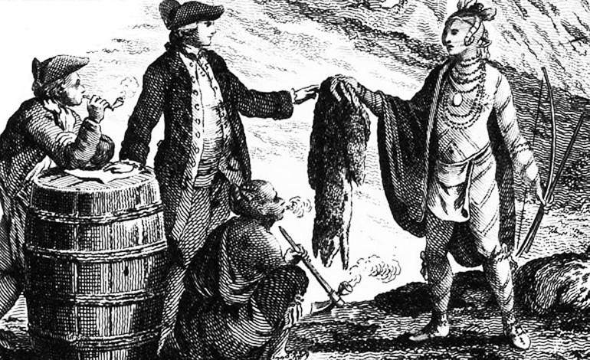
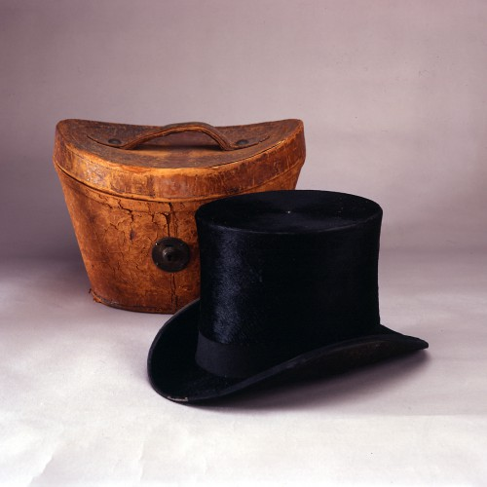
Trade and Economy
One of the most prominent reasons for France to colonize North America was adding to France’s wealth and power.
The colony would supply France with raw materials and buy finished products back, thus stimulating the French economy.
The most significant and consistent export of New France was fur. Beaver pelts were in high demand because of France’s need for beaver felt hats.
The French were competing directly with the Hudson's Bay Company and the Iroquois who were trading with the English and Dutch.
French companies sent men over on contracts to work in New France as farmers and fur traders.

Slide 4
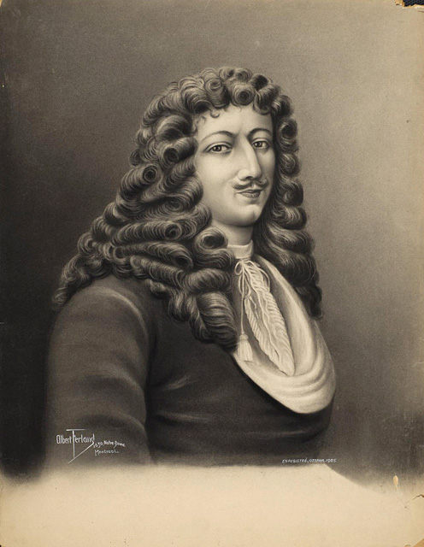
Jean Talon
Jean Talon was sent to New France by Louis XIV to help establish royal government as well as grow and improve its usefulness to France.
Talon had farmers diversify and expand their crops so they could export food, cloth, and leather. Soon after he started exporting lumber, which was successful.
He tried to create a shipbuilding industry. The industry didn’t last because too many components were imported from France and there were very few skilled builders in New France.
Jean Talon was responsible for expanding French sovereignty to three quarters of the continent to the west and south.

Slide 5
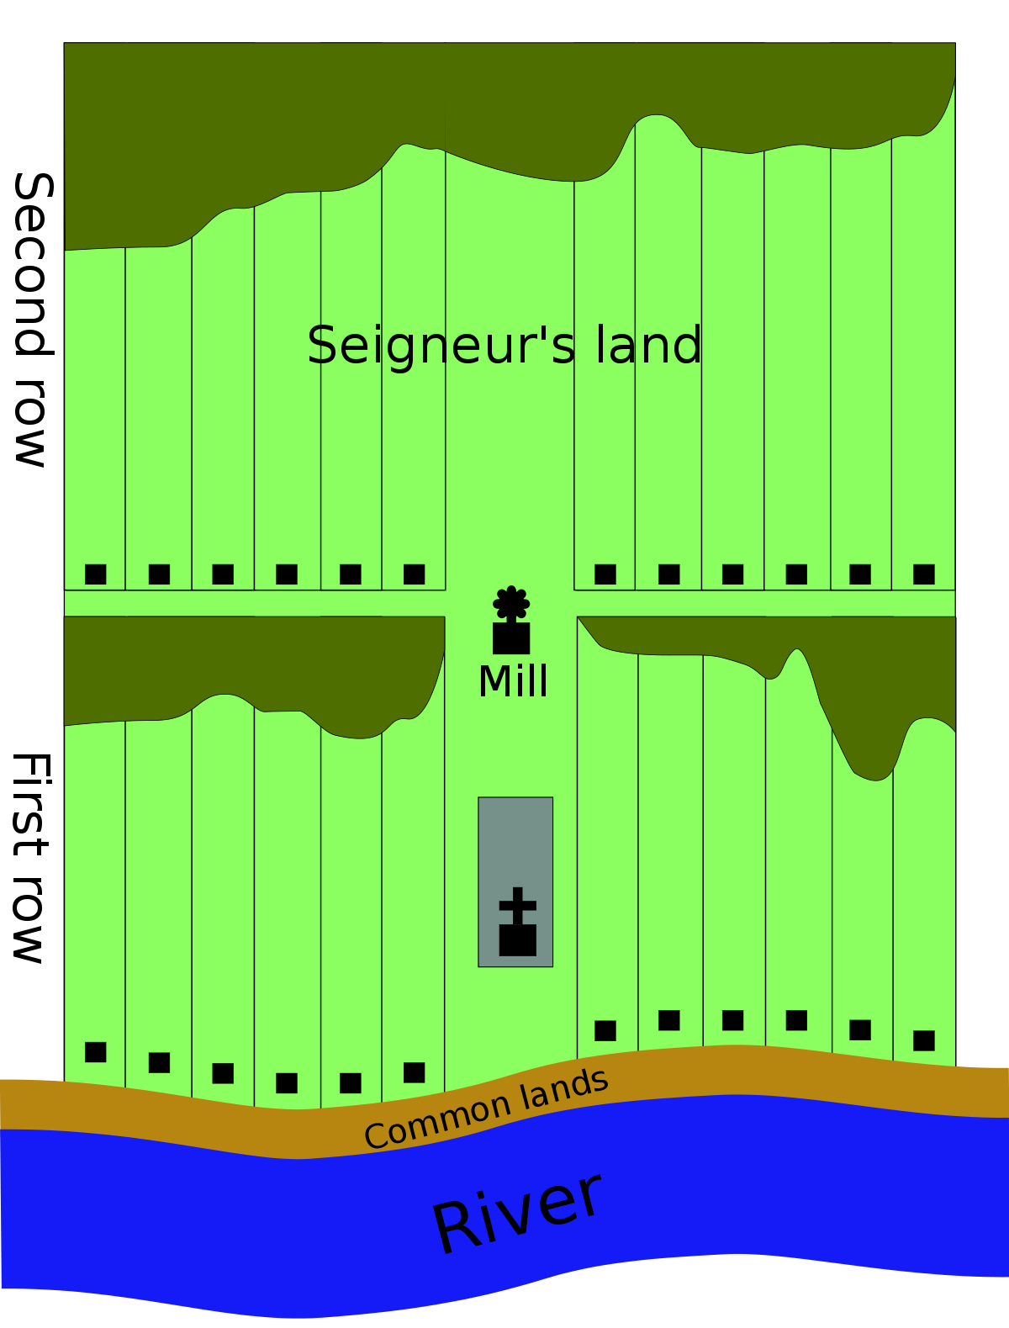
Seigneurial System
This part of the feudal system was imported from France. The king gave seigneurs land to hold and settle, they recruited people to come from France to clear and farm the land. Those recruited were called habitants, they were given long, skinny strips of land along the river bank (180m by 1800m primarily the St Lawrence)
In exchange for living in the seigneur’s land as well as farming, hunting, fishing and using his mill the habitants paid annual fees to the seigneur.
Habitants were contractually required to work for a certain number of days and pay tithes to the church once per year. Initially the tithes were one thirteenth of their yearly crop, after much protest this was changed to one twenty sixth of their crop.
The habitants of New France preferred smaller villages that were more spread out, this meant that Seigneurs often had trouble collecting enough fees to fulfill their contract.
By 1740 there were two hundred surrounding the St Lawrence

Slide 6
Daily Life
Eighty percent of people living in New France were Habitants, the rest lived in cities nearby. Some families supplied the cities with food, but most produced little more than enough for their own families, however it all really depended on the season.
When men were off hunting or absent with the militia women took over the farms, and when the men were home they still helped with butchering and bringing in the harvest.
Much of their diet was the same as it was in France, lots of bread, meat and dairy. In the spring they also foraged for berries and hunted game when it was in season.
Family was a lot more important than in France, children often stayed at home instead of apprenticing a trade in town. Many colonial administrators believed this to be influenced by native lifestyle.
The home was the hub for socializing, with nowhere else to congregate they gathered in homes to drink, play cards and music as well as dance and sing. The clergy often worried about their new rebellious and self sufficient lifestyle.

Slide 7
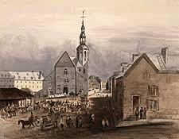
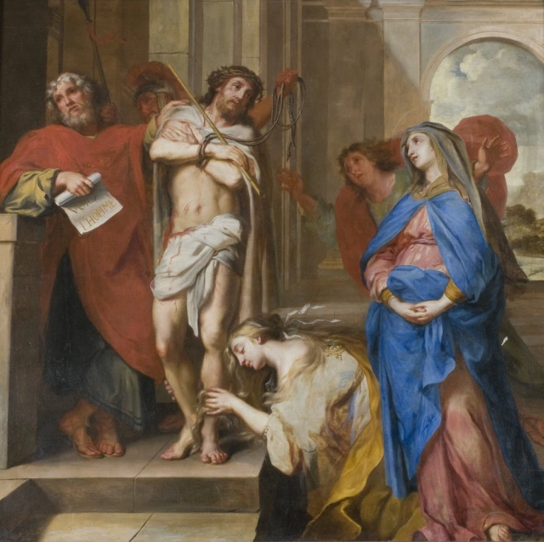
Religion
New France, much like France was very catholic. Initially only catholics were allowed to colonize New France, after the crown realized how little interest there was this rule was quickly dissolved.
The catholic church was dead set on converting natives to catholicism, however their big attempts kept being postponed due to the government wanting a peaceful relationship with natives.
Almost all art created in New France was based around religion. The most prominent artists of New France were Frère Luc and Hugues Pommier. Some of their creations were considered religious propaganda.

Slide 8
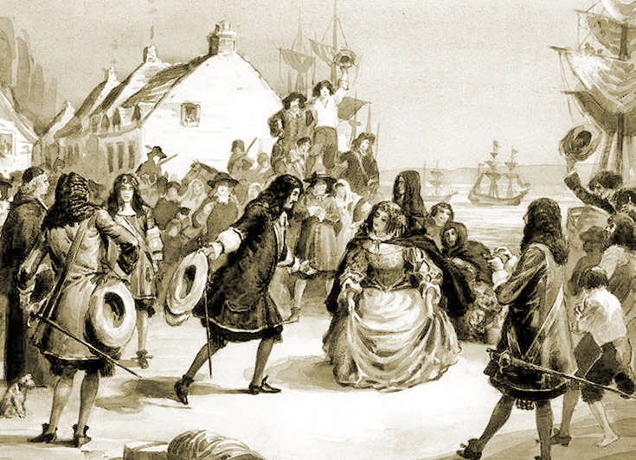
Les Filles du Roi and Marriage
Private companies almost exclusively sent men to New France to work. Because of this there was a huge gap in gender. To balance this, create more population, and as an incentive for men to stay and colonize Louis XIV decided to send between 800 and 900 single or widowed women aged 16-45 to New France. They were known as The King’s Daughters.
Population was something that Louis really wanted to increase, so he said that any man younger than 20 or woman younger than 16 that got married would receive twenty pounds on their wedding day. He also gave a yearly pension of 300 pounds to families with ten children and 400 to families with twelve.
In an attempt to increase population and convert natives at the same time a policy was created for men to marry native women. This ended up having the opposite effect and the men became more interested in native culture than the other way around.

Slide 9
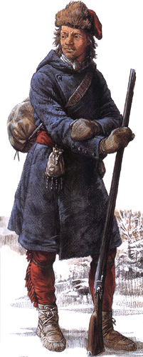
Canadian Militia
The canadian militia was formalized in 1669 by the king, he stated that every able bodied man from 16 to 60 had to belong to a militia. These militias helped with defence, construction around the village and some offensive missions and raids.
They were considered effective and feared by their enemies. They had learned tactics in guerilla warfare from native allies and many were hunters or coureurs de bois, meaning they knew the land well and were good with guns.
By 1700 every parish along the St Lawrence had a militia lead by a local captain.

Slide 10
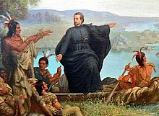
Native Relationships
Many native tribes were considered allies in war and trade, those who weren’t made up the majority of french slaves.
The French were allied with the Huron and Mi'kmaq against the Iroquois who had trade alliances with the English and Dutch.
The French created boarding schools and enrolled native children. The subject matter didn’t make sense to them so their parents removed them or the children took it upon themselves to run away.
The church was always trying to convert them, but when met with resistance they often backed off to preserve good relationships. They ignored their differences for their own benefit.

Slide 11
Societal changes
Because the people of New France were from very diverse backgrounds and places in France society shifted. In New France a peasant could eventually become someone in high standing, such as a seigneur or an established businessman. Often seigneurs weren’t much wealthier than the people that lived on their land.
Villages were fewer and smaller, many of the french didn’t want to live in densely populated areas.
Seigneurs often found secondary ways of making money. Many got involved with the fur trade or the lumber industry.

Slide 12
Sources
https://www.thecanadianencyclopedia.ca/en/article/filles-du-roi
https://www.historymuseum.ca/virtual-museum-of-new-france/daily-life/foodways/
https://www.thecanadianencyclopedia.ca/en/article/new-france
http://faculty.marianopolis.edu/c.belanger/quebechistory/encyclopedia/CanadaReligiousHistory_000.htm

