Slide 1
People on the Move
Immigration

Slide 2
Why do people move?
There are many reasons why people migrate, or move, to a new place. There are two categories that we can divide these reasons:
Push Factors: These cause people to want to leave their current location. Examples include: lack of political/religious freedom, war, famine, poverty, climate change, natural disasters, and unemployment.
Pull Factors: These attract people to a new location. Examples include: greater economic opportunity, availability of land, to be with family, milder climate, discovery or development of resources, access to tech, and a democratic political system.

Slide 3
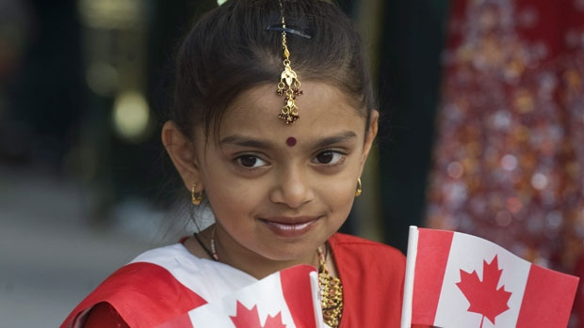
Migratory Movements
Canada has a reputation for welcoming immigrants from a wide range of countries.
The number of immigrants vary from year to year depending on the economic conditions and social and political attitudes of the time period.

Slide 4
In 1971, Canada was the first country in the world to adopt multiculturalism as an official policy. By so doing, Canada affirmed the value and dignity of all Canadian citizens regardless of their racial or ethnic origins, their language, or their religious affiliation. The 1971 Multiculturalism Policy of Canada also confirmed the rights of Aboriginal peoples and the status of Canada’s two official languages.
While we pride ourselves on our relatively new-found sense of acceptance we have never always been so welcoming.

Slide 5
In the past, it was typical for Canadians to be more ethnocentric than we are today.
This belief that our way of life is superior to others led to a govt. policy influenced by prejudice. Immigrants from places that shared similar beliefs, customs, language and ethnic background were given preferential treatment when coming to Canada.
Who do you think were the preferred? What about the shunned?
Notes:
Ethnocentric - the belief in the inherent superiority of one's own ethnic group or culture.
Preferred immigrants: British, American, Northern/Western Europe.

Slide 6
Examples of Discrimination
African-American farmers were turned away at the boarder in the early 1900s.
The Chinese Immigration Act of 1923 forbade the entry of Chinese into Canada, it was repealed in 1947.
Canada was unwilling to accept Jewish refugees fleeing Nazi Germany in the 1930s.
Those Jews that did make it to Canada were often put into prison camps along side Germany POWs.
Notes:
Japanese, Indian and some pacifist religious sects from Russia/Northern Europe also experienced racism and discrimination.

Slide 7
Jewish Refugee Admission During WW2 by Country
United States | 240,000
Britain | 85,000
China | 25,000
Argentina | 25,000+
Brazil | 25,000+
Canada | < 5,000

Slide 8
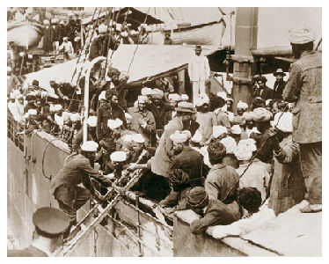
In 1914 the arrival of the Komagata Maru in Vancouver with East Indian immigrants touched off violent demonstrations in Vancouver. As a result they were refused entry.

Slide 9
Historical Information
Prior to WW1 Canada had relocated many aboriginal people in the west to reserves and were starting to encourage European immigrants to populate the west.
Between 1919 and 1929, 1.3 million people moved to Canada before the influx of new people slowed. By 1930 many Canadians opposed immigration. Why?
After WW2, Canada changed its policies on immigration as the atrocities witnessed during the war made people sensitive to the suffering of others.
Notes:
In the 1930s the Great Depression struck and many Canadians were fighting for jobs, many feared immigrants would take the available jobs.
1947-1950: displaced refugees from WW2
1956: Hungarian refugees
1968-1969: Czechoslovakian refugees
1971-1980: Ugandan refugees
1972: Chilean refugees
1975-1981: Indo-Chinese refugees (boat people)
1999: refugees from Kosovo

Slide 10
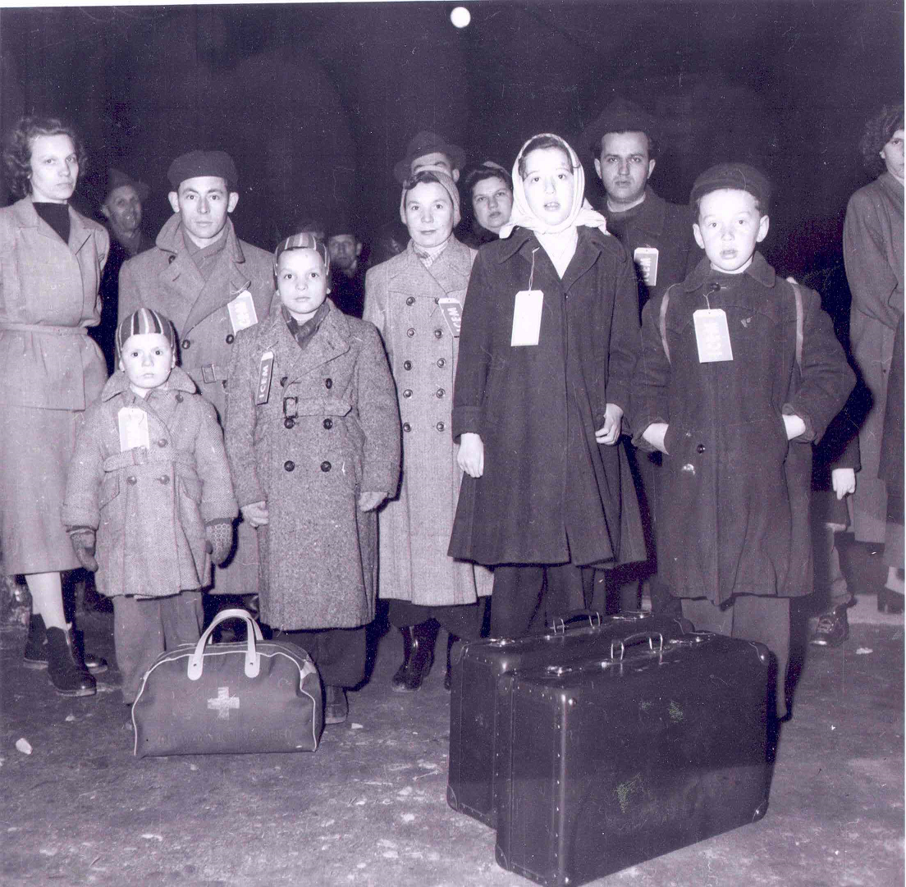
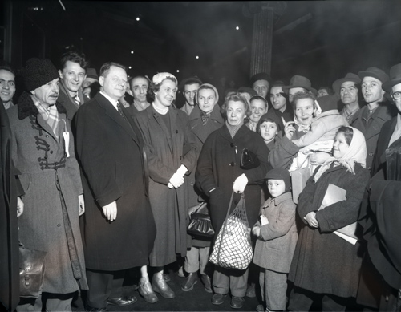
1956: Hungarian Refugees

Slide 11
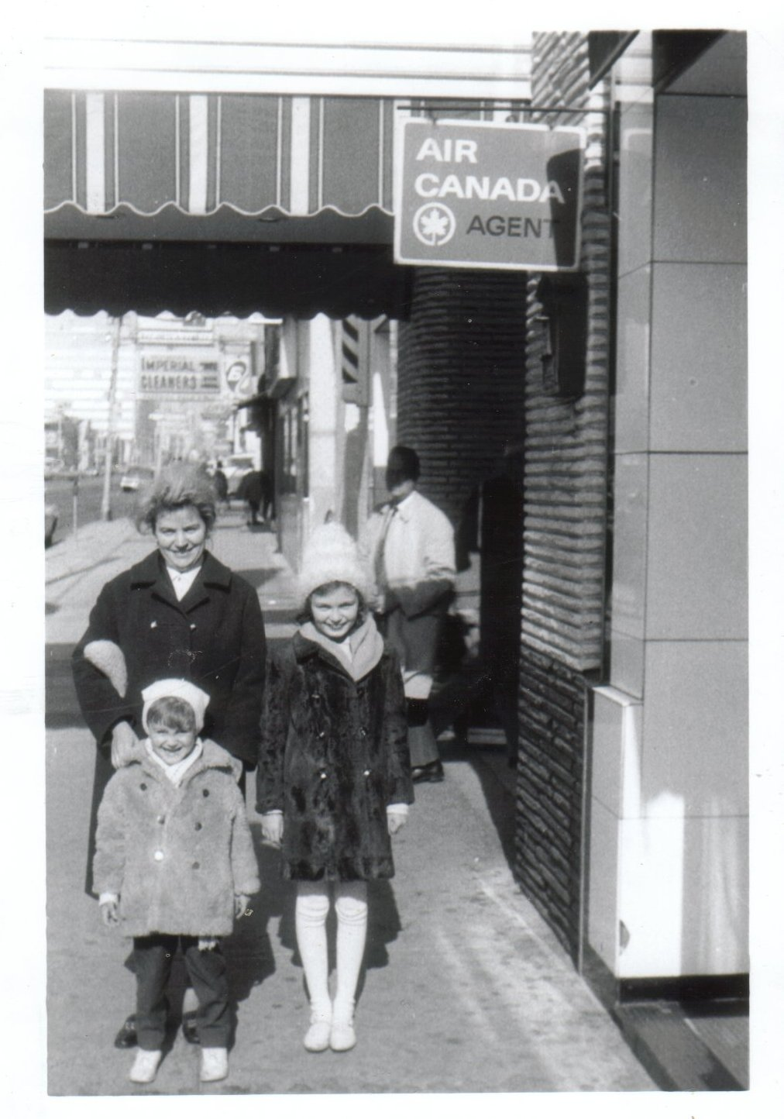
1968-1969: Czechoslovakian refugees

Slide 12
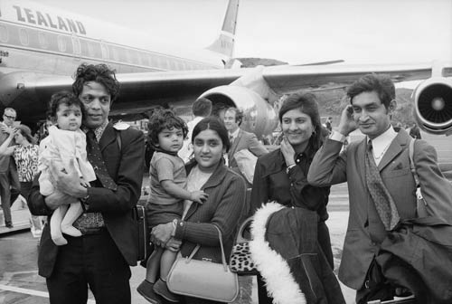
1971-1980: Ugandan Refugees

Slide 13
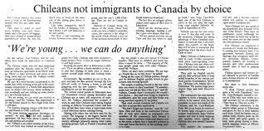
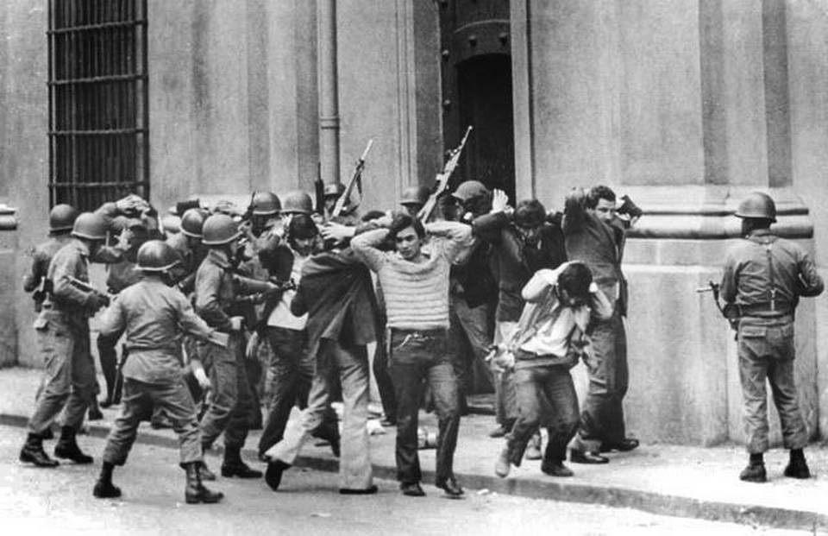
1972: Chilean refugees
Notes:
Supporters of President Allende are rounded up by Pinochet’s troops (1973)

Slide 14
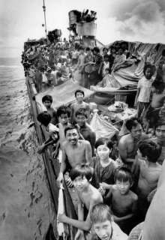
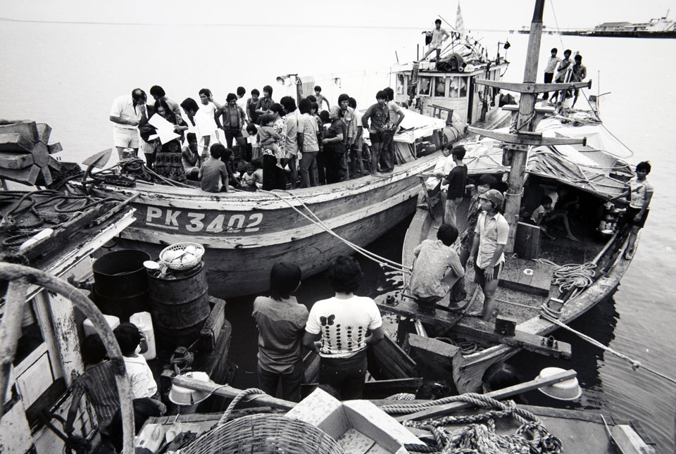
1975-1981: Indo-Chinese refugees (boat people)

Slide 15
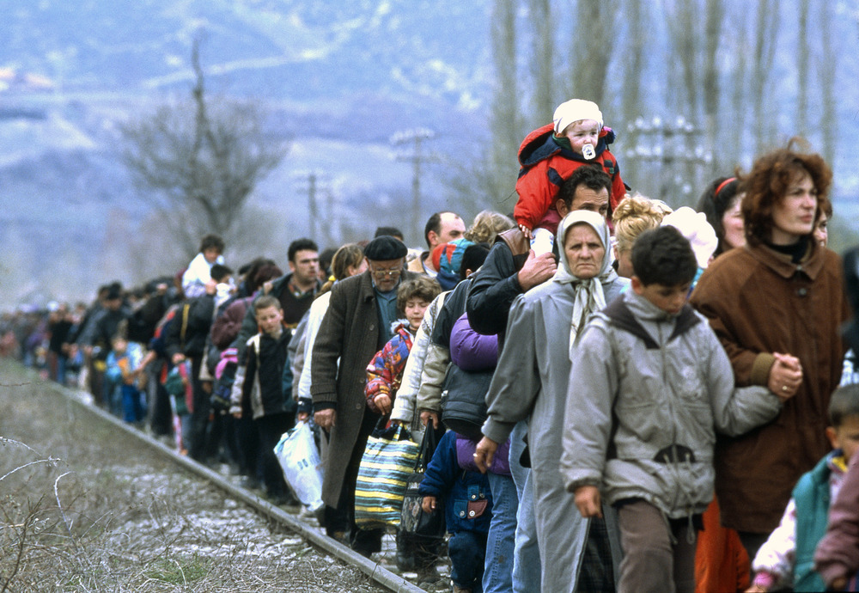
1999: refugees from Kosovo

Slide 16
Immigration Policy Today
Immigrants are classified into three groups:
Family Class: A close relative living in Canada can sponsor family members to move to Canada.
Humanitarian or Refugee Class: An immigrant fleeing “great personal danger” in their homeland.
Independent Class: These applicant must meet a point system to establish that their move will be positive for Canada as well as the applicant.
Notes:
In 2006, 54% of immigrants were admitted under the economic component of the immigration policy (including principal applicants as well as their spouses, partners and dependents). Among those immigrants, the principal applicants were selected for economic reasons—meaning that they were considered to be more likely to stimulate economy or integrate into the labour market given their age, education level and knowledge of Canada's official languages.

Slide 17
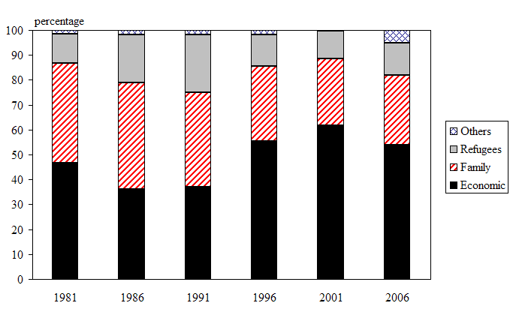
Immigrants to Canada by category, 1981 to 2006
Notes:
Note: The category "Others" includes deferred removal order class, post-determination refugee claimant class, temporary resident permit holders and humanitarian and compassionate/public policy cases.

Slide 18
From the Dept of Immigration, Refugees, and Citizenship
Canadian multiculturalism is fundamental to our belief that all citizens are equal. Multiculturalism ensures that all citizens can keep their identities, can take pride in their ancestry and have a sense of belonging. Acceptance gives Canadians a feeling of security and self-confidence, making them more open to, and accepting of, diverse cultures. The Canadian experience has shown that multiculturalism encourages racial and ethnic harmony and cross-cultural understanding, and discourages ghettoization, hatred, discrimination and violence.

Slide 19
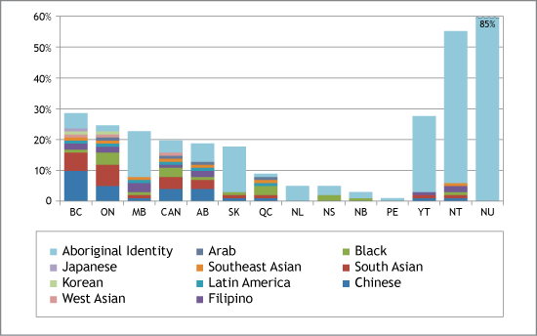
Canada's Visible Minority and Aboriginal Population by Region

Slide 20
Questions to Answer
Are you in favour of or opposed to increased immigration in Canada’s future? Why?
Has your family, or relative, moved to a new country, city or province? What push/pull factors may have been a factor in there decision?
How does immigration affect Canadian Identity?

