Slide 1
The Fall of New France
Canadian History 122

Slide 2
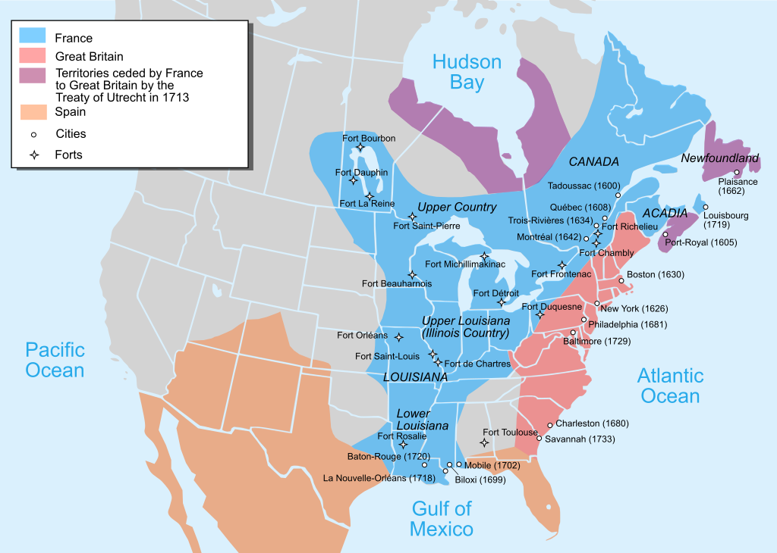
Map of the British and French settlements in North America before the Seven Years' War

Slide 3
The Beginning of the End : The Seven Years’ War (1756-1763)

Slide 4
The Beginning of the End: The Seven Years’ War
During the Seven Years’ War (1756-1763) the great Empires Of Europe struggled to maintain colonial territory, economic wealth and power on the European continent and in lands far removed from Europe
The Fall of New France was a part of British prime minister's William Pitt master plan to fight and defeat France by use of naval power on a world wide basis
When William Pitt became British prime minister in 1757 , he began to concentrate British forces on defeating France in North America. If France was gaining ground in Europe the British would focus their attention on winning war in North America
Notes:
Overseas territories, like Canada and the thirteen colonies became pawns in a larger game.
While France focused on victory in mainland Europe, the British decided the focus of their strategy would be conquering colonies.

Slide 5
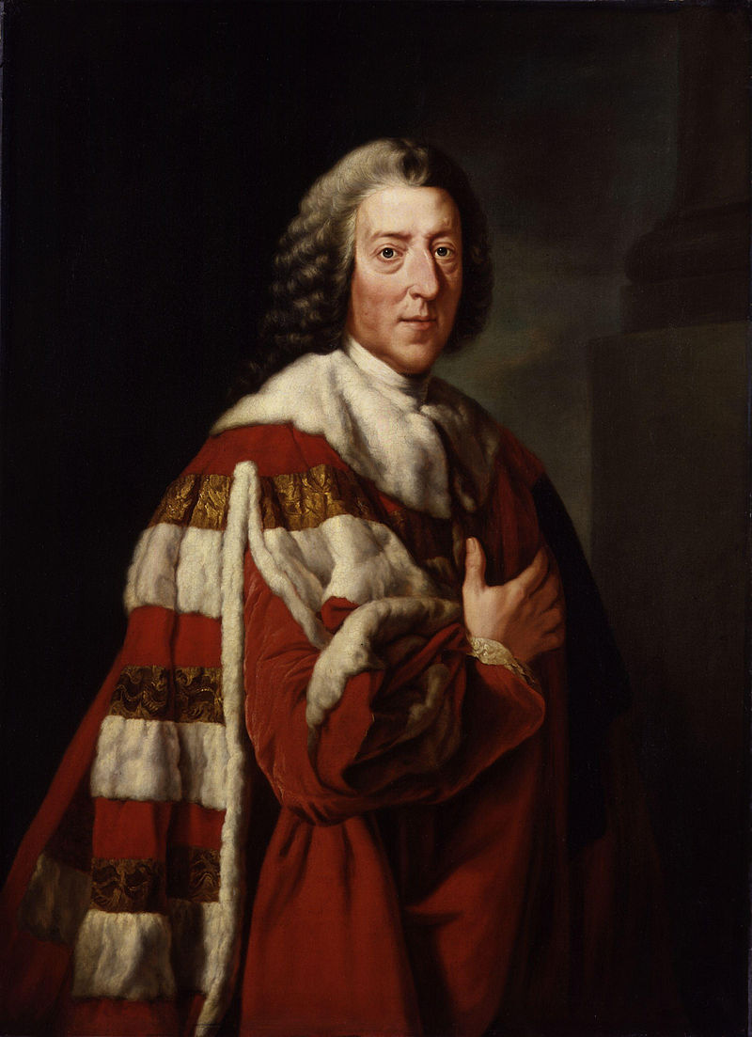
William Pitt The Elder First Ministry 1757-61 , Second Ministry 1766-68
Dominated the political scene influencing government from within and without. He is remembered for his skills as a wartime leader during the Seven Years' War
Pitt was the son of a member of Parliament and the grandson of Thomas Pitt who had helped to build British trade in India

Slide 6
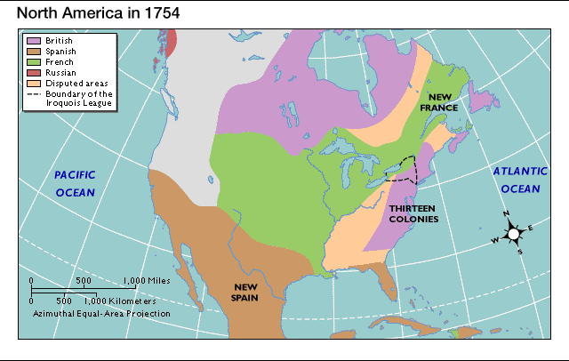
French Expansion and The Thirteen Colonies
New France’s expansion into the Ohio and Mississippi valleys had started in the mid-seventeenth century with Jean Talon​
The Thirteen Colonies were a group of British colonies on the Atlantic coast of North America founded in the 17th and 18th centuries
During the year between 1747 and the outbreak of the Seven Years’ War, there were battles in the Ohio valley between the French, French Canadians, and their Aboriginal allies on the one side and the British, the militia of The Thirteen Colonies, and their aboriginal allies on the other side
Notes:
The French had claimed sovereignty over native land spanning from the Mississippi to the Gulf of Mexico.
Despite their claim, however, there was little military force to protect the land.
Seizing the opportunity, the British established bases and a trade company in Ohio valley, to undermine French power. The British wanted the fertile farmlands of this region.
Over the course of the ensuing conflicts, the Ohio valley became a killing field for both sides, as fighting often took place between French aligned natives and the British aligned Thirteen colonies.

Slide 7
Aboriginal Position
While there were still some Aboriginal groups who remained allies of the French and some who became allies of the British, other Aboriginal Peoples believed that neither the French nor the English would protect their land for them.
During the war, The Iroquois Confederacy were allied with the French. Seeing French defeat, in 1760 The Iroquois Confederacy resigned from the war and negotiated the Treaty of Kahnawake with the British. Among its conditions was their unrestricted travel between Canada and New York, as the nations had extensive trade between Montreal and Albany
The Algonquin were interested in fighting against the Iroquois

Slide 8
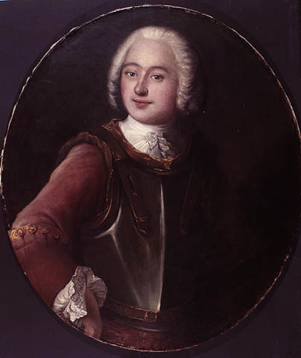
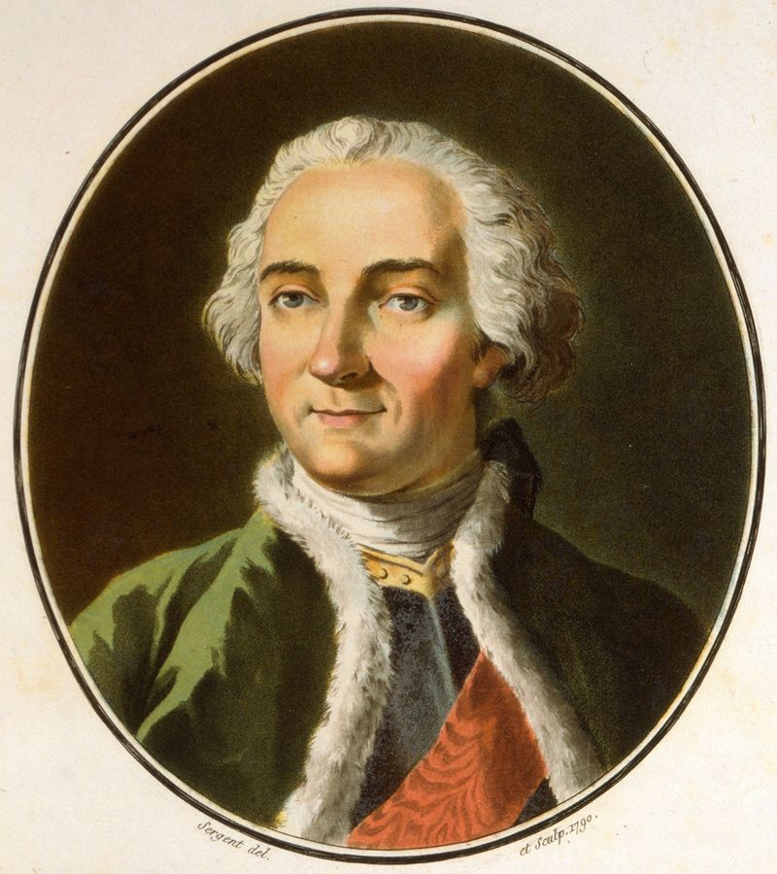
Montcalm and Vaudreuil
Pierre de Rigaud de Vaudreuil de Cavagnial, Marquis de Vaudreuil
The governer of Quebec, Vaudreuil, a native french canadian, knew the country and believed that his strategies would keep Quebec from being conquered by the British.
He wanted to strengthen the canadian militia with thirty-six hundred French regular troops, co-ordinate large numbers of aboriginal war parties with french force,and launch series of surprise guerilla raids at various points along the st. Lawrence River.
Louis-Joseph de Montcalm
He judged Vaudreuil to be "too Canadian".Montcalm thought that Vaudreuil's strategies would not be effective, and they were contrary to the European tradition of war.He said that "it is no longer time when few scalps, or the burning of a few houses is any advantage or even an object.Petty means,petty ideas, petty councils about details are now dangerous and a waste of time".
Montcalm wanted to concetrate French troops along the inner defences of the St.Lawrence and Richeliieu rivers,and he wanted the canadian militia incorporated into the regular army
Notes:
Montcalm and Vaureuil were two French generals tasked with defending new France.
Vaureuil wanted to launch surprise attacks and raids against British assets, strengthen the French forces by incorporating militia units, and utilize the skills of the first nations tribes to their fullest potential.
Montcalm, on the other hand wanted to fight traditional pitched battles against the British.

Slide 9
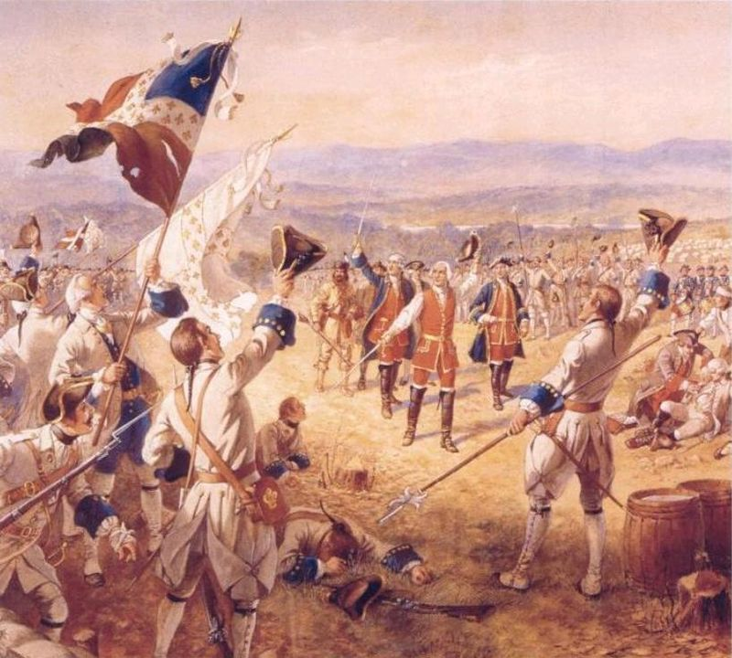
The Battles
Before the Seven Years' War was officially declared, the French achieved a number of visitories against the British. They defeated British troops at Fort Duquesne, and stopped attacks at Fort Niagara and in the lake Champlain area.In the early days of the war,both Montcalm and Vaudreuil achieved more victories
Montcalm was placed in supreme command of all French forces in North America
In July of 1758, a British force of fifteen thousand soldiers, the largest army amassed in North America to that time, attacked Montcalm and the French at Fort Carillon. Montcalm, with only thirty-six hundred soldiers, kept the British at bay ,though with a heavy loss of life.
"The Victory of Montcalm's Troops at Carillon" by Henry Alexander Ogden
Notes:
Fearing they would lose their land, the French began building forts throughout their territory in New France.
One of those forts, built in modern day Pittsburg caused conflict, when the British claimed it was on their territory.
In 1754, George Washington and a crew of 150 British soldiers demanded the French leave Fort Duquesne, and fired at a French scouting party, killing 10 men. This was the start of the war.
Prior to the beginning of the seven years war, both of the existing French generals achieved multiple victories over the British.
Eventually Montcalm, one of the two, was given supreme command of all French forces in North America.
For some time the French would hold their own, even holding off a British force of 15 000 with only 3 600 of their own troops in 1758.
The sheer number of British assets in the continent however, was overwhelming.

Slide 10
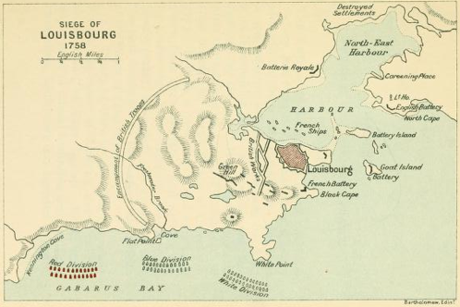
The Siege of Louisbourg (8 June–26 July 1758)
In 1758, the British sent thirty-nine ships, more than twelve thousand troops and almost one thousand mounted guns to attack Louisbourg.
The British commander, General Jeffery Amherst, laid siege to the fort and began the bombardment. The governor of Louisbourg, Augustin de Drucour knew that his town could not hold forever. Food supplies were getting dangerously low, and the hospital had been destroyed
On 26 July 1758, the French surrendered
Notes:
Years of conflict in North America had reduced French military capacity significantly.
Fortress Louisbourg was the last remaining French military emplacement in the Atlantic, and had become a thorn in the side of the British, harboring privateers, blocking British naval access to the Saint Lawrence, and supplying France with a large supply of Atlantic fish.
In 1758, the British sent 39 ships 12 000 troops and almost 1 000 mounted guns to lay siege to the fortress.
Within only a few months, with food storages running out, the French were forced to surrender.

Slide 11
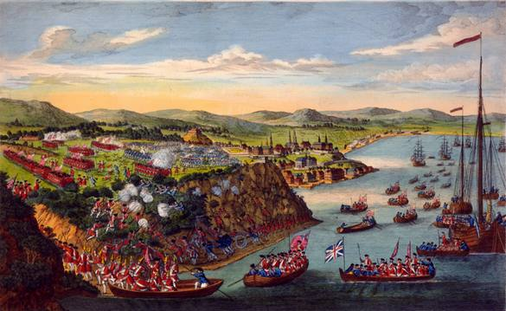
The Siege of Quebec City
The bombardment of the town of Quebec began on July 12,1759 and lasted for nine weeks.
The French command were not optimistic about their chances for winning the battle for Quebec
Drawing by a soldier of Wolfe's army depicting the easy climbing of Wolfe's British soldiers
Notes:
As the war progressed, many of the Quebecois men were leaving their farms and jobs to fight the British.
As a result, food shortages became chronic, with rations being implemented.
Meanwhile, more and more refugees, soldiers, and allies were entering the city, increasing strain on the depleted food stores.
The crowded conditions also resulted in a smallpox epidemic.
When the British arrived, their fleet of ships numbered in the hundreds of the best warships ever made.
The fleet’s population was more numerous than that of the entire city of Quebec.
The bombardment of Quebec began on July 12, 1759 and lasted nine weeks.
All farms within 150 miles of Quebec were destroyed, adding to the growing famine in the city.

Slide 12
The Battle of the Plains of Abraham (Battle of Quebec)
On the morning of 13 September, Wolfe's army formed a line first with their backs to the river, then spread out across the Plains with its right anchored by the bluff along the St. Lawrence and its left by a bluff and thick wood above the St. Charles River.
While the regular French forces were approaching from Beauport and Quebec, the Canadian militia and native sharpshooters engaged the British left flank, sheltering in the trees and scrub; the militia held these positions throughout the battle and fell back on this line during the general retreat, eventually holding the bridge over the St. Charles River
During the battle were mortally wounded commanders of both armies-General Wolf and Montcalm
The result of the battle was the rapid surrender of Quebec on September 18, 1759
Notes:
On September 12, 1759, British General Wolfe decided to bait the French into an outright battle.
Hearing that British army was just outside the walls of Quebec, Montcalm gathered all the troops he could muster from around the region, and marched to meet them.
The ill prepared, underequipped, outnumbered, and unmotivated French army was routed in only three hours.

Slide 13
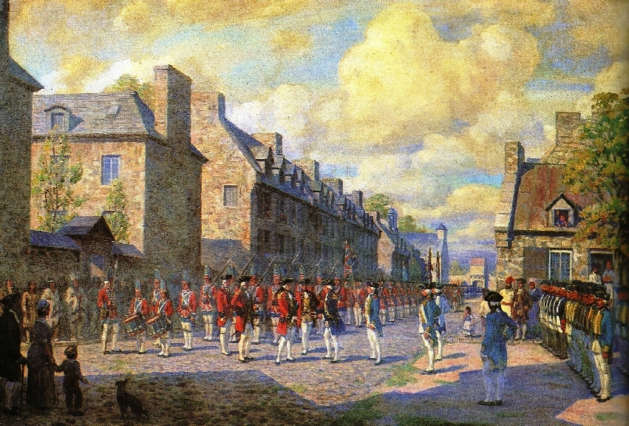
The Capitulation of Montreal
Vaudreuil decided that the war for the French colony had been lost.There was nothing to be gained from further bloodshed and loss of life
On September 8, 1760 Vaudreuil signed the Articles of Capitulation and surrendered the whole of New France to General Amherst
Notes:
Following the battle of the Plains of Abraham, French and Canadian survivors fled to Montréal.
In April of 1760 they returned, and defeated a British force in St. Foy.
The British retreated into the walls of Quebec.
By May, three British armies arrived at Montréal, and captured the city.
With no hope of support from France, the French surrendered on September 8, 1760.

Slide 14
Aftermath
After the battle, most people were allowed to continue living their lives as they had before, the main legal difference being to whom taxes were payed.
New France ceased to exist as a French settlement, becoming a British colony.
Land and property remained in the hands of whoever had owned it during the French rule.

Slide 15
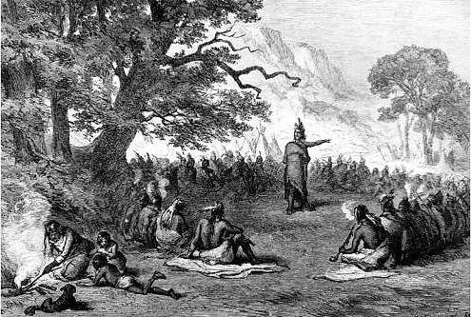
Pontiac's War
Although fighting in Pontiac's Rebellion began in 1763, rumors reached British officials as early as 1761 that discontented Native Americans were planning an attack
The war began at Fort Detroit under the leadership of Pontiac, and quickly spread throughout the region. Eight British forts were taken

Slide 16
Discussion questions:
In your opinion, what are the reasons for the Fall of New France?
In your opinion, what event was a turning point in the war between Great Britain and France in North America? Why?
Do you think there is a connection between the fall of New France and Pontiac's War? Why?
Notes:
Why do you think the British didn't seize the land they captured from its French occupants, and redistribute it among their own?
Why might first nations tribes have been valued by some generals and largely ignored by others?
How do you think the outcome would have been different at Quebec, had Montcalm kept his soldiers behind the fortifications at Quebec?

Slide 17
Bibliography/references:
https://en.wikipedia.org/wiki/Thirteen_Colonies
https://en.wikipedia.org/wiki/French_colonial_empire
http://www.canadahistory.com/sections/Eras/newfrance/thefall.htm
https://en.wikipedia.org/wiki/Seven_Years%27_War
https://en.wikipedia.org/wiki/Louis-Joseph_de_Montcalm
https://en.wikipedia.org/wiki/Pontiac%27s_War

