Slide 1
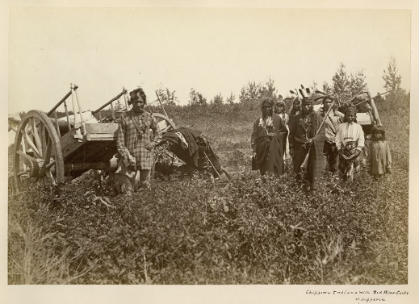
The Metis
During the 1800s

Slide 2
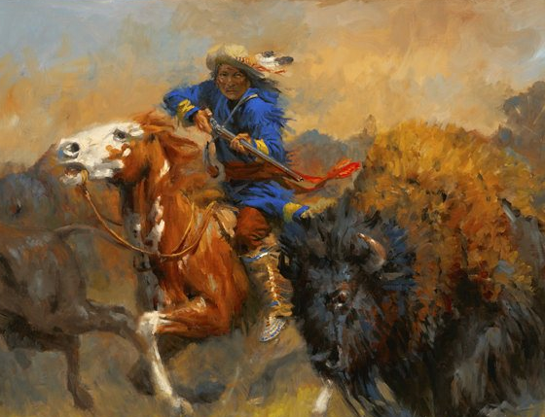
Not all battles during the 1800s were with the United States. In the northwest a ‘new nationality” was taking shape: the Metis, who were a mix of French, Scots, and Aboriginals.
These frontier people, largely French speaking and Catholic, had developed a nomadic lifestyle largely based on the buffalo hunt.
Notes:
As the buffalo died out many of these Metis began to settle down into an agricultural life.

Slide 3
Intermarriage between Aboriginal women and fur trading Europeans and soldiers had started back in the 17th century and continued as more settles moved into the New World.
While some of the children joined the mothers in French Canada and other stayed with the Aboriginal tribes it was the beginning of a new “mixed” people who saw themselves as a distinct nation who shared a culture with others with similar heritage.
These Metis were around well before the British Conquest in areas around the Great Lakes and in today’s Prairie provinces.
Notes:
These early marriages were often encouraged by both colonial administrators and the clergy as it was a way to promote trade relations with the aboriginal populations as well as bring more converts into the Christian faith.

Slide 4
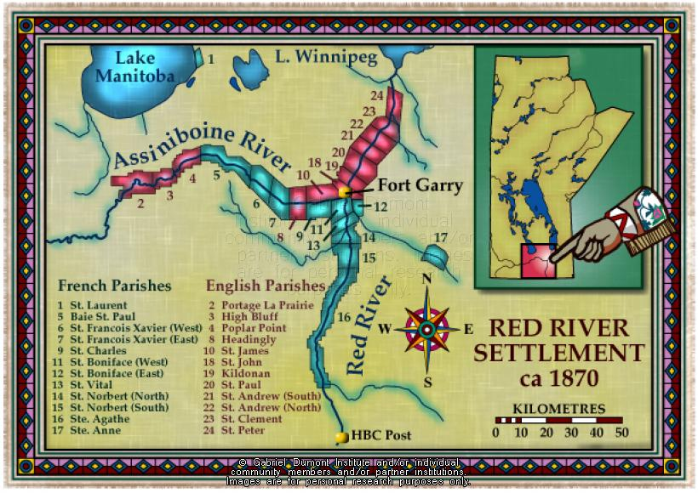
By the mid-1800s there was around 10 thousand Metis in the Red River area of what is today Winnipeg, Manitoba.
Because these Metis had no official paper land titles the British regarded them as having fewer rights than the full blooded Aboriginal peoples had.

Slide 5
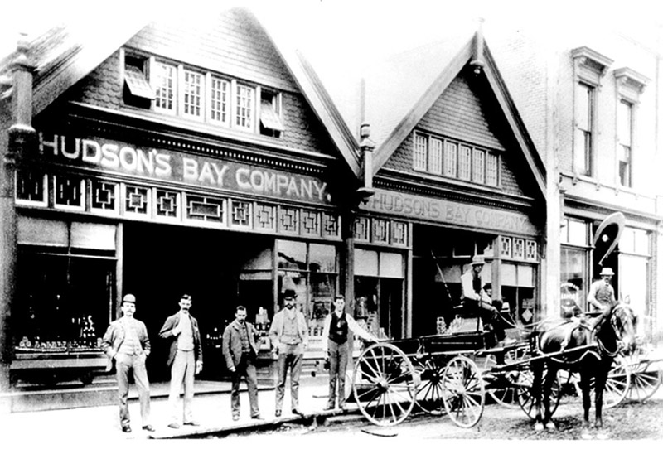
Two Types
There were two distinct groups of Metis that appeared in Canada: those who descended from French and Aboriginal parents and those who came from Aboriginal and English/Scottish parentage.
While the Hudson’s Bay Company forbade intermarriage by its workers it happened nevertheless.

Slide 6
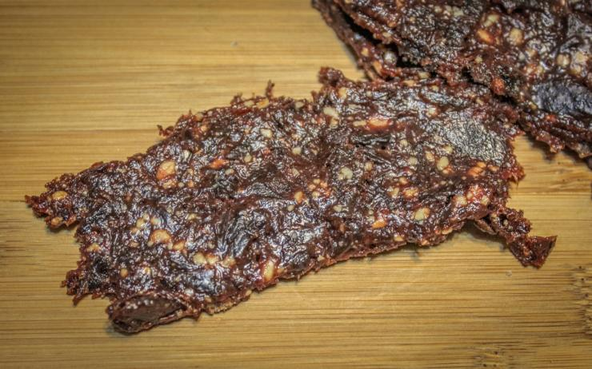
Languages Emerge
The French speaking Metis developed a language called Michif, which was a combination of French and Cree.
The English-speaking Metis developed Bungi, a combination of Scottish and Cree.
In the 19th century the English Metis often worked as labourers at trading post while the French Metis worked as guides, boatmen, and they provided pemmican for voyagers and explorers.
Notes:
Pemmican was buffalo meat, cut into strips, dried in the sun and then pounded into pulp. This pulp would then be combined with berries and boiled with buffalo fat, the berries were to prevent scurvy.
This pemmican fueled the whole fur trade, feeding voyagers and Metis trades alike.
The Metis also developed carts that could be pulled through the challenging muck found in the prairies and could even be converted into boats to cross bodies of water.

Slide 7
Lord Selkirk and the Pemmican War
In the early 1800s the Hudson’s Bay Company had fallen under the control of Scottish investors led by Thomas Douglas, Earl of Selkirk.
Selkirk wanted to create a homeland for displaced Scots and Irish tenant farmers, as he had already done in PEI and Upper Canada.
In 1811, the HBC granted him a tract of land in the Red River Valley.
Notes:
This tract of land was over 300,000 square kilometres in what is today Manitoba, North Dakota, and Minnesota.

Slide 8
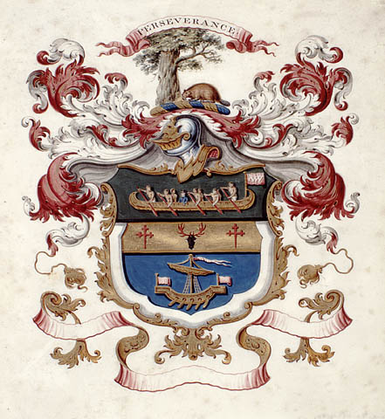
North West Company
Within a year Selkirk had established a small colony in the junction between the Red and the Assiniboine River (in what is now downtown Winnipeg).
Intentionally or not, Selkirk had placed this colony in the middle of the North West Company and Metis trade routes.
Notes:
The North West Company were direct rivals to the HBC.

Slide 9
Pemmican or pemmican’t
The Nor’westers were convinced the colony was a ploy for the HBC to establish a base to reach further into the interior of Canada where the NWC had a monopoly.
The settlers were unhappy with meat being taken from their lands and soon threatened an embargo on pemmican. The North West Company chased the colonists away and burnt their settlement to the ground.
Selkirk returned to re-establish the community with the help of an HBC armed force. Tragedy followed.
Notes:
Embargo - an official ban on trade or other commercial activity with a particular country.

Slide 10
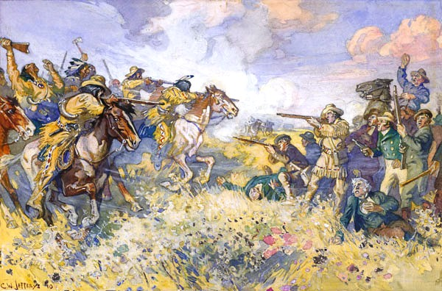
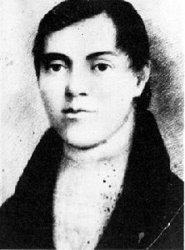
Seven Oaks
On June 19, 1816, at a cluster of trees known as Seven Oaks, a band of Metis suppliers led by Cuthbert Grant, a reputable Metis leader, clashed with a small band of settlers.
The “battle” was more a massacre as 21 settlers were killed, including their governor, Robert Semple.
Notes:
Cuthbert Grant, fur trader, Métis leader, captain of the Métis at Seven Oaks. Grant, his reputation tarnished by the events at Seven Oaks, overshadowed in history by Riel, has not been given due credit for his leadership of the Métis. Of Scottish and Cree or Assiniboine background and educated apparently in Montréal, Grant came back to the North West as a trader-bourgeois of the North West Company in 1815. In 1816 he led the Métis to victory at Seven Oaks, an unplanned clash of Métis and Selkirk settlers.

Slide 11
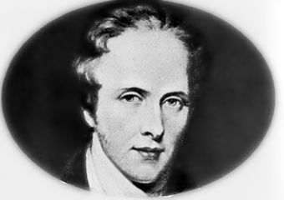
The Response
After the bloodshed at Seven Oaks, Lord Selkirk sent in troops and seized a NWC fort, arresting several traders, including one of the company’s leaders. The village at Red River, miraculously survived as a remote outpost of British society.
This community remained isolated until a few years later when more settlers arrived when the HBC merged with the NWC.
Notes:
Seven Oaks is still celebrated by the Metis as a defining moment in their nation’s history.

Slide 12
The Red River Colony struggled against grasshoppers, floods, droughts, prairie fires…all to become the first permanent colony on the Canadian prairies.
With the frontier at peace and the Americans repulsed, the next challenge to Canadian colonial stability would come not from outside but from within.
Notes:
From here we look to the upper Canadian rebellion(democratic reform, and an end to the rule of a privileged oligarchy) and the lower Canadian rebellion (looking for a responsible govt with an elected assembly).

