Slide 1
The Postwar Development of Canadian Culture 1945-1969
By: Keegan Burns

Slide 2
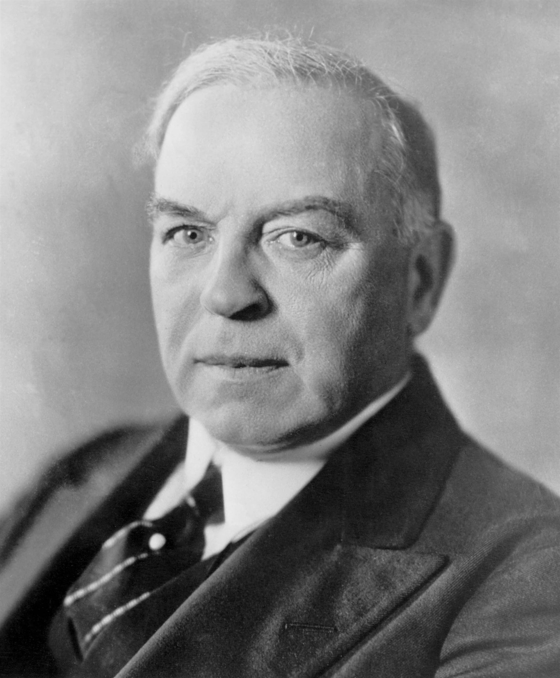
Aftermath of the Second World War
Canada had exited The Second World War as one of the two richest Nations in the world (along with the United States). We had the third largest navy, the fourth largest air force and our gross national product had doubled since entering the war.
The aftermath of WWII left Canada in a mixed state of turmoil and prosperity, as 1946 became the worst year for strikes since 1919.
A surge in population of 50 percent filled Canada between the years of 1946 and 1961 (grew from 12 million to 18 million)
“The Ogensburg Agreement” and “The Hyde Park Declaration”, cemented the new found relationship and coalition of Canada and the United States.
William Lyon Mackenzie King was the longest-reigning Canadian Prime Minister from the years 1921–26, 1926–30 and 1935–48

Slide 3
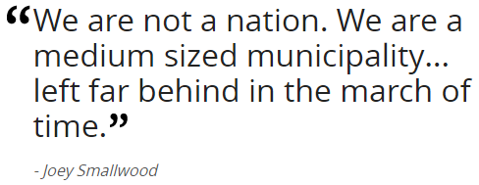
Newfoundland Joining Canada?
After the Second World War Newfoundland had found itself in a tricky position geographically. It had had U.S military stations located on the island since 1941 and also had both Canadian and British troops occupying the land as well. This made Newfoundland an ideal target for intercontinental bombing if the opportunity arose for their enemies. Faced with these dilemma's, it left Newfoundland with three choices…
Remain a colony under British administration
Declare independence and return to their own responsible government
Join Canada

Slide 4
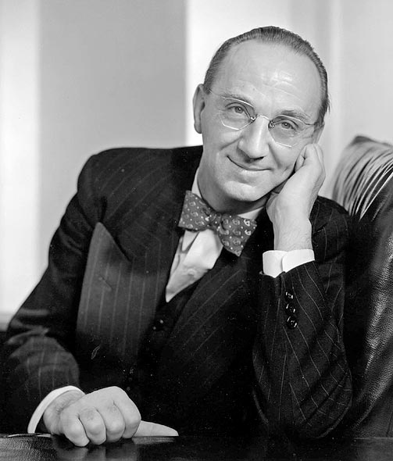
Newfoundland Joins Canada: Joey Smallwood
After World War 2 Newfoundland had become increasingly agitated and had decided that they wanted their own government (again). Great Britain listened to the people of Newfoundland and announced that in 1946 there would be an election for a Newfoundland National Convention.
Originally, it had been decided that there would only be two choices for the people of Newfoundland (remain a colony of Great Britain or form there own responsible government in independence). However, a third option was soon made viable and the man greatly responsible for this movement was Joey Smallwood.
After a first referendum had occurred (responsible government beating out confederation and British rule) the findings were thought to be to indecisive to truly rule out a winner, so a second referendum was held where this times Joey and his efforts prevailed so, Newfoundland would join Canada as its tenth province.

Slide 5
The Massey-Lévesque Report on Canadian Culture
In 1949 the Privy Council established a Royal commission on national Development in Arts, Letters, and Sciences. This was chaired and co-chaired respectively by Vincent Massey and Georges-Henri Lévesque.
In 1951 the report was publicized and disclosed that “No novelist, poet, short story writer, historian, biographer, or other writer of non-technical books can make a modestly comfortable living by selling his work in Canada. No composer of music can live on what Canada pays him for his compositions. Apart from radio drama, no playwright, and only a few actors and producers, can live by working in the theatre in Canada.”
The report served as a warning to Canada and its dying culture. If no changes were to be made, our culture as a whole would starve and dwindle into nothingness.
This led to the founding of several institutions and laws built to help fund the development of our culture. It also helped establish the National library of Canada in 1953 and the Canada Council in 1957.

Slide 6
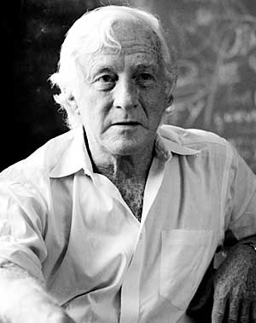
A Maturing Industry…
World War II had greatly bolstered the publishing industry in French Canada, as writers from Nazi-occupied France had fled to Montreal, and had the freedom of expression to publish their works. This led to the surge of the number of books printed in Montreal. This trend ceased once the war ended and French citizens returned to their home country.
As the Massey-Lévesque report started to spur change, the financial aid and support of the Canada Council, began giving grants to several authors… including Margaret Atwood, Timothy Findley, and Michael Ondaatje.
The blossoming industry would need support, and soon they’d receive it from small presses and Universities around the country, pitching in to the booming development of Canadian publishing culture.
Jack McClelland; president of the publishing company McClelland and Stewart publishing house from 1961-1985

Slide 7
Influential Writers
Canadian writing around the postwar period timeline, mainly reflected the issues that fellow Canadians had grown up with and were still struggling with, however, they were just reaching a wider audience globally. Here is a brief list of some of the most influential Canadian writers around the Postwar period.
Leonard Cohen (1934-2016) – He was one of the most well known and influential writers in Canada in the 1960’s, because of his wide variety of mediums.
Margaret Laurence (1926-1987) – She explored the theme of “women rebelling against a defeatist small-town heritage” in four novels. The Stone Angel became the first Canadian novel to be a requirement reading piece in France’s agrégation examination.
Gabrielle Roy (1909-1983) – Said to be the best-known francophone writer of the postwar period, Roy won three Governor General’s Awards for various novels from the 40’s through 70’s. Her work showed tremendous range, as she tackled troubles through Ukrainian and Chinese immigration, the slums of Winnipeg, and the clash between whites and Inuit people.
Josef Skvorecky (1942-2012) – After the Soviet invasion of Czechoslovakia forced Josef and his wife to flee to Canada, they founded Sixty Eight Publishers to publish the works of Czech exiles. The success of The Bass Saxophone’s translation into English, added to his growing reputation, and he received numerous national and international literary prizes for his portals of life.

Slide 8
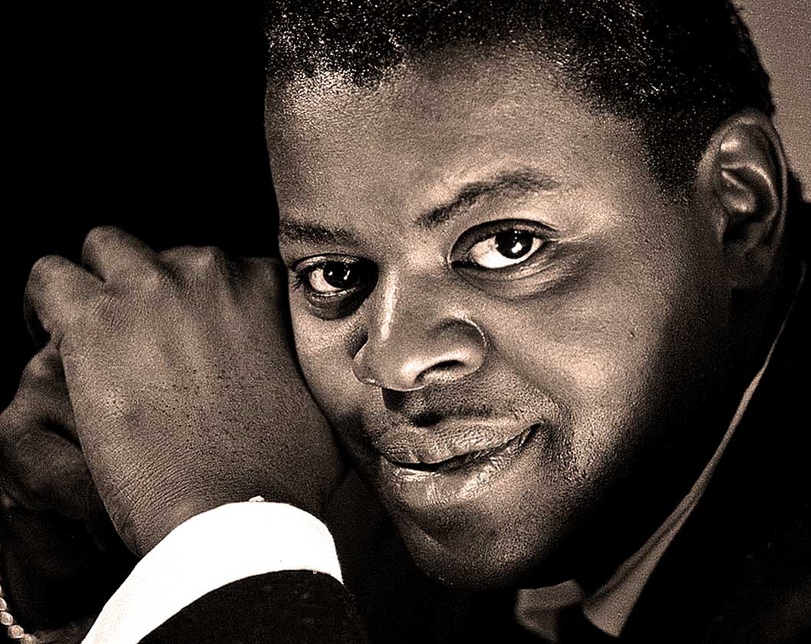
The Content Dilemma: The Struggle for Canadian Content
Even after Canadian content became more and more mainstream within the international music communities, Canadian radio stations were still electing to play the top American and British music, and Canadian composers and performers still had to go south of the border to be recognized in Canada.
The argument of the radio stations at the time was that “people wanted to hear what was already mainstream in the U.S or the U.K”, however performers argued that the stations were suffering from a colonial mentality, and that they didn’t want to take the time to invest in Canadian content.
The reality of the situation was that the station owners (financially wise) didn’t need to incorporate Canadian content to make an adequate living, so why take the risk to attempt and develop a Canadian music culture.
This corrupt mindset of the time period, forced the Canadian government to step in and create content rules and guidelines that would create an explosion of the Canadian music industry going forward.
Oscar Peterson (1925-2007) was the most accomplished jazz pianist in Canadian history as he sold more than 130 million albums and won many recording awards.

Slide 9
The Television Era: The CBC
When the Canadian Broadcasting Corporation (CBC) was first founded in 1936, one million homes had a radio in Canada. However, at its peak at the time, the CBC was only reaching about 49 percent of the country.
In response, in 1937 the CBC built new transmitters in Montreal and Toronto (increasing the coverage to 76 percent of the countries population) and was also allocated numerous clear and shared channels to also aid in the cross-country distribution of its service.
Finally, in 1952, the CBC had reached its goal of providing radio coverage across Canada. By 1952, nine of every ten Canadian homes had a radio, and the audiences numbered in the millions. This led to the decision and success of their transition to Television in the early autumn of 1952.
With the increasing success and popularity of televisions, the culture of families began to change with the movement. Soon, living areas were designed around families’ TV sets, new furniture was being added to homes like the foldup TV table and TV cushions for children to sit on and TV dinners became common on most family’s grocery lists, as they were easy to cook and hold.

Slide 10
The Growing Film Industry
Although the first Canadian films were produced in 1897, it took many years before independent production became common in Canada. The surge in independent production of films actually grew immensely during the first World War, but was quickly snuffed out by the quick assertion of financial control by Hollywood.
Unlike government in Europe, at the time the Canadian government made no effort to take action to protect its domestic industry, and the Canadian industry nearly died during the great depression.
The establishment of the National Film Board in 1939 allocated the opportunity for the Canadian film industry to rebound from the harsh times, because its documentaries provided a great opportunity for training filmmakers.
The early 1960’s signalled real change and hope in aspiring filmmakers, as films like Nobody Waved Good-bye and the development of the inexpensive 16 mm camera pioneered low-budget feature production. No longer would there be nearly as much risk in developing a Canadian culture of film.
Finally, in 1967, Telefilm Canada, a Crown corporation (originally named the Canadian Film development Corporation or CFDC) was established to “foster and promote the development of a feature film industry in Canada”.

Slide 11
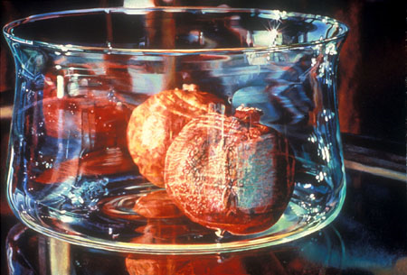
Postwar Art, Architecture, and Galleries
Throughout the postwar era, the number of artists in the visual arts and the variety of mediums for said artist to express themselves expanded exponentially. This was because of various cultural supports like the Canada Council and provincial arts councils that meant Canadians could finally stay in Canada to express themselves, and make a modest living.
Although the support was extremely important, The Canada Council was mainly responsible for the growth of alternative spaces, artist-run co-ops, galleries, museums, craft fairs, and university and college art departments.
Artists of the time, often expressed the conflicting and controversial views of how the direction art should be going, but dialogue became an incredible source of creativity for aspiring artists.
Due to the growing insurgence of a need for culture and an interest in our pasts, Canadians began investing more aggressively into museums, galleries, and diverse architecture, which lead to many prominent artistic movements and influential artists of the late 1940’s and beyond.
Two Pomegranates in a Glass Bowl (1982) by Mary Pratt, one of the most renowned Canadian realist painters from Atlantic Canada, whom was born in Fredericton, New Brunswick.

Slide 12
The Flag Debate: Growing Nationalism in Canada
By the 1960’s Canadians were feeling increasingly proud of their Canadian identity, and they felt that they were finally succeeding in separating themselves from Great Britain and the United States. With this growing nationalism, “The Great Flag Debate” emerged from its almost 20-year hiatus to once again fill the news and minds of Canadian citizens.
In 1925 a committee of the Privy Council began researching new concepts for a flag, but nothing happened. Years later in 1946, a parliamentary committee was given a similar task and received over 2600 designs, but once again nothing changed.
By the 1960’s, it had become apparent that three distinct camps would dominate the talks of a new flag. The French-Canadians and New Democratic Party, wanted a flag with no affiliation to a British past, John Diefenbaker suggested a flag that was comprised of the Union jack and a fleur-de-lis, and a third camp (war veterans) wanted no change.
This version of The Red ensign was used as Canada’s National flag from 1957-1965.

Slide 13
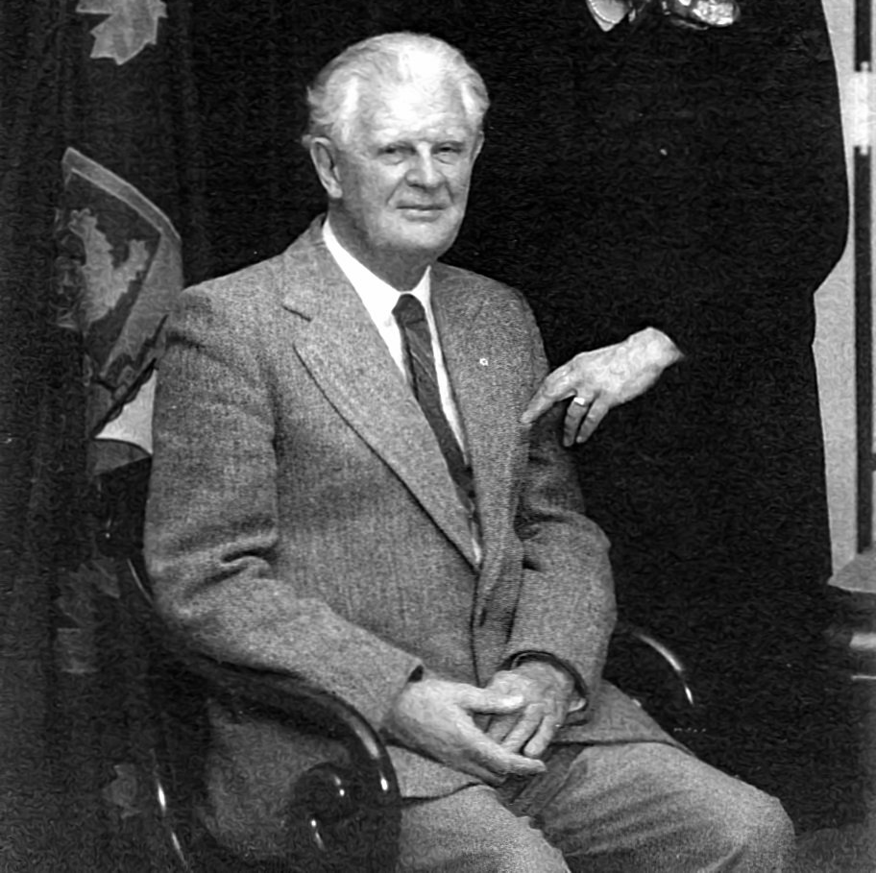
The Flag Debate: Continued
Prime Minister Pearson had promised a new flag during his campaign in 1963, but he needed to hurry. The centennial year was right around the corner, and if there was going to be a controversy, it would be best to get it out of the way.
Again, a committee was formed, and thousands of Canadians responded with various designs were sent in to Pearson and his committee. Pearson’s favourite design featured three red maple leafs on a white background with blue bars on each end. However, when introduced to the legion, the veterans were not pleased, and a huge uproar ensued across Canada.
Pearson dodged the hate and uproar, by appointing MP John Matheson to bring a flag proposal to Parliament. Although his proposal was said to have disappointed both the supporters of the red ensign and the supporters of Pearson’s flag, after a successful vote on February 15, 1965 the maple leaf was raised at parliament hill
George F.G Stanley was a Canadian historian, author, soldier, teacher, and designer of the current Canadian flag.

Slide 14
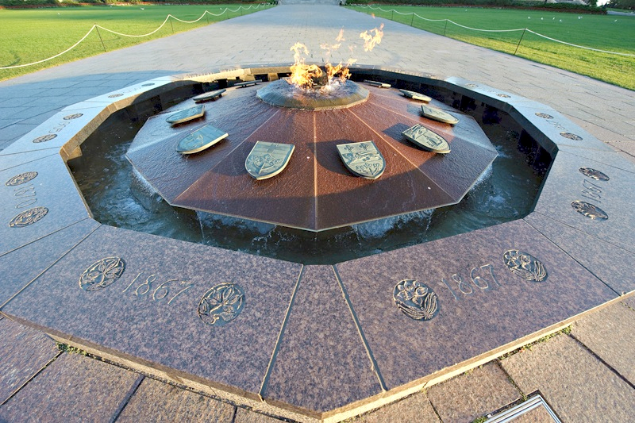
One Hundred Years
On December 31, 1966, Prime Minister Pearson and thousands of Canadians gathered outside of Parliament Hill waiting for the clock to strike midnight. When it did, a wave of Happy Birthday’s erupted because Canada’s hundredth year anniversary had started.
In general, postwar Canadians felt great about their country. We were characterized by low unemployment, high wages, low inflation, low interest rates, abundant consumer project, the baby boom was just beginning, and the Country felt young. It was the perfect time for a yearlong celebration about our country.
With our atmosphere booming with tangible excitement, Provincial, territorial, and municipal governments were eager to provide Centennial events and projects for the citizens of Canada, and any tourists visiting. Many artworks, designs, songs, monuments, and buildings were assembled all over Canada. The mint pitched in on the celebrating, and produced special coins, and the first ever Canada games were held in Quebec City.
Above, is the Centennial Flame lit in 1967. It resides in front of the parliament building in Ottawa.

Slide 15
Expo 67
Although the celebrations of Canada’s Centennial year were felt across the entire nation, the largest event of the Anniversary was the World’s Fair known as Expo 67 located in Montreal from April 28, 1967 to October 27, 1967.
Originally, both Canada and the Soviet union had applied to host the world fair of 1967 and the Soviet Union won the vote by a score of sixteen to fourteen as the Soviet’s were celebrating their fiftieth anniversary. However, later Moscow officials, who were worried about the immense cost of hosting the event, changed their minds. This meant that Canada would get the chance to showcase themselves to the world.
The project of hosting the event was huge. The sheer size of the Expo would mean that Quebec would have to not only enlarge Île Ste-Hélène but they would also have to build a new island (Île Notre-Dame). This astronomically rose the budget of the Expo from an estimated cost of $10 million to $40 million.
The success of the Expo 67’ would leave an impact on the rest of the world as we had proved that we could put on a world-class event.

Slide 16
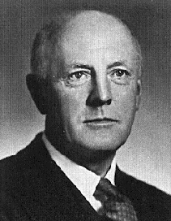
Growth of Universities and Activism
After the Second World War, the need for specialized skills became increasingly important in the workforce. Women were now more likely to be at the very least working part time, and the importance of hiring youth for jobs became less of a necessity. With this boom, came the surge of people looking to attend University.
One “consequence” of the increasing number of youth attending university, all from different backgrounds, was that they began to see themselves as people who could change the traditional values society had constructed.
Youth began to tackle a variety of complex issues like the value and/or abuse of tenure, alcoholism, marijuana and social constructs. This led to hundreds of protests and strikes in Universities, all around the Nation with a large number of them happening in the late 1960’s.
The Teachers, on the other hand, wanted to maintain tenure even if it could be abused under certain circumstances out of the fear that they could be pushed out like Frank Underhill was almost dismissed in 1941.
Frank Underhill was a historian at the University of Toronto, who was attempted to be dismissed for his views on Canada post World War II

Slide 17
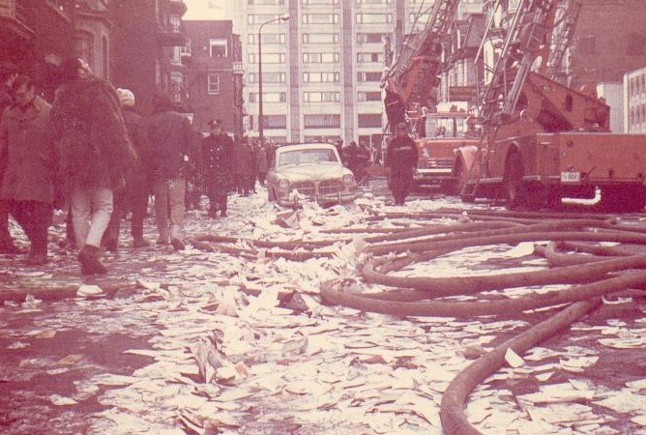
Sir George Williams University Riot
On the occasion, student unrest resulted in serious confrontations. One memorable confrontation took place at Sir George Williams University in early 1969, where six black students from the Caribbean accused an assistant biology professor of being racist.
In response, the university set up a committee to review the accusation, however the students were disappointed in the chosen representatives and around two hundred students chose instead to protest, by occupying the University’s computer room. Negotiations to end the conflict went on for eleven days, but they failed and the police had to intervene arresting ninety-seven people (sixty-nine from the University).
The incident had shown how out-of-touch the Universities had become with their student populations. Administrators took note and began inviting student representatives to sit in on decision-making bodies, making sure that from that point forward, no student voice or concern would be left behind again.

Slide 18
Questions
Do you think Canadian Content and Culture would have died had the Massey-Lévesque Report not enlightened the Canadian Government at the time?
Do you think events like Expo 67, the flag debate, and the Content Dilemma by deserve more recognition and respect by Canadians?
Does this Era deserve more credit for shaping our nation than it’s been given by Canadians in the past?
Do you think the government should still focus heavily on maintaining our culture, or do you think we’ve gotten to a point where our culture is what it is?

Slide 19
Bibliography
https://www.cbc.ca/2017/canadathestoryofus/how-joey-smallwood-convinced-newfoundlanders-to-join-confederation-1.4112419
https://www.thecanadianencyclopedia.ca/en/article/newfoundland-joins-canada-feature
https://www.investopedia.com/terms/g/gnp.asp
https://www.canada.ca/en/privy-council.html
Canadian History for Dummies
Defining Canada: History Identity, and Culture

