Slide 1
Towards Confederation
Canadian History 122

Slide 2
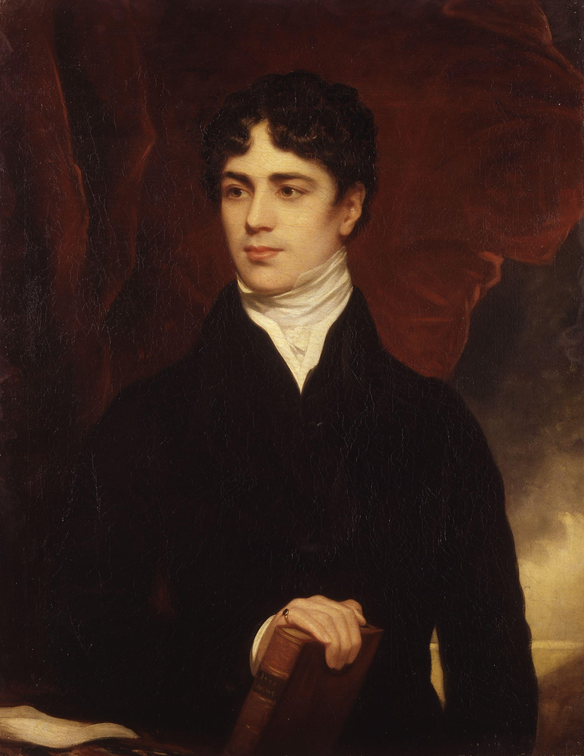
Lord Durham

Slide 3
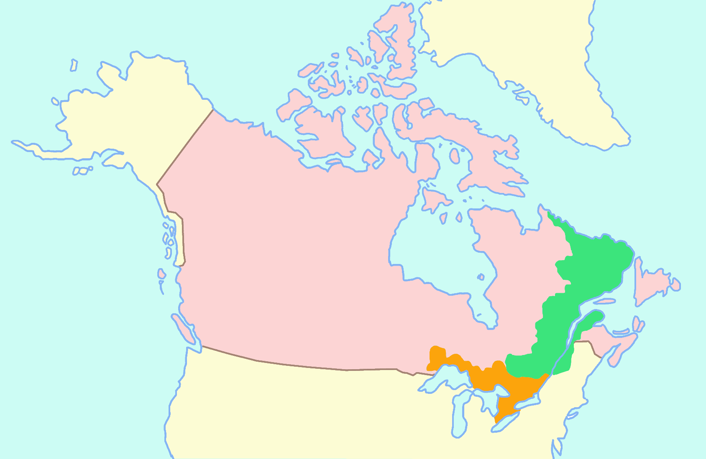
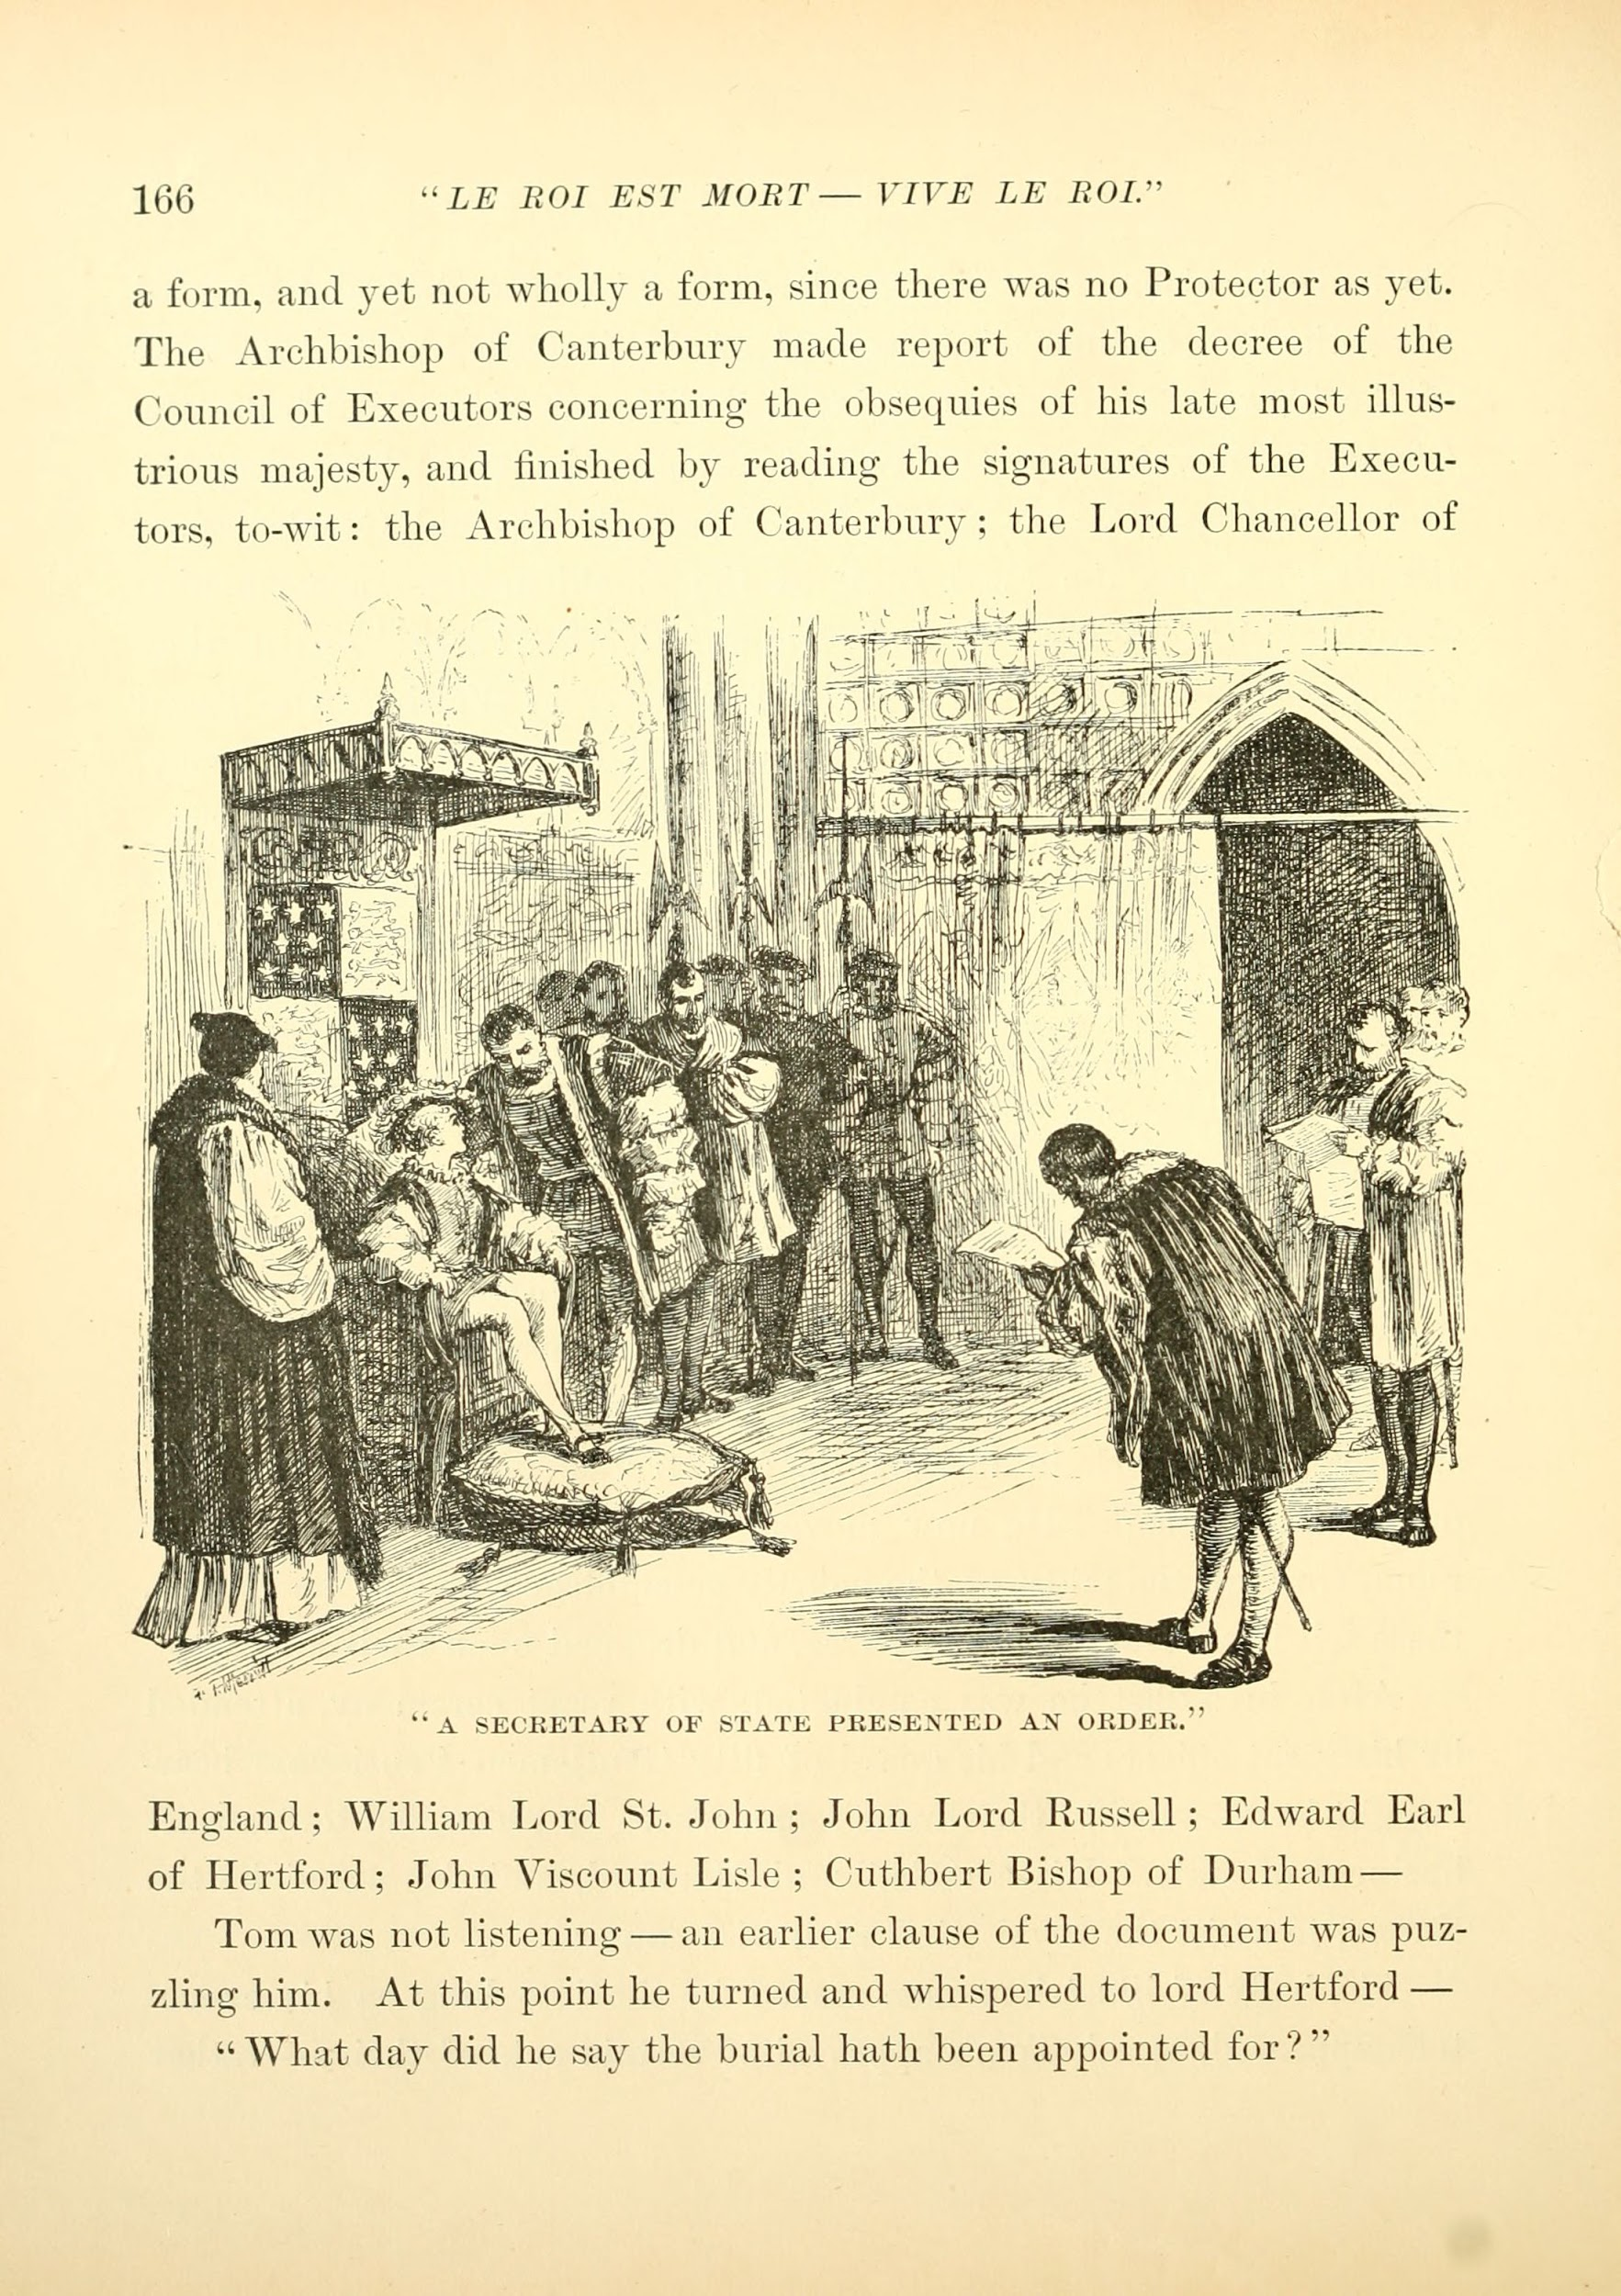
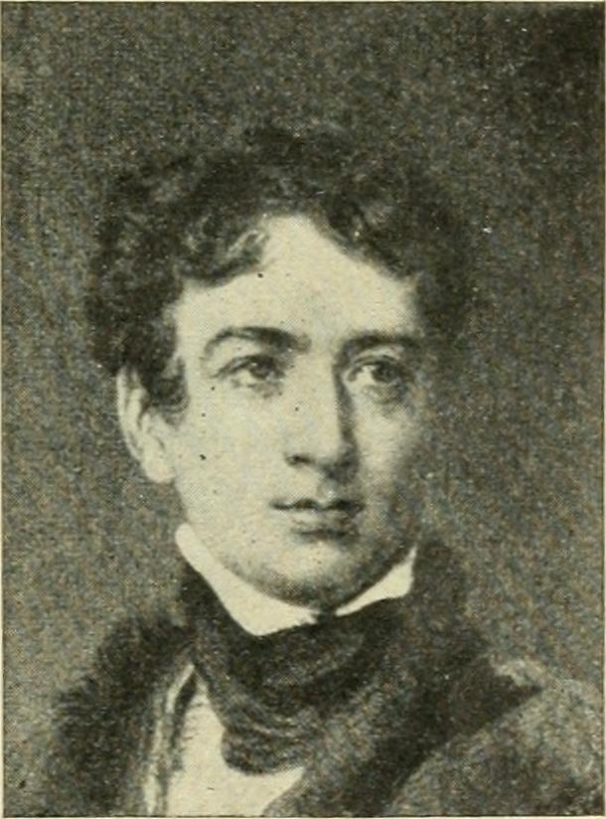
Lord Durham and His Report
He was a British politician who came to Canada in 1838
Was appointed governor general of British North America in May 1838
Made decisions outside his jurisdiction and resigned
BUT he did write a significant report
This report outlined the 2 main problems in British North America
- Friction between the democratically elected and British appointed branches
- Conflict between French and English Canadians
- Proposed unification of Upper and Lower Canada
- Wanted French Canadians assimilated into English Canada

Slide 4
Other societal factors in this time period
Corn Laws were British policies that gave colonies preferential trade rates for corn
Corn = cereal crops at this time
Repealed in 1840 to the detriment of Canadian exports
Corn Laws Repealed

Slide 5
Other societal factors in this time period
Trade with the United States increases
Reciprocity is suggested
Reciprocity = freer trade across borders and increased trade privileges
Reciprocity

Slide 6
Other societal factors in this time period
$100 million invested in railways between 1852-1867
Grand Trunk was the largest, with 2055km of track
Railways

Slide 7
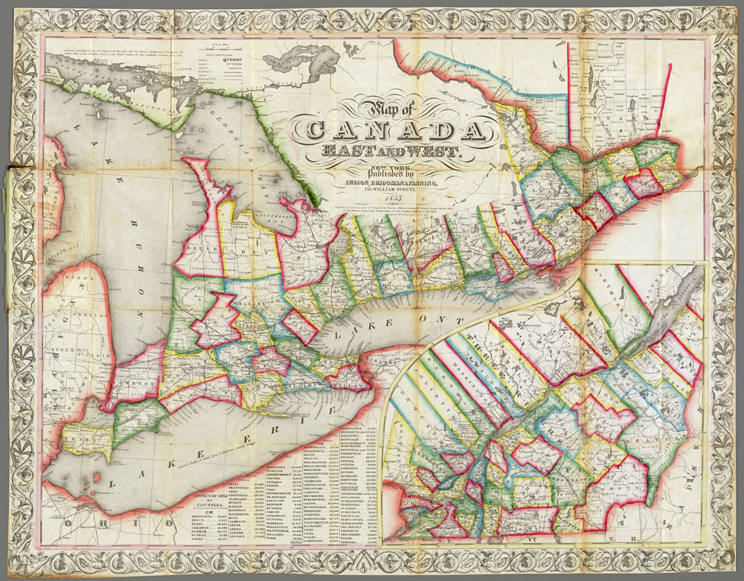
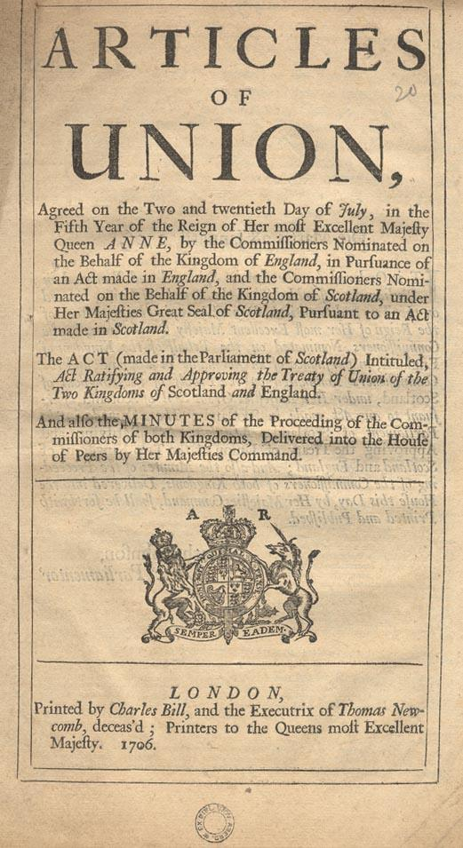
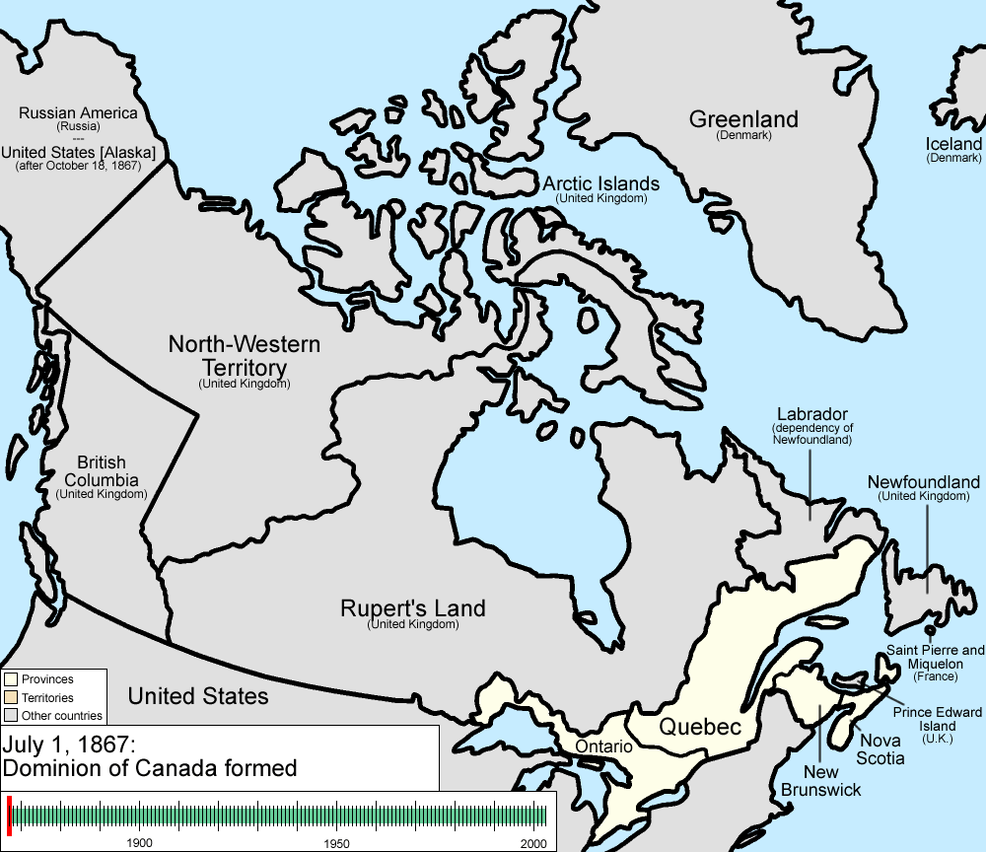
Act of Union 1841
Upper and lower Canada joined into one colony (Canada East and West)
quite unpopular amongst citizens
English were afraid of French and their power
French were rightfully upset at being assimilated
Elections in the legislative assembly were often split, meaning nothing could get done

Slide 8
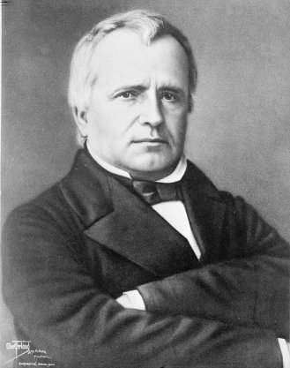
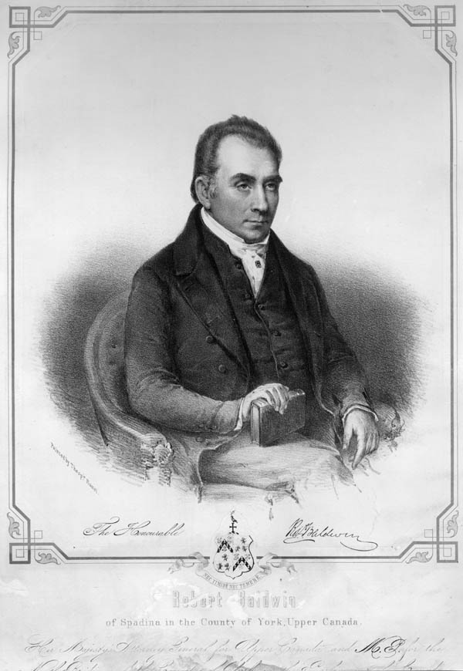
The First East-West Coalition
Louis-Hyppolyte LaFontaine, a French Canadian, elected in North York (in Canada West)
Robert Baldwin, Englishman, elected in Rimouski (in francophone Canada East)
The two men decide to form a coalition (1842), fighting for responsible government
1848 form responsible government. Appointed executive council now required support of elected legislature
Some conservatives are angered by the loss of the oligarchy
Montreal parliament burned down in a riot

Slide 9
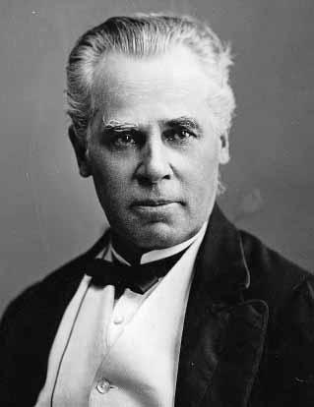
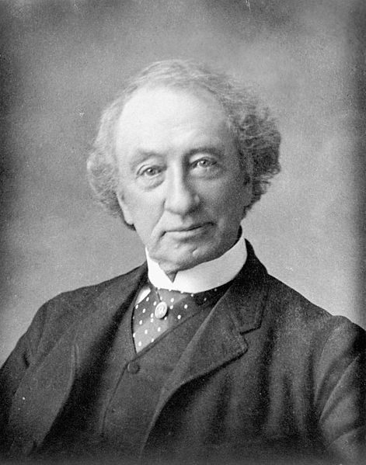
Macdonald-Cartier Coalition
American Civil War breaks out, everyone is worried about invasion
George-Étienne Cartier, French Canadian lawyer
John A Macdonald, Scottish immigrant and lawyer
Two men form coalition, both dream of transcontinental railway
Main enemy of this coalition was George Brown, publisher of the Globe
Brown caused many disagreements, but in actuality all three
men were reformists
The three form new coalition after hearing Britain may allow
the union of all British North American colonies

Slide 10
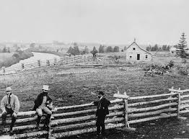
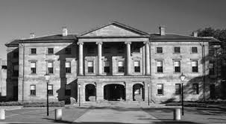
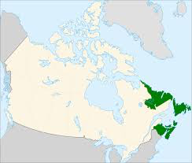
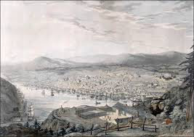
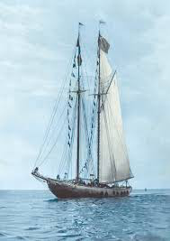
Meanwhile in the atlantic colonies…

Slide 11
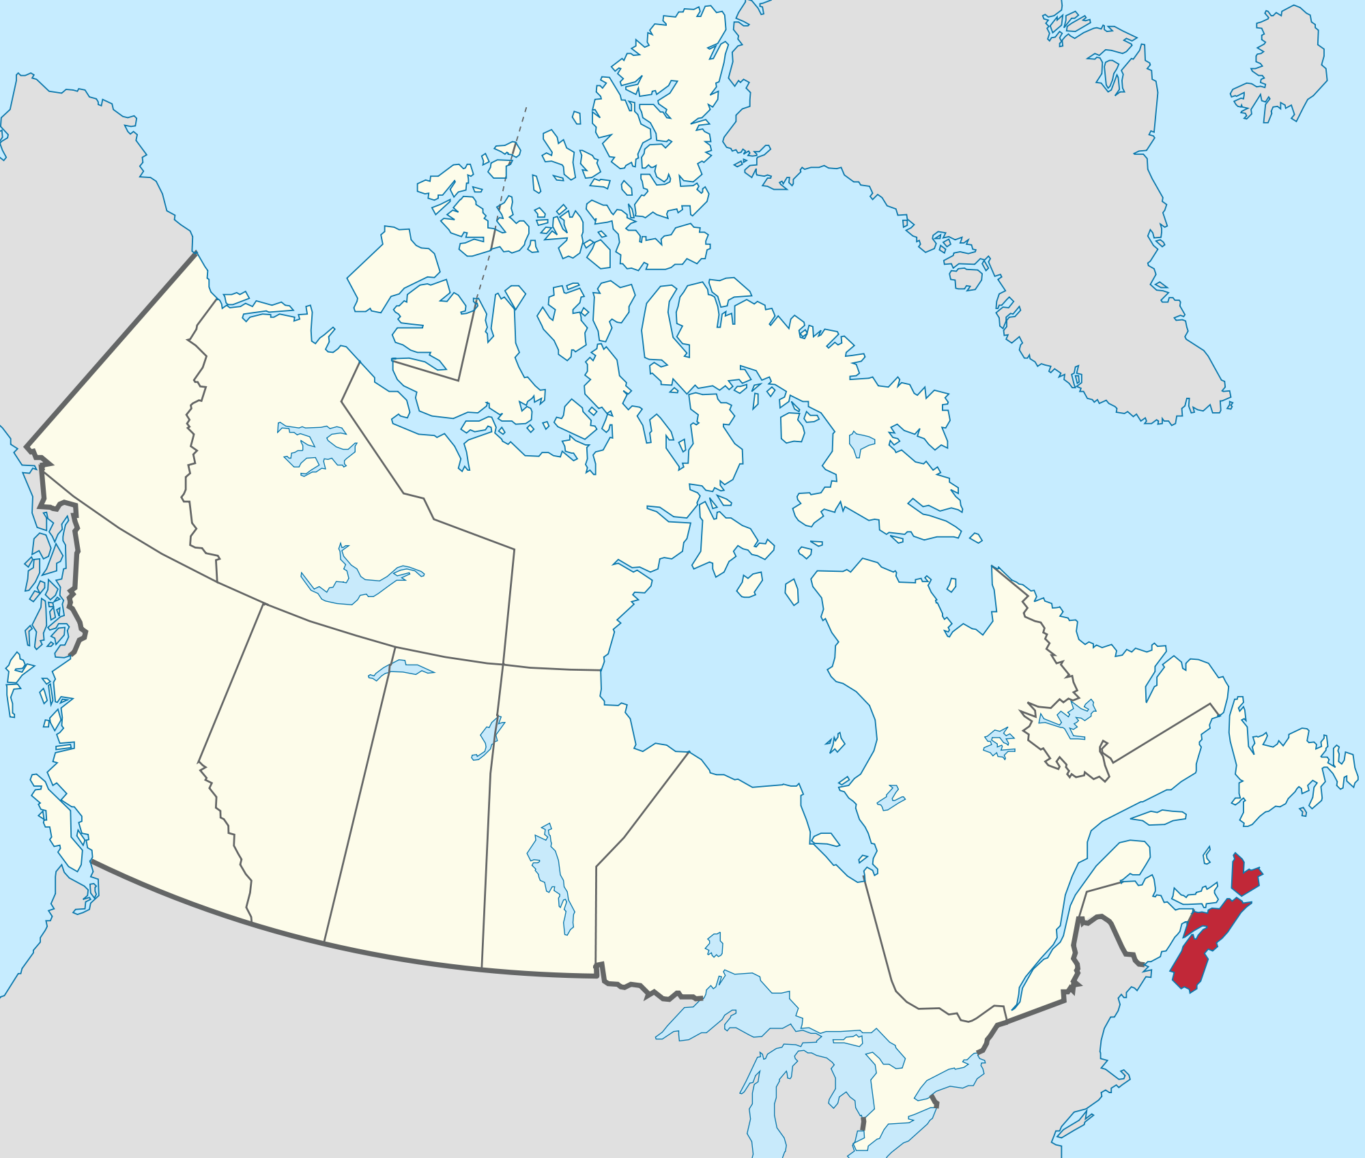
Nova Scotia
Great Britain is fairly popular
Citizens wanted the same rights as the British, and to disband the colonial elite
1848 Nova Scotia becomes the first responsible government in the British Empire
Many politicians opposed confederation
When the United States became a threat public
opinion begins to shift

Slide 12
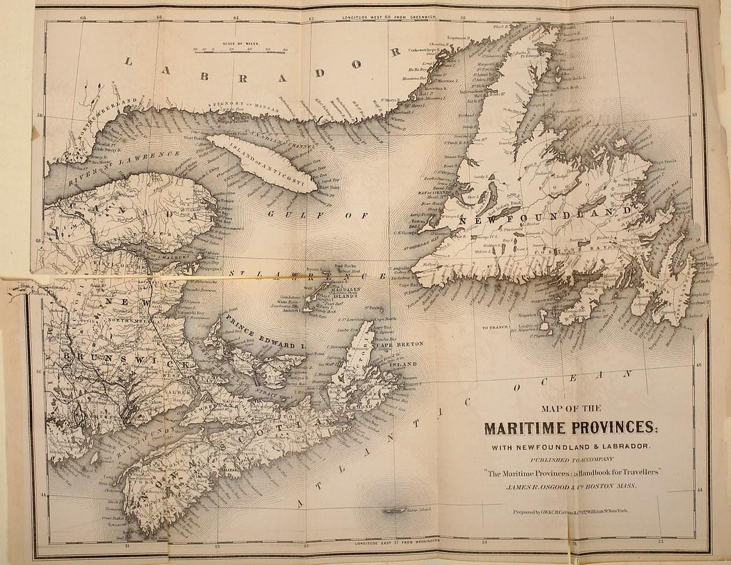
New Brunswick
Similar controversies as in Nova Scotia regarding executive council
Misuse of crown lands and timber rights
Elected assembly gains jurisdiction over crown lands in 1837
A railway is proposed, but unclear if it will connect NB to the Canadian colonies or to the US
Fenians (Irish Canadians who believed attacking
the British in Canada would end British rule in Ireland)
threaten invasion in 1866

Slide 13
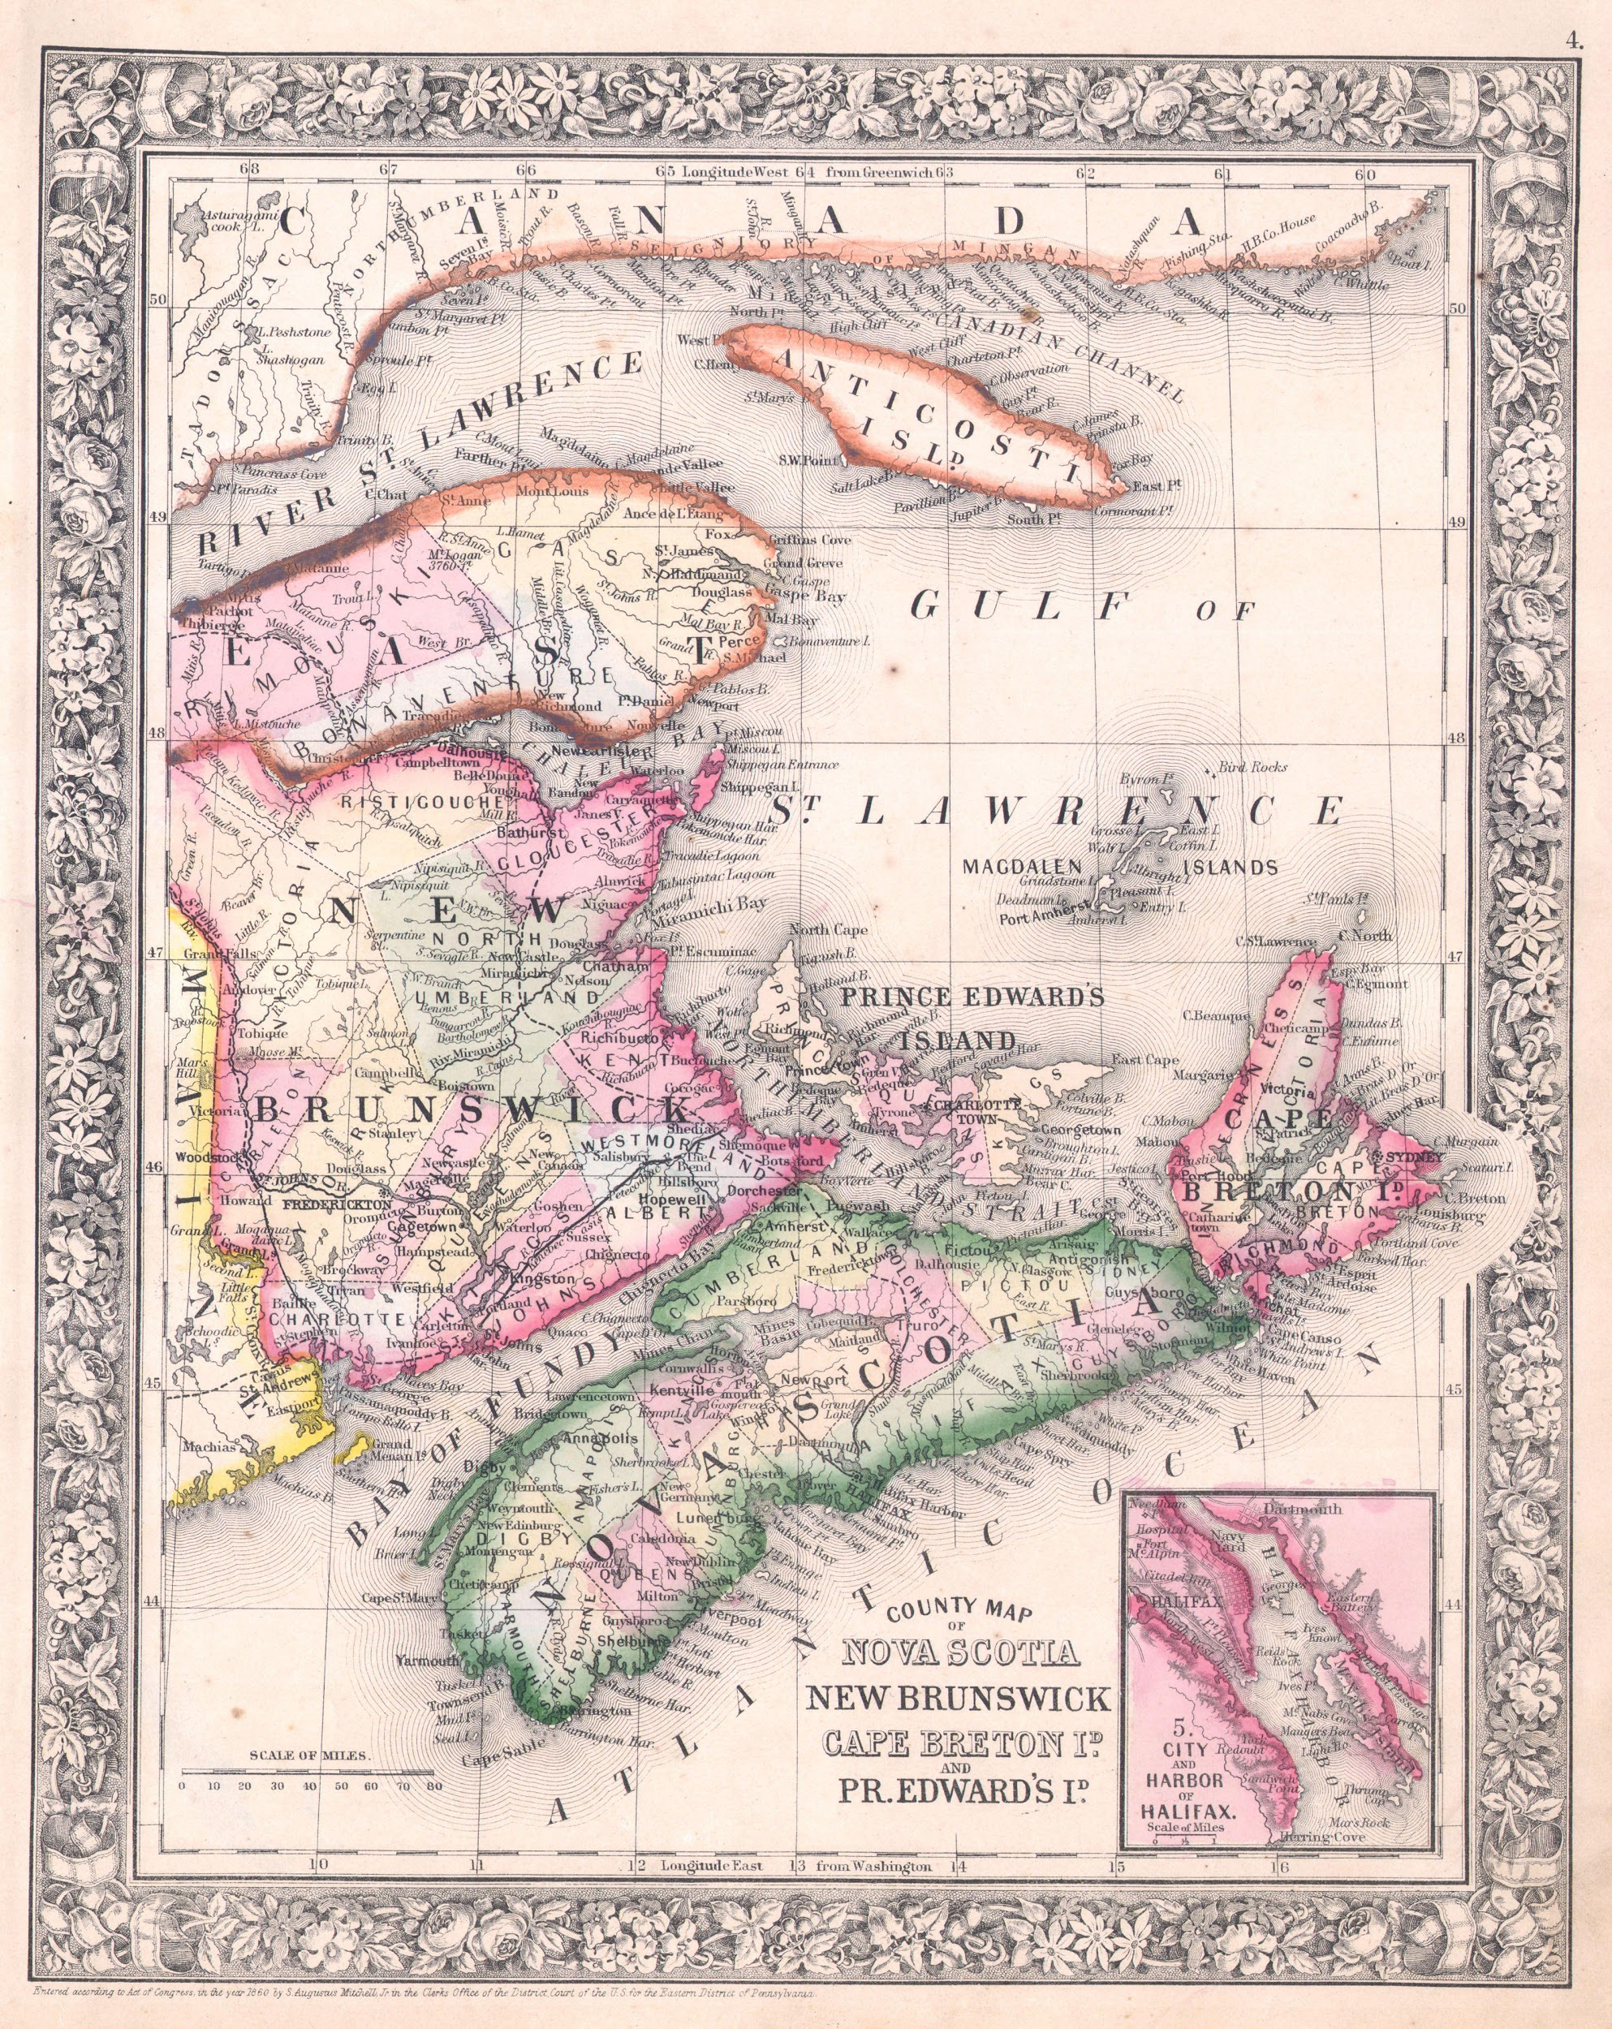
Prince Edward Island
Most significant problem is absentee landlords (landlords who live elsewhere charging rent to the farmers who have always lived and worked on the land)
May of 1864 farmers are urged to stop paying rent
Mobs begin meeting rent collectors
Idea of confederation sounds promising as it may
solve this problem

Slide 14
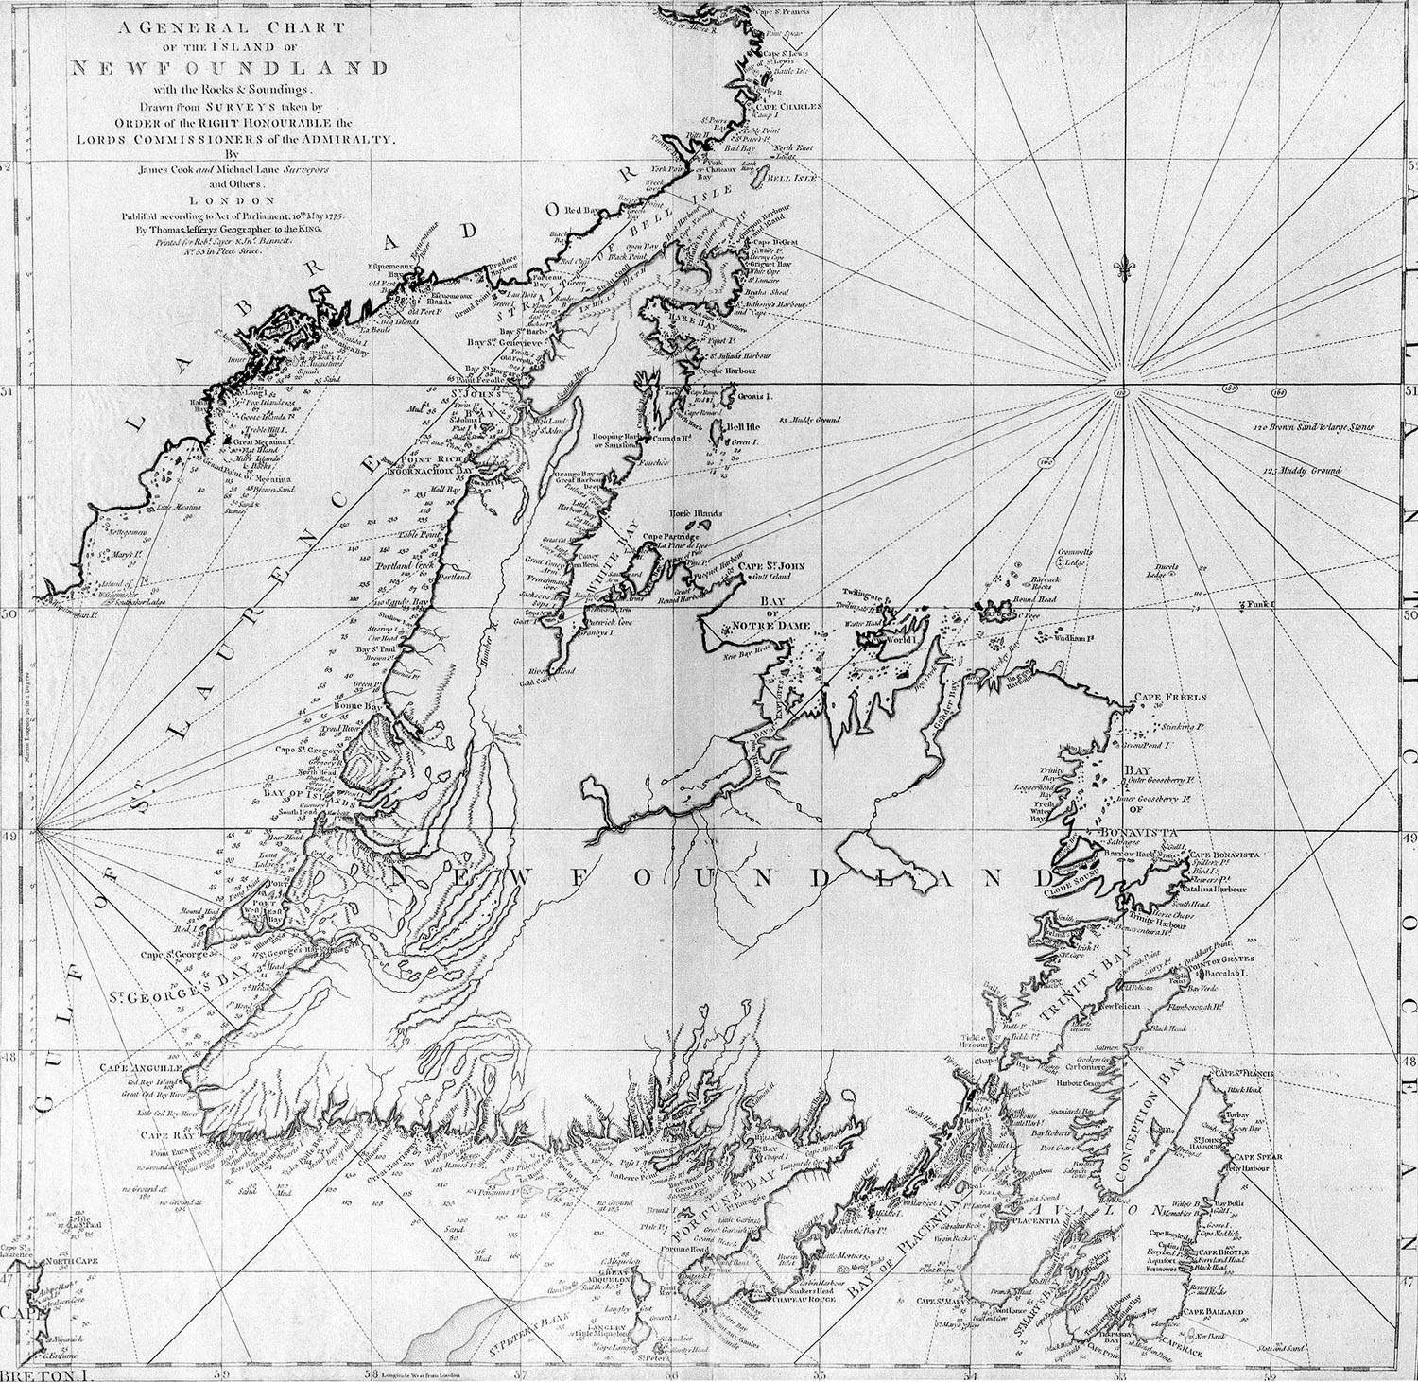
Newfoundland
Mostly fishing industries and little agriculture
Fairly ignored by Britain comparatively, they had no resident govenor until 1825
Granted election rights in 1832 (first election was held in 1834)
Became full British North American colony
(and gained responsible government) in 1855
Therefore not particularly interested in yet
more changes

Slide 15
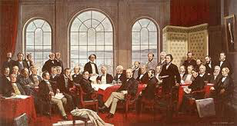
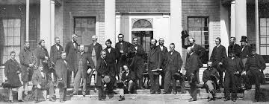
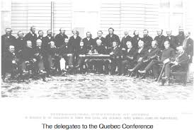
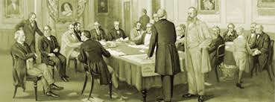
Confederation

Slide 16
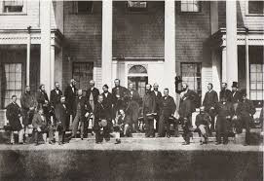
Charlottetown Conference, summer 1864
Arthur Gordon of NS wants to discuss unification of Atlantic colonies
Premiers as well as opposition leaders were invited, although Newfoundland refused to send anyone
Delegates from Canada East and West
also attended
Cartier, Macdonald and Brown gave
strong arguments for unification

Slide 17
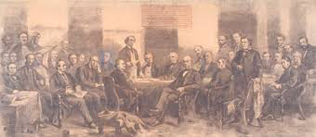
The Proposal
Central government assumes debt of the provinces
Government would send annual per capita subsidies to the provinces
Federal system, which means division of powers between levels of government
Continental railway
No details were official, but from now on confederation is seen as a possibility

Slide 18
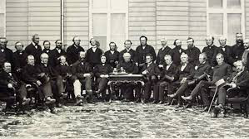
Québec Conference, October 1864
33 delegates attended (Newfoundland now included)
American Civil war has Canadians on edge, Americans were threatening Canada
Wrote a constitution

Slide 19
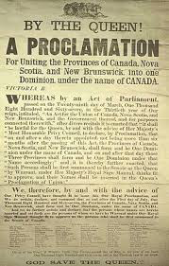
The Constitution
Keep ties with Britain and Britain’s constitution
It would be a federation (multiple levels of government)
There would be a House of Commons and a Senate
No buying out PEI’s absentee landlords
NB and NS were worried about being absorbed by the larger provinces
Everyone is very proud of not having a revolution. This wasn’t about ‘inalienable rights’ of enlightenment. Focused on material progress

Slide 20
The Challenges
Delegates didn’t legally represent their provinces so no
official decisions could be made
Two options
letting the electorat vote (only NB did this)
Have provincial legislatures decide (everyone else)
After 6 months only the colony of Canada East and West had officially agreed (controversial)

Slide 21
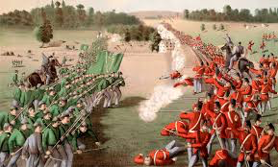
So why did it happen?
Britain passed legislation to implement the constitution more efficiently
A lack of US reciprocity and fear of Fenian raiders lead to shift in NB’s position (June 1866)
NS came to the same decision
PEI didn’t approve it, because the lack of
help with the absentee landlord problem

Slide 22
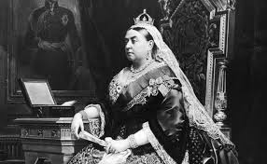
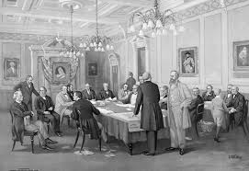
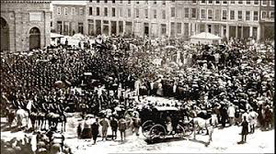
Show Time

Slide 23
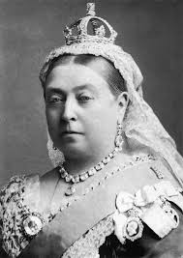
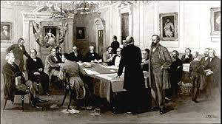
London, November 1866
Delegates from Canada East, West, NS and NB went to
London
Presented their constitution (British North America Act)
to British government for approval
Queen Victoria signed the Act into law March 29 1867, date of proclamation would be July 1 of the same year
John A Macdonald would be Prime Minister, and Ottawa was declared the new capital

Slide 24
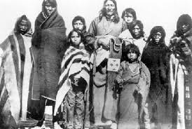
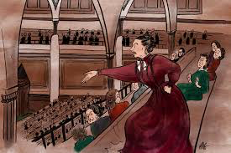
Other important notes
Federal government was given more responsibilities
than provincial governments, but provinces could control property and civil rights and language and religion
No ‘mothers of confederation’, women weren’t considered persons under
the law
No indigenous representatives were present at the
Charlottetown or Quebec conferences, and they
weren’t mentioned in any confederation related
documents

Slide 25
Discussion Questions
In what ways was cooperation between the French and English in Canada East and West necessary? Between Canada and the Atlantic colonies? Is this cooperation still relevant today?
Was Canadian confederation an inevitability?
Compared to the French and American revolutions, this change was based less on ideals and rather on “material progress”. What does this mean for Canadian Identity?
How might our nation be different if women and indigenous populations had been included in confederation?

Slide 26
Sources
Defining Canada, McGraw-Hill Ryerson
https://www.thecanadianencyclopedia.ca/en/article/corn-laws
https://www.britannica.com/event/Constitutional-Act
https://www.thecanadianencyclopedia.ca/en/article/durham-report
https://www.thecanadianencyclopedia.ca/en/article/john-george-lambton-1st-earl-of-durham

